Slide 1
Curating Existing Resources for Course Content
Feb. 24 2021
McMaster Library Services DeGroote’s Teaching and Learning Services
Notes:
Welcome
Intros:
Nidia Cerna, Educational Developer DeGroote TLS
Jeannie An, Research Services Librarian – MBA programs (RJC)
Ines Perkovic, Business Librarian – Undergraduate programs (campus)

Slide 2
AGENDA
HSTalks
Linkedin Learning
Open Educational Resources
Harvard Business Publishing Education
Course Reserves
Business Library/Research Guides
Notes:
Guidebook:
https://ecampusontario.pressbooks.pub/degrooteteachingonline/chapter/curating-resources/

Slide 3
HSTalks

Slide 4
Curating Resources from HSTalks
HSTalks
What is HSTalks?
Full name of database: Henry Stewart Talks: Business & Management Collection
Added to McMaster’s library holdings in Jan 2021 based on feedback and funding from DeGroote
Coverage: 2006 to present
The online Business & Management Collection has over 1400 multimedia lectures, case studies and interviews from scholars and expert practitioners.
Access is available for all faculty, staff, students (including executive education) and alumni. You should be granted full viewing rights when accessing the collection via the library or at: https://hstalks.com/login/
Select McMaster from the list of institutions and sign-in using your MAC ID

Slide 5
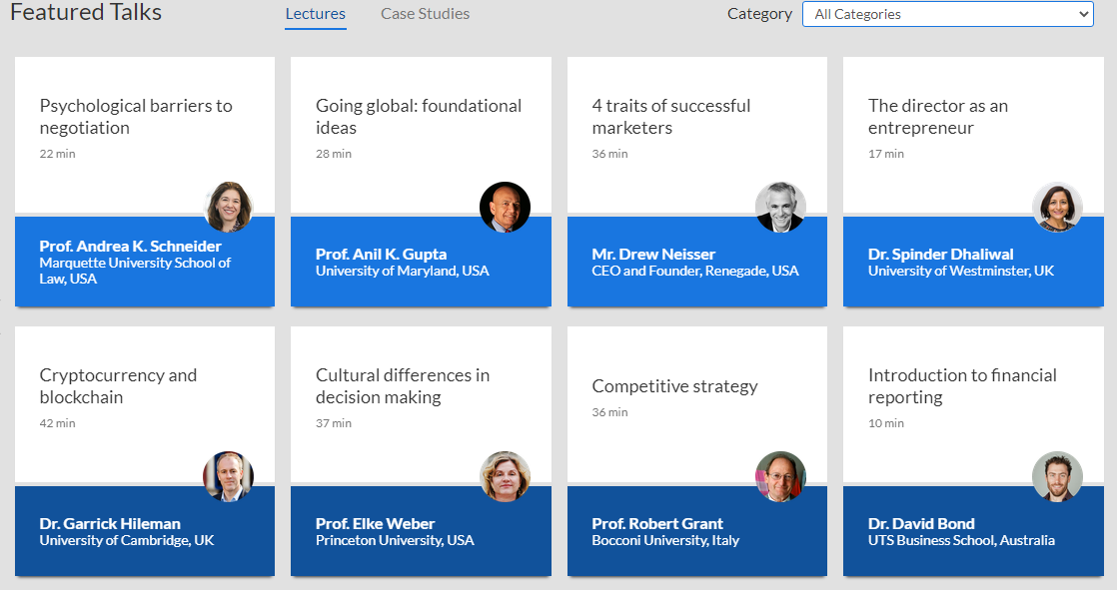
HSTalks
Browse by:
Subject Areas
Features Talks
Leading Experts
Peer reviewed Vocational Journals

Slide 6
Adding content from HSTalks to A2L
Example:
Course: Psychological Barriers to Negotiation (Andrea K. Schneider)

Slide 7
Embedding HSTalks course/videos to A2L
Click on “Embed in Course / Own Notes” and follow instructions on the screen
Two options available:
Embed as Link OR Embed as Video
Use as Embed as Video option to embed the code in your A2L course
You can share the entire course, or select videos within the course (specific slides from presentation)
For additional assistance, including content suggestions contact:
Email: access@hstalks.com or Joe Moody: joem@hstalks.com

Slide 8
Linkedin Learning

Slide 9
Curating Resources: LinkedIn Learning
Available for all McMaster faculty, staff and students

Slide 10
LinkedIn Learning
What is LinkedIn Learning?
LiL (formerly known as Lynda.com) has been in use on campus since approximately 2017
LiL is a web-based service that offers over 130,000 video training courses taught by experts in software, creative, IT, and business skills

Slide 11
Why Use LinkedIn Learning?
Importance of Digital Literacy:
“Ability to use information and communication technologies to find, evaluate, create and communicate information” (American Library Association)
Additionally, emphasis on “Digital Fluency” skills
Navigate websites
Create spreadsheets
Learn new skills quickly
Share resources
Digital Citizenship: properly use tools like social media and online forums

Slide 12
Benefits of LinkedIn Learning
Some benefits of LiL include:
Courses available for all skill and technical levels
Watch from your computer, tablet or mobile device and switch back and forth as you choose
Create and save lists of courses you want to students to watch
Unlimited access, 24/7

Slide 13
Accessing LinkedIn Learning
Access LinkedIn Learning (via UTS Teaching & Learning portal)
Login using MAC ID
First time users: link your LiL with your LinkedIn profile (suggested by not mandatory)
First time users: Select skills options to customize the content you see on your LiL homepage
Recommended Resources:
How to Use LinkedIn Learning (collection of courses)
McMaster LiL User Guide
LiL Library Guide
Email: linkedin@mcmaster.ca

Slide 14
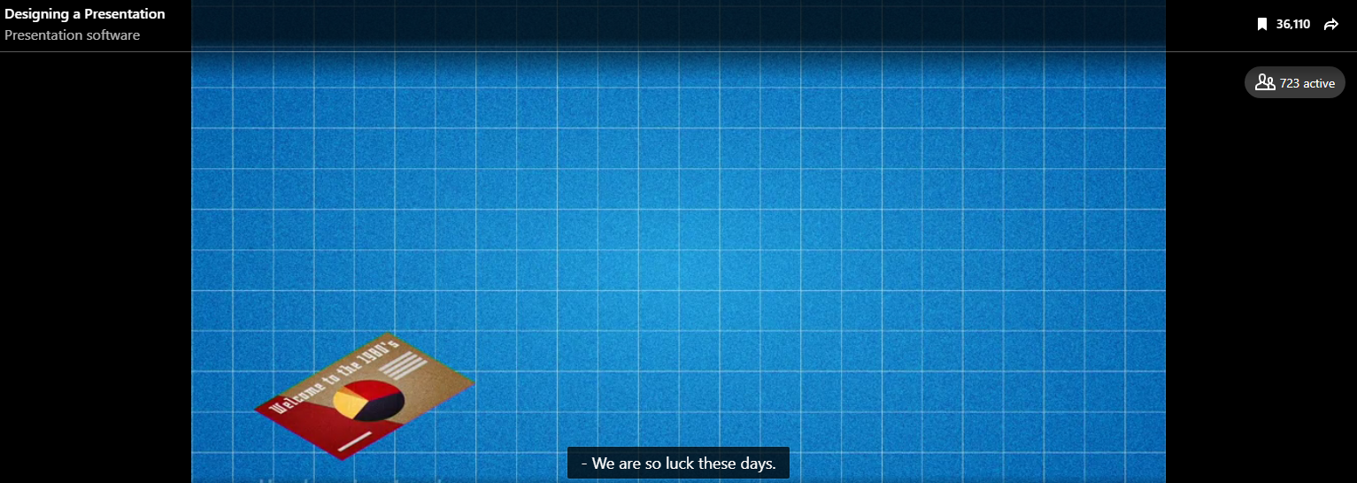
Adding LiL Content to A2L
Example: Designing a Presentation (browse LiL or search for content)
Select content you want to share with your students
Click on the sh share icon (top right of screen)

Slide 15
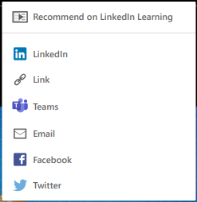
Adding LiL Content to A2L
Share options:
HINT: When embedding the link in your A2L course, append this statement &auth=true
at the end of the link, no spaces
Students can then access LiL courses directly (No authentication required)

Slide 16
Upcoming LiL Training Sessions
LiL offers additional training sessions for students, staff and faculty
Next LiL Session for Faculty: March 17, 3pm EST
How to leverage LiL in the classroom, as part of a blended learning strategy, and easily finding the right content
There is no cost to attend the session and available for everyone

Slide 17
Open Educational Resources

Slide 18
Notes:
https://pressbooks.bccampus.ca/facultyoertoolkit/chapter/creative-commons-licensing/
Retain - the right to make, own, and control copies of the content
Reuse- the right to use the content in a wide range of ways (e.g., in a class, in a study group, on a website, in a video)
Revise - the right to adapt, adjust, modify, or alter the content itself (e.g., translate the content into another language)
Remix - the right to combine the original or revised content with other open content to create something new (e.g., incorporate the content into a mashup)
Redistribute - the right to share copies of the original content, your revisions, or your remixes with others (e.g., give a copy of the content to a friend)

Slide 19
Benefits of Using OER
For Faculty
For Students
Increases retention.
Low or no cost materials. Students may perform better.
Ability to customize course materials and publish.
More engaging materials, many formats.
Easier access to materials.
Variety of formats support learning styles.
Help students stay on budget.
Online access to materials from anywhere.
Notes:
Source:
https://libguides.mcmaster.ca/oer/faculty
Materials are accessible and available in many formats
Low or no cost means students won't forego purchasing required course material and may perform better as a result
Ability to customize course materials and publish them under a Creative Commons License
Facilitates e-Learning
https://libguides.mcmaster.ca/oer/students
Ideal for students who use accessible materials or who have unique learning styles
Low cost materials help students stay on budget
Can access course materials from anywhere with an internet connection
Pressbooks 101 - https://docs.google.com/presentation/d/1bhzcSqmhyz8UUtJ_a19OaRHbJtLLd_DPyOEbHQeJp_g/edit#slide=id.g8540b1f688_2_15
Impact on learning. Large studies consistently find learning outcomes stay the same or increase.
Educators can curate, tailor, and share OERs to suit their curriculum, and share their innovations freely.
Students have ‘Day 1 through Day ∞’ access and can customize their learning to better meet their needs.
Students save $ on textbooks.

Slide 20
OER for Business
OER by Discipline Guide: McMaster University
eCampus Ontario Open Library
OER Collections
Notes:
Sources for Business
Examples:
OER BY DISCIPLINE
https://ecampusontario.pressbooks.pub/mcmasteroerdiscipline/ Commerce Use this Guide of 180+ open textbooks, listed by McMaster Faculty and Departments.
OPEN LIBRARY Fundamentals of Business: Canadian Edition
https://ecampusontario.pressbooks.pub/businessfuncdn/
Teamwork
GENERAL COLLECTIONS
https://libguides.mcmaster.ca/oer/collections

Slide 21
OER Committee at McMaster
Raises understanding and awareness.
Participate in local, provincial and national meetings.
Hosts events for McMaster students, faculty and staff.
Notes:
Source:
McMaster Research Guide https://libguides.mcmaster.ca/oer/home
https://libguides.mcmaster.ca/oer/committee

Slide 22
The McMaster OER Grant Program
Increase access Reduce costs New teaching approaches
Grantees for 2020-2021
Adaptation:
Zhen He, Assistant Professor, Dept. of Economics
Creation:
Alex Peace, Assistant Professor, School of Geography and Earth Sciences
Felicia Vulcu and Caitlin Mullarkey, Associate Professor and Assistant Professor, Dept. of Biochemistry and Biomedical Sciences
CALL Applications Spring 2021!
Notes:
https://libguides.mcmaster.ca/oer/grant
The OER Grant Program is generously funded through the MacPherson Institute, the Office of the Provost and Vice-President (Academic) and the University Libraries. An amount of $16,000 has been allocated for each of 2020/21, 2021/22 and 2022/23 to support the use of OER to benefit teaching and learning through increasing access to and discoverability of learning resources and contributing to student cost savings.
The McMaster OER Grant Program aims to:
Increase access to, and maximize use of, open textbooks and other open educational resources for students, instructors, and the community
Reduce the cost of textbooks and other course materials for students
Encourage the exploration of new teaching approaches using OER and development of course materials that are customizable and support course learning outcomes

Slide 23
Harvard Business Education Publishing

Slide 24
Harvard Business Publishing Education
Educator (site)
Teaching advise, guides, tips
Teaching Resources (free account)
Collections and coursepacks
Up to 60% off
The Faculty Lounge (newsletter)
Webinars
Testimonials
Articles: insights, tips, etc.
Notes:
Some materials free: articles with insights, tips, teaching strategies
Newsletter allows to select areas of interest and frequency
Educator account is free but teaching resources are not

Slide 25
Course Reserves

Slide 26
Course Reserves
Reserves are course related items (books or other materials) that are made available to students through McMaster libraries for free.
Reserves can be accessed
in person from Library Service Desks; physical items (books, DVDs, etc.) can be borrowed for short-term loan (e.g., 2-4 hours) currently suspended due to COVID-19 restrictions
or
online via Avenue to Learn using the Library’s new e-Reserves system (Ares)

Slide 27
eReserves
Highlights
Instructors simply share their list of course materials and Library staff will ...
scan chapters
provide permalinks to articles and e-book chapters
investigate e-book purchases
link out to open access educational resources
request I.L.L. (interlibrary loan) scans for items not available at McMaster
Library ensures your eReserve content is copyright compliant and in an accessible format
Library may be able to negotiate copyright permissions for course readings that exceed library licences or fair dealing policy.
eReserves are accessible to students 24 hours a day at no cost within Avenue to Learn (A2L) courses

Slide 28
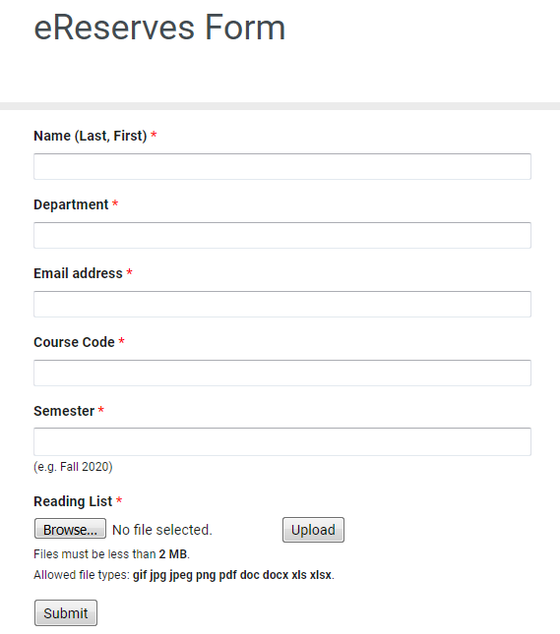
eReserves: Instructors
Submit your list of course materials to the Library
Complete the eReserves form
http://library.mcmaster.ca/forms/ereserves-form
Items found on eReserve
links to library resources like databases, articles, eBooks and open access sources
PDF of scanned short excerpts & transcripts
audio and video files
web links to publicly available resources
Items not found on eReserve
multiple chapters from a single print source under fair dealing; purchasing permissions may be possible
textbooks generally not available for libraries to purchase as an e-book
materials that fall outside of copyright compliance or our licensing agreements
Notes:
To help you navigate the world of copyright, please read McMaster's Copyright and Fair Dealing guidelines.
Please keep in mind when using copyrighted materials within your course readings, you can copy or upload the following:
Book: 1 chapter or 10% of the book.
Audio-visual material (i.e. video, sound recording): 10% of the work.
Journal Article: an entire article (Linking to Library online resources or Internet resources, where possible, is preferred).
Visual Work (i.e. cartoon, chart, diagram, photograph, or other image): an entire work.

Slide 29
eReserves: Instructors
Activate your course or request new course shell in A2L
select Content in the Avenue to Learn toolbar
select a module by clicking on the name (left side) or create a module by going to the Add a module … box (bottom left side) > type in a module name > press Enter key
select (from the middle of module screen) Add Existing Activities > External Learning Tools
select eReserves from the Add Activity list
once the eReserves link has been created click on the link to finish the configuration

Slide 30
eReserves: Instructor
Reminders
Submit eReserve requests EARLY to avoid delays
turnaround time at beginning of academic term is 3 to 4 weeks, at other times 1 to 2 days
a partial list can be sent first and additions sent later
inclusion of complete references will speed up processing
ordering and acquiring new books can take several weeks, lists must be received well in advance of the start of a course
when photocopies are being requested, a copy of the course syllabus must be submitted along with the reserve lists
eReserves removed at end of academic term
notify Library in writing about keeping materials on reserve for a longer period; send to ereserve@mcmaster.ca or library@mcmaster.ca
Instructor eReserves FAQ
Notes:
How long does it take material to be available on eResearves.
depends on number of submissions - beginning of each term may take 3-4 weeks; at other times may take 1–2 days; availability of materials may also effect processing time
How long does material stay on eReserves?
until end of academic term if course not being offered in subsequent terms or if when no written request from instructor is received to keep material on reserve for longer period
any materials in which we have obtained copyright permission for must be removed at the end of each term. If the item is required for a subsequent term, then permission needs to be obtained again.
Deadline for eReserve submissions?
since ordering and acquiring new books can take several weeks, lists must be received well in advance of the start of a course
a partial list can be sent first and additions sent later
when photocopies are being requested, a copy of the course syllabus must be submitted along with the reserve lists
inclusion of complete references will speed up the processing of lists

Slide 31
Custom Courseware
Transitioning to Library
Starting Spring 2021, the University Library will become the initial point of contact for developing Custom Courseware to better leverage existing licenses and make use of our new eReserves platform.
Over the course of the transition, the Library will be offering three course material delivery options:
traditional printed Custom Courseware
digital Custom Courseware
eReserves
Custom Courseware will continue to be listed and sold in the Campus Store, alongside other course materials
Submissions can be submitted through this form.
Questions about Custom Courseware? E-mail ccw@mcmaster.ca
Notes:
Why eReserves? As more course materials are being made online, instructors are increasingly opting for course materials from library electronic resources, open educational resources or other online tools. eReserves is a new service offered by the University Library that can support the delivery of electronic course material to students

Slide 32
Linking to Library’s e-Resources
DIY (Do-It-Yourself) Option
Issue:
Adding links the usual way (copying and pasting the URL that appears in your browser) doesn't always work since the URLs often contain variables that change every time the eResource is accessed.
Also, the URLs you copy from your browser do not contain the code necessary to make off-campus access possible (i.e., MacID)
Solution:
Create permalinks or permanent URLs that work on and off-campus for McMaster users
Notes:
Most license agreements permit instructors to link to articles as long as there is a proxy prefix added to the stable URL address
; this combination allows students to access individual articles from off campus.
Note that all databases with full text articles (in HTML or PDF formats) generally do not allow instructors to download copies for posting on a course management site such as Canvas, so it is important to use the modified UR L structure described below

Slide 33
Creating Permalinks @ McMaster
We Have a Tool for That!
TIPS
“Copy Link Address” before connecting to e-resource
Ensure Library’s libaccess proxy info not in middle of URL or permalink, remove if noted
https://www.jstor.org.libaccess.lib. mcmaster.ca/stable/44508558
Accessing Library e-resources using McMaster’s VPN + Remote Desktop can minimize this issue
Test all permalinks
Find a reliable URL (also known as stable URL, durable URL, etc.) or DOI (Digital Object Identifier)
https://www.jstor.org/stable/44508558
10.1177/0001839216682728
Append Library’s proxy prefix to the URL or DOI
http://libaccess.mcmaster.ca/login?url=
Create the permalink by combining … Library proxy prefix + reliable URL (no spaces)
http://libaccess.mcmaster.ca/login?url=https://www.jstor.org/stable/44508558 or
Library proxy prefix + DOI string [http://dx.doi.org/] + DOI itself (no spaces)
http://libaccess.mcmaster.ca/login?url=http://dx.doi.org/10.1177/0001839216682728
Notes:
https://www.jstor.org/stable/e48503352

Slide 34
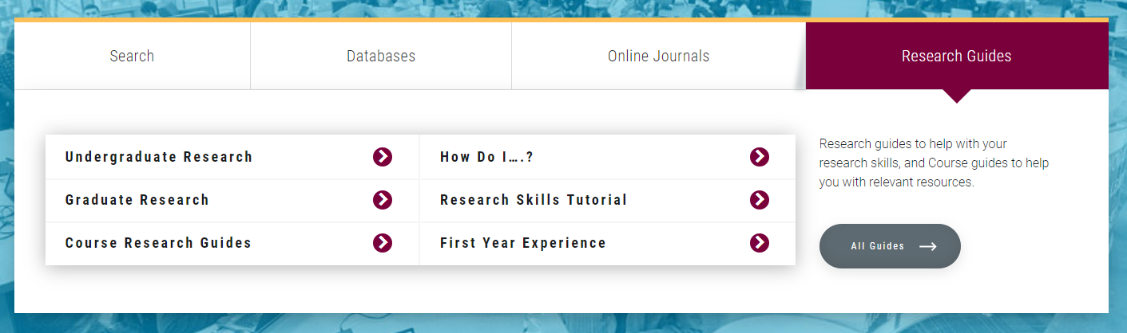
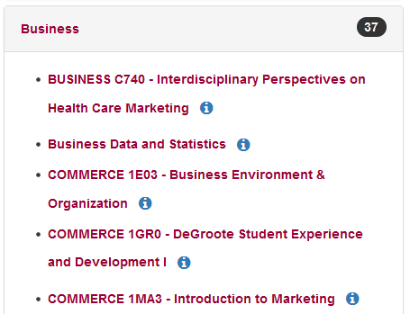
Research Guides for Business
Library > Research Guides > All Guides > Business
Includes business research guides for courses and general topics such as How Do I Find …
Business Cases
Company Annual Reports
Industry Reports
Financial Ratios
Top Business Databases
and more …
Have a suggestion for a business guide?
Contact Jeannie or Ines.

Slide 35
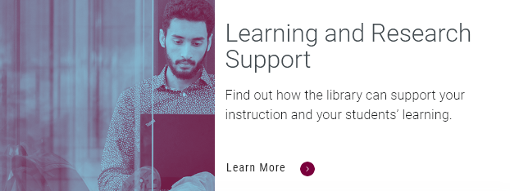
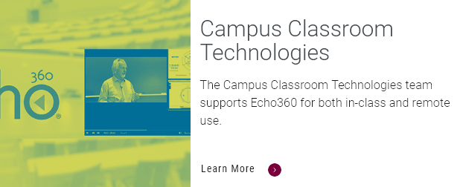
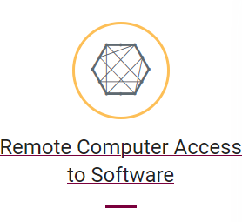
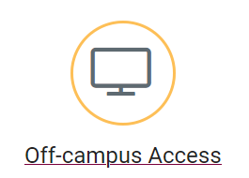
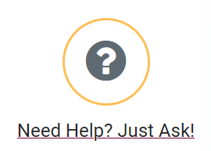
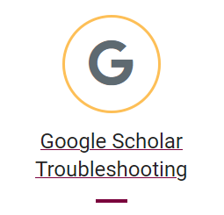
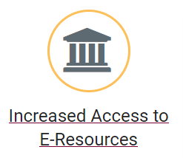
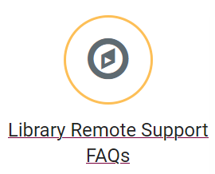
Library Remote Support Hub: Instructors
https://library.mcmaster.ca/remotesupport

Slide 36
Contact Us
DeGroote's Teaching and Learning Services
Nidia Cerna, Educational Developer, cernan@mcmaster.ca
E-mail: dsbEdDev@mcmaster.ca
Jeannie An, RJC Research Services Librarian, anjean@mcmaster.ca
Ines Perkovic, Business Librarian, perkovic@mcmaster.ca
E-mail: library@mcmaster.ca
Phone: 905-525-9140, ext. 22077 Mills Service Desk
Live Chat: http://library.mcmaster.ca/justask/
McMaster University Library

