Slide 1
The Foundations of Human Movement and Physical Fitness
Chapter 9: Lower Body Exercises

Slide 2
9.0 Learning Objectives
At the end of this chapter, you will be able to:
Explain the role balance plays in physical activity engagement.
Explain the 3 systems which allow us to maintain balance.
Describe why controlled breathing is necessary for physical activity and provide examples of how breathing patterns may differ between activity types.
Identify basic lower body exercises; describe how they should be performed; and how they can be modified.
Differentiate between and describe the rationale for choosing isolated and compound exercises.

Slide 3

9.1 Balance
Balance involves maintaining centre of mass over base of support. It relies on the visual, vestibular, and proprioceptive systems, each contributing unique feedback for posture and stability.
“Yoga” by Undraw, Undraw License

Slide 4
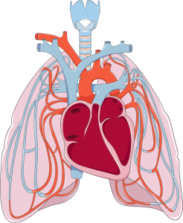
9.2 Breathing and Control
Proper breathing delivers oxygen, fuels muscle activity, and stabilizes the core. Breathing patterns differ by activity type—endurance, intervals, strength training, and explosive actions.
“Cardiovascular system – Pulmonary circulation — Smart-Servier” by Laboratoires Servier, CC BY-SA 3.0

Slide 5
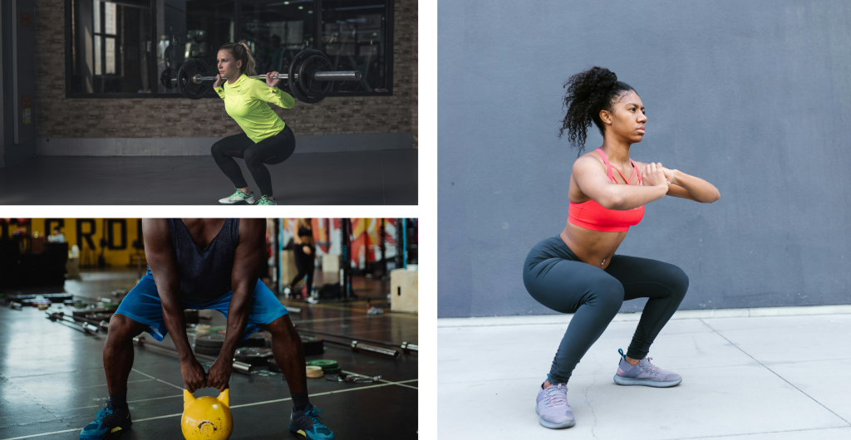
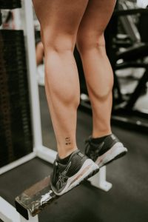
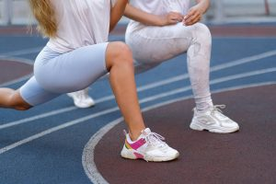
9.3 Basic Lower Body Exercises: Free Body
Describes squats, lunges, and calf raises. Stresses neutral spine, core engagement, controlled motion, and how foot placement or resistance can change difficulty.
Figure 1
Figure 2
Figure 3
Figure 1: Types of squats and various foot positions, “Woman Lifting Barbell” (top left) by Li Sun, Pexels License, “Man Using Yellow Kettlebell” (bottom left) by Ketut Subiyanto, Pexels License, “Woman in Activewear Exerercising” (right) by RDNE STock project, Pexels License
Figure 2: “Calves of Woman at Gym” by Amar Preciadodf, Pexels License
Figure 3: Photo by Anna Shvets, Pexels License

Slide 6
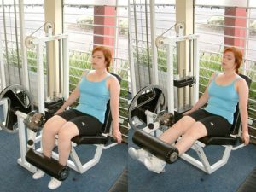
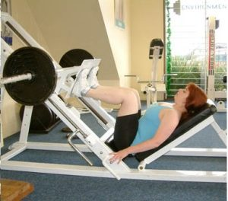
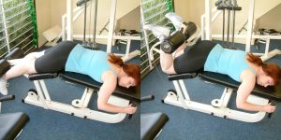
9.4 Basic Lower Body Exercises: Machine-Based
Covers leg press, leg extension, and hamstring curl. Focuses on form, ROM, core engagement, seat setup, and adjusting resistance or foot placement.
“Lying Leg Cur Machine Exercise” by GeorgeStepanek, CC BY-SA 3.0
“Leg Extension Machine Exercise” by GeorgeStepanek, CC BY-SA 3.0
Leg Press” by GeorgeStepanek, CC BY-SA 3.0

Slide 7
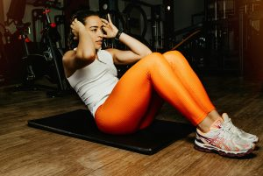
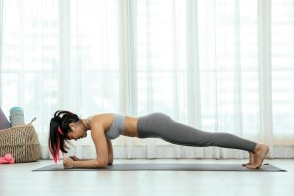
9.5 Isolated vs Compound Movements
Isolated exercises target a single muscle (e.g., leg extension), while compound ones use multiple joints and muscles (e.g., squats), ideal for strength and coordination.
Photo by Miriam Alonso, Pexels License
“Woman doing sit ups” by Johnathan Borba, Pexels License

Slide 8


9.6 Exercise Modifications
Modifications personalize exercises based on ability, injury, or goals. Adjustments include weight, tempo, ROM, equipment, and contact points to improve safety and effectiveness.
Sean is a hockey player in his off-season, and he would like to focus on strengthening his legs. He chooses a front squat with a weighted barbell to emphasize his quadriceps muscles. Because Sean wants to increase strength, he typically completes 3-4 sets or six repetitions of a moderate to heavy weight.
Sean is a hockey player in his off-season, and he would like to focus on strengthening his legs. He chooses a front squat with a weighted barbell to emphasize his quadriceps muscles. Because Sean wants to increase strength, he typically completes 3-4 sets or six repetitions of a moderate to heavy weight.
Avatar(s) by Undraw, Undraw License

Slide 9
9.7 Chapter Summary (Key Takeaways) 1/2
Balance and Its Systems: Balance is essential in physical activity, relying on the visual, vestibular, and proprioceptive systems. These systems work together to maintain posture, stability, and control during movement. Impairment in any can lead to instability and increased injury risk.
Controlled Breathing and Activity Type: Breathing patterns affect performance, energy use, and stability. Patterns differ by activity: rhythmic for endurance, controlled bursts for interval or explosive exercises, and paced inhaling/exhaling for strength training. Conscious breath control enhances performance and prevents fatigue or dizziness.
Form, Safety, and Lower Body Exercises: Proper technique is critical for exercises like squats, lunges, and calf raises. Maintaining a neutral spine, engaging core muscles, and moving with control are emphasized to avoid injury. Variations and equipment like resistance bands or weights help adapt exercises to different fitness levels.

Slide 10
9.7 Chapter Summary (Key Takeaways) 2/2
Machine-Based Exercises: Exercises like the leg press, leg extension, and hamstring curl isolate or challenge key muscle groups safely. Proper seat adjustments, range of motion control, and avoiding momentum ensure effective and injury-free training.
Isolated vs. Compound Movements: Isolated exercises target a single muscle group (e.g., leg extensions), useful for rehab or precision training. Compound exercises (e.g., squats, lunges) engage multiple joints and muscles, ideal for building overall strength, function, and coordination.
Modifications for Individual Needs: Modifications are essential, not a weakness. They help accommodate injuries, mobility limits, or different goals (e.g., strength vs. endurance). Exercises can be modified by adjusting weight, ROM, tempo, contact points, equipment, or posture to ensure safe, effective workouts for every individual.

Slide 11
9.7 Chapter Summary (Key Terms) 1/2
Balance: Maintaining centre of mass over base of support.
Stability: Resisting movement to maintain joint/body control.
Centre of Mass (COM): Point where body mass is evenly distributed.
Visual System: Eyes, nerves, and brain regions that orient space.
Vestibular System: Inner ear structures detecting movement and posture.
Proprioceptive System: Sensors in muscles and joints detecting position.
Endurance Activity: Sustained movement needing oxygen and pacing.
Explosive Activity: Short, high-power movement with breath control.
Repetition/Set-Based Activity: Structured strength exercises with rep counts.
Neutral Spine: Natural spinal curve alignment for safe movement.

Slide 12
9.7 Chapter Summary (Key Terms) 2/2
Isolated Exercise: Targets one muscle/joint for rehab or precision.
Compound Exercise: Engages multiple muscles and joints.
Modification: Adjusting movement for individual needs.
Contact Points: Body parts touching the support surface.
Tempo: Speed of movement affecting control/intensity.
Intra-abdominal Pressure: Core pressure that aids lifting stability.

