Slide 1
The Foundations of Human Movement and Physical Fitness
Chapter 7: Biomechanics

Slide 2
7.0 Learning Objectives
At the end of this chapter, you will be able to:
Define biomechanics and explain how it relates to human movement.
Differentiate between an internal and external force and how they impact the body.
Explain Newton’s Laws of Motion and how they apply to human movement.
Describe lever types and identify examples of them in the human body.
Describe basic biomechanical principles (e.g., COM) and recognize how they impact body stability.

Slide 3
7.1 What is Biomechanics?
Biomechanics studies how forces affect human movement. It combines biology and mechanics to analyze motion in living organisms, particularly humans.

Slide 4
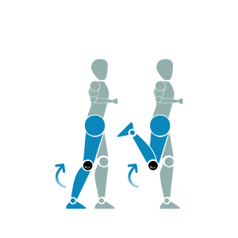
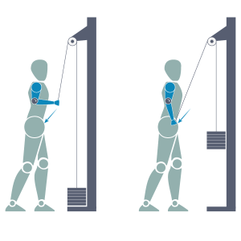
7.2 What is Force?
Force is a push or pull acting on or from within the body, affecting movement. External forces include gravity, wind, and friction. Internal forces are created by muscle contractions: concentric, isometric, and eccentric.
Figure 1
Figure 2
Figure 1: “Standing Tricep Extension with cable machine and hand grip while standing”, by Koen Liddiard, CC BY-NC-SA 4.0
Figure 2: “Standing Hamstring Curl using bodyweight” by Koen Liddiard, CC BY-NC-SA 4.0

Slide 5
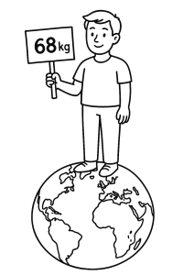
7.3 Newton’s First Law of Motion
The Law of Inertia states that an object remains at rest or in motion unless acted upon by an external force. Inertia is proportional to mass, and weight is calculated as mass times gravity.
Figure 1
Figure 1: “How much do you weigh?” image: OpenAI. (2025). ChatGPT. [Large language model]. https://chat.openai.com/chat Prompt: Create an illustration of a person who weighs 68kg standing on the Earth. Convert to black and white and remove clouds.

Slide 6
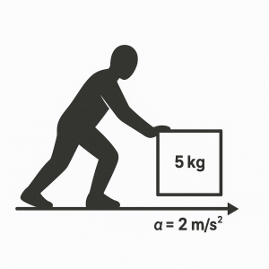
7.4 Newton’s Second Law of Motion
The Law of Acceleration explains that force equals mass times acceleration (F = ma). This law helps describe how objects speed up or slow down and introduces the concept of momentum.
“Force and Acceleration” image: OpenAI. (2025). ChatGPT. [Large language model]. https://chat.openai.com/chat Prompt: A 5 kg box being pushed across a floor with an acceleration of 2 m/s².

Slide 7
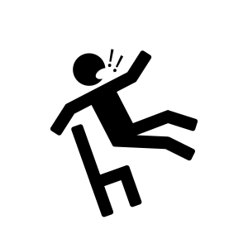
7.5 Newton’s Third Law of Motion
The Law of Action and Reaction states that every action has an equal and opposite reaction. For example, gravity pulls you down, but surfaces push back with a normal force.
“Falling off chair” by Koen Liddiard, CC BY-NC-SA 4.0

Slide 8
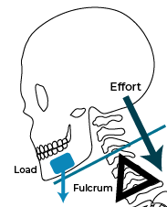
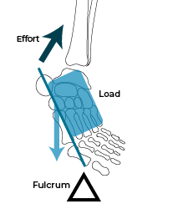
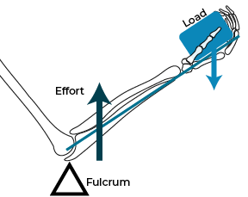
7.6 Levers
The body uses bones and muscles as levers to produce movement. Levers include a lever arm, fulcrum, resistive force, and applied force. The body has three classes of levers: first (e.g., head nod), second (e.g., calf raise), and third (e.g., biceps curl).
First-Class Levers
Second-Class Levers
Second-Class Levers
“1st lever” by Koen Liddiard, CC BY-NC-SA 4.0
“2nd lever” by Koen Liddiard, CC BY-NC-SA 4.0
“3rd lever” by Koen Liddiard, CC BY-NC-SA 4.0

Slide 9
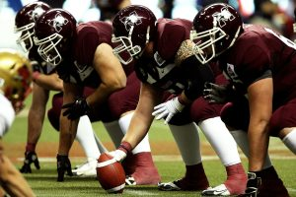
7.7 Stability
Stability is the body's ability to maintain or return to equilibrium when external forces act on it. It depends on mass, centre of mass (COM), base of support (BOS), and their positioning.
“Football” by Pixabay, Pexels License

Slide 10
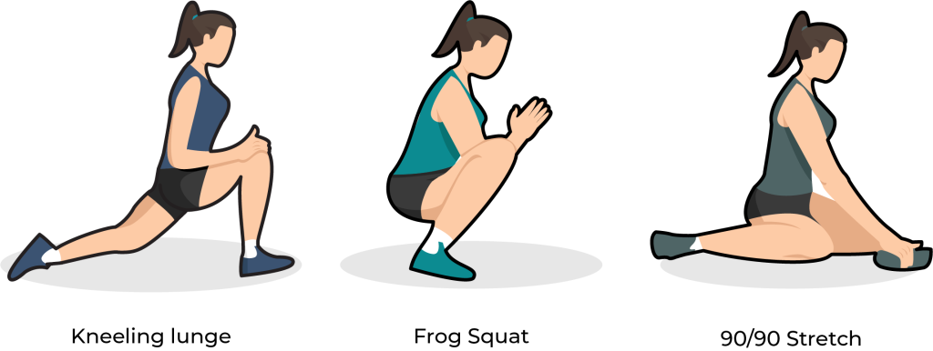
7.8 Maximum Force, ROM, and Joint Rotation
To generate maximum force, all joints must move through full range of motion (ROM) and follow correct joint sequencing—activating large muscle groups before smaller ones.
“ROM Exercises” by Koen Liddiard, CC BY-NC-SA 4.0

Slide 11
7.9 Chapter Summary (Key Takeaways) 1/3
Biomechanics bridges biology and mechanics: Biomechanics is the scientific study of how forces interact with living bodies, especially human movement. It combines knowledge of living systems (“bio”) and physical forces (“mechanics”) to explain how motion occurs and how it can be optimized.
Forces influence movement and come from inside and outside the body: Internal forces, such as muscle contractions (concentric, eccentric, isometric), originate within the body, while external forces like gravity, wind, and friction come from the environment and impact our movement capabilities and stability.

Slide 12
7.9 Chapter Summary (Key Takeaways) 2/3
Newton’s Laws of Motion:
  The First Law (Inertia) explains that an object at rest remains at rest, or if in motion, remains in motion at a constant velocity unless acted on by a net external force.
  The Second law (F = ma) explains that a force applied to an object is directly proportional to the magnitude and direction of the resultant acceleration of that object, but inversely proportional to the object’s mass.
  The Third law explains that for every action, there is an equal and opposite reaction that exists both in magnitude and direction against the object from which the force originated.
Three classes of Levers in the body to aid movement: The body uses three types of levers involving bones, joints (fulcrums), and muscles.
  First-class: balanced motion (e.g., head nodding).
  Second-class: strength advantage (e.g., calf raise).
  Third-class: speed and range advantage (e.g., biceps curl).

Slide 13
7.9 Chapter Summary (Key Takeaways) 3/3
Stability depends on mass, COM, and BOS: Stability is greatest when the center of mass (COM) is low and falls within a wide base of support (BOS). Adjusting body posture and contact points helps maintain or regain equilibrium, especially during movement or impact.
Maximum force requires full joint movement and proper sequencing: To generate maximum force in movement (e.g., throwing or serving), the body must utilize its full range of motion (ROM) and coordinate joint activation from large to small muscle groups in the correct order.

Slide 14
7.9 Chapter Summary (Key Terms) 1/3
Acceleration: The rate at which an object changes velocity or how fast or slow an object speeds up or slows down.
Base of support (BOS): The area beneath a person or object that includes every point of contact that supports it against gravity.
Biomechanics: A broad class of science which involves the study of movement in living things.
Centre of mass (COM): The imaginary center point at which the mass of an object is equally distributed.
External forces: All forces that originate outside the body, such as gravity, wind, and friction.
Inertia: The ability of an object to resist changes in its motion (resist acceleration).
Internal forces: All forces that originate within the body, typically generated through skeletal muscle contraction.

Slide 15
7.9 Chapter Summary (Key Terms) 2/3
Lever system: Contains a lever arm, a fulcrum, a resistive force, and an applied force; three classes describe their configurations.
Mass: Measured in kilograms (kg), it's the amount of matter in something, including anything attached to the body.
Maximum force: Refers to an individual exerting maximum effort during a physical task using full ROM and proper sequencing.
Momentum: The motion of an object related to its mass and velocity.
Range of motion (ROM): The measure through which a joint moves from full flexion to full extension.
Sequencing of joint rotation: Achieving maximum force by activating large muscle joints before small ones.

Slide 16
7.9 Chapter Summary (Key Terms) 3/3
Stability: The ability of an object to maintain or return to a position of equilibrium when acted upon by external forces.
Velocity: The rate at which an object is moving over time.
Weight: The measure of gravitational pull on an object, calculated using both gravity and mass.

