Slide 1
The Foundations of Human Movement and Physical Fitness
Chapter 6: Energy Systems, Fueling, and Training Principles

Slide 2
6.0 Learning Objectives
At the end of this chapter, you will be able to:
Define ATP and its role in fueling physical activity.
Differentiate between anaerobic and aerobic metabolic pathways.
Recognize which metabolic pathways primarily fuel specific types of activity.
Identify and differentiate between training principles.
Recognize how to apply training principles.

Slide 3
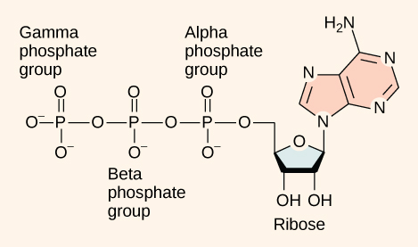
6.1 Adenosine Triphosphate (ATP)
ATP is the body’s primary energy currency, enabling muscle contraction and bodily functions. It is constantly resynthesized by different energy systems due to high demand.
“ATP Energy Molecule” by Amanda Shelton, CC BY 4.0

Slide 4

6.2 Anaerobic Metabolism: ATP-CP
The ATP-CP system uses creatine phosphate to rapidly resynthesize ATP for short bursts of energy (10–15 seconds), common in sprinting or weightlifting.
Examples of activities that use the ATP-CP Pathway: shotput, 100m dash, olympic weightlifting. Image (left): “Woman Athlete” by Boom, Image (top right) by Andrea Piacquadio, and Image (bottom right) by Victor Freitas, Pexels License.

Slide 5

6.3 Anaerobic Metabolism: Glycolysis
Glycolysis breaks down glucose or glycogen without oxygen, producing 2–3 minutes of energy and lactic acid as a byproduct. It supports moderate-duration high-intensity activity.
Examples of activities that utilize glycolysis: football, 600 to 800m dash, hockey. Image (top left): “Football player” by Pixabay, Image (bottom left): “Girl running” by Nathan Cowley, Image (right): “Hockey players” by Lynda Sanchez, Pexels License

Slide 6
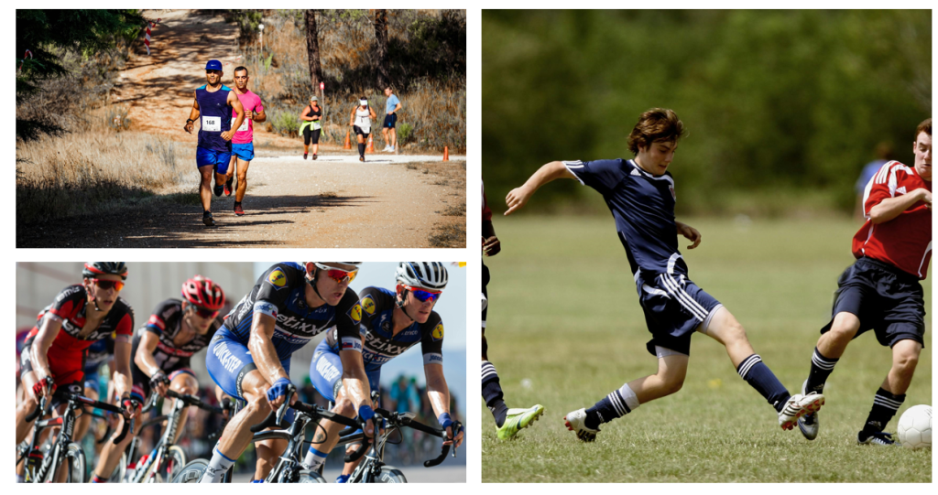
6.4 Aerobic Metabolism: Cellular Respiration
Aerobic metabolism uses oxygen to break down carbohydrates, fats, and proteins for long-lasting energy. It's efficient but slower, supporting endurance events.
Examples of activities that use the aerobic system: Marathon, soccer, biatholon. Image (top left): “Two men running” by RUN 4 FFWPU, Image (bottom left): “Cycling” by Pixabay, Image (right):”Three men playing soccer” by Pixabay, Pexels License

Slide 7
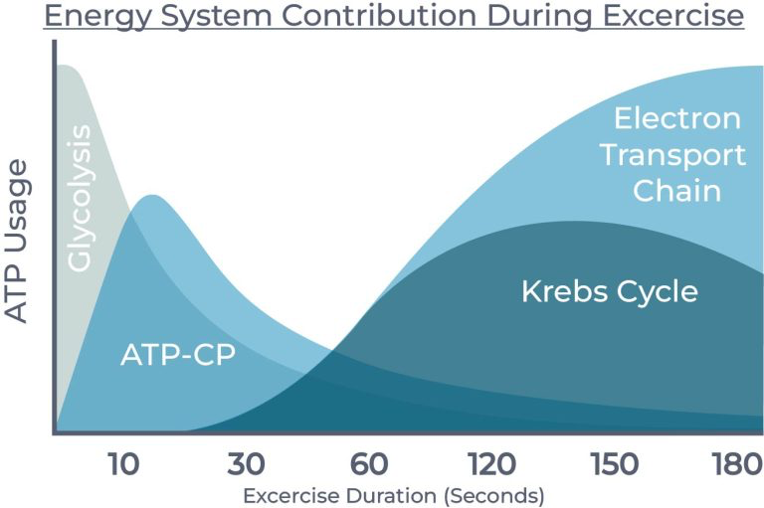
6.5 Anaerobic vs Aerobic Metabolism
Anaerobic systems are fast but short-lived; aerobic systems are slower but long-lasting. All systems work simultaneously in varying degrees depending on activity demands.
Energy System Contribution During Exercise Graph: OpenAI. (2025). ChatGPT. [Large language model]. https://chat.openai.com/chat Prompt: "I need a graph type image that shows what energy systems are prodomiently active during exercise duration over time. I need it to include the ATP-CP pathway, glycolysis, the krebs cycle and the Electron transport chain."

Slide 8
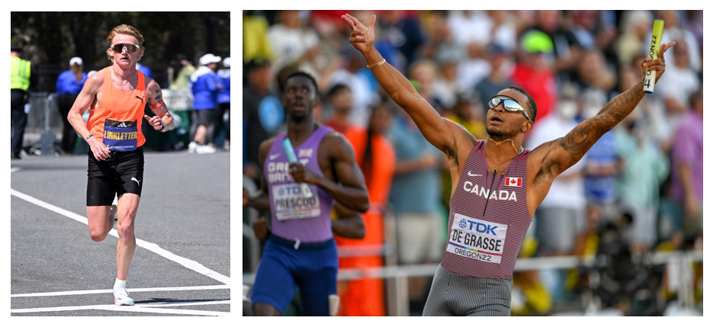
6.6 Energy Systems vs Muscle Make-up
Muscle fibre types influence energy usage: Type 1 (slow-twitch) supports endurance (aerobic), while Type 2 (fast-twitch) supports power and speed (anaerobic). Training can shift fibre makeup.
Left photo: Rory Linkletter, by 4300streetcar, CC BY 4.0, Right photo: Andre De Grasse, by Erik van Leeuwen, GNU License

Slide 9

6.7 Training Principles
Five training principles guide exercise: progressive overload, specificity, reversibility, diminishing returns, and individuality. Tailoring workouts based on these principles ensures sustainable fitness progress.
“Woman doing exercise” by Pixabay, Pexels License

Slide 10
6.8 Chapter Summary (Key Takeaways) 1/2
ATP is the Body’s Universal Energy Currency: All physical activity relies on adenosine triphosphate (ATP), a molecule generated from food that fuels muscle contraction. Because the body uses large amounts of ATP, it synthesizes it through multiple energy systems.
ATP-CP system (Anaerobic) provides energy for up to 15 seconds of high-intensity effort using creatine phosphate.
Glycolysis (Anaerobic) supports short bursts (1 to 3 minutes) using glucose or glycogen without oxygen, producing lactic acid.
Cellular Respiration (Aerobic) includes the Krebs Cycle, the ETC, and uses oxygen and various fuels (carbs, fats, proteins) to supply sustained energy for prolonged activities.

Slide 11
6.8 Chapter Summary (Key Takeaways) 2/2
Muscle Fibre Types Influence Energy Use: Type 1 (slow-twitch) fibres are optimized for aerobic endurance, while Type 2 (fast-twitch) fibres support anaerobic, explosive activities. Training can shift muscle fibre balance based on the energy system predominantly used.
  Type 1 (slow-twitch) fibres are optimized for aerobic endurance and they more red in colour because they have greater blood supply for oxygen transport.
  Type 2/ 2b (fast-twitch) fibres are optimized for aerobic, short lived physical activity and they are paler than type 1 fibres because they do not utilized oxygen in the production of ATP.
Training Principles Guide Effective Exercise: Concepts like progressive overload, specificity, reversibility, diminishing returns, and individuality help tailor fitness programs for continued improvement and sustainability.
Energy Systems Work Together, Not Separately: The body does not switch from one energy system to another but uses all systems in varying degrees depending on activity type, intensity, and duration to maintain adequate ATP levels.

Slide 12
6.8 Chapter Summary (Key Terms) 1/3
Adenosine Triphosphate (ATP): A molecule that stores and transfers energy within cells, acting as the primary energy currency for muscle contraction and other bodily functions.
Anaerobic Metabolism: Energy production that occurs without the use of oxygen; supports short-duration, high-intensity physical activity.
Aerobic Metabolism: Energy production using oxygen to convert carbohydrates, fats, and proteins into ATP; supports long-duration, moderate-intensity activity.
ATP-CP Pathway (Anaerobic): An Anaerobic system that supplies ATP to working muscle using creatine phosphate for 10-15 seconds of intense activity.

Slide 13
6.8 Chapter Summary (Key Terms) 2/3
Cellular Respiration (Aerobic): A complex aerobic process involving the Krebs Cycle and Electron Transport Chain to produce ATP from glucose, fat, or protein.
  Electron Transport Chain (ETC): The final stage of aerobic respiration that produces the majority of ATP in cells through oxidative phosphorylation.
  Krebs Cycle: A sequence of chemical reactions in aerobic metabolism that generates energy through the oxidation of acetyl-CoA.
Diminishing Returns: A principle stating that as fitness levels increase, the rate of improvement decreases, and gains become harder to achieve.
Glycolysis (Anaerobic): An Anaerobic system that supplies ATP to working muscles for 1-3 minutes of intense activity through the breakdown of glucose into pyruvate.
Individuality: A training principle acknowledging that each person responds differently to exercise, requiring personalized training plans.

Slide 14
6.8 Chapter Summary (Key Terms) 3/3
Progressive Overload: A training principle that involves gradually increasing the stress placed on the body to stimulate adaptation and improvement.
Reversibility: A training principle describing how fitness gains are lost when training ceases or is significantly reduced.
Specificity: A training principle that states improvements are specific to the type of activity performed; exercises should mimic the desired outcome.
Type 1 Muscle Fibres (Slow-Twitch): Muscle fibres that fatigue slowly, are rich in mitochondria and capillaries, and are adapted for endurance and aerobic activity.
Type 2 Muscle Fibres (Fast-Twitch): Muscle fibres that fatigue quickly, have fewer mitochondria and capillaries, and are adapted for power and anaerobic activity.

