Slide 1
The Foundations of Human Movement and Physical Fitness
Chapter 5: Muscular System

Slide 2
5.0 Learning Objectives
At the end of this chapter, you will be able to:
Define what a muscle is and what it is made up of.
Identify and explain the three types of muscle tissue.
Explain how muscle attaches to bone and how this is associated with muscular contraction.
Identify and describe the location, name, and action of musculature throughout the human body.

Slide 3
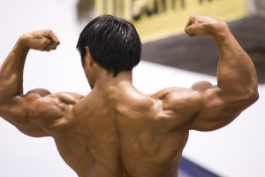
5.1 Mind Muscle
Introduces the concept of muscle beyond aesthetics, highlighting its functional role in movement and physiology.
“Hypertrophy” by OpenStax, CC BY 4.0

Slide 4
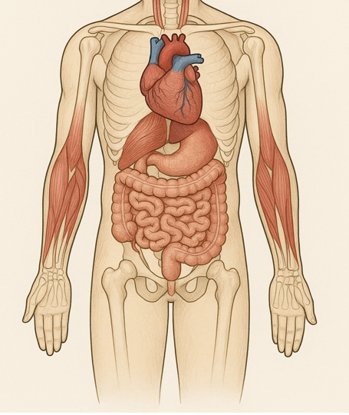
5.2 What Are Muscles?
Describes the three muscle types—skeletal, cardiac, and smooth—and distinguishes between voluntary and involuntary control.
“10.2 Skeletal Muscle” from Anatomy & Physiology by Lindsay M. Biga, Staci Bronson, Sierra Dawson, Amy Harwell, Robin Hopkins, Joel Kaufmann, Mike LeMaster, Philip Matern, Katie Morrison-Graham, Kristen Oja, Devon Quick, Jon Runyeon, OSU OERU & OpenStax is licensed under a Creative Commons Attribution-ShareAlike 4.0 International License, except where otherwise noted.

Slide 5
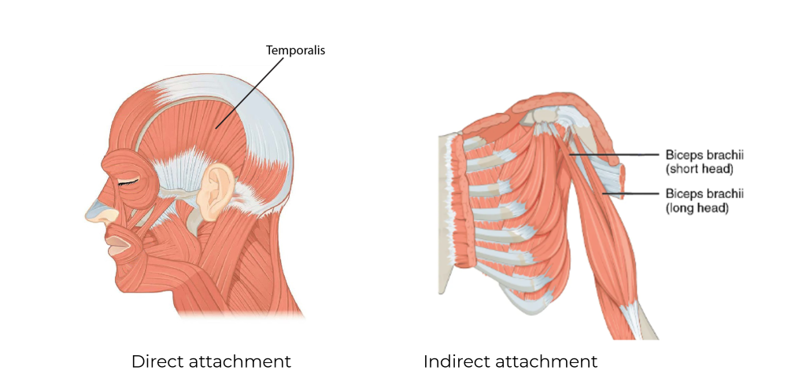
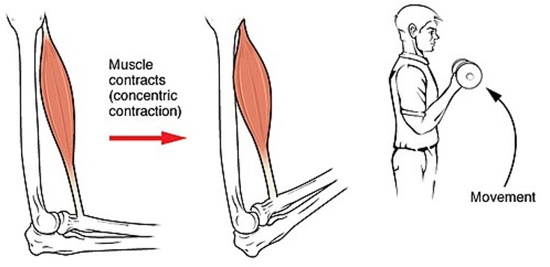
5.3 Muscular Attachments and Contraction
Explains muscle origin and insertion, and types of contraction: concentric, eccentric, and isometric. Discusses agonist, antagonist, stabilizer, and synergist roles.
Muscle Attachments
Muscle Contractions
Image by OpenStax, CC BY 4.0. Modified text labels, cropped and merged.
Illustraton by OpenStax, CC BY 4.0 Modified: Cropped

Slide 6
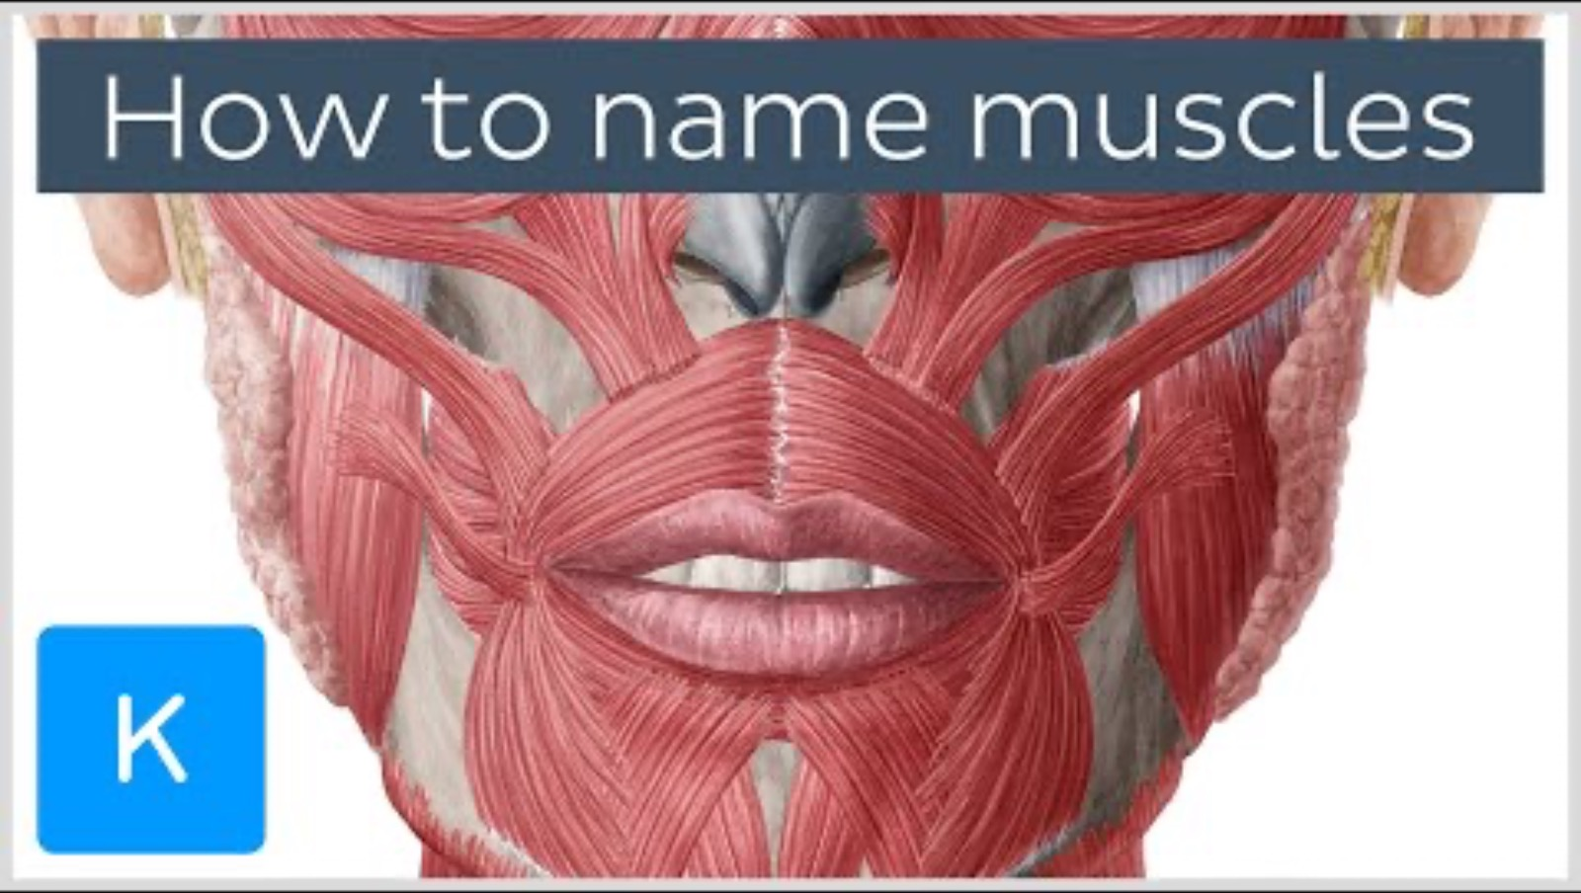
5.4 Naming Muscles
Outlines how muscles are named based on action, location, shape, attachments, and number of heads.
Video: “How are muscles named? – Terminology – Human Anatomy | Kenhub” by Kenhub – Learn Human Anatomy [11:31] is licensed under the Standard YouTube License. Transcript and closed captions available on YouTube.

Slide 7
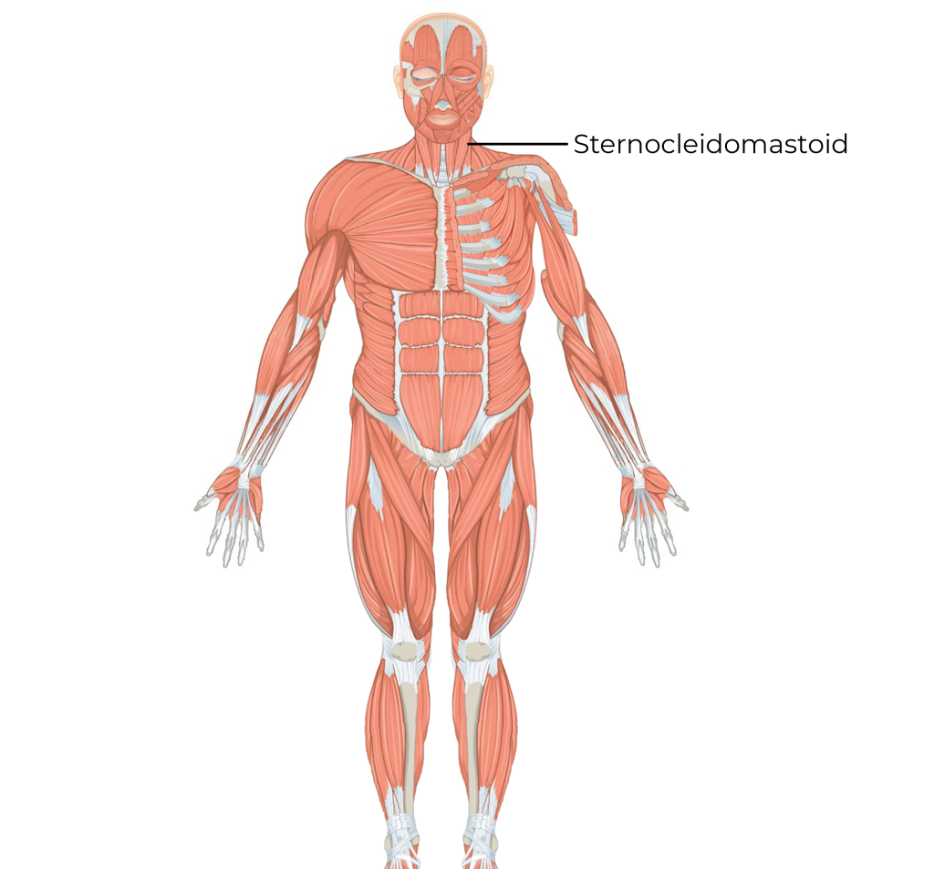
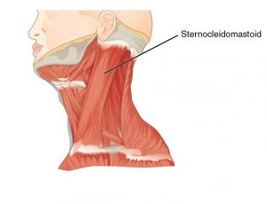
5.5 Muscles of the Neck
Covers the sternocleidomastoid muscle, which flexes, rotates, and laterally bends the neck.
Images(s) by OpenStax, CC BY 4.0. Modified text labels

Slide 8
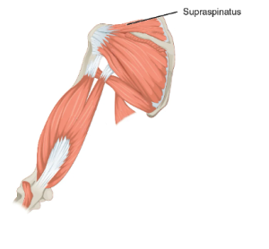
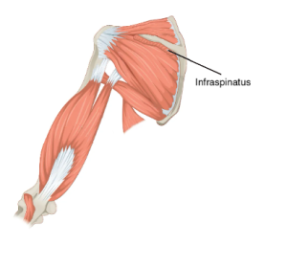
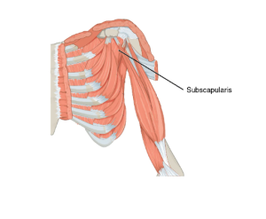
5.6 Muscles of the Scapula
Highlights rotator cuff muscles—supraspinatus, infraspinatus, subscapularis—and their roles in shoulder movement.
Images(s) by OpenStax, CC BY 4.0. Modified text labels

Slide 9
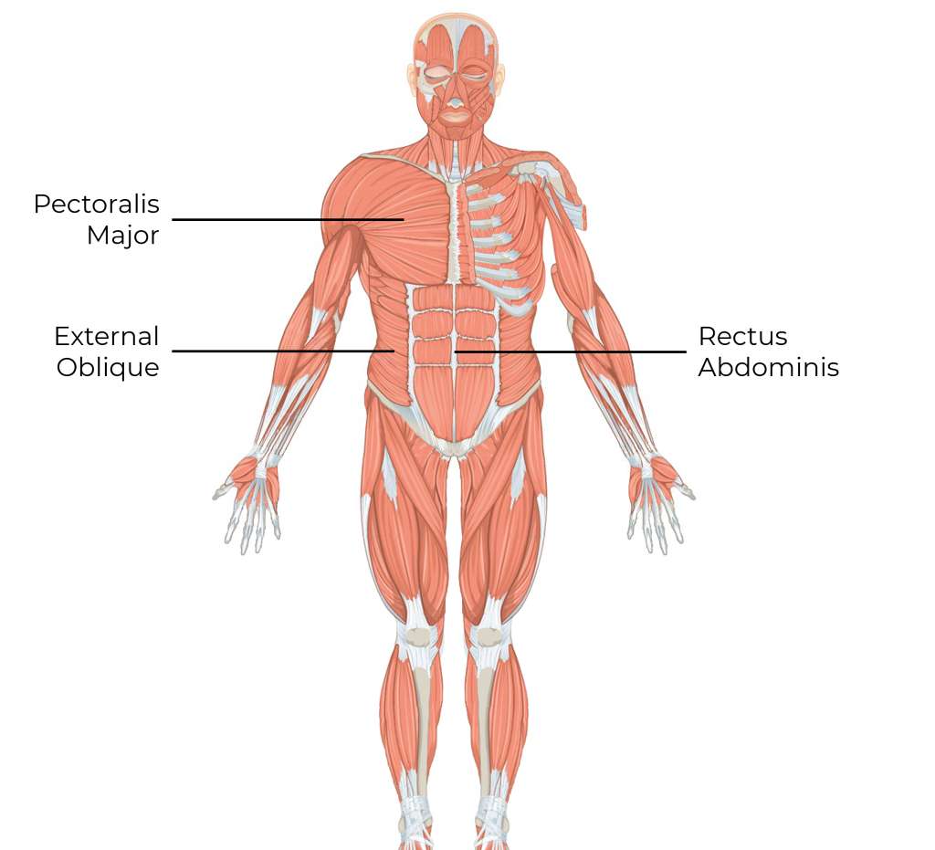
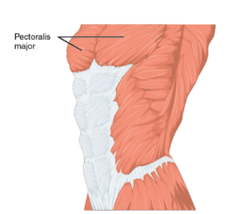
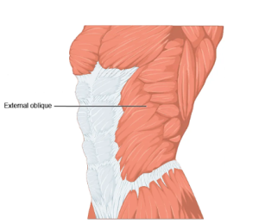
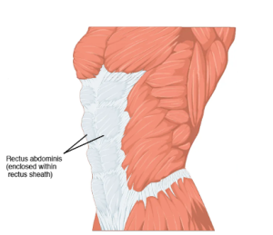
5.7 Muscles of the Thorax and Abdomen
Describes pectoralis major, external oblique, rectus abdominus, and diaphragm, which control trunk movement and breathing.
Images(s) by OpenStax, CC BY 4.0. Modified text labels

Slide 10
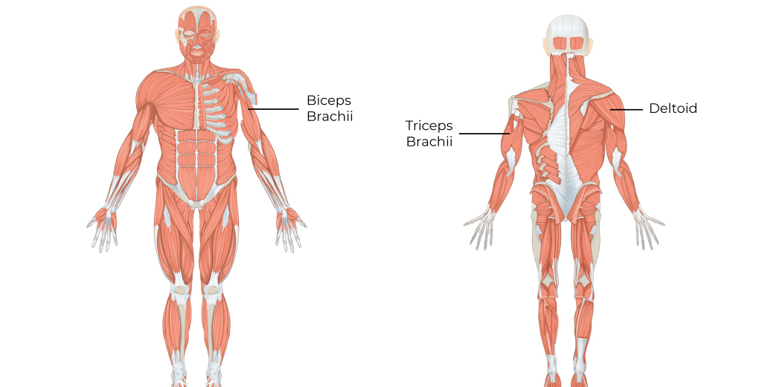
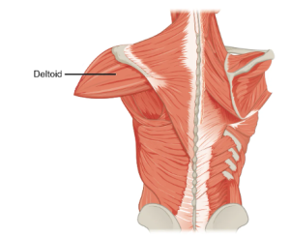
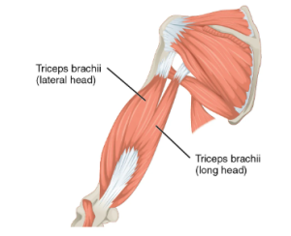
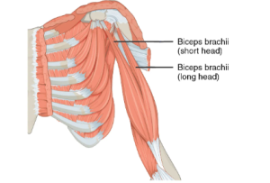
5.8 Muscles of the Upper Limb
Covers deltoid, biceps brachii, and triceps brachii, which are essential for shoulder and elbow movement.
Images(s) by OpenStax, CC BY 4.0. Modified text labels/cropped

Slide 11
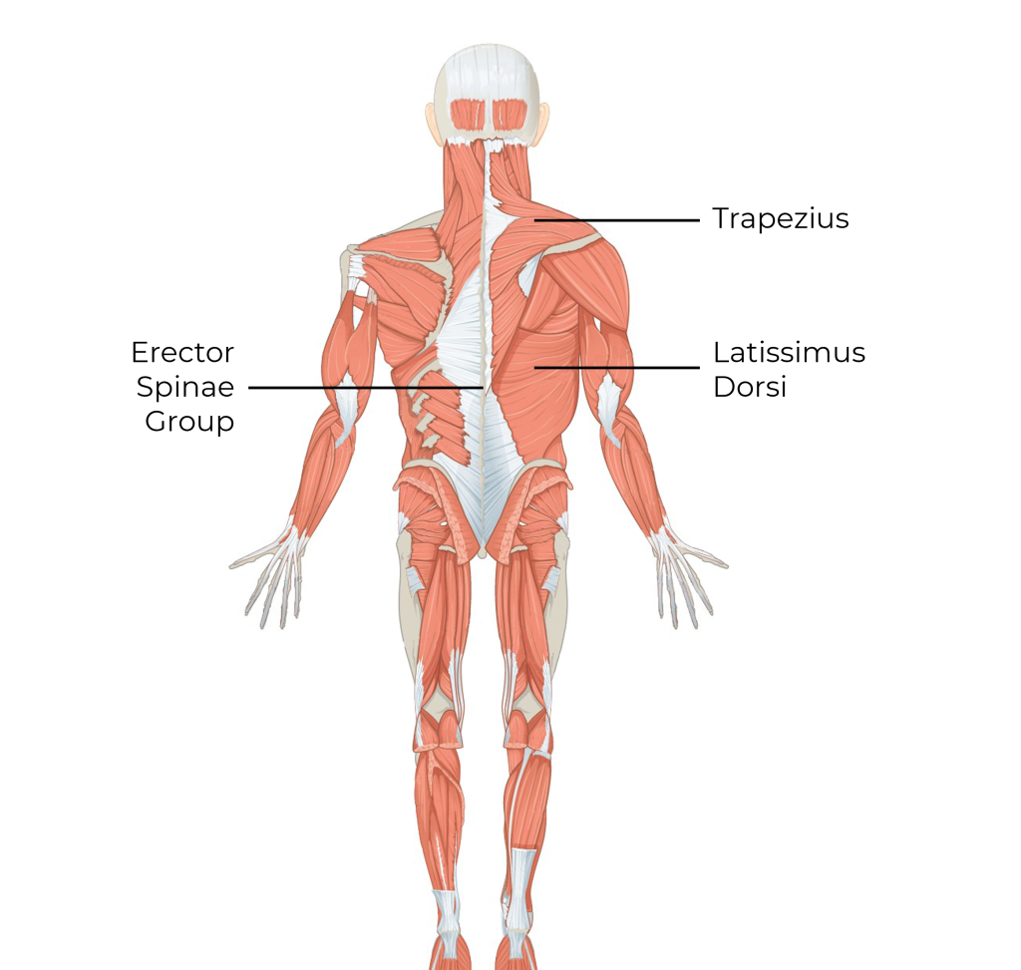
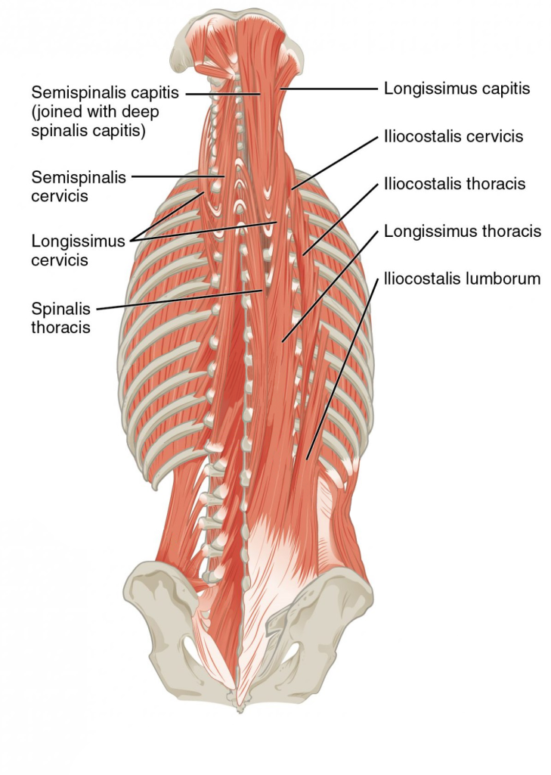
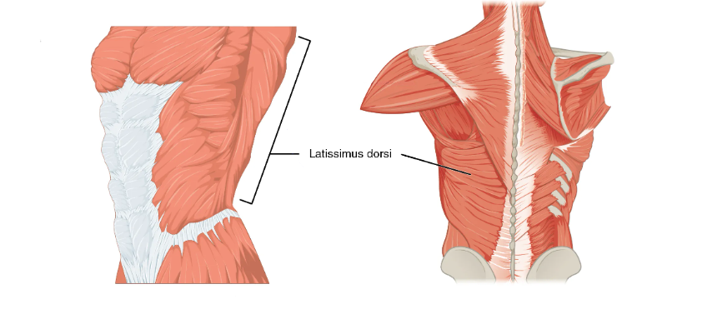
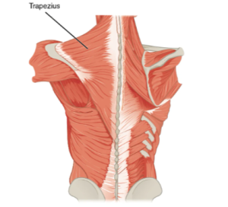
5.9 Muscles of the Back
Explains latissimus dorsi, trapezius, and erector spinae group and their function in posture and spinal movement.
Images(s) by OpenStax, CC BY 4.0. Modified text labels

Slide 12
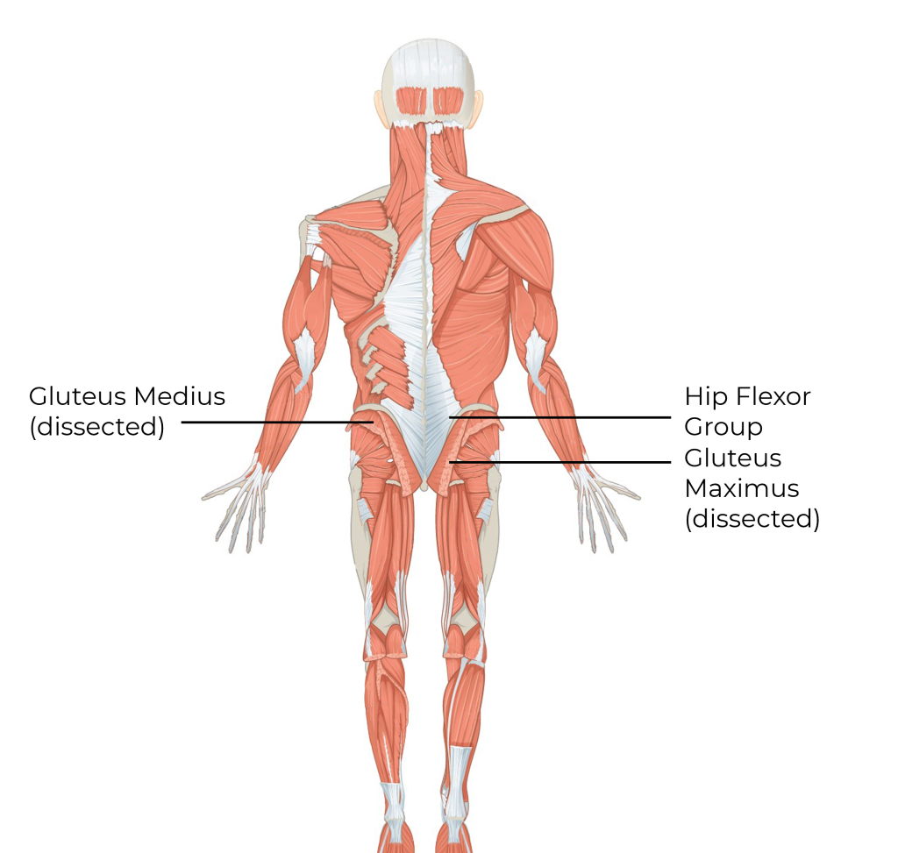
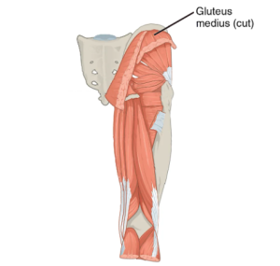
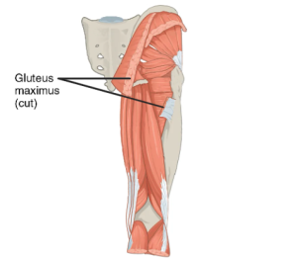
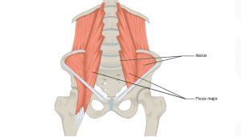
5.10 Muscles of the Hip
Details the hip flexor group, gluteus maximus, and gluteus medius in hip movement.
Images(s) by OpenStax, CC BY 4.0. Modified text labels

Slide 13
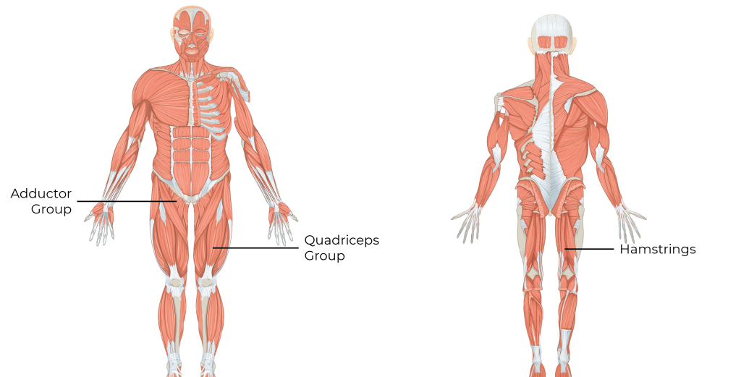
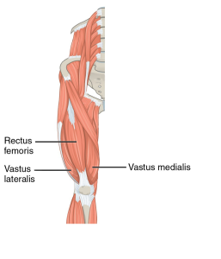
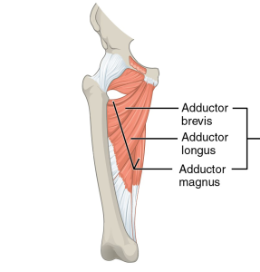
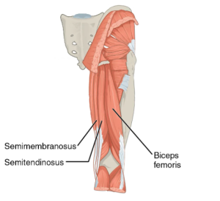
5.11 Muscles of the Upper Leg
Discusses quadriceps, hamstrings, and adductors in knee and hip motion.
Images(s) by OpenStax, CC BY 4.0. Modified text labels

Slide 14
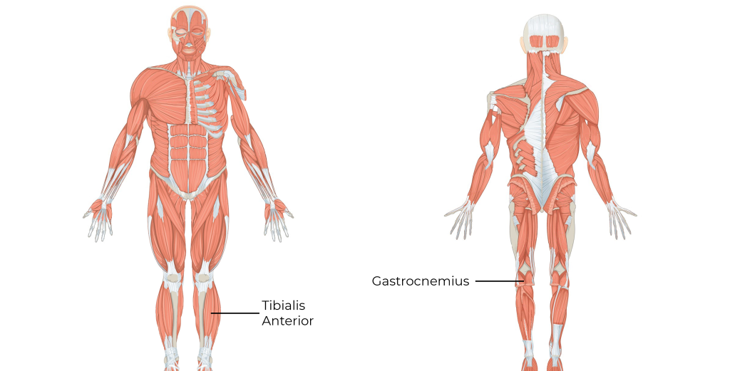
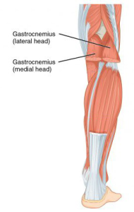
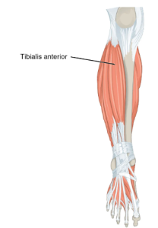
5.12 Muscles of the Lower Leg
Covers tibialis anterior and gastrocnemius, responsible for dorsiflexion and plantarflexion.
Images(s) by OpenStax, CC BY 4.0. Modified text labels

Slide 15
5.13 Chapter Summary (Key Takeaways) 1/2
Types and Functions of Muscle Tissue: The human body contains three types of muscle tissue: smooth, cardiac, and skeletal. Smooth muscle controls involuntary actions within internal organs, cardiac muscle enables heart function, and skeletal muscle, which is under voluntary control, is primarily responsible for body movement and posture. Skeletal muscles are composed of fibres organized into fascicles, with microscopic units called sarcomeres being the functional contractile components.
Muscle Attachments and Movement Mechanics: Muscles attach to bones either directly or via tendons and act at two key points: the origin (stationary) and insertion (movable). Muscles operate by pulling, not pushing, and can contract in three ways: concentric (shortening), eccentric (lengthening), and isometric (static). Muscles work in functional pairs or groups: agonists (prime movers), antagonists (opposers), synergists (assistants), and stabilizers (supporters during motion).

Slide 16
5.13 Chapter Summary (Key Takeaways) 2/2
Naming Conventions and Memorization Aids: Many muscles are named based on Latin or Greek terms describing their shape, location, number of heads, or function. For example, the sternocleidomastoid references its attachment points, while rectus abdominis indicates its straight, abdominal location. These naming patterns help in memorizing anatomical structures effectively.
Regional Muscle Group Breakdown: The chapter provides an overview of key muscles in various body regions, including the neck (e.g., sternocleidomastoid), thorax and abdomen (e.g., diaphragm, rectus abdominus), back (e.g., trapezius, latissimus dorsi), rotator cuff (e.g., supraspinatus), upper limb (e.g., biceps and triceps brachii), hip (e.g., gluteus maximus), upper leg (e.g., quadriceps, hamstrings), and lower leg (e.g., tibialis anterior, gastrocnemius). Each muscle is linked with its primary action.
Application Through Movement and Support: Muscles play a vital role in supporting and enabling functional movements such as walking, lifting, breathing, and maintaining posture. The collaboration between agonists, antagonists, synergists, and stabilizers allows for controlled and efficient physical activity, making an understanding of muscular anatomy essential for fields like health, fitness, rehabilitation, and kinesiology.

Slide 17
5.13 Chapter Summary (Key Terms) 1/3
Agonist: Primary muscle responsible for movement.
Antagonist: Opposes the action of the agonist.
Cardiac Muscle: Involuntary muscle found in the heart.
Cleido-: Refers to the clavicle.
Concentric Contraction: Muscle shortens during contraction.
Eccentric Contraction: Muscle lengthens during contraction.
Gluteus: Pertains to the buttocks.
Infra-: Below.
Insertion: Movable attachment of a muscle.
Isometric Contraction: Muscle length remains constant.

Slide 18
5.13 Chapter Summary (Key Terms) 2/3
Mastoid: Refers to the mastoid process of the skull.
Maximus/Medius/Minimus: Largest, middle, and smallest.
Muscle Belly: Thick, central part of a muscle.
Muscle Fascicle: Bundle of muscle fibers.
Muscle Fibre: Single muscle cell.
Myofibril: Threadlike component inside muscle fiber.
Oblique: Diagonally oriented muscle fibers.
Origin: Fixed muscle attachment site.
Rectus: Straight; vertically aligned fibers.
Sarcomere: Basic unit of muscle contraction.

Slide 19
5.13 Chapter Summary (Key Terms) 3/3
Skeletal Muscle: Voluntary muscle attached to bone.
Smooth Muscle: Involuntary muscle in internal organs.
Stabilizer: Muscle that stabilizes a joint.
Sterno-: Refers to the sternum.
Sub-: Under or beneath.
Supra-: Above.
Synergist: Assists the agonist during movement.

