Slide 1
The Foundations of Human Movement and Physical Fitness
Chapter 4: Bones

Slide 2
4.0 Learning Objectives
Identify and describe the major functions of the skeletal system and explain how it supports overall body function.
Classify bones by shape and provide examples of each type.
Distinguish between the axial and appendicular skeleton and list the main bones found in each division.
Locate and name key bones of the skull, spine, ribcage, upper limb, and lower limb using appropriate anatomical terminology.
Explain the role of specific bones in movement, support, and protection of vital organs.
Use anatomical language to describe the structure and location of major bones in relation to body regions and other bones.

Slide 3
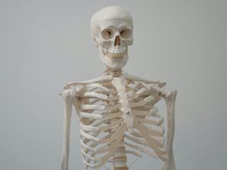
4.1 The Human Skeleton
The skeleton supports body structure, enables movement, protects organs, produces blood cells, and stores minerals. Adults have 206 bones.
“Human Skeleton Model” by Tima Miroshnichenko, Pexels License

Slide 4
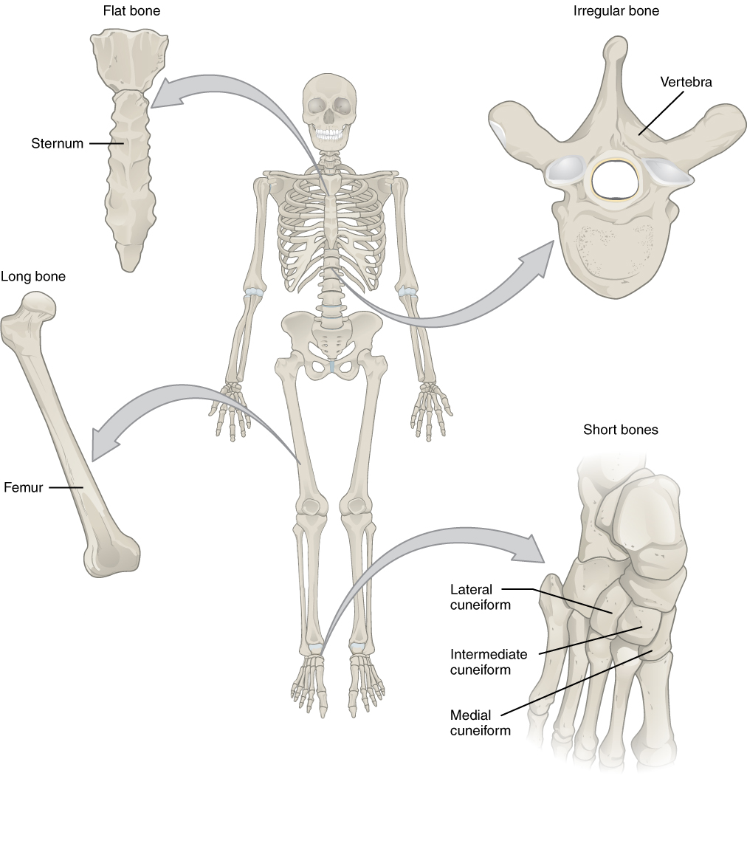
4.2 Types of Bone
Bones are classified into four types: long (movement), short (stability), flat (protection), and irregular (specialized functions).
”Bone Classification” by OpenStax College, CC BY 3.0

Slide 5
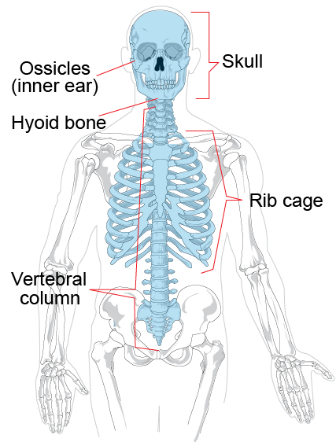
4.3 Bones of the Axial Skeleton
Includes skull, spine, and ribcage. Provides support and protects the brain, spinal cord, and vital organs.
Image by Lady of Hats, Public Domain Modified: some labels removed

Slide 6
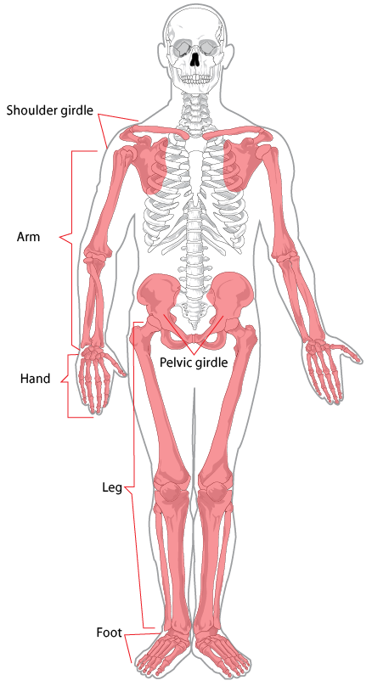
4.4 Bones of the Appendicular Skeleton
Includes shoulder girdle, upper limbs, pelvis, and lower limbs. Enables movement and supports body structure.
Image by Lady of Hats, Public Domain

Slide 7
4.5 Chapter Summary (Key Takeaways) 1/2
The skeletal system provides essential structure and function: It supports the body, protects vital organs (like the brain and heart), enables movement through joints and muscle attachments, produces blood cells in bone marrow, and stores minerals such as calcium.
There are four major bone types, each with specific roles: Long bones (e.g., femur, humerus) aid in movement, short bones (e.g., carpals, tarsals) offer stability, flat bones (e.g., ribs, skull) protect organs, and irregular bones (e.g., vertebrae, pelvis) have complex shapes for specialized functions.
The skeleton is divided into two parts – the axial and appendicular skeleton. The axial skeleton includes the skull, spine, and ribcage and provides central support and protection. The appendicular skeleton includes limbs, shoulders, and pelvis and is responsible for movement and interaction with the environment.

Slide 8
4.5 Chapter Summary (Key Takeaways) 2/2
Each bone in the body has a specific location and purpose: For example, the femur supports body weight, the radius and ulna control forearm rotation, and the vertebrae protect the spinal cord while allowing flexibility.
Bones grow and change over time: Babies are born with approximately 270 bones, which fuse into 206 bones by adulthood, particularly in the skull and spine, reflecting the body’s development and specialization.

Slide 9
4.5 Chapter Summary (Key Terms) 1/5
Skeletal System: Framework supporting, protecting, enabling movement, and producing blood cells.
Bone Marrow: Soft tissue inside bones that produces blood cells.
Long Bones: Longer than wide; aid movement (e.g., femur, humerus).
Short Bones: Cube-shaped; stability with limited motion (e.g., carpals).
Flat Bones: Thin and curved; protect organs (e.g., ribs, skull).
Irregular Bones: Complex shapes with specialized functions (e.g., vertebrae).
Axial Skeleton: Central bones: skull, spine, sternum, ribs.
Appendicular Skeleton: Limbs, shoulder, pelvis; enable movement.
Frontal Bone: Forehead area.

Slide 10
4.5 Chapter Summary (Key Terms) 2/5
Parietal Bone: Top/sides of the skull.
Temporal Bone: Sides of skull near ears.
Nasal Bone: Bridge of the nose.
Zygomatic Bone: Cheekbone.
Maxilla: Upper jaw.
Mandible: Lower jaw; movable.
Occipital Bone: Back of skull.
Cervical Vertebrae: 7 neck bones.
Thoracic Vertebrae: 12 mid-back bones.
Lumbar Vertebrae: 5 lower back bones.

Slide 11
4.5 Chapter Summary (Key Terms) 3/5
Sternum: Flat chest bone.
True Ribs: First 7 ribs; direct sternum attachment.
False Ribs: Next 3; indirect attachment.
Floating Ribs: Last 2; no sternum attachment.
Clavicle: Collarbone.
Scapula: Shoulder blade.
Humerus: Upper arm bone.
Radius: Forearm bone (thumb side).
Ulna: Forearm bone (pinky side).
Carpals: Wrist bones.

Slide 12
4.5 Chapter Summary (Key Terms) 4/5
Metacarpals: Hand bones.
Phalanges: Finger and toe bones.
Pelvis: Basin-shaped lower body structure.
Ilium: Upper pelvis.
Ischium: Lower rear pelvis.
Pubis: Front pelvis.
Femur: Thigh bone; longest/strongest.
Tibia: Shin bone.
Fibula: Lateral lower leg bone.
Calcaneus: Heel bone.

Slide 13
4.5 Chapter Summary (Key Terms) 5/5
Talus: Foot bone at ankle joint.
Metatarsals: Mid-foot bones.

