Slide 1
The Foundations of Human Movement and Physical Fitness
Chapter 3: Directional And Movement Terms

Slide 2
3.0 Learning Objectives
Identify and define common anatomical prefixes and suffixes and explain how they help break down complex terms.
Describe anatomical position and explain its importance as a universal reference point in kinesiology.
Differentiate between the three anatomical planes and axes and match them with appropriate movement examples.
Use directional terms (e.g., anterior, superior, distal) to describe the location of body parts in relation to one another.
Define and provide examples of common joint movements (e.g., flexion, abduction) and identify which plane and axis each movement occurs in.
Communicate and interpret exercise instructions or movement cues using correct anatomical and directional terminology.

Slide 3
3.1 Anatomical Language
Introduces common word parts (prefixes/suffixes) that help break down complex anatomical and movement terms.

Slide 4
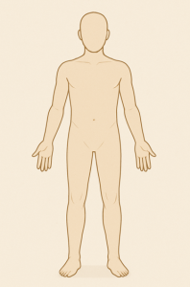
3.2 Anatomical Position
Explains the universal reference posture used to describe body position consistently across settings.
Figure 1
Figure 1: “Anatomical Position” Image: OpenAI. (2025). ChatGPT. [Large language model]. https://chat.openai.com/chat. Prompt: Create a generic simplified image of the human body that is a faceless mannequin and represents a neutral anatomical model.

Slide 5
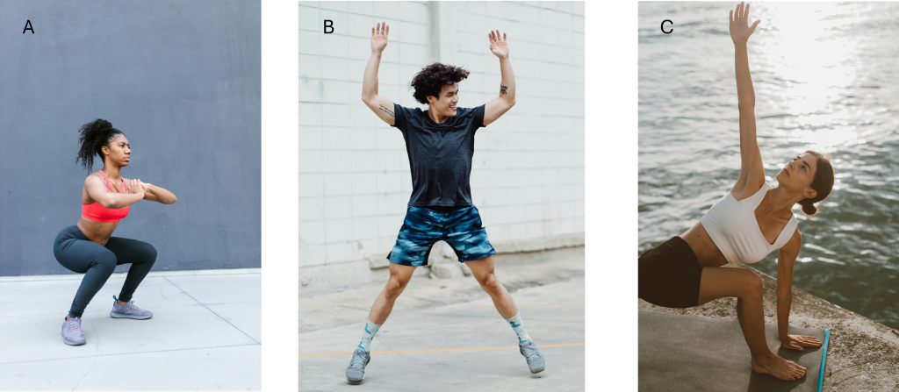
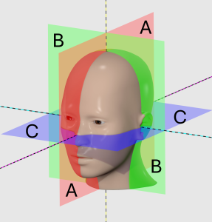
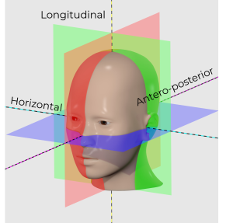
3.3 Dividing the Body
Describes planes (sagittal, frontal, transverse) and axes (horizontal, anteroposterior, longitudinal) used to analyze human movement.
Photo A by RDNE Stock project, Photo B by Ketut Subiyanto, Photo C by ROMAN ODINTSOV, Pexels License
Image(s) by Slashme, CC BY-SA 4.0 Modifications: text added

Slide 6
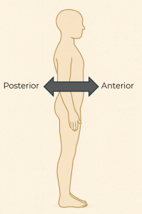
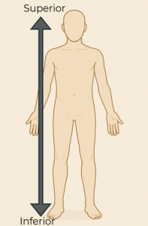
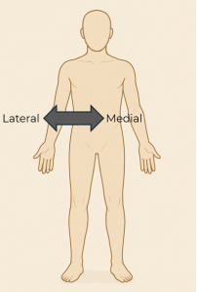
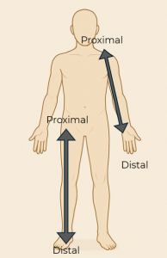
3.4 Directional Terms
Covers anatomical vocabulary for describing body part location (e.g., anterior, lateral, proximal) relative to anatomical position.
All images: OpenAI. (2025). ChatGPT. [Large language model]. https://chat.openai.com/chat.
Prompt: Create a generic simplified image of the human body that is a faceless mannequin and represents a neutral anatomical model in both front and side profile. Modifications: Added text and arrows.

Slide 7

3.5 Movement Terms
Explains common joint movements (e.g., flexion, abduction, rotation) and their associated planes and axes.
Photo by MART PRODUCTION, Pexels License

Slide 8
3.6 Chapter Summary (Key Takeaways)
Anatomical terminology is like a language built from prefixes and suffixes that help decode complex terms.
Anatomical position is the universal starting point used to describe body structure, movement, and direction.
Directional terms (e.g., anterior, superior, distal) describe where body parts are located in relation to one another.
The body can be divided into three main planes (sagittal, frontal, transverse) and axes (horizontal, antero-posterior, longitudinal) to describe movement.
Movements happen in a specific plane and around a specific axis, which are always perpendicular to each other.
Common joint actions like flexion, extension, abduction, and rotation are used to describe how body parts move.

Slide 9
3.6 Chapter Summary (Key Terms) 1/6
Ab-: Away from
Ad-: Toward
Post-: After, behind
Super-/Supra-: Above, over
Infra-: Below, beneath
Inter-: Between
Intra-: Within
Sub-: Under, below
Epi-: On, upon
Circum-: Around

Slide 10
3.6 Chapter Summary (Key Terms) 2/6
Trans-: Across, through
Hyper-: Over, excessive
Hypo-: Under, below normal
Dorsi-: Back, upper
Plantar-: Sole of foot
-flexion: Bending or decreasing joint angle
-extension: Straightening or increasing joint angle
-duction: Movement toward/away from midline
-version: Turning
-logy: Study of

Slide 11
3.6 Chapter Summary (Key Terms) 3/6
Anatomical Position: Universal body posture: upright, palms forward
Sagittal Plane: Divides body left/right
Frontal Plane: Divides body front/back
Transverse Plane: Divides body top/bottom
Horizontal Axis: Runs side-to-side; allows flexion/extension
Anteroposterior Axis: Front-to-back axis; allows ab/adduction
Longitudinal Axis: Vertical axis; allows rotation
Anterior: Toward the front
Posterior: Toward the back
Superior: Above

Slide 12
3.6 Chapter Summary (Key Terms) 4/6
Inferior: Below
Medial: Toward midline
Lateral: Away from midline
Proximal: Closer to limb attachment
Distal: Farther from limb attachment
Flexion: Decreasing joint angle
Extension: Increasing joint angle
Abduction: Away from midline
Adduction: Toward midline
Dorsiflexion: Toes toward shin

Slide 13
3.6 Chapter Summary (Key Terms) 5/6
Plantarflexion: Toes downward
Inversion: Sole inward
Eversion: Sole outward
Internal Rotation: Rotation toward midline
External Rotation: Rotation away from midline
Circumduction: Circular movement
Elevation: Raising a body part
Depression: Lowering a body part
Supination: Palm upward
Pronation: Palm downward

Slide 14
3.6 Chapter Summary (Key Terms) 6/6
Protraction: Moving forward
Retraction: Pulling back

