Slide 1
The Foundations of Human Movement and Physical Fitness
Chapter 1: The Study of Human Movement

Slide 2
1.0 Learning Objectives
At the end of this chapter, you will be able to:
Define Kinesiology and list physiological, psychological, and sociological components influencing human movement.
Summarize the main areas of kinesiology and other names that it may go by.
List potential career opportunities for kinesiology graduates, including roles within health and fitness as well as careers utilizing transferable skills outside the field.
Explain similarities and differences between movement, physical activity, physical exercise, and physical fitness, providing relevant examples of each.
Define and explain the health risks and causes of physical inactivity and obesity on a global scale.
Identify and categorize barriers to physical activity with appropriate examples.

Slide 3


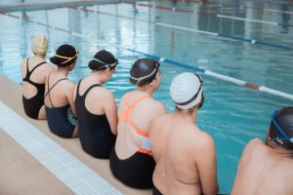
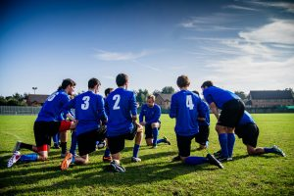
1.1 Kinesiology
Kinesiology is the scientific study of movement, integrating physiological, psychological, and sociological aspects. It includes exercise physiology, biomechanics, motor learning, and more.
Figure 1
Figure 2
Figure 3
Figure 4
Figure 1: “Sportswoman checking fitness tracker” by Ketut Sabiyanto, Pexels License
Figure 2: Photo by Markus Spiske, Pexels License
Figure 3: Photo by Pixabay, Pexels License
Figure 4: Photo by Ali Alcántara, Pexels License

Slide 4

1.2 Possible Career Paths
Careers include personal training, coaching, therapy, education, health promotion, and transferable roles in business, law enforcement, and customer service.
Photo (top left) by Kampus Production, Photo (top right) by Xhemi Photo, Photo (bottom left) by ThisIsEngineering, Photo (bottom right) by Anna Shvets, Pexels License

Slide 5
1.3 Movement-Related Terms
Clarifies differences between movement, physical activity, physical exercise, and physical fitness, highlighting intention, structure, and fitness goals.

Slide 6
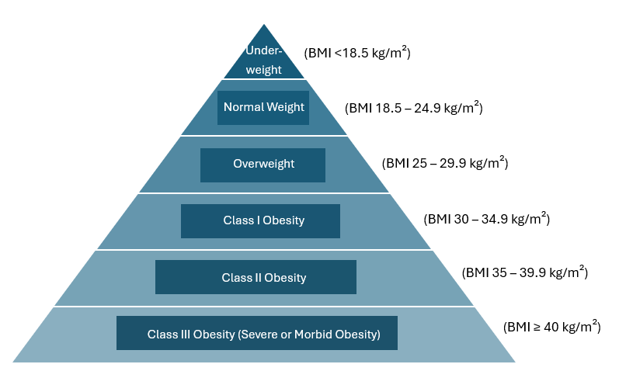
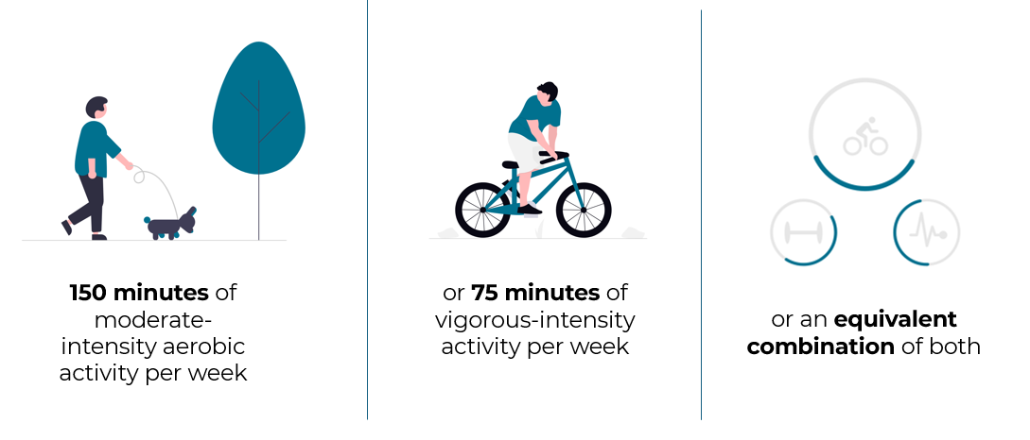
1.4 Physical Inactivity & Obesity
Explains causes, risks, and global statistics of physical inactivity and obesity. Both are major health threats influenced by behaviour, genetics, and environments.
Recommended Physical Activity
Body Mass Index (BMI)
“Dog walking”, “Bike ride” and “Activity tracker” by Undraw, Undraw License Modified: Added text
“BMI Triangle” by saudette, CC BY-NC-SA 4.0

Slide 7
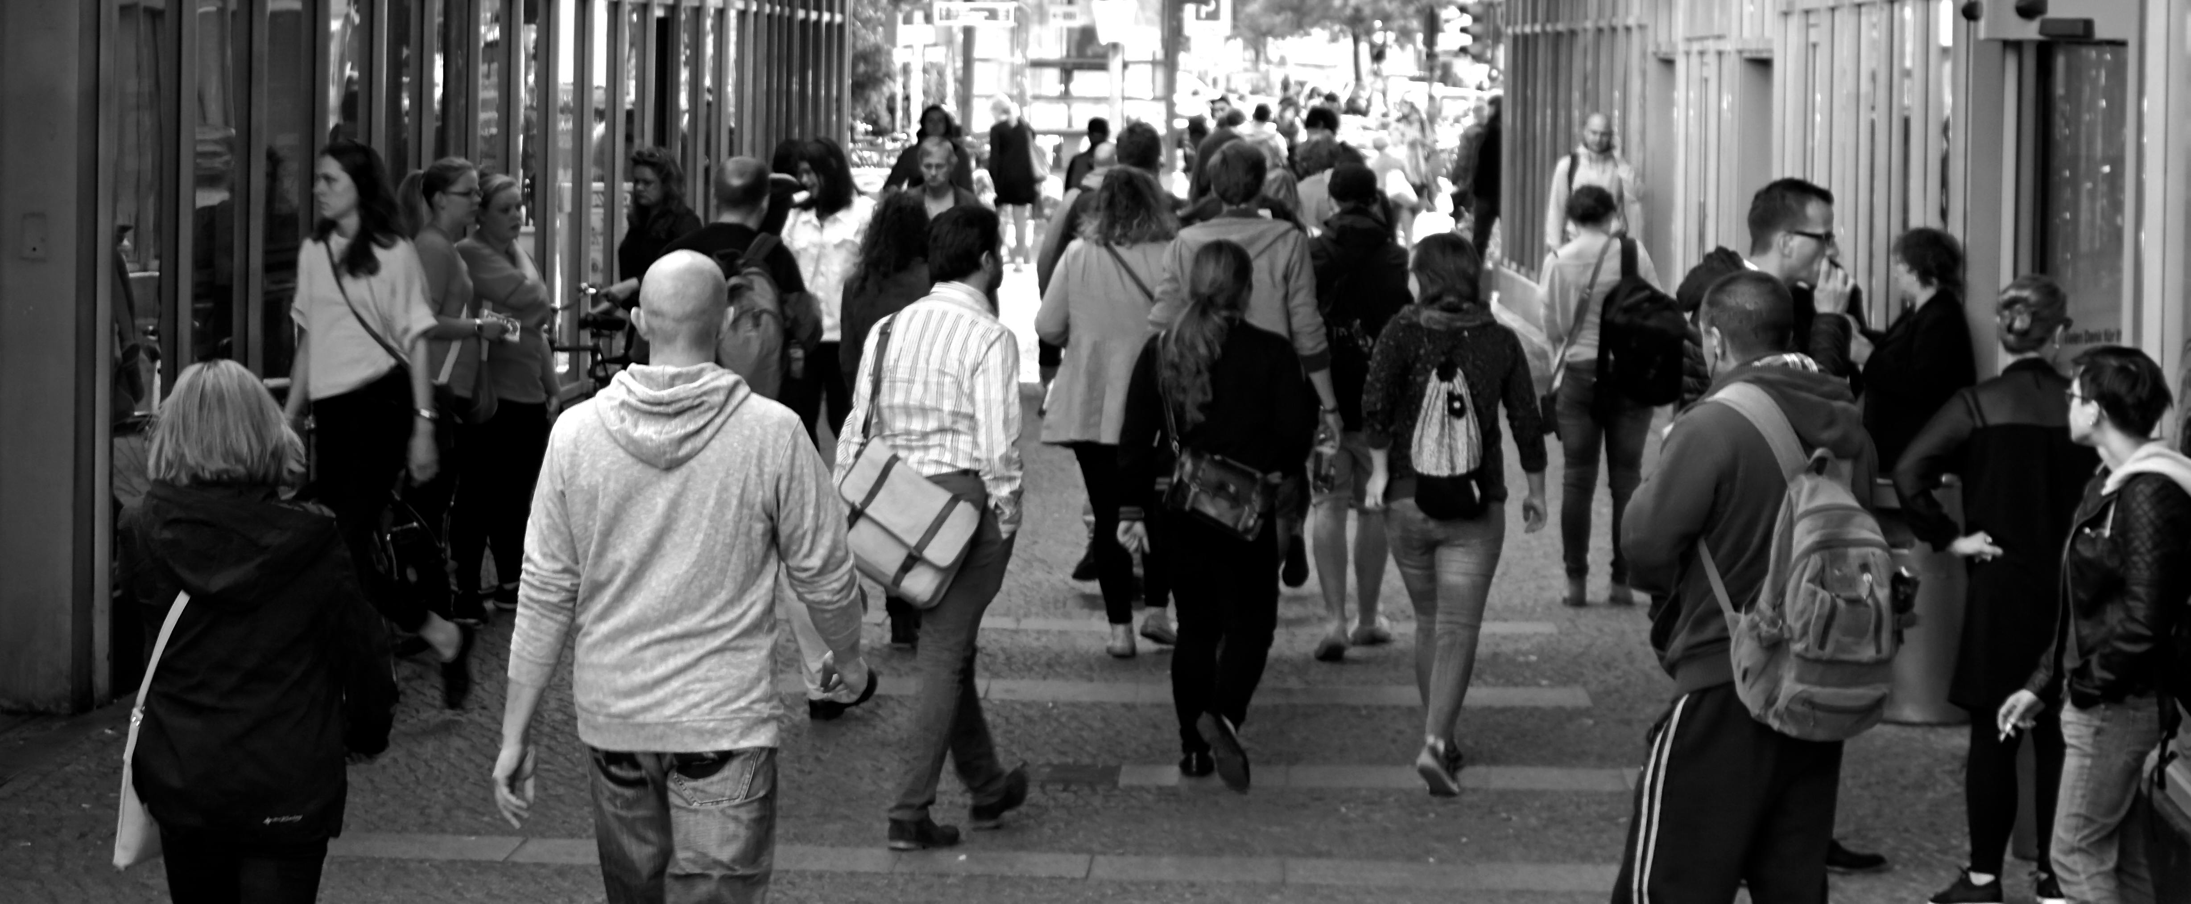
1.5 Barriers to Physical Activity
Barriers include environmental, socioeconomic, personal, cultural, and psychological factors that limit participation. Understanding them supports inclusive fitness solutions.
“People Crowd” by Surprising_Media, Pexels License

Slide 8
1.6 Chapter Summary (Key Takeaways)
Kinesiology is the study of how the body, mind, and society influence how and why we move.
Terms like Exercise Science, Human Kinetics, Physical Education, and Sport Science are related but may focus on different aspects like teaching, health, or athletic performance.
Graduates from kinesiology-related post-secondary programs go on to pursue a variety of career paths, some kin-related, some not.
Movement, physical activity, physical exercise, and physical fitness are related but have distinct meanings.
Physical inactivity and obesity are prevalent and costly health challenges worldwide.
Barriers to being physically active can be environmental, financial, personal, cultural, and/or mental health related.

Slide 9
1.6 Chapter Summary (Key Terms) 1/3
Kinesiology: The scientific study of human movement and how it affects health and performance.
Exercise Physiology & Anatomy: Study of how muscles, bones, lungs, and heart respond to activity.
Biomechanics: Application of physics to movement to understand body forces and motion.
Motor Learning & Skill Acquisition: How people develop and improve motor skills.
Social, Psychological & Historical Aspects: Explores how movement is influenced by mental health, culture, and society.
Fitness Training, Recreation & Leisure: Promoting physical activity for all ages and abilities.
Exercise Science: Study of exercise's effects on body systems and performance.
Human Kinetics: Canadian term similar to kinesiology, often health-focused.
Physical Education: Teaching movement skills and promoting active lifestyles.

Slide 10
1.6 Chapter Summary (Key Terms) 2/3
Sport Science: Focuses on enhancing athletic performance and preventing injury.
Movement: Any bodily action from muscle contraction.
Physical Activity: Energy-expending movement produced by skeletal muscles.
Physical Exercise: Planned, structured activity to improve fitness.
Physical Fitness: The ability to perform physical tasks efficiently.
Physical Inactivity: Not meeting recommended activity levels.
Obesity: Excess body fat that impairs health.
BMI: Body Mass Index, a height-to-weight screening tool.
Barrier: Anything that prevents or discourages physical activity.
Environmental Barriers: Unsafe or inaccessible spaces (e.g., poor urban design).

Slide 11
1.6 Chapter Summary (Key Terms) 3/3
Socioeconomic Barriers: Financial limits, lack of time or transportation.
Personal Barriers: Low confidence, motivation, knowledge, or physical issues.
Cultural/Social Barriers: Norms, customs, or social factors limiting activity.
Psychological Barriers: Mental health conditions like depression or anxiety.

