Slide 1
The Foundations of Human Movement and Physical Fitness
Chapter 11: Tissues, joints, and movement related pathologies

Slide 2
11.0 Learning Objectives
At the end of this chapter, you will be able to:
Differentiate between muscle tissue types.
Describe skeletal muscle anatomy and explain the function of a sarcomere.
Outline the role of each joint classification.
Recall specific soft tissue injuries and describe how they impair movement.
List the signs of inflammation and understand the relation to movement impairment.
Describes ways in which muscle dysfunction can impair movement.
Identify common movement-related pathologies.
Provide examples of physical activity or sport that common movement-related pathologies are associated with.

Slide 3
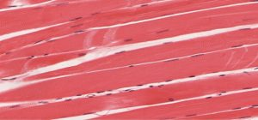
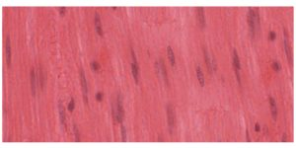
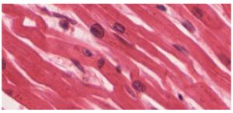
11.1 Skeletal Muscle Tissue
Covers the three muscle types: skeletal (voluntary), cardiac (involuntary, rhythmic), and smooth (involuntary, slow). All muscles share contractility, extensibility, and elasticity. Focus is placed on skeletal muscle for its role in movement.
Skeletal Muscle
Smooth Muscle
Cardiac Muscle
All three images: Image by OpenStax College, CC BY 3.0, Modifications: Cropped

Slide 4
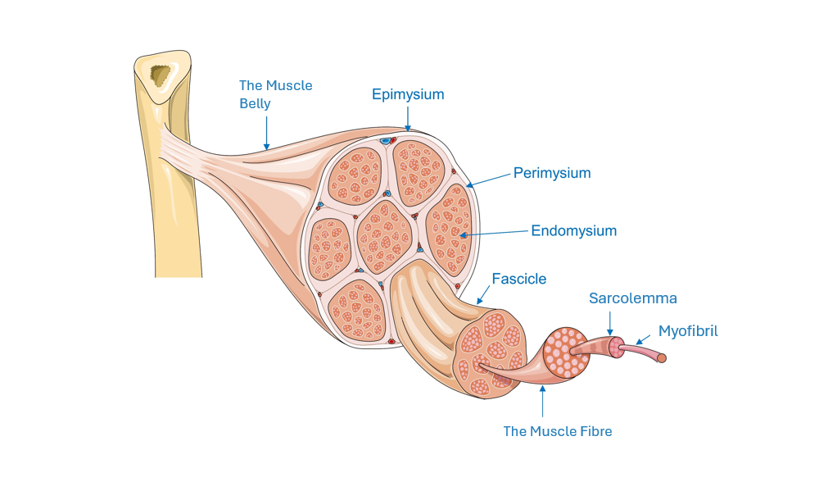
11.2 Skeletal Muscle Anatomy
Explains skeletal muscle structure, highlighting sarcomeres, the smallest contractile units. The sliding filament theory describes muscle contraction via actin and myosin interaction.
Image by Labaoratorios Servier, CC BY NC SA 3.0

Slide 5
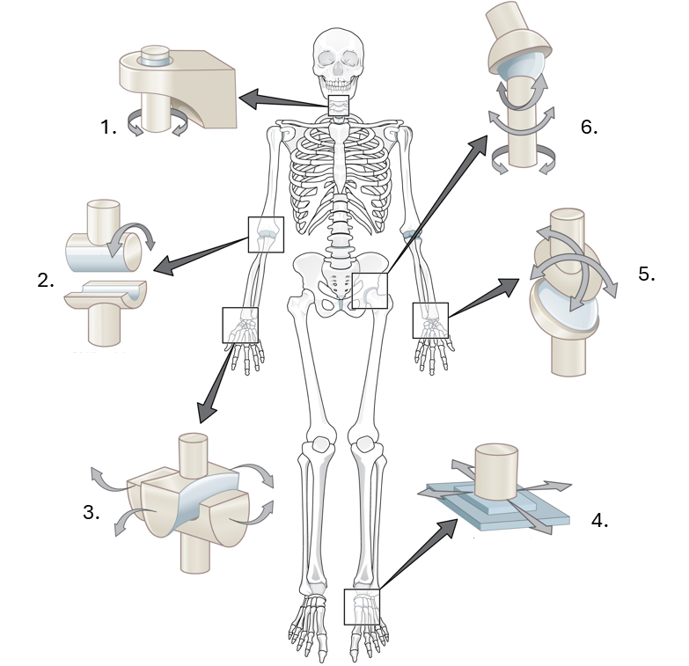
11.3 Joints: Synovial
Synovial joints enable movement and include six types:
Pivot
Hinge
Saddle
Plane
Condyloid
Ball-and-socket
They are supported by tendons, ligaments, menisci, and bursae.
Illustration showing the location and types of synovial joints. Image by OpenStax College, CC BY 3.0. Modifications: Text removed and replaced with numbers.

Slide 6
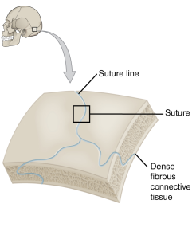
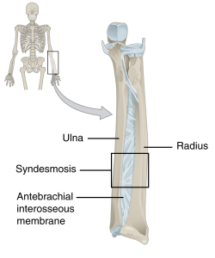
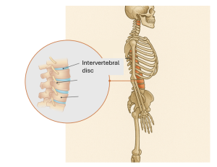
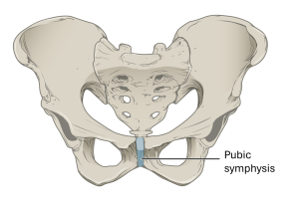
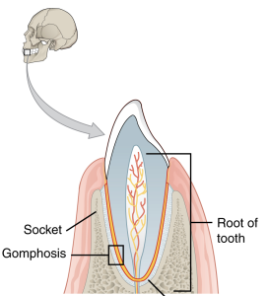
11.4 Joints: Cartilaginous and Fibrous
Cartilaginous joints (e.g., intervertebral discs) allow limited movement; fibrous joints (e.g., sutures in the skull) allow none. Each type provides structural support.
Cartilaginous Joints
Fibrous Joints
Figure 2
Figure 3
Figure 1
Figure 5
Figure 4
Figure 1: “Cartilaginous joints” by OpenStax, CC BY-SA 3.0
Figure 2: “Skeletal side profile” Image: OpenAI. (2025). ChatGPT. [Large language model]. https://chat.openai.com/chat Prompt: Create a side skeletal side profile of the human body. Highlight the intervertebral discs.
Figure 3-5: “Fibrous Joints” by OpenStax College, CC BY 3.0, Modified: Cropped

Slide 7
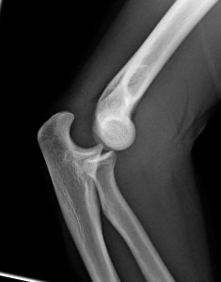
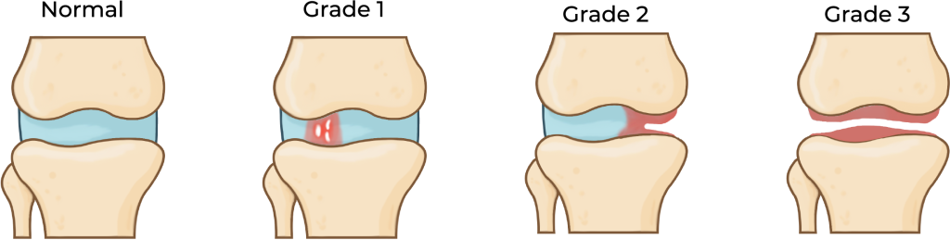
11.5 Soft Tissue Injuries
Differentiates sprains (ligament damage) and strains (tendon/muscle damage). Introduces dislocations (complete misalignment) and subluxations (partial displacement) of joints.
Lateral X-ray of a dislocated right elbow, Image by James Heilman, MD, CC BY-SA 3.0
“Degrees of strains” by Koen Liddiard, CC BY-NC-SA 4.0

Slide 8
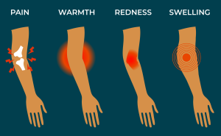
11.6 Inflammation
Describes inflammation’s role in healing (pain, redness, swelling) and related conditions like tendinitis, bursitis, and arthritis. Identifies -itis as a suffix indicating inflammation.
“The four cardinal signs of inflammation” by Koen Liddard, CC BY-NC-SA 4.0

Slide 9
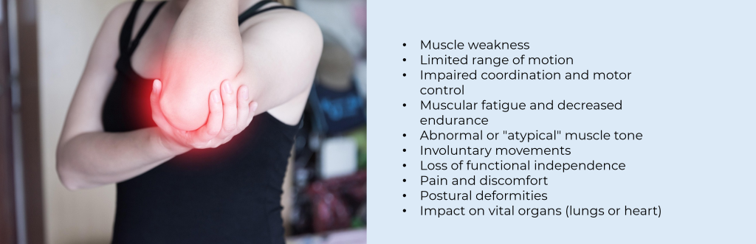
11.7 Muscular Dysfunction
Outlines causes and types of muscular dysfunction including muscular dystrophy, rigidity, and spasticity. These limit strength, coordination, and control.
Photo by nattanan23, Pixabay License

Slide 10

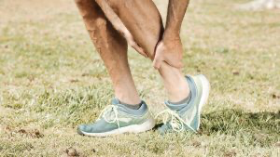
11.8 Common Injuries
Summarizes acute and overuse injuries, such as contusions, sprains, and stress fractures. Warning signs include pain, swelling, weakness, and reduced motion.
Photo by Kindel Media, Pexels License
Photo(Upper left) by Andrea Piacquadio, Pexels License
Photo(Upper right) by Daniel Reche, Pexels License
Photo (Lower left) by Pixabay, Pixabay
Photo (Lower right) by unknown Pixabay license

Slide 11
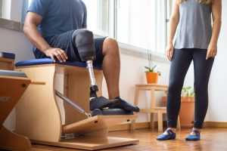
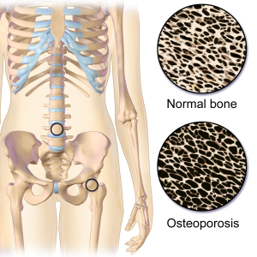
11.9 Conditions Impacting Movement
Details how neurological, musculoskeletal, metabolic, and psychological conditions affect movement. Includes Parkinson’s, osteoporosis, obesity, depression, and fear of falling.
Photo by Kampus Production, Pexels License
“Osteoporosis Locations” by BruceBlaus, CC-BY-SA 4.0

Slide 12
11.10 Chapter Summary (Key Takeaways) 1/2
Muscle Tissue Types and Function: There are three types of muscle tissue: skeletal (voluntary movement), cardiac (involuntary rhythmic contractions of the heart), and smooth (involuntary movement in organs). All share properties like contractility, extensibility, and elasticity, which are essential for human function and movement.
Joints and Movement: Joints are classified as synovial (freely movable), cartilaginous (slightly movable), and fibrous (immovable). Synovial joints, including hinge and ball-and-socket joints, play the most significant role in movement. Joint components like tendons, ligaments, menisci, and bursae provide support and reduce friction.
Soft Tissue and Joint Injuries: Common injuries include sprains (ligament damage), strains (muscle or tendon damage), dislocations, and subluxations. These can result from overuse, trauma, or improper technique. Inflammation (e.g., tendinitis, bursitis) is the body’s healing response but can impair motion when excessive or chronic.

Slide 13
11.10 Chapter Summary (Key Takeaways) 2/2
Muscular Dysfunction and Disorders: Movement can be impaired by muscular issues such as muscle weakness, rigidity, and spasticity, often due to conditions like muscular dystrophy, Parkinson’s disease, or cerebral palsy. These dysfunctions reduce strength, coordination, and range of motion, sometimes affecting vital organs or posture.
Conditions Affecting Movement: Neurological, musculoskeletal, metabolic, and psychological conditions can all impact physical function. Examples include osteoporosis, obesity, diabetes, depression, and fear of falling. These affect energy, posture, motivation, proprioception, and gait—demonstrating how holistic body health is essential to movement.

Slide 14
11.10 Chapter Summary (Key Terms) 1/3
Addison’s Disease: A disorder affecting hormone production, causing fatigue and reduced stress tolerance.
Arthritis: Inflammation of joints, resulting in pain, stiffness, and reduced movement.
Bursa (Bursae): A fluid-filled sac reducing friction between bones and tissues; inflamed it causes bursitis.
Contusion: Bruising caused by direct blow, resulting in bleeding beneath the skin.
Depression: A mental condition reducing energy, motivation, and physical activity.
Diabetes: A metabolic disorder affecting nerve function and proprioception.
Dislocation/Subluxation: Complete or partial joint displacement causing pain and instability.
Elasticity, Extensibility, Contractility: Muscle properties enabling recoil, stretch, and contraction.
Fear of Falling (FOF): A psychological condition affecting gait and balance.

Slide 15
11.10 Chapter Summary (Key Terms) 2/3
Hypothyroidism: A condition that slows metabolism and can cause muscle stiffness and fatigue.
Inflammation: Body’s protective response to injury, causing swelling, redness, and pain.
Menisci: Crescent-shaped cartilage that absorbs shock in joints.
Muscular Dystrophy (MD): Genetic disorders causing progressive muscle weakness.
Osteoarthritis: Joint cartilage breakdown due to wear and tear.
Osteoporosis: Weak, brittle bones due to low bone density.
Parkinson’s Disease: Neurological disorder causing tremors and rigidity.
Plantar Fasciitis: Inflammation of the foot’s connective tissue from overuse.
Proprioceptive: Sense of body position and movement.
Rheumatoid Arthritis: Autoimmune disorder causing chronic joint inflammation.

Slide 16
11.10 Chapter Summary (Key Terms) 3/3
Rigidity: Increased muscle tone resisting motion equally.
Sliding Filament Theory: Muscle contraction through actin and myosin interaction.
Spasticity: Increased muscle tone with faster movement resistance.
Sprain: Ligament injury from overstretching.
Stress Fracture: Small bone crack from repetitive stress.
Strain: Muscle or tendon injury due to overstretching.
Synovial Joint: Freely movable joint with a fluid-filled cavity.
Tendinitis: Tendon inflammation from repetitive use.
Vertigo: Sensation of spinning that affects balance.

