Slide 1
The Foundations of Human Movement and Physical Fitness
Chapter 10: Exercise Neuroscience

Slide 2
10.0 Learning Objectives
At the end of this chapter, you will be able to:
Recognize the connection between the brain and body as it pertains to movement.
Identify the four lobes of the brain and their function(s).
Explain the frontal lobe’s role in initiating movement.
Discuss the direct and indirect effects of exercise on brain health, psychological well-being, and mental health.
Describe exercise-induced increases in cognitive function.

Slide 3

10.1 Brain Fog
Explores the concept of brain fog—difficulty concentrating, memory lapses, and mental fatigue—and introduces the chapter’s goal of understanding how the brain and body interact to influence movement and health.
Image by Kaboompics.com, Pexels License

Slide 4
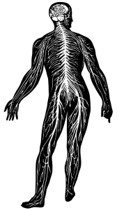
10.2 The Brain and Body Interaction
Neuroscience studies the nervous system, revealing how the brain sends signals to and from the body. Exercise neuroscience examines how physical activity affects the brain and vice versa.
“Nervous System” by j4p4n, Public Domain

Slide 5
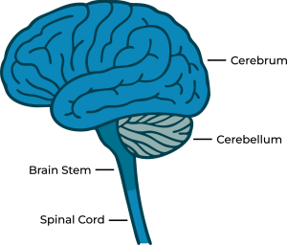
10.3 Human Movement and the Brain
The cerebrum, especially the frontal lobe's primary motor cortex, initiates voluntary movement through a complex signal pathway from the brain to muscles.
The brain is made up of these four key components – cerebrum, brain stem, cerebellum and spinal cord.
“Parts of the Brain” by Koen Liddiard, CC BY-NC-SA 4.0

Slide 6

10.4 Exercise and Mental Health
Exercise supports mental health by regulating cortisol, boosting endorphins, improving sleep and mood, enhancing confidence, and promoting social interaction.
“Sportive woman with bicycle” by Andrea Piacquadio, Pexels License

Slide 7
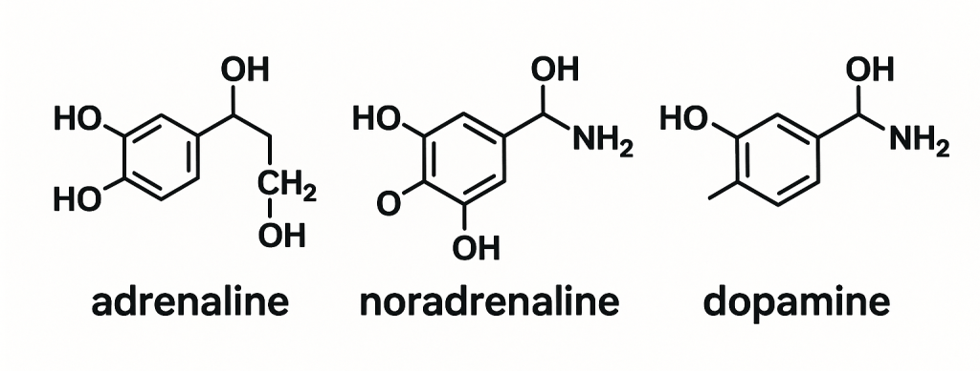
10.5 Exercise-Induced Cognitive Enhancement
Exercise improves attention, executive function, memory, and motor control through increased blood flow and chemicals like dopamine, noradrenaline, and BDNF.
“Chemical bonds”combination of Noradrenalin by 28Smiles, CC BY-SA 4.0, Epinephrine by Roland1952, Public Domain, Dopamine by OldakQuill, CC BY-SA 3.0

Slide 8

10.6 Physical Activity and Nervous System Health
Both acute and chronic exercise boost brain health, reduce risks of Alzheimer’s and Parkinson’s, and improve focus, memory, and emotional regulation.
“Personal holding a stress ball” by Mattias Zomer, Pexels License

Slide 9
10.7 Chapter Summary (Key Takeaways) 1/2
The Brain-Body Connection Enables and Benefits from Movement: The nervous system coordinates body movement through electrical and chemical signals. The frontal lobe, especially the primary motor cortex, initiates voluntary movement. In turn, physical activity enhances brain health and function.
Exercise Improves Mental Health and Emotional Well-being: Regular physical activity helps reduce anxiety and depression, enhances mood, regulates cortisol (stress hormone), boosts endorphins, and improves sleep and social interaction—all of which contribute to better mental health.
Physical Activity Enhances Cognitive Function: Both acute and chronic exercise improve cognitive domains such as attention, executive function, memory, and motor control by increasing blood flow, stimulating BDNF, and elevating catecholamines like dopamine and adrenaline.

Slide 10
10.7 Chapter Summary (Key Takeaways) 2/2
The Brain Has Four Lobes with Distinct Functions: The frontal, parietal, temporal, and occipital lobes control different aspects of movement, sensation, memory, and perception. Understanding these functions is key to recognizing how exercise can stimulate specific brain regions.
Exercise Promotes Brain Health and Reduces Risk of Neurodegenerative Disease: Acute exercise boosts focus, memory, and mood, while long-term exercise reduces symptoms of depression and anxiety, enhances long-term memory, and lowers the risk of Alzheimer’s and Parkinson’s disease.

Slide 11
10.7 Chapter Summary (Key Terms) 1/3
Acute Exercise: A single bout of physical activity with immediate effects.
Adrenaline: A catecholamine hormone released during exercise or stress.
Attention: The ability to focus on specific tasks or stimuli.
BDNF: A protein aiding brain cell growth and memory.
Catecholamines: Stress/exercise-related hormones like adrenaline and dopamine.
Cerebrum: Largest brain part, controlling cognition and motor functions.
Chronic Exercise: Regular exercise over time with long-term benefits.
Cognitive Function: Mental abilities like memory, attention, and planning.
Cortisol: The stress hormone regulated by exercise.
Dopamine: A neurotransmitter for reward and motor control.

Slide 12
10.7 Chapter Summary (Key Terms) 2/3
Endorphins: Chemicals reducing pain and increasing pleasure.
Executive Function: Processes like decision-making and problem-solving.
Frontal Lobe: Controls planning, decisions, and movement.
Language: The capacity for spoken/written communication.
Learning & Memory: Acquiring, storing, and retrieving information.
Mental Health: A state enabling people to manage stress and function.
Motor Control: Coordinating movement in line with goals.
Neurodegenerative Diseases: Conditions like Alzheimer’s and Parkinson’s.
Neuroscience: The study of the nervous system.
Noradrenaline: Hormone aiding attention and arousal.

Slide 13
10.7 Chapter Summary (Key Terms) 3/3
Parietal Lobe: Processes sensory data like touch.
Primary Motor Cortex: Initiates voluntary muscle movements.
Social Cognition: Understanding social settings and cues.
Temporal Lobe: Handles hearing and memory formation.

