Slide 1

Fundamentals of Operations Management
Chapter 1: Introduction to Operations Management
Unless otherwise noted, this work is licensed under a Creative Commons Attribution-NonCommercial-ShareAlike 4.0 International (CC BY-NC-SA 4.0) license. Feel free to use, modify, reuse or redistribute any portion of this presentation.

Slide 2
1.0 Learning Objectives
In this chapter, we will:
Explore the key current trends in Operations Management.
Define operations management and its core functions within a business.
Explain the role of operations management in transforming inputs (materials, labour) into outputs (goods, services) for a business.
Explain why a business student should study Operations Management.
Identify some of the Professional Organizations involved in Operations Management.
Describe the phases of Operations Management history.
Discuss how producing goods is different from performing services.

Slide 3

1.1 Operations Management
Operations management is the management of the processes that transform inputs into goods and services that add value for the customer.
It is the foundation for any organization, ensuring efficient resource utilization in producing the products we rely on daily.
The role of operations management is to design, plan, direct, and improve all the activities involved in producing goods or services.
Figure 1.1.1: “Operations Management in Everyday Life, London, Ontario” by Sanaz Habib CC BY-NC-SA

Slide 4
1.1 Producing Goods and Services
In operations management, both the production of goods and the delivery of services play crucial roles.
Key Differences Include
Nature of Output: | Goods are tangible; services are intangible.
Customer Interaction: | Services involve more direct contact; manufacturing rarely involves customer visits to the production facility.
Labor Content: | Services require more labor than manufacturing.
Input Variability: | Services face greater variability due to unique customer needs; manufacturing inputs are more standardized.
Quality Measurement: | Manufacturing quality is technically straightforward; service quality is subjective.
Productivity Measurement: | Manufacturing productivity is easier to measure; services are harder to quantify.
Inventory Handling: | Manufacturing can store goods; services cannot store capacity.

Slide 5
1.2 Transformation Processes
A transformation process is any activity or group of activities that takes one or more inputs, transforms and adds value to them, and provides outputs for customers or clients.
Organizations often need to transform three types of input: materials, information, and customers.
These transformation processes can be grouped into four categories: Manufacture, Service, Supply, and Transport.
Manufacture
The physical creation of products, e.g. automobiles
Service
Treatment of customers, storage of products, e.g. hospitals, warehouses
Supply
Change in ownership of goods, e.g. retail
Transport
The movement of materials/customers, e.g. taxi services
Figure 1.2.1: Categories of transformation processes.

Slide 6
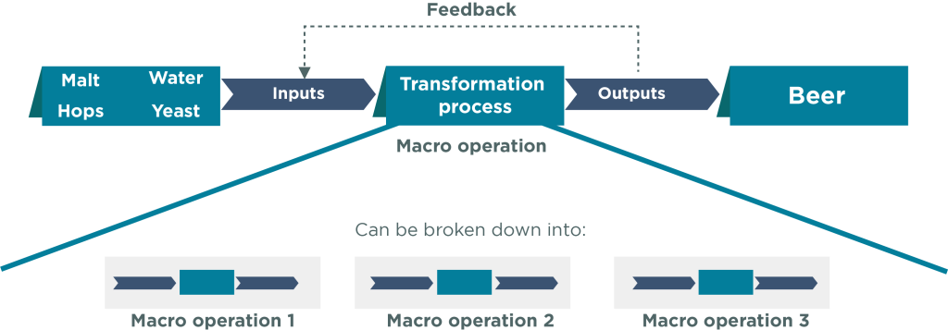
1.2 Transformation Processes (cont.)
The overall transformation can be described as the macro-operation.
The more detailed transformations within this macro-operation are micro-operations.
Figure 1.2.2: “Macro and Micro Operations (transformation processes)” by The Open University, CC BY-NC-SA 4.0. Mods: re-coloured by Fanshawe College

Slide 7
1.3 The Operations Function
Every organization has a fundamental function related to producing goods and services. This involves resource procurement, conversion into outputs, and distribution to users.
The effectiveness of operations significantly impacts customer satisfaction.
Operations management is concerned with designing, managing, and improving the systems that create the organization‘s goods or services.

Slide 8
1.3 Fundamental Functional Areas
A typical organization has four fundamental functional areas: operations, marketing and sales, finance, and human resources.
Operations
Oversees creation and implementation of product or service
Marketing & Sales
Ensures customer’s values are met and represented in product or service
Human Resources
Hires and trains employees; oversees compensations, benefits, etc.
Finance
Ensures that funds for materials, supplies, payroll, etc. are always accessible

Slide 9

1.4 Why study Operations Management?
More Opportunities
Typically, the biggest department, with many job openings
Focus on Company over Job Title
Focus on finding a great company culture and worry less about the specific job title
With a good work ethic, you can likely get promoted to your desired role later.
Figure 1.4.1: Operations Management. Microsoft (2024).

Slide 10
1.4 What is Operational Innovation?
It’s about finding new ways to run the business – fulfilling orders, developing products, providing customer service, and more.
Businesses want to do the right things (effectiveness) in the best way possible (efficiency).
Effectiveness: This means making choices and taking actions that benefit the business and, most importantly, add value for the customer. Think of it as picking the winning strategy.
Efficiency: It’s about doing things well, but without wasting resources. This means finding ways to streamline tasks and avoid unnecessary steps that cost time or money. Think of it as getting the job done smartly.

Slide 11
1.5 Development of Operations Management
Operations have evolved significantly over time, particularly in manufacturing. There are three major phases – craft manufacturing, mass production, and the modern period.
Craft Manufacturing
Skilled artisans made unique products for individual customers
Mass Production
Outputting large quantities of standardized goods at lower costs
The Modern Period
Introduction of flexible specialization, lean production, mass customization, and agile manufacturing

Slide 12
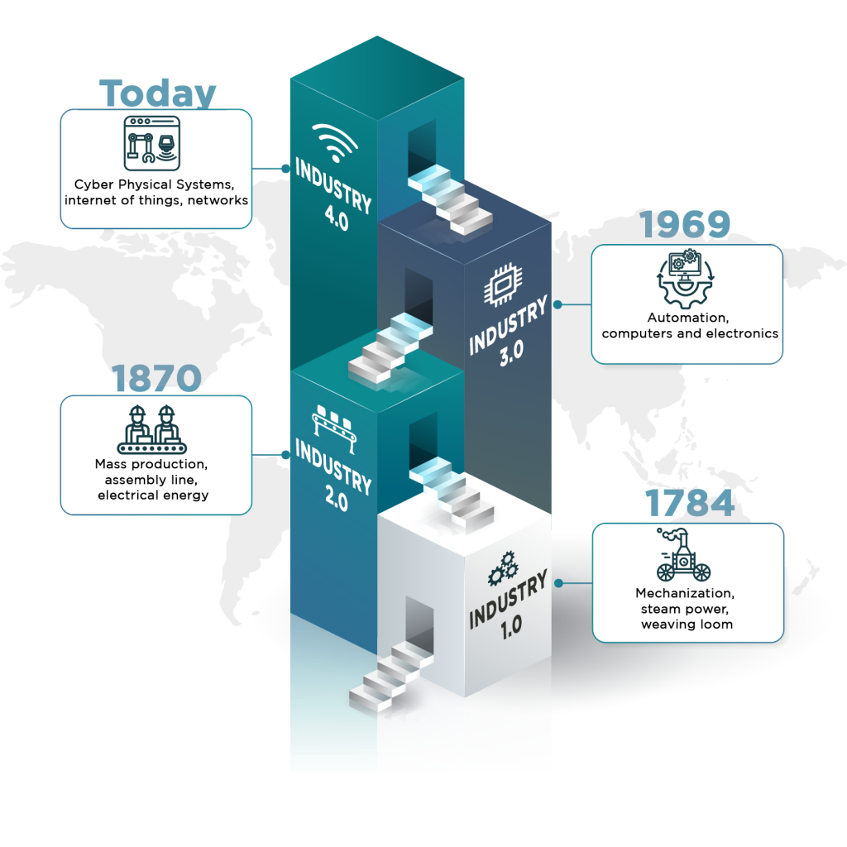
1.5 Fourth Industrial Revolution (4IR)
The Fourth Industrial Revolution (4IR) builds upon the innovations of the Third Industrial Revolution, also known as the digital revolution.
Leverages four key technology categories: Connectivity, Data, and Computational Power, Analytics and Intelligence, Human–Machine Interaction, and Advanced Engineering.
Figure 1.5.1: “Industrial Revolution” by Sanaz Habib CC BY-NC-SA

Slide 13
1.6 Key Trends in Operations Management
Globalization
Source materials and set up manufacturing in countries with lower costs.
Supply Chain Expansion
Increased trade volume facilitated more supply sources and new markets for businesses.
E-Commerce
Allowed businesses to sell to other businesses or customers online.
Technology
IT is vital in facilitating commerce between businesses (B2B) or between businesses and consumers.
Sustainability
Balance profit with social and environmental gains, emphasizing fair labor, closed-loop supply chains, and life cycle analysis.
Recent (Post-Covid) Trends
Accelerated digital advances, reduced personal connections, and increased scrutiny of social and environmental impacts.

Slide 14
1.7 Chapter Summary & Review
Defines operations management as transforming inputs into valuable outputs (goods and services) and highlights its role in efficient resource utilization.
Stresses the importance for business students to understand and improve organizational systems.
Covers historical phases from craft manufacturing to mass production and the modern period.
Differentiates between tangible, standardized goods and intangible, customer-interactive services.
Highlights the interconnectedness of operations with marketing, finance, and human resources for organizational success.
Discusses recent trends like globalization, e-commerce, technology, sustainability, and the impact of COVID-19 on business practices.

