Slide 1

Fundamentals of Operations Management
Chapter 5: Facility Location
Unless otherwise noted, this work is licensed under a Creative Commons Attribution-NonCommercial-ShareAlike 4.0 International (CC BY-NC-SA 4.0) license. Feel free to use, modify, reuse or redistribute any portion of this presentation.

Slide 2
5.0 Learning Outcomes
In this chapter, we will:
Explain the strategic importance of facility location decisions and their long-term implications on an organization's profitability and competitiveness.
Analyze the key factors influencing facility location decisions, including proximity to raw materials, labour considerations, transportation infrastructure, utility costs, tax incentives, customer proximity, and community factors.
Differentiate the location decision factors for manufacturing and service organizations, recognizing each industry's unique priorities and considerations.
Apply quantitative methods, such as the Location Factor Rating (Weighted Scoring Model) and the Centre of Gravity method, to evaluate and compare potential facility locations based on specific operational requirements and strategic objectives.
Assess the impact of e-commerce and web-based retail industries on facility location decisions, particularly for service-oriented companies.
Develop a comprehensive facility location strategy that aligns with the organization's objectives, optimizes operational efficiency, minimizes costs, and enhances responsiveness to customer demands.

Slide 3
5.1 Location Strategy: A Critical Decision
Crucial Strategic Decision
Geographic location of operations is a key strategic choice across all sectors.
Long-term Implications
Location decisions have lasting effects on profitability.
Substantial Capital Investment
Significant portion of operating costs tied to location.
High Operating Costs in Retail
Location expenses can exceed 40% of total costs.
Service vs. Manufacturing
Service businesses need proximity to customers; manufacturers prioritize raw materials and labor.
Industry Nature and Product Type
Location influenced by whether the business is in manufacturing or services.

Slide 4
5.1 Factors and Trends in Location Decisions
Rise of E-Commerce:
Online services reduce dependence on physical locations.
Service Industry Adaptations:
Banks and retailers moving services online to cut costs.
Manufacturing Needs:
Production facilities must consider raw material access and labor.
Location Impact on Performance:
Location decisions affect overall performance and market responsiveness.
Prioritizing Factors:
The importance of factors varies by situation and industry type.
Cost and Responsiveness:
Optimal location minimizes costs and maximizes market responsiveness.

Slide 5







5.2 Key Factors in Location Decision-Making
  Facilities locate near raw material sources to minimize transportation costs, e.g., paper mills near forests.
  Location decisions are influenced by wage rates, workforce availability, education levels, and union activity.
  Efficient roads, railways, and ports are essential for distributing finished goods cost-effectively.
Proximity to Raw Materials and Suppliers
Labour
Transportation Infrastructure
  Tax incentives and regulatory environments affect the financial viability of a location.
  Being near customers is crucial for service firms and industries with high transport costs or perishable products.
  Communities attract businesses with incentives and favorable attitudes towards specific industries.
  The cost and reliability of utilities impact a facility's operating expenses.
Tax Incentives and Regulations
Proximity to Customer Market
Community Factors
Utility and Energy Costs

Slide 6
5.3 Location Factor Rating Method
Identify Key Factors: Determine crucial factors for the facility location decision, such as proximity to suppliers, business environment, wage rates, community characteristics, proximity to customers, availability of labour, and transportation access.
Assign Weights: Assign a weight (0 to 1.0) to each factor, reflecting its importance. Ensure the total sum of weights equals 1.0.
Score Locations: Evaluate each potential site against each factor and assign a score (0 to 100), with higher scores indicating better performance.
Calculate Weighted Scores: Multiply each factor's score by its weight for each location to obtain weighted scores.
Determine Optimal Location: Sum the weighted scores for each location; the site with the highest total score is the most attractive.

Slide 7
5.3 Break-Even Method
Compare Production Costs
Forecasted Demand
Break-Even Analysis
Total Cost Formulation
Graphical Representation
  Evaluate fixed (land, building, rent) and variable costs (labour, material, utilities) across multiple locations.
  Ensure all locations can meet the forecasted market demand, either as a single quantity or a range.
  Use break-even analysis to compare production costs or projected profits for each location.
  Formulate total costs for each location using simple linear equations.
  Depict total costs graphically or use Excel to visualize and compare costs across locations.

Slide 8
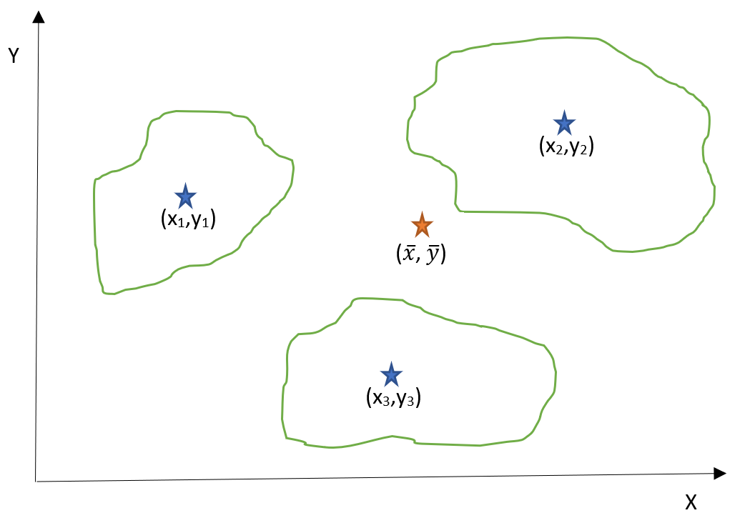
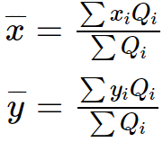
5.3 Centre of Gravity Method
This method minimizes transportation costs by determining the optimal facility location (e.g., warehouse) using an (X-Y) coordinate system based on the geographical locations and demand volumes of multiple areas.
Mathematical Formulation: Calculate the x and y coordinates for the new facility using the formulas:
Figure 5.3.1: Three market areas on an X-Y coordinate axis.

Slide 9
5.4 Strategic Significance of Location Decisions
Facility location is a critical strategic decision with significant financial implications in today’s competitive business environment, impacting manufacturing and service sectors.
No single factor dictates facility location decisions; prioritization depends on organizational objectives, whether focused on cost minimization or profit maximization.
The importance of location factors varies across industries, operational needs, and strategic goals, necessitating a tailored evaluation process.
Effective decisions integrate a holistic assessment of factors aligned with long-term organizational goals and competitive positioning.
Prioritizing relevant factors enables organizations to optimize facility locations, enhancing operational efficiency and responsiveness to customer needs.
This chapter offers a comprehensive framework for operations managers to navigate facility location complexities, empowering strategic decision-making that drives organizational success.

Slide 10
Summary & Review
The chapter underscores the strategic importance of selecting the right geographical location for organizational operations, impacting profitability and competitiveness significantly.
Key factors influencing location decisions include proximity to raw materials, labour availability, transportation infrastructure, utility costs, tax incentives, and proximity to customer markets.
It acknowledges the evolving impact of e-commerce, noting varying dependencies on physical locations between service-oriented and manufacturing firms.
Quantitative methods such as the Location Factor Rating and Centre of Gravity are presented to aid in informed location decisions, focusing on weighted factor evaluation and minimizing transportation costs, respectively.
Effective facility location decisions necessitate a comprehensive evaluation aligned with strategic objectives, enhancing operational efficiency, cost-effectiveness, and market responsiveness.
By systematically prioritizing these factors, organizations can attain a competitive advantage through optimal facility location choices.

