Slide 1
Critical Thinking in the Age of Artificial Intelligence
Chapter 1: Introduction to Critical Thinking

Slide 2






Learning Outcomes
Define key concepts in classical logic, including syllogisms and their structure.
Identify the most frequently used syllogisms found in critical argumentation.
Explain how historical figures like Socrates and Aristotle contributed to logical reasoning.
Describe the most common logical fallacies that appear in routine argumentation.
Analyze recent historical events for fallacious reasoning.
Apply logical reasoning in academic, professional, and civic contexts.

Slide 3
What is Critical Thinking?
Critical thinking is the ability to think clearly and rationally about what to do or believe. It involves reflective and independent thinking. Someone with critical thinking skills can:
Understand the logical connections between ideas.
Identify, construct, and evaluate arguments.
Detect inconsistencies and common mistakes in reasoning. Solve problems systematically.
Identify the relevance and importance of ideas.
Reflect on the justification of one’s own beliefs and values.
Critical thinking is not merely accumulating information. A good memory or knowledge of facts does not necessarily equate to good critical thinking. Critical thinkers can deduce consequences, use information to solve problems, and seek relevant information.

Slide 4
Importance of Critical Thinking
Critical thinking should not be confused with being argumentative or critical of others. While it can expose fallacies, it also plays an important role in cooperative reasoning and constructive tasks.
Critical thinking can help us:
Acquire knowledge
Improve our theories
Strengthen arguments
Enhance work processes
Improve social institutions

Slide 5
Additional Benefits of Critical Thinking Skille:
Domain-general thinking skill
Important in the new knowledge economy
Enhances language and presentation skills
Crucial for self-reflection
Foundation of science and democracy
Metacognitive skill

Slide 6
Improving Thinking Skills
Theory: If we want to think correctly, we need to follow the correct rules of reasoning.
Practice: merely knowing the principles that distinguish good and bad reasoning is not enough. We might study in the classroom about how to swim, and learn about the basic theory, such as the fact that one should not breathe underwater. But unless we can apply such theoretical knowledge through constant practice, we might not actually be able to swim.
Attitudes: Requires the right motivation and attitude for persistent practice to bring improvement. Obstacles include preferring to be given answers, relying on gut feelings, not reviewing mistakes, and disliking criticism. To improve, one must recognize the importance of reflecting on reasons for belief and action, be willing to debate, break old habits, and deal with linguistic complexities and abstract concepts.

Slide 7
Logic and Syllogisms
Critical thinking is the application of logic to the formulation of thoughts, ideas, and observations. Logical thinking has evolved over thousands of years, with origins in ancient civilizations like Babylon and Egypt, flourishing in ancient Greece.
Syllogism: A syllogism is a form of deductive reasoning with three parts: a major premise, a minor premise, and a conclusion
Example:
Major premise: All mammals are animals.
Minor premise: All rabbits are mammals.
Conclusion: All rabbits are animals.

Slide 8
Types of Syllogisms
There are different categories of syllogisms, which invite deeper contemplation.
Categorical Syllogism: Based on categories, following the structure "If A is part of C, then B is part of C."
Conditional (Hypothetical) Syllogism: Follows an "If A is true, then B is true" pattern.
Disjunctive Syllogism: Follows an "Either A or B is true; if A is false, then B must be true" pattern.
Universal Syllogism: Uses absolute terms like "all" or "none."
Particular Syllogism: Uses terms like "some" or "most" instead of absolutes.

Slide 9
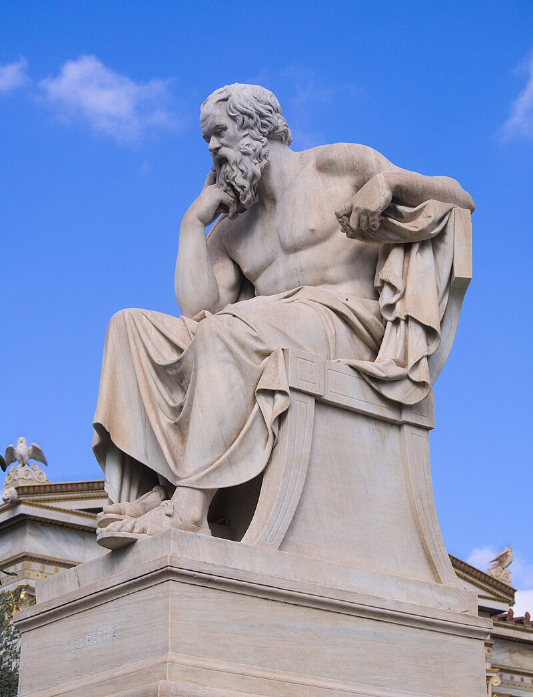
The Influence of Socrates
Socrates played a crucial role in shaping logical thinking through his Socratic method, a form of inquiry that uses systematic questioning to expose contradictions and refine ideas.
His approach emphasized critical thinking, dialogue, and self-examination, laying the groundwork for Plato’s dialectical reasoning and influencing Aristotle’s formal logic.
Socrates believed that true wisdom comes from recognizing one's ignorance, which encouraged deeper intellectual inquiry.
Socrates Academy of Athens by Leonidas Drosis. CC BY-SA 4.0

Slide 10
The Socratic Method
The Socratic Method, which relies on systematic questioning, has influenced modern logic by encouraging structured argumentation and the identification of contradictions or flaws in the premises of critical thinking. These flaws are called Fallacies.
These flaws, or “defective”, “uninformed”, or otherwise illogical ideas, usually appear in the form of statements uttered or written by an author, who pretends to influence the reader’s perception, feelings or ideas about a specific problem, impose a possible solution, or “sell” a course of action to their audience.

Slide 11
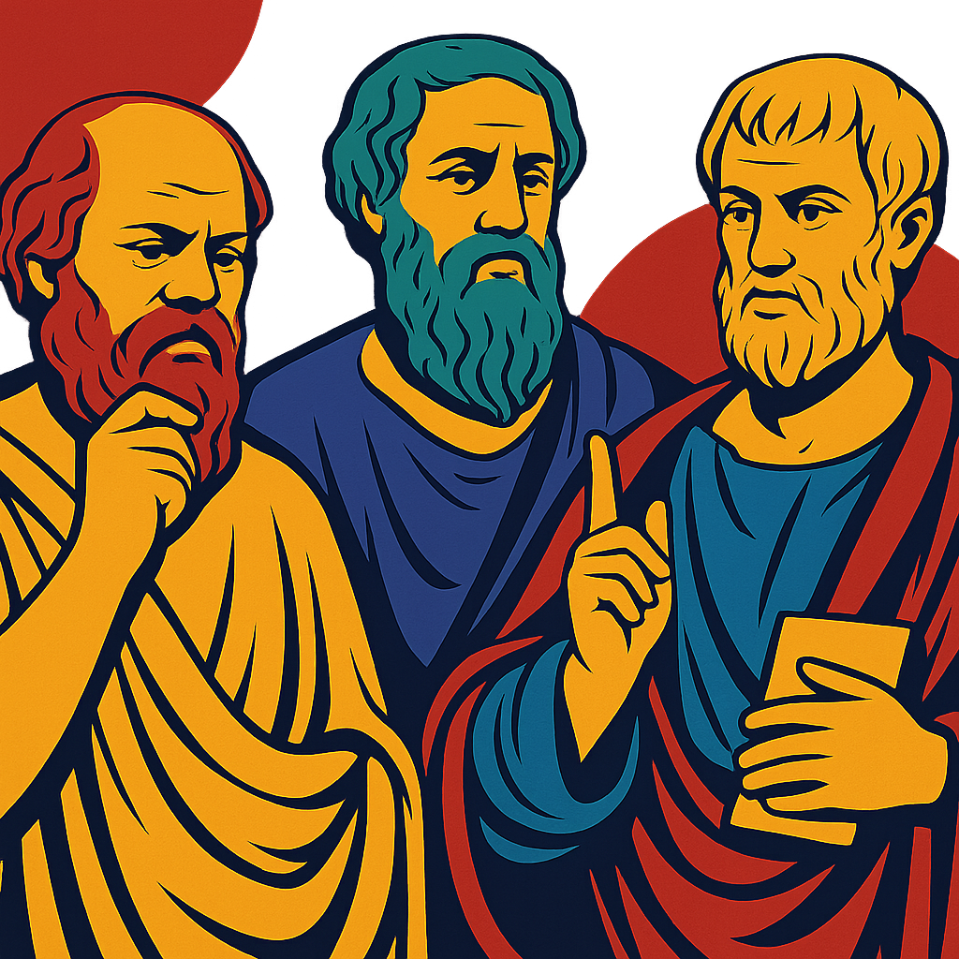
14 Fallacies of Argument
Let’s engage in the descriptions of these main “defective” premises that can lead manipulators to manipulate and the manipulated audiences to be manipulated.
AI Image: Source

Slide 12
Understanding Fallacies of Argumentation Part 1
Hasty Generalization: Making a broad statement based on insufficient evidence.
Example: A student fails one history quiz and claims, "I'm horrible at history and will never understand it."
Recent Event: Early reactions to COVID-19 (2020) dismissed it as "just another flu" based on limited early cases.
Post Hoc (False Cause): Assuming that because one event occurred before another, the first caused the second.
Example: A student wears "lucky shoes" for an A on a test and believes the shoes caused the good grade.
Recent Event: The 5G Conspiracy Theory (2020) falsely claiming 5G caused COVID-19 because they happened concurrently.

Slide 13
Understanding Fallacies of Argumentation Part 2
Post Hoc (False Cause): Assuming that because one event occurred before another, the first caused the second.
Example: A student wears "lucky shoes" for an A on a test and believes the shoes caused the good grade.
Recent Event: The 5G Conspiracy Theory (2020) falsely claiming 5G caused COVID-19 because they happened concurrently.
Bandwagon Appeal: Suggesting something is good or correct because many people believe or do it.
Example: A student claims she needs a new phone because "Everyone in class has one!" Recent
Event: The GameStop Stock Surge (2021) where many invested without understanding risks simply because others were doing it.

Slide 14
Understanding Fallacies of Argumentation Part 3
Straw Man: Misrepresenting an opposing argument to make it easier to attack.
Example: In a debate about school uniforms, a student argues, "You just want everyone to be miserable!"
Recent Event: Debates over Universal Healthcare where opponents misrepresent it as "government control over all medical decisions."
Ad Hominem: Attacking the person making an argument rather than the argument itself.
Example: A student dismisses a classmate's argument by saying, "You don't know anything about this topic; you're just a kid."
Recent Event: U.S. Presidential Elections (2020, 2024) debates where candidates personally attacked each other instead of focusing on policy.

Slide 15
Understanding Fallacies of Argumentation Part 4
Either/Or (False Dilemma): Presenting only two possible options when more exist.
Example: A student says, "Either we cancel all tests, or we students will be stressed forever!"
Recent Event: The Brexit Debate (2016-2020), where arguments framed Brexit as "total independence" or "complete loss of sovereignty," ignoring other options.
Appeal to Authority: Relying on the opinion of an authority figure without considering actual evidence or their expertise.
Example: "This book is the best because my favourite celebrity said so.“
Recent Event: Media ad campaigns where celebrities endorse unproven health products based on fame rather than scientific expertise.

Slide 16
Understanding Fallacies of Argumentation Part 5
Appeal to Pity: Trying to win an argument by playing on emotions rather than using logic.
Example: A student argues they should be class president because "I've had a tough year, so you should vote for me."
Recent Event: Immigration policy debates in countries with heavy migration movements, focusing solely on emotional stories instead of broader policy implications.
Appeal to Force: Attempting to win an argument by using threats or intimidation.
Example: A student tells their study group, "If you don't support my idea, I'll make sure you don't get credit for this project."
Recent Event: The Russian invasion of Ukraine (2022) where Russia justified actions by claiming Ukraine posed a threat, using military force instead of diplomatic reasoning.

Slide 17
Understanding Fallacies of Argumentation Part 6
Begging the Question: Assuming the very point that needs to be proven.
Example: "This book is a classic because it's very popular and widely read."
Recent Event: Arguments against renewable energy, like "Solar power is unreliable because it doesn't work all the time," assume the unreliability.
Non Sequitur: A conclusion that does not logically follow from the premises. (Latin for "it does not follow").
Example: "You don't want to volunteer at the fundraiser? Guess you don't care about the school at all!"
Recent Event: Social media misinformation claiming, "If you don't support this movement for truth, you must hate freedom," making an illogical leap.

Slide 18
Understanding Fallacies of Argumentation Part 7
False Analogy: Comparing two things that aren’t truly alike.
Example: "Our school should be run like a business because businesses are efficient."
Recent Event: Comparisons between COVID-19 restrictions and dictatorship, despite key differences.
Circular Argument (Petitio Principii): The premise of an argument assumes the truth of the conclusion, rather than providing evidence.
Example: A student says, "God exists because the Bible says so, and the Bible is true because it is the word of God."
Recent Event: Political rhetoric surrounding election integrity debates in North America in 2025: "This election was rigged because it was unfair. It was unfair because it was rigged." This prevents meaningful debate and can undermine public trust.

Slide 19
The Effects of Fallacious Thinking
Understanding fallacies is crucial for identifying problems, analyzing contexts (stakeholders, resources, limitations), and proposing feasible solutions.
Recognizing and avoiding fallacies is essential for sound reasoning and effective communication.
Flawed reasoning can significantly shape public debate and impact individual lives. Students are encouraged to analyze real-world cases to become more discerning thinkers and responsible citizens.

Slide 20
Key Takeaways
Critical thinking involves reflective, independent, and rational analysis of beliefs, decisions, and problems. It includes identifying logical connections, evaluating arguments, and solving problems systematically.
Critical thinking is rooted in logic, formalized by Aristotle through syllogisms—structured arguments with premises leading to a conclusion
Understanding the real-world impact of fallacies helps learners become more discerning thinkers and responsible citizens in a complex, information-rich world.

Slide 21
AI Image References
Slide 11: OpenAI. (2025). ChatGPT. [Large language model]. https://chat.openai.com/chat
Prompt: Create a decorative image of Socrates, Plato and Aristotle, to be used on a slide introducing the Fallacies of Argumentation. Use the following colour hex codes in the design: #febe01,#9f0052, #443988, #227dac, #0d733c, and #b3272d. Do not include any text on the image.

