Slide 1
Biology Essentials 2
Chapter 9: Ecology and the Biosphere

Slide 2
Learning Objectives
By the end of this chapter, you will be able to:
Define and explain key population ecology concepts.
Compare and contrast exponential and logistic population growth models.
Differentiate between density-dependent and density-independent limiting factors.
Evaluate the ecological principles used in conservation efforts.
Analyze the impact of invasive species on ecosystems.
Interpret human population trends and their ecological implications.

Slide 3
9.1 Overview of Population Ecology

Slide 4
Overview of Population Ecology
Population ecology focuses on how populations change over time—how many individuals are born, die, and interact with their environment. Scientists study population size, density, distribution, and growth to understand species survival and adaptation.

Slide 5

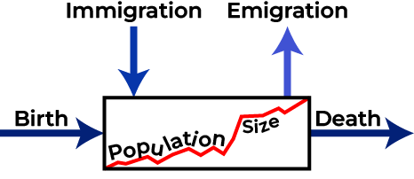
Population Size and Density
Population Size
Density
Population size refers to the number of individuals at a given time, influenced by births, deaths, immigration, and emigration.
Density measures individuals per unit area. High densities can increase competition and disease, while low densities can impact reproduction.
Image by Koen Liddiard, CC BY-NC-SA 4.0
Image by Ian Alexander, CC BY-SA

Slide 6
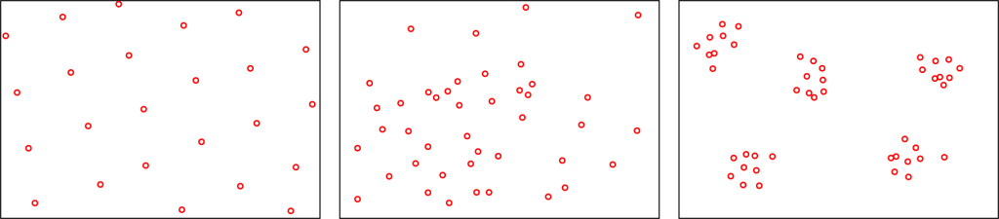
Species Distribution
Distribution refers to how individuals are spaced: Clumped (common in nature), uniform (competition-driven), or random (rare, occurs with evenly distributed resources). Distribution offers insight beyond density alone.
Image by Yerpo, CC BY-SA 4.0 Modified to horizontal layout

Slide 7
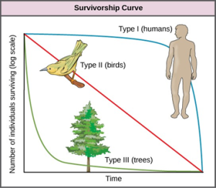
Survivorship Curves
Survivorship curves illustrate how survival rates vary by age. These reflect reproductive strategies:
Type I: High survival to old age
Type II: Consistent death rate
Type III: High juvenile mortality
"Survivorship Curve" by OpenStax, CC BY-SA 4.0

Slide 8
Life History Strategies
r-selected species reproduce rapidly with many offspring and little care, thriving in unpredictable environments.
Examples include insects, bacteria, and many types of plants.
K-selected species reproduce slowly, with fewer offspring and more care, suited to stable environments.
Examples include elephants, whales, and humans.

Slide 9
9.2 Population Growth & Regulation

Slide 10
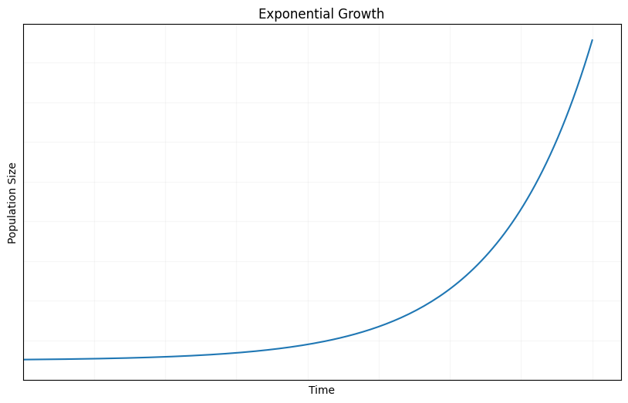
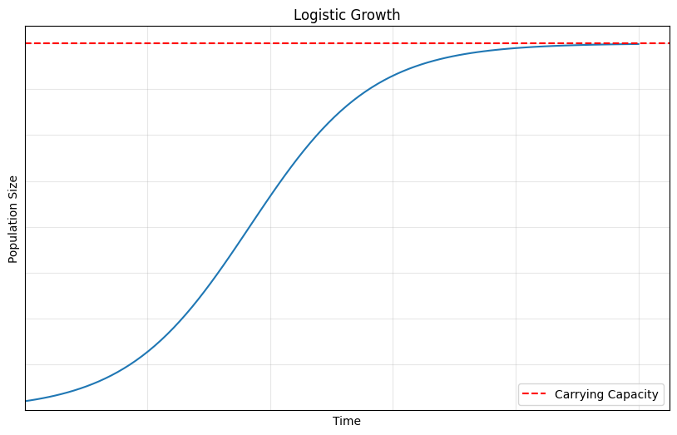
Population Growth and Regulation
Exponential growth occurs with unlimited resources, creating a J-curve. Logistic growth reflects resource limits, forming an S-curve and levelling off at carrying capacity.
"Exponential Growth" plotted by Aaron Po using Matplotlib 3.10.3 and NumPy 2.3.1, CC0 1.0
"Logistic Growth." Created by Aaron Po using Matplotlib 3.10.3 and NumPy 2.3.1, CC0 1.0

Slide 11
Population Dynamics and Regulation
Real population dynamics involve changing carrying capacities and complex factors. Limiting factors can be density-dependent (e.g., competition, disease) or density-independent (e.g., weather, pollution).

Slide 12
Applications of Population Ecology
Population ecology is applied in conservation, sustainable resource management, and invasive species control. It informs decisions that support biodiversity and ecological balance.

Slide 13
9.3 Applications of Population Ecology

Slide 14

Conservation of Endangered Species
Population ecology helps identify threats like habitat loss and low reproduction, guiding recovery strategies. A successful example is the bald eagle, once endangered due to DDT.
“Bald Eagle“, by davidfbird, CC0 1.0

Slide 15
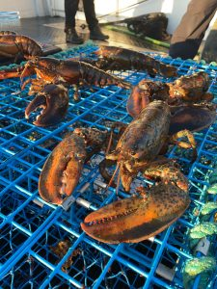
Sustainable Resource Management
Population data is used to manage natural resources sustainably. Canada's lobster fishery uses trap limits, size restrictions, and egg protection to maintain populations.
“American Lobster“, by ninalaflamme, CC BY-NC 4.0

Slide 16
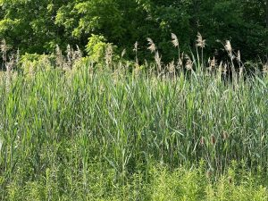
Invasive Species Management
Invasive species like Phragmites threaten ecosystems. Population ecology informs early detection, mechanical removal, herbicide use, and monitoring of control strategies.
Examples of invasive species that you are likely to encounter in Ontario:
Common Buckthorn
Garlic Mustard
European Starling
Emerald Ash Borer
Zebra Mussel
“common reed“, by brendanboyd, CC BY 4.0

Slide 17
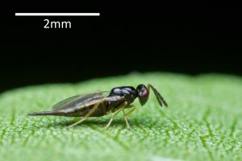
Biological Control of Pests
Biocontrol introduces natural enemies to manage pests. Ontario uses parasitic wasps and moths to suppress the emerald ash borer and Phragmites, showing that ecological balance can be restored.
Image by andrewsonea, CC BY-NC 4.0

Slide 18
9.4 Human Population Growth

Slide 19
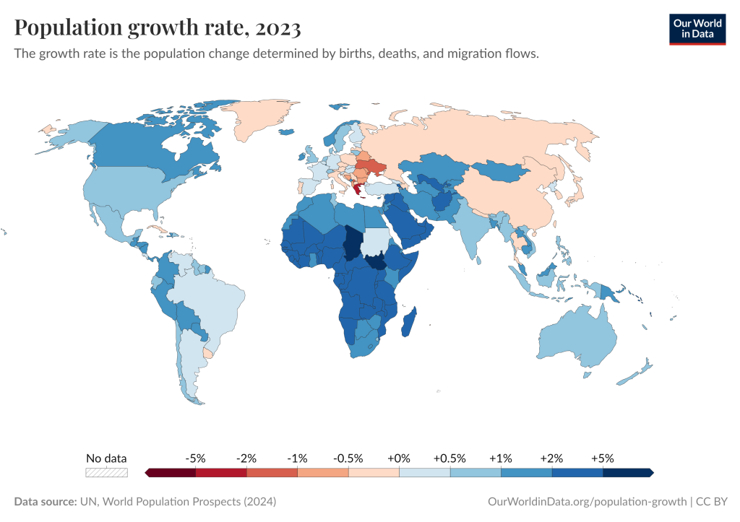
Historical Patterns and Future Projections
The Industrial Revolution in the 18th and 19th centuries brought significant advances in medicine, sanitation, and food production, resulting in a decline in death rates and triggering exponential economic growth.
The global population now exceeds 8 billion but is slowing due to declining fertility rates. Peak expected at 10.3 billion in the 2080s.
“Population Growth Rate, 2023" by Our World In Data, CC BY 4.0

Slide 20
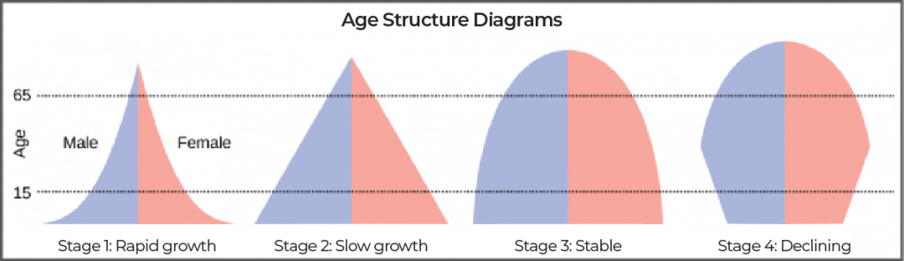
Age Structure and Economic Development
Age structure diagrams reveal whether populations are growing, stable, or shrinking. Young populations strain education systems; aging populations challenge healthcare and the workforce.
Image by OpenStax, CC BY 4.0 Modifications made to text labels

Slide 21
Carrying Capacity of Humans
Human carrying capacity depends on population size, consumption, and technology. Ecological footprints show humanity exceeds Earth's biocapacity. Sustainable living is essential. To live within Earth’s carrying capacity, we must:
Reduce overconsumption and waste.
Transition to renewable energy.
Protect and restore ecosystems.
Shift toward sustainable food systems and urban planning.

Slide 22
Key Takeaways (1/2)
Population ecology examines how populations change over time, focusing on population size, density, distribution, birth and death rates, and environmental interactions to understand species survival and adaptation.
Population size and density are influenced by birth, death, immigration, and emigration, and are typically estimated using sampling methods such as quadrant sampling and mark-recapture techniques due to practical constraints.
Species distribution patterns (clumped, uniform, and random) reveal important ecological interactions, such as resource availability, competition, and social behaviour, which influence survival and reproductive success.

Slide 23
Key Takeaways (2/2)
Survivorship curves (types I, II, III) illustrate a species’ life history strategies, while r- and K-selection explain reproductive patterns.
Exponential and logistic models describe population growth, with exponential growth showing unchecked increases and logistic growth incorporating environmental limits, stabilizing populations around carrying capacity.
Population regulation is shaped by both density-dependent and density-independent limiting factors, such as competition, disease, predation, natural disasters, and climate.

