Slide 1
Biology Essentials 2
Chapter 8: Ecology and the Biosphere

Slide 2
Learning Objectives
By the end of this chapter, you will be able to:
Define ecology and explain its central goal of understanding the distribution and abundance of organisms through interdisciplinary approaches.
Identify and describe the four major levels of ecological study.
Differentiate between biotic and abiotic factors in an organism’s habitat.
Explain the role of adaptations in organismal ecology, using examples.
Analyze population-level ecological concepts, including factors influencing population dynamics, such as habitat fragmentation and human activity.
Interpret the interactions between species and organisms and their environment, especially in community and ecosystem contexts.

Slide 3
8.1 What is Ecology?

Slide 4
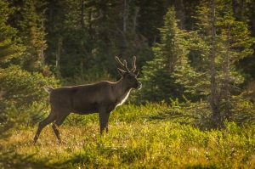
What is Ecology?
Ecology studies how organisms interact with their environment. It includes various levels like organism, population, community, and ecosystem. Each level examines unique questions. Woodland caribou are used as a case study across these levels.
Photo by ThartmannWiki, CC BY-SA 4.0

Slide 5
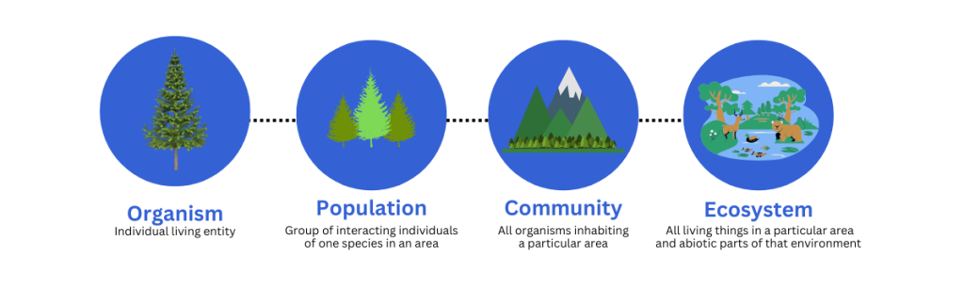
Levels of Ecological Study
Ecology studies how organisms interact with their environment. It includes various levels like organism, population, community, and ecosystem. Each level examines unique questions. Woodland caribou are used as a case study across these levels.
Graphic by Shauna Roch, CC BY-NC-SA 4.0

Slide 6
8.2 Distribution of Life

Slide 7
The Biosphere and Abiotic Factors
The biosphere is the global sum of all ecosystems—it includes every region of Earth where life exists. Many abiotic factors play a crucial role in determining where life can exist and what types of organisms are found in different regions. These include:
Energy source: Most life on Earth depends on energy from the sun.
Temperature: Directly affects where organisms like the wood frog can live and how they adapt to survive.
Water availability: Adaptions of organisms that live in salt versus freshwater.
Inorganic nutrients: Pitcher plants have adapted to live in nutrient-poor soils that lack enough nitrogen and phosphorus.

Slide 8
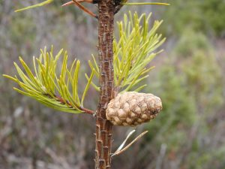
Other Abiotic Factors
Water: cold/fast-moving water, warm/still water, salinity, currents, tides.
Wind: increases evaporation/transpiration, moves soil, seeds, pollen and small organisms.
Fire: Recycles nutrients, reduces competition, opens canopy, opens cones and releases seeds.
"Jack pine", by alexisgodin , CC BY 4.0

Slide 9
Responding to Changing Abiotic Conditions
Physiological responses: Short-term, reversible adjustments that help organisms maintain homeostasis under changing conditions (i.e., hibernation, acclimation).
Anatomical responses: Physical, often reversible changes in body structure to adapt (i.e., thicker fur).
Behavioural responses: Actions organisms take to minimize unfavourable conditions (i.e., migration or altering activity times).

Slide 10
8.3 Terrestrial Biomes

Slide 11
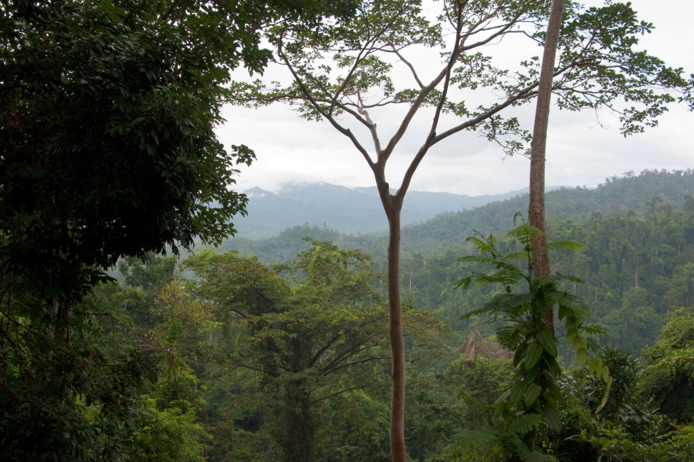
What is a Biome?
A biome is a large geographic region defined by its long-term climate (temperature and precipitation) and characteristic vegetation, which together determine its animal life.
"Palawan, Tropical jungle rainforest" by Vyacheslav Argenberg, CC BY 4.0

Slide 12
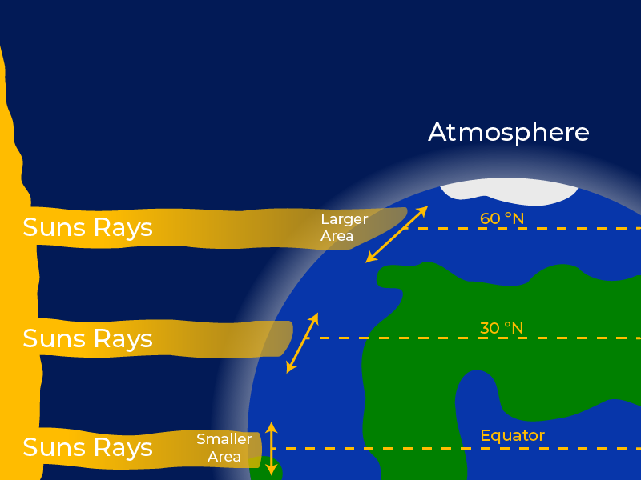
What Controls Climate on Earth?
Key climate drivers include latitude, Earth’s axial tilt, global air circulation patterns, proximity to water, and topography (e.g., rain shadows). These variables create predictable patterns, such as rainforests near the equator and deserts around 30° latitude.
"Latitude and climate" by Koen Liddiard, CC BY-NC-SA 4.0

Slide 13
Major Terrestrial Biomes
Each biome supports species uniquely adapted to its temperature, precipitation, and growing conditions. Major terrestrial biomes include:
Tropical rainforests (biodiverse, warm, wet)
Savannas (grasslands with seasonal drought)
Deserts (dry, extreme temperatures)
Chaparral (shrubland with fire-adapted species)
Temperate grasslands and forests (seasonal climates)
Boreal forests (cold-adapted evergreens)
Tundra (frozen, low productivity)

Slide 14
8.4 Aquatic Biomes

Slide 15
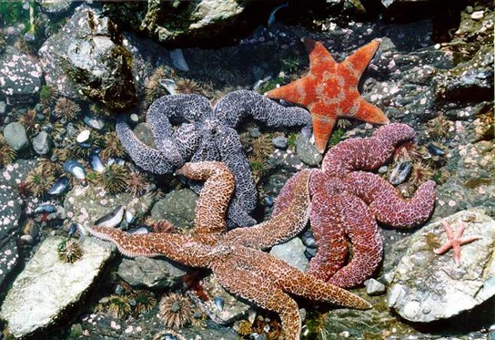
Aquatic Biomes
Aquatic biomes are water-based biomes defined by factors such as water depth, temperature, salinity, and the amount of sunlight that penetrates the water. Aquatic ecosystems support a wide variety of life and play a crucial role in global processes like climate regulation, oxygen production, and nutrient cycling. Aquatic biomes are divided into two main types:
Marine
Freshwater
Photo by NOAA, Public Domain

Slide 16
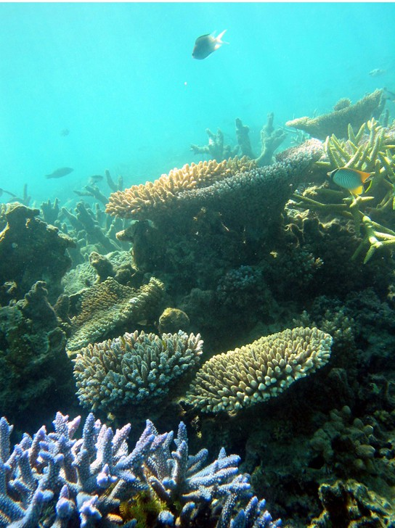
Marine Biomes
Marine biomes include all saltwater environments. These ecosystems are the largest on Earth and support a vast diversity of organisms, from microscopic plankton to the largest animals on the planet. They include:
Ocean
Coral reefs
Estuaries
Photo by Terry Hughs, CC BY 2.5

Slide 17
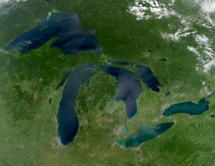
Freshwater Biomes
Humans rely on freshwater biomes to provide aquatic resources for drinking water, crop irrigation, sanitation, recreation, and industry. Freshwater biomes include:
Lakes and ponds
Rivers and streams
Wetlands
Photo by NASA, Public Domain

Slide 18
Key Takeaways (1/3)
Ecology examines how organisms interact with their environment and each other, with research conducted at four main levels - organismal, population, community, and ecosystem.
The distribution of life on Earth is heavily influenced by abiotic (non-living) factors such as solar energy, temperature, water availability, and inorganic nutrients.
Organisms adapt in three main ways to changing environments: Physiological, anatomical changes, and behavioural strategies.
Biomes are large regions defined by climate, which influences vegetation and the animals that live there. Key climate drivers include latitude, Earth’s axial tilt, air circulation patterns, proximity to water, and topography.
Each biome supports species uniquely adapted to its temperature, precipitation, and growing conditions. Major terrestrial biomes include tropical rainforests, savannas, deserts, chaparral, temperate grasslands and forests, boreal forests and tundra. Major aquatic biomes include marine (ocean, coral reefs and estuaries), and freshwater biomes (lakes/ponds, rivers/streams, and wetlands).

