Slide 1
Biology Essentials 2
Chapter 7: Vertebrate Animals

Slide 2
Learning Objectives
By the end of this chapter, you will be able to:
Identify the key characteristics that distinguish vertebrates from other chordates.
Classify vertebrates into major groups.
Compare and contrast jawless, cartilaginous, and bony fishes in terms of anatomy, habitat, and evolutionary traits.
Explain the evolutionary significance of major adaptations.
Describe the unique traits and behaviours of primates—including humans—that reflect their evolutionary adaptations to arboreal life and social living.
Trace the key milestones in human evolution by examining derived traits, tool use, brain size, and cultural development from early hominins to Homo sapiens.

Slide 3
7.1 General Features of Vertebrates

Slide 4
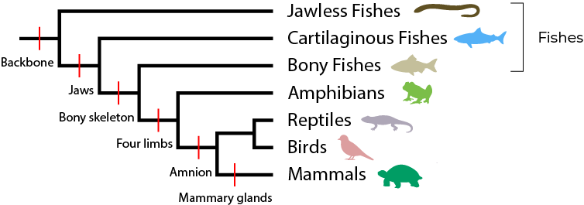
Vertebrate Animals
Vertebrates share common anatomical features such as a backbone made of vertebrae, a cranium to protect the brain, and advanced organ systems such as a closed circulatory system and a complex nervous system. They belong to the phylum Chordata and are divided into five major groups: fishes, amphibians, reptiles, birds, and mammals.
Figure 7.1.2 “Classification of Vertebrates” by Koen Liddiard, CC BY-NC-SA 4.0

Slide 5
7.2 Vertebrate Groups

Slide 6
Fishes
Fishes were the first vertebrates to evolve, starting with jawless forms like hagfishes and lampreys. The evolution of jaws and paired fins gave rise to cartilaginous fishes (sharks and rays) and later to bony fishes, which are now the most diverse group of vertebrates.

Slide 7
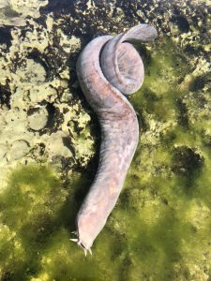
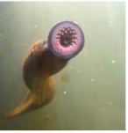
Jawless Fish
Jawless fishes represent an ancient lineage of craniates (animals with a skull), which includes all chordates except tunicates and lancelets. Major groups of jawless fishes include:
Hagfishes
Lampreys
“Broadgilled Hagfish”, by liamclaytonmedia, CC0 1.0, Photo by jilldevito , CC0 1.0

Slide 8
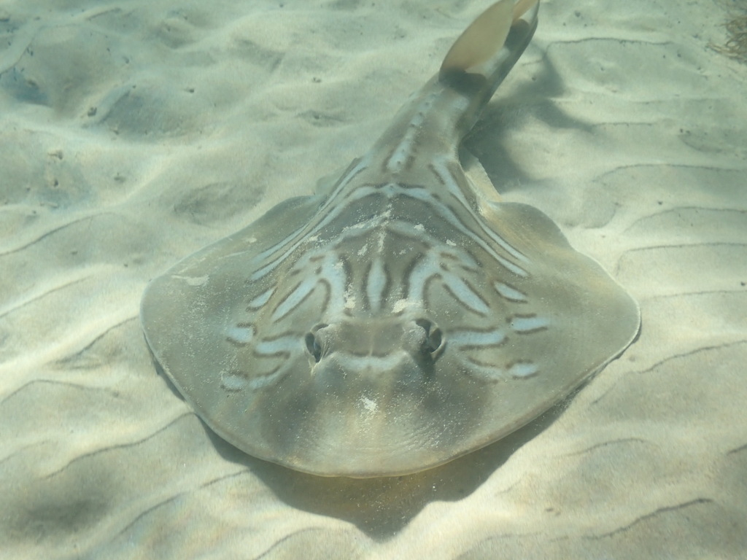
Jawed Fishes
Cartilaginous fishes (sharks, rays) have cartilage skeletons. Sharks have rows of replacement teeth and electroreception. Rays are bottom dwellers with flattened bodies.
Bony fishes have skeletons of bone, gills covered by operculum, and swim bladders for buoyancy. They are divided into:
Ray-finned fishes
Lobe-finned fishes
“Southern Fiddler Ray“, by djnugent, CC0 1.0

Slide 9
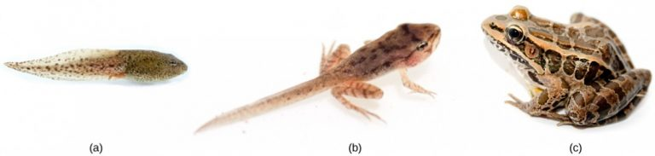
Amphibians
Amphibians like frogs and salamanders are tetrapods with dual aquatic and terrestrial life stages. Eggs are laid in moist environments, and larvae undergo metamorphosis. Adults breathe through lungs and skin and are carnivorous. Some species exhibit parental care.
(a) “Tadpole“, (b) “Wood Frog Tadpole” and (c) “The Pickerel Frog (c)” by Brian Gratwicke, CC BY 2.0,

Slide 10
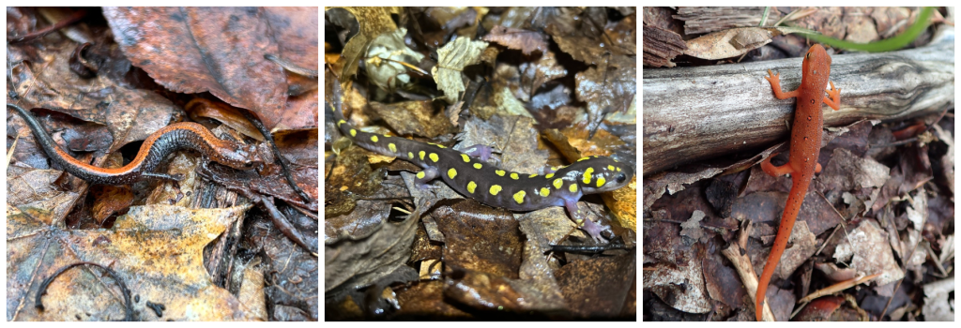
Amphibians - Salamanders
Salamanders typically have elongated bodies, tails, and four limbs. There are around 500 species, with some living in water, others on land, and some transitioning between the two.
"Eastern Red-backed Salamander"(left) by andreakautz, Public Domain, "Spotted Salamander" (middle) by andreakautz, Public Domain, "Eastern Newt" (right) by tniernberger, Public Domain

Slide 11
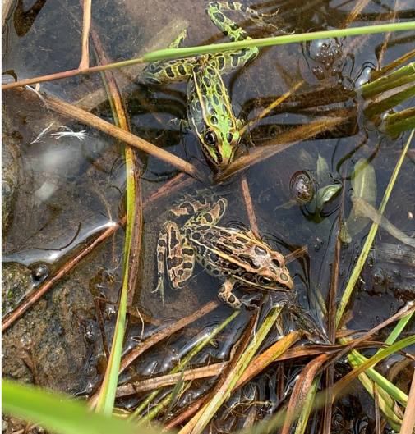
Amphibians - Frogs
Frogs are the most diverse amphibian group, with about 5000 species. They have a body plan specialized for jumping, with long, muscular hind limbs. Frogs use various strategies to avoid predators, including camouflage and poisonous skin secretions.
Northern Leopard Frog (right) by paulypod, Public Domain

Slide 12
Amphibians and Evolution
Amphibians were the earliest vertebrates to adapt to life on land. They evolved from lobe-finned fishes over 360 million years ago. These early amphibians developed key adaptations such as limbs for movement on land, lungs for breathing air, and stronger skeletal structures to support their bodies outside of water. The emergence of amphibians represents a major evolutionary milestone that bridges the gap between fully aquatic fishes and the later emergence of fully terrestrial reptiles.

Slide 13
The Amniotes
The amniotes—which include reptiles, birds, and mammals—are distinguished from amphibians by their amniotic egg, an evolutionary adaptation that allowed vertebrates to reproduce away from water. The amniotic membranes within the egg create a self-contained aquatic environment, enabling gas exchange, waste storage, and water retention.
Although birds are now understood to be a lineage of reptiles, they are often discussed separately due to their many unique adaptations. In this section, we will explore reptiles and birds as distinct groups, while recognizing their shared evolutionary history.

Slide 14
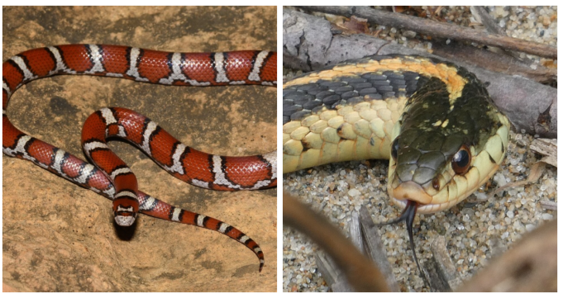
Reptiles
Reptiles reproduce via amniotic eggs laid on land and rely on lungs for breathing. They are ectothermic and have scaly skin. Major groups of reptiles that live on land and in water include:
Crocodilians: Show parental care
Lizards and snakes: Lizards have four limbs, eyelids and external ears, while snakes lack these features
Turtles: Have protective shells
“Eastern Milksnake” (left) by wildreturn, Public Domain, “Common Garter Snake” (right) by raffib128, Public Domain

Slide 15
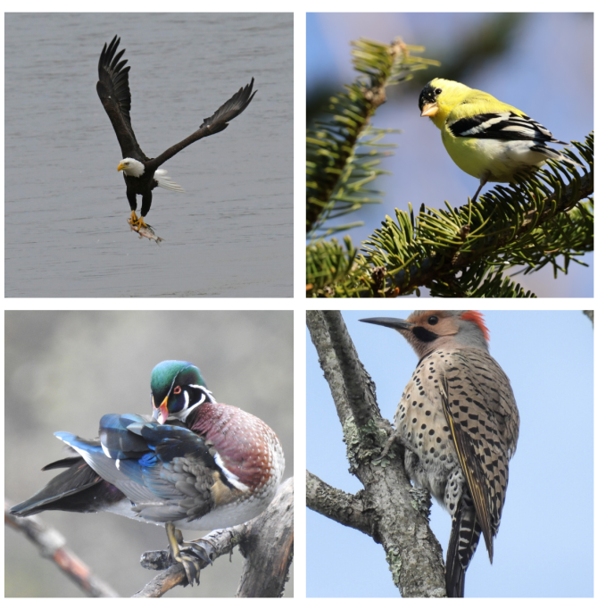
Birds
Birds are endothermic reptiles that evolved from dinosaurs. Their feathers are modified scales. Adaptations include hollow bones, fused skeletons, and preening for feather maintenance. Birds migrate seasonally using environmental cues for navigation.
Bald Eagle (top middle), wildreturn, Public Domain, American Goldfinch (top right), smays, Public Domain, Wood Duck (bottom middle), quillipede, Public Domain, Northern Flicker (bottom right), erikschiff, Public Domain

Slide 16
Mammals
Vertebrates with hair and mammary glands
Endothermic; hair insulates by trapping warm air
Whiskers (vibrissae) act as tactile sensors
Hair may aid camouflage/protective coloration
Sebaceous glands secrete sebum for water resistance/lubrication
Sudoriferous (sweat) glands aid thermoregulation and scent signaling
Mammary glands produce milk to nourish young
Three groups: monotremes, marsupials, eutherians (placental)

Slide 17
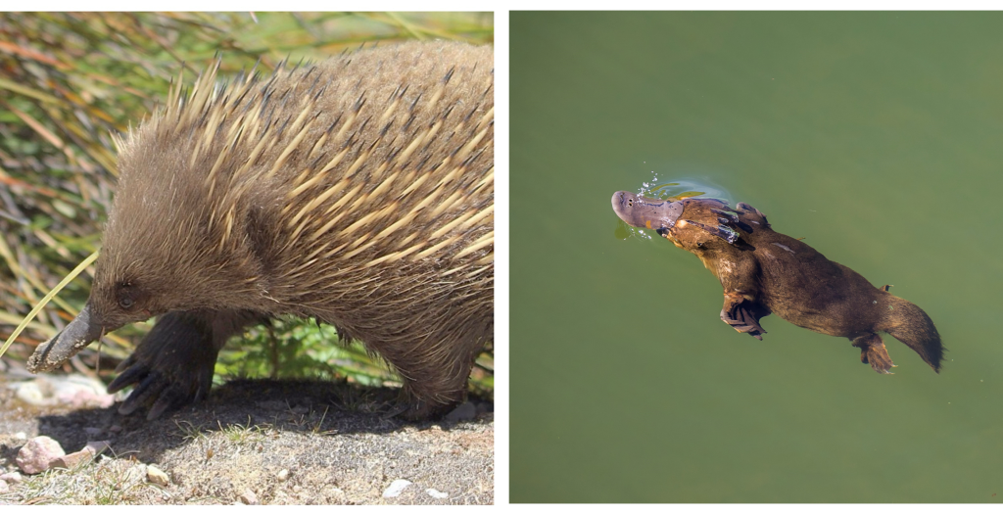
Mammals - Monotremes
Monotremes are the most primitive living mammals that include only the platypus and two echidna species with the following characteristics:
Egg-laying (leathery eggs); eggs retained in the mother until near hatching
After hatching, females secrete milk from pores on a ventral mammary ridge
Tasmanian Echidna" (left)by jason_graham, Public Domain, "Duck-billed platypus" (right) by Charles J. Sharpe, CC BY-SA 4.

Slide 18
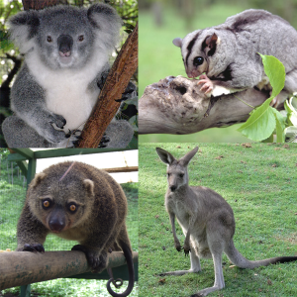
Mammals - Marsupials
Birth to an underdeveloped young that crawl to a pouch to attach and nurse
Pouch (marsupium) supports continued growth and prolonged lactation
Placenta present but simple, compared with placental mammals
Distribution: Mainly Australia and nearby islands with a few in the Americas (e.g., opossums)
Examples: kangaroos, koalas, bandicoots, Tasmanian devil
Image by Daniele Pugliesi, CC BY-SA 3.0

Slide 19
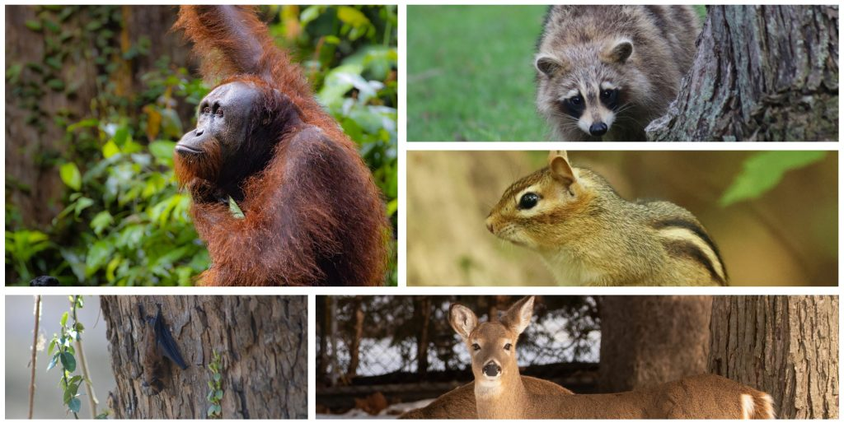
Mammals - Eutherians
Most widespread & diverse mammals
Complex placenta exchanges nutrients/gases/wastes between mother and fetus
Longer gestation and young born more developed
Occupy many habitats with varied diets and lifestyles
"Bornean Orangutan" (top left), by myrmecophil, CC BY-NC 4.0, "Common Raccoon" (top right) by jacksonkusack, Public Domain, "Eastern Chipmunk" (middle right) by glennberry, Public Domain, "Big Brown Bat" (bottom left) jacksonkusack, Public Domain, "White-tailed Deer" (bottom right) by glennberry, Public Domain

Slide 20
7.3 Primates

Slide 21
Primates
Primates are a group of mammals that includes humans so studying their characteristics and evolution helps us trace the roots of our own species. Primates evolved from small, tree-dwelling mammals over 65 million years ago. This arboreal ancestry shaped many of their defining traits, including hands and feet adapted for climbing and swinging through trees. Primates are generally divided into two broad groups:
Wet-nosed: Generally smaller, nocturnal, have a stronger sense of smell and relatively smaller brains (lemurs, lorises and bush babies).
Dry-nosed: Larger brains, rely on vision more than smell, exhibit complex social structures (tarsiers, monkeys and apes).

Slide 22
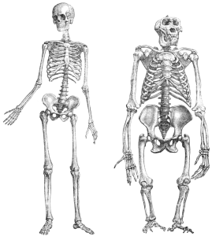
Human Evolution
Humans evolved from hominins with these derived traits:
Bipedalism
Smaller teeth
Bigger brains
Tool use
Complex culture
Notable hominin species include Australopithecus afarensis, Homo habilis, Homo erectus, Homo neanderthalensis, and Homo sapiens
Image by unknown from Brehms Tierleben, Small Edition 1927, Public Domain.

Slide 23
Key Takeaways
Vertebrates share common anatomical features
Fishes were the first vertebrates to evolve
Amphibians represent a transitional group
Reptiles and birds are amniotes
Mammals are endothermic vertebrates with hair and mammary glands
Primates—including humans—are characterized by traits such as stereoscopic vision, grasping limbs, and large brains

