Slide 1
Biology Essentials 2
Chapter 6: Invertebrate Animals

Slide 2
Learning Objectives
Describe the general features shared by all animals.
Differentiate types of body symmetry with examples.
Explain how animals are classified into phyla.
Compare and contrast the major invertebrate groups.
Identify the defining traits of chordates.
Connect invertebrate diversity to ecological and human contexts.

Slide 3
6.1 General Features of Animals

Slide 4
Common Features of Animals
Eukaryotic and multicellular.
Most have specialized tissues (cells organized for specific functions).
Motile at least in one life stage.
Heterotrophic—ingest living or dead organic matter (unlike autotrophic plants and externally digesting fungi).
Diets include carnivory, herbivory, omnivory, or parasitism.
Mostly reproduce sexually.
Offspring pass through set developmental stages that establish a determined body plan.

Slide 5
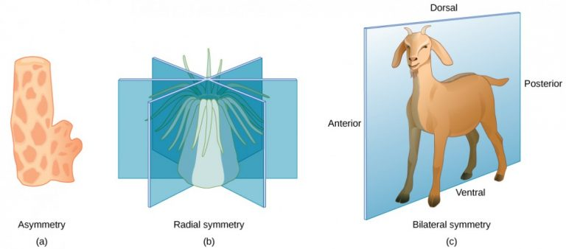
Body Symmetry
Asymmetrical: no pattern (sponge).
Radial: multiple planes (sea anemone).
Bilateral: right/left halves (goat).
Image by OpenStax, CC BY 4.0

Slide 6
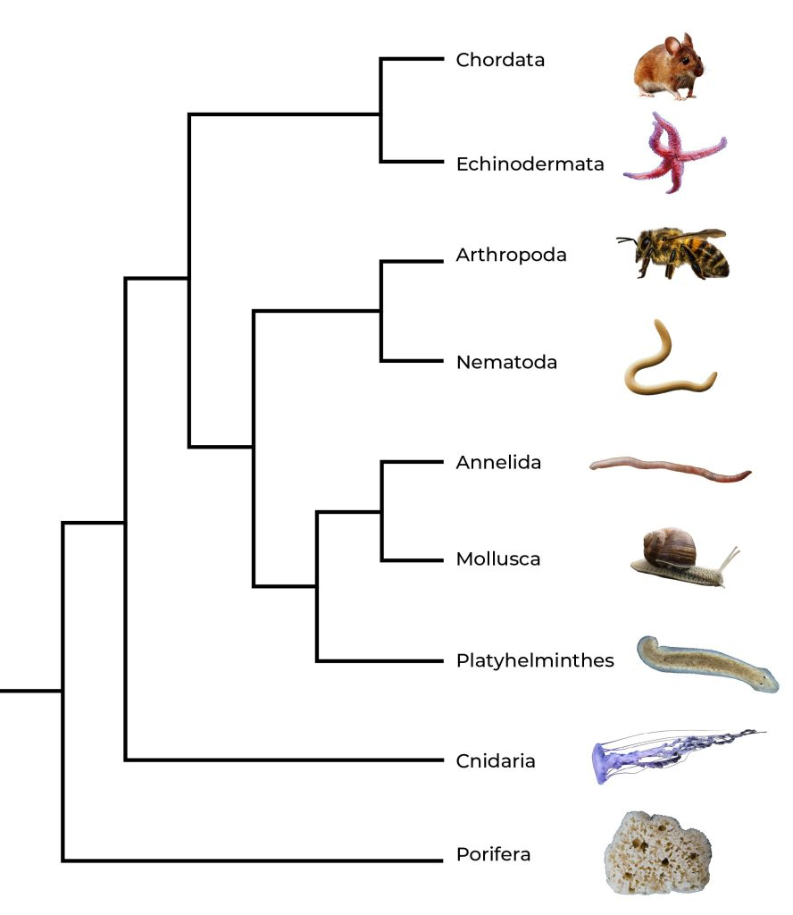
Invertebrates vs. Vertebrates
Invertebrates: No backbone (~95% of species).
Vertebrates: Contains a backbone.
Although vertebrates, such as mammals, birds, and fish, are more familiar to us, they make up only a small part of the animal kingdom and all belong to just one phylum – Chordata.
Image by Koen Liddiard, CC BY-NC-SA 4.0

Slide 7
6.2 Invertebrate Groups

Slide 8
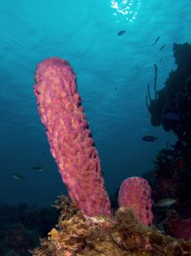
Sponges (Porifera)
Sponges are the simplest animals and live in water. They are over 500 million years old with the following characteristics:
No true tissues/organs or nervous system.
Water enters small pores and exits from a large opening (osculum). This flow brings food/O₂ and removes waste.
Choanocytes’ flagella drive currents and trap particles, and amoebocytes digest and distribute nutrients.
Reproduction is both sexual and asexual (budding, fragmentation). Most are hermaphrodites.
"Stove-pipe Sponge-pink variation" by Nick Hobgood, CC BY-SA 3.0

Slide 9
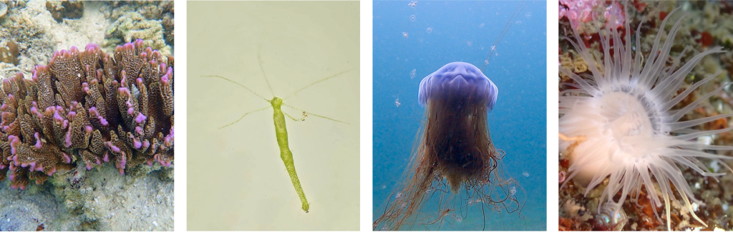
Cnidarians (Cnidaria)
Characteristics include:
Made of true tissues, and tentacles armed with stinging cells.
Body plans: Polyp (attached) & medusa (free-swimming).
Contain a gastrovascular cavity with one opening.
Examples include sea anemones, corals, hydras, and jellies.
“Coral” by Frédéric Ducarme, CC BY-NC-ND, “Green Hydra” by carolbeauchesne, CC BY-NC 4.0, “Lion’s Mane Jellies” by emma12fowler, CC BY-NC 4.0, “Plumose sea anemone” by teriyakiturtle, CC BY-NC 4.0

Slide 10
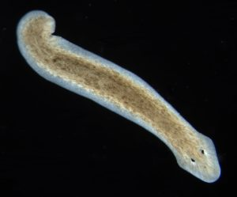
Flatworms (Platyhelminthes)
Bilateral symmetry and flattened, ribbon-like form
No circulatory or respiratory systems—diffusion handles gases/nutrients, limiting thickness.
Simple nervous system with head ganglia and two longitudinal nerve cords.
Some have eyespots/chemo-sensors.
Some can reproduce asexually via fragmentation/regeneration.
Live in marine, freshwater, and moist terrestrial environments.
Free-living or parasitic (tapeworms attach with a scolex, lack a gut, and absorb nutrients).
"Dugesia Subtentaculata" by Eduard Solà, CC BY-SA 3.0

Slide 11
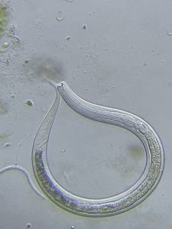
Nematodes (Roundworms)
Characteristics include:
Cylindrical body, tapered ends, tough cuticle.
Complete digestive system (mouth & anus).
Free-living decomposers or parasites (hookworms).
"Nematodes" by gyefiri, CC BY-NC 4.0

Slide 12
Arthropods (Anthropoda)
Characteristics include:
Most diverse animals: ~85% of described species – includes insects, myriapods, crustaceans, and arachnids.
All habitats: Oceans, freshwater, land, and air.
Jointed appendages: Specialized for walking, swimming, flying, feeding, or defense.
Exoskeleton (cuticle): Support/protection and muscle attachment (must moult to grow).
Segmented body: Commonly organized into head, thorax, and abdomen
Possess a complete digestive system.

Slide 13
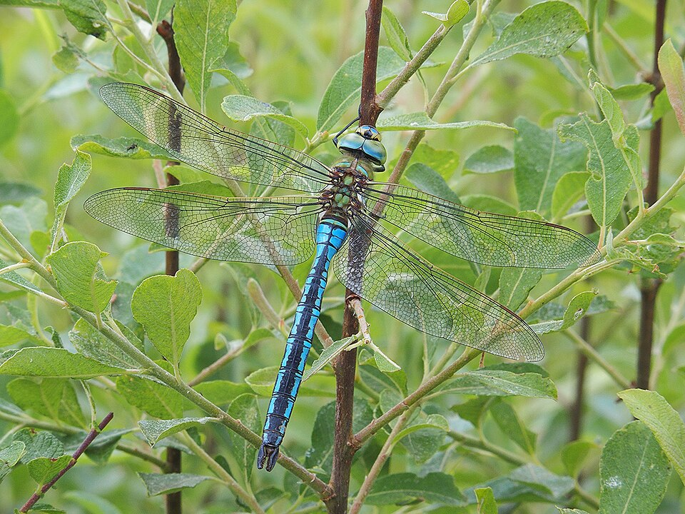
Arthropods – Insects
Insects are the largest arthropod group in nearly all habitats. Characteristics include:
Body plan: Head–thorax–abdomen, 3 pairs of legs, usually 1 to 2 pairs of wings on the thorax.
    Complete metamorphosis: Egg to larva to pupa to adult (butterfly lifecycle).
Incomplete metamorphosis: Nymph to adult through moults.
Widely used as bioindicators to assess the health of rivers, streams, and lakes.
"Blue Emporer" by Ocrdu, CC BY-SA 4.0

Slide 14
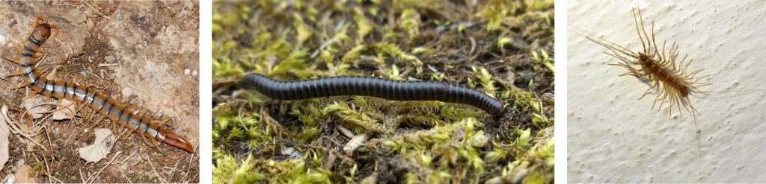
Arthropods – Myriapods
Myriapods are terrestrial arthropods with long, segmented bodies and many legs. The most commonly found examples are centipedes and millipedes. Centipedes are fast-moving predators with one pair of legs per segment. Millipedes are slower detritivores with two pairs of legs per segment.
"Scolopendra" (left) by Fritz Geller-Grimm, CC BY-SA 2.5, "Tachypodoiulus niger" (middle) by Stemonitis, CC BY 2.5, "House centipede" (right) by Filip. vidinovski, GNU Free Documentation License

Slide 15
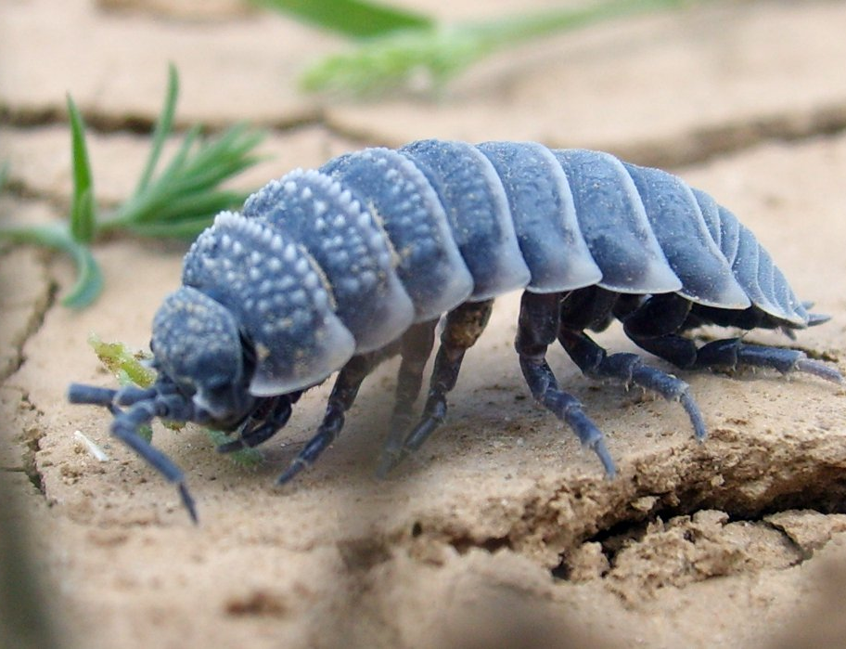
Arthropods – Crustaceans
Crustaceans are primarily aquatic arthropods such as crabs, lobsters, shrimp, and barnacles.
Some are terrestrial, such as pill/sow bugs.
Body plan: Cephalothorax (fused head + thorax) typically covered by a carapace.
Reinforced exoskeleton: Often hardened with calcium carbonate for extra strength.
Habitats: Mostly marine/freshwater, with a few lineages adapted to land.
Isopod" by Frenc Vilisics, modified by Stemonitis, CC BY-SA 3.0,

Slide 16
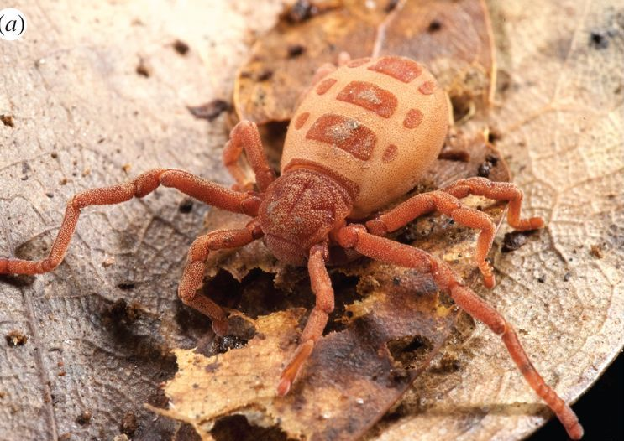
Arthropods – Arachnids
Characteristics include:
Eight legs (four pairs).
Two body segments: Cephalothorax + abdomen.
No antennae.
First appendages modified for feeding or injecting venom.
Examples include spiders, scorpions, and ticks.
Photo by Rosa Fernández, Gonzalo Giribet, P. Naskrecki, CC BY 4.0

Slide 17
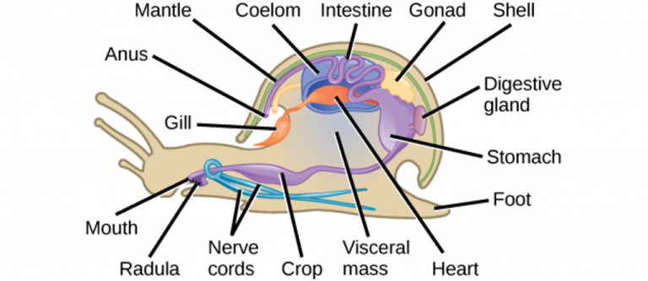
Mollusks (Mollusca)
Although they are mostly marine, they can also be found in freshwater and terrestrial environments. Characteristics include:
Soft-bodied with a hard shell.
Body plan: Muscular foot, visceral mass, mantle.
Many also have a radula (tongue-like structure with rows of tiny teeth for feeding).
Three major groups: Bivalves, Gastropods, and Cephalopods.
Image by OpenStax, CC BY 4.0

Slide 18
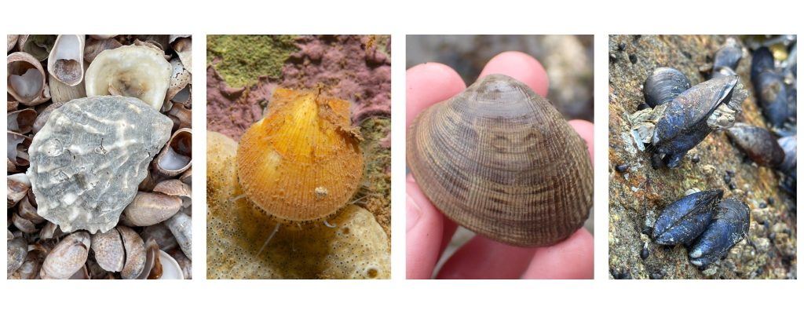
Bivalves
Bivalves are aquatic mollusks with bodies enclosed in a pair of hinged shells, or valves, joined at the dorsal (back) side. They lack a radula and instead feed by filtering food particles from water, which they draw in through a siphon. Bivalves include clams, oysters, mussels, and scallops.
“Eastern Oyster” by pyta, CC BY-NC 4.0, “Icelandic Scallop” by alex_shure, CC BY-NC 4.0, “Pacific Littleneck Clam” by quillipede, CC BY-NC 4.0, “Black Mussels” by nartb, Public Domain

Slide 19
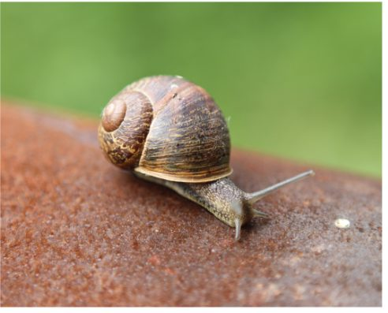
Gastropods
Gastropods have a soft, asymmetrical body typically protected by a coiled shell, though some species lack a shell entirely. They can be found in marine, freshwater, and terrestrial environments. They move using a broad, muscular foot and feed with a radula. Many gastropods have a distinct head with tentacles and eyes. Gastropods include snails and slugs.
Image by OpenStax, CC BY 4.0

Slide 20
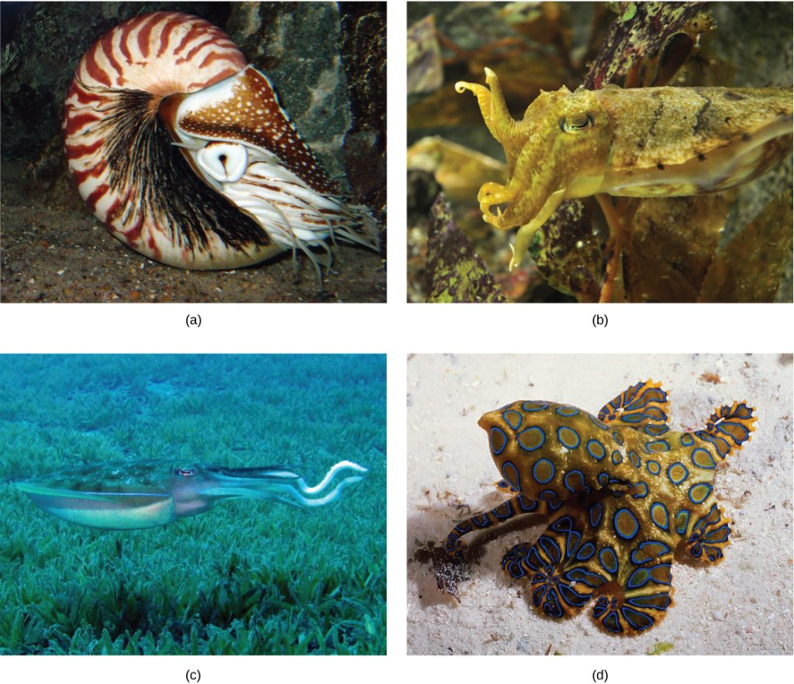
Cephalopods
Have a prominent head, large eyes, and a set of tentacles that surround the mouth.
Able to move quickly via jet propulsion.
Have a well-developed brain, which supports problem-solving, learning, and communication.
Some change colour using pigment cells in their skin.
Examples include octopuses, squids, cuttlefish, and nautiluses.
Image by OpenStax, CC BY 4.0

Slide 21
Annelids (Annelida)
Annelids are segmented worms with ring-like “annuli” that allow flexibility and regional specialization. Characteristics include:
Live in marine, freshwater, and moist terrestrial environments.
Bilateral symmetry.
Complete digestive system.
Closed circulatory system.
Many have chaetae (bristles) for movement.
Examples include earthworms, leeches, and polychaetes.

Slide 22
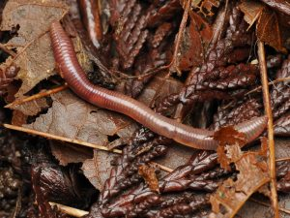
Annelids - Earthworms
Earthworms are terrestrial or freshwater annelids with a smooth, segmented body and few chaetae per segment. They have a clitellum, a thickened ring that secretes mucus during reproduction and forms a cocoon for the eggs. Earthworms play an important role in soil health by aerating and enriching it.
"Genus Lumbricus" by quillipede, Public Domain

Slide 23
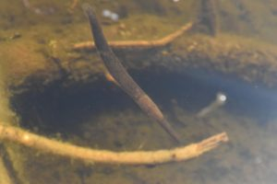
Annelids - Leeches
Leeches are mostly freshwater annelids with suckers at both ends of the body and no chaetae. Their body segmentation is often not reflected internally, allowing them to expand when feeding. Some leeches are blood-feeding parasites, while others are predators or scavengers.
"Leeches" by bradenjudson, Public Domain

Slide 24
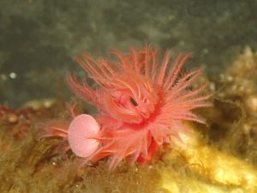
Annelids - Polychaetes
Polychaetes are mostly marine worms with many chaetae arranged on paired, fleshy appendages used in movement and gas exchange. They are often colourful and may live freely or in protective tubes.
"Genus Serpula" by stephbrulot, Public Domain

Slide 25
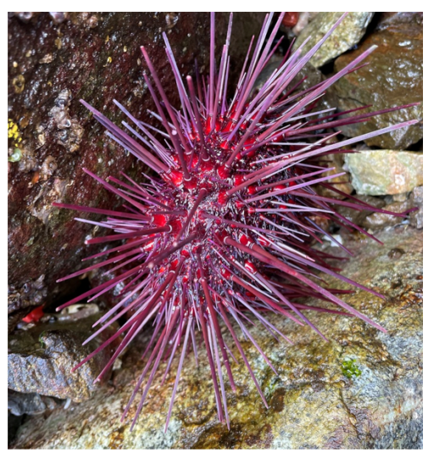
Echinoderms (Echinodermata)
Echinoderms are marine invertebrates with spiny skin. Characteristics include:
Can regrow lost parts, sometimes from small fragments.
Endoskeleton of calcium carbonate plates for support/protection.
Water vascular system (fluid-filled canals) for movement, gas exchange, and nutrient transport.
Tube feet are driven by hydraulic pressure, enabling slow, strong movement.
Examples include sea stars, urchins, sand dollars, brittle stars, and sea cucumbers.
"Red Sea Urchin" (far right) by carolynprentice, Public Domain

Slide 26
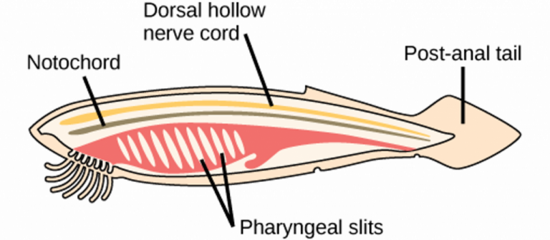
Chordates (Chordata)
A flexible rod along the body called the notochord provides support and sets the basic body plan.
A tube above the notochord called the dorsal hollow nerve cord develops into the brain and spinal cord.
Openings in the pharynx called pharyngeal slits serve as filter-feeding or become gills in aquatic forms.
A post-anal tail extends beyond the anus and aids swimming in aquatic species, and helps balance/communication on land.
Image by OpenStax, CC BY 4.0

Slide 27
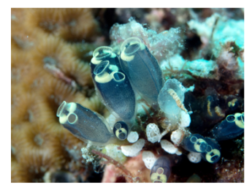
Chordates - Tunicates
Tunicates, also called sea squirts, are marine animals that live in dark or shaded areas attached to rocks in shallow ocean waters. As adults, they have a sac-like body and filter food using pharyngeal slits. Although adult tunicates lack a notochord, nerve cord, and tail, their larvae have all four chordate features.
"Tunicate (Claveline robusta)" by Rickard Zerpe, CC BY 2.0

Slide 28
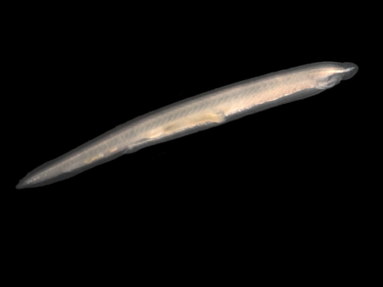
Chordates - Lancelets Tunicates
Lancelets are small, blade-like animals that grow to only a few centimetres in length. They are typically found buried in sand in warm, shallow waters. Unlike many other chordates, adult lancelets retain a notochord, a dorsal hollow nerve cord, pharyngeal slits, and a post-anal tail. They swim using their tail and filter food from the water using their pharyngeal slits.
"Branchiostoma Lanceolatum" (right) by Hans Hillewaert, CC BY-SA 4.0

Slide 29
Key Takeaways
Animals share common features: multicellular, heterotrophic, and motile.
Body symmetry is a key classification trait.
Invertebrates dominate animal diversity (~95%).
Major phyla include Sponges, Cnidarians, Flatworms, Nematodes, Mollusks, Annelids, Arthropods, and Echinoderms.
Chordates are defined by four key traits; most are vertebrates, but tunicates & lancelets are invertebrates.
Invertebrates play essential ecological roles and connect to human life.

