Slide 1
Biology Essentials 2
Chapter 5: Plants and Fungi

Slide 2
Learning Objectives
Explain how land plants evolved from aquatic green algae and adapted to life on land.
Identify key terrestrial adaptations in plants.
Compare the major plant groups—bryophytes, seedless vascular plants, gymnosperms, and angiosperms.
Describe the reproductive processes in each plant group using terms like spores, seeds, pollen, flowers, and fruits.
Analyze how plant structures like roots, vascular tissue, and lignin support survival in different environments.
Describe how plant-pollinator interactions and seed dispersal strategies increase angiosperm success and diversity.

Slide 3
5.1 Plant Adaptions to Life on Land

Slide 4
Definition of Land Plants
Land plants are eukaryotic photoautotrophs whose cells contain a nucleus, mitochondria, ER, Golgi apparatus, and chloroplasts for photosynthesis.
The ancestor of all plants was an aquatic, green algae–like organism with cellulose cell walls.

Slide 5
Advantages to Living in Water
Advantages of living in water compared to land:
Constant moisture—no specialized absorption or anti-desiccation tissues needed.
Buoyancy provides external support; land life needs added structural reinforcement.
Gametes swim and don’t dry out in water.
Water filters out UV light, which is highly destructive to DNA.

Slide 6
Why Adapt to Land?
Life on land offers several advantages:
More light: Sunlight is more abundant on land (water filters and alters light).
More CO₂: Carbon dioxide diffuses faster in air, making it more available.
Fewer early predators: Plants colonized land before animals; herbivory later drove defences like spines, thorns, and toxins.

Slide 7
Terrestrial Adaptions
The 5 major terrestrial adaptations in many land plants include:
Waxy cuticle: Reduces water loss and helps shield from UV
Stomata: Contains pores for gas exchange - absent in liverworts
Roots/root-like structures: Anchors plants and aids water absorption
Gametangia: Protects gametes (archegonia = eggs, antheridia = sperm)
Alternation of generations: Haploid gametophyte makes gametes (mitosis), diploid sporophyte makes spores (meiosis)

Slide 8
5.2 Major Plant Groups

Slide 9
Major Plant Groups
As plants began to colonize land, they evolved additional adaptations that helped them survive and reproduce in terrestrial environments. In this section, we will focus on four major groups of land plants:
Nonvascular plants (bryophytes)
Seedless vascular plants
Seed plants (gymnosperms)
Flowering plants (angiosperms)

Slide 10
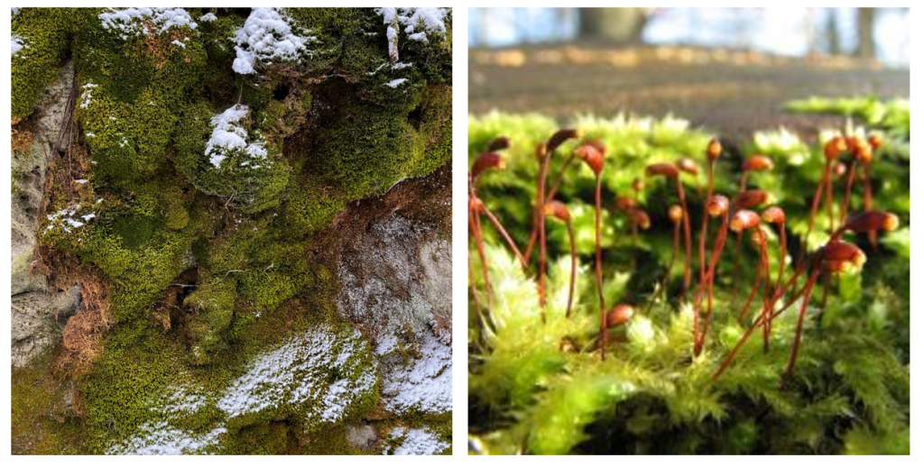
Nonvascular Plants (Bryophytes)
Have adaptations like a waxy cuticle and rhizoids but no vascular tissue, keeping them small and water-dependent
Require moist environments because their flagellated sperm(no seeds) must swim through water to reach eggs
Includes liverworts, hornworts, and mosses
“Family Neckeraceae” by morekari, Public Domain, Green feathery moss with reddish-brown sporophytes growing upward (image on right), “Moss spores” by Lordgrunt, CC BY 3.0

Slide 11
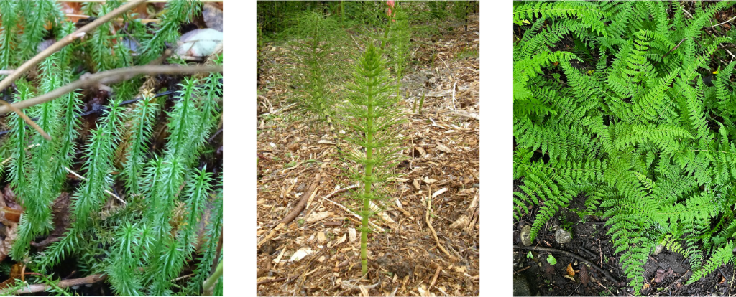
Seedless Vascular Plants
They evolved true roots for deeper water and nutrient absorption
Vascular tissue (xylem and phloem) enabled taller growth and the transport of water and sugar throughout the plant
Lignin strengthened cell walls, providing structural support for upright growth
Rely on water for reproduction
Includes club mosses, horsetails, and ferns
"Clubmoss" (right), by reuvenm, Public Domain , "Horsetail" (middle) by CNX OpenStax, CC BY 4.0, "Fern" (right) by morekari, Public Domain

Slide 12
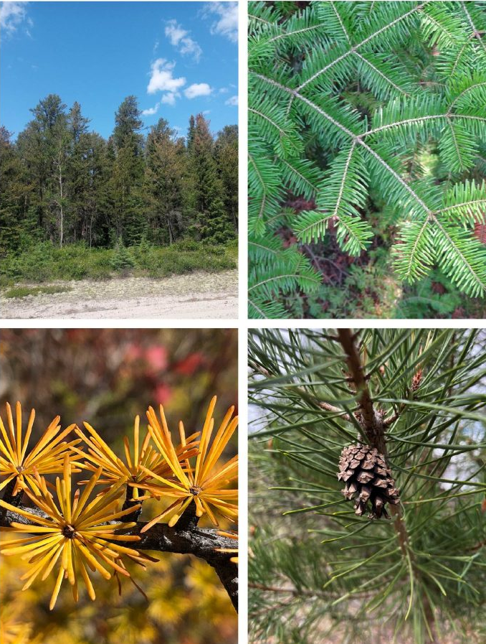
Gymnosperms
Gymnosperms (“naked seed” plants) appeared ~350 million years ago.
Pollen allows sperm transfer by wind, eliminating the need for water in fertilization.
Seeds in cones protect embryos with food and a coat, enabling survival in dry conditions and dormancy until growth is favourable.
Includes conifers (pines and spruces) with needle-like leaves.
“Jack pines” (top left) by reuvenm, Public Domain, “Balsam Fir” (top right) by reuvenm, Public Domain, “Tamarack (a deciduous gymnosperm)” (bottom left) by Famartin, CC BY-SA 4.0, “Scots Pine” (bottom right) by morekari, Public Domain

Slide 13
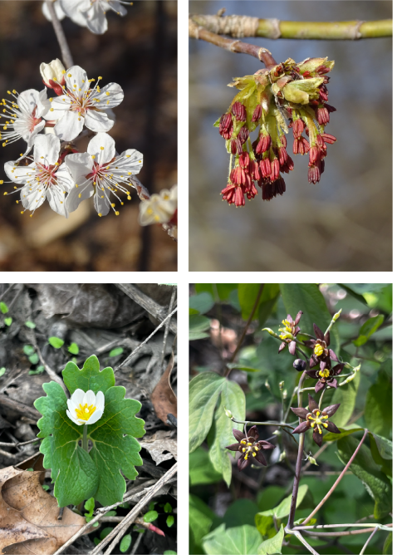
Angiosperms (Flowering Plants)
Angiosperms (flowering plants) appeared ~130 million years ago and are the most diverse plant group.
Flowers attract pollinators, making fertilization more efficient than wind pollination.
Seeds enclosed in fruit are eaten by animals, which aids in seed dispersal when the seed is deposited somewhere new in the feces.
Diversity of flower morphology. "Canada Plum" by reuvenm, "Manitoba Maple", by reuvenm, "Bloodroot", by morekari, "Early Blue Cohosh" by morekari,

Slide 14
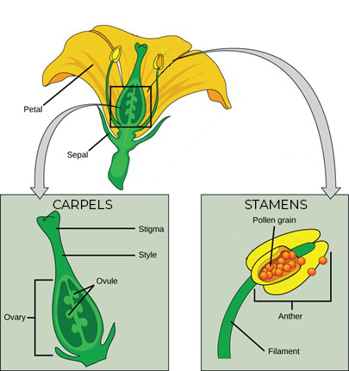
Flower Structure
Sepals: Outermost part of the flower that protects the flower bud when it opens.
Petals: Brightly colored to attract pollinators.
Stamens: Male parts (filament and anther).
Carpels or pistils: Female parts (stigma, style, and ovary).
Modification of Image by CNX OpenStax, CC BY 4.0

Slide 15
Fruit
After fertilization, the ovule becomes a seed and the ovary becomes the fruit; many “vegetables” (e.g., zucchini, peppers) are actually fruits.
Fruits are classified as fleshy (juicy, e.g., berries, peaches) or dry (hard/papery, e.g., nuts, wheat).
They can form from a single ovary (apple), multiple ovaries in one flower (raspberries), or clusters of flowers (pineapples).
Fruits aid seed dispersal by wind (dandelions), animal ingestion (berries), animal transport (burs), or water (coconuts).
Their structures and features are adapted to their method of dispersal, helping seeds spread to new environments.

Slide 16
Plant Group Summary Table
Plant Group | Vascular | Seeds | Flowers
Bryophytes | No | No | No
Seedless Vascular | Yes | No | No
Gymnosperms | Yes | Yes | No
Angiosperms | Yes | Yes | Yes

Slide 17
5.3 Fungi

Slide 18
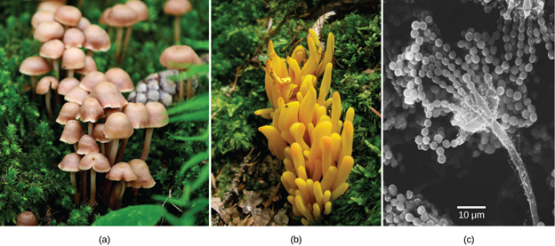
What are Fungi?
A diverse kingdom of eukaryotic organisms that obtain nutrients by absorbing them from organic matter. There are over two million species, which include mushrooms, yeasts, moulds, and many more.
(a) Familiar mushroom, (b) Coral fungus, and (c) the spore-bearing structures of Aspergillus, Image by Open Stax, CC BY 4.0

Slide 19
Structure
Eukaryotes that grow as hyphae forming a nutrient-absorbing mycelium; mostly multicellular (mushrooms), some unicellular (yeasts).
Once thought plant-like, but DNA shows fungi are closer to animals.
Heterotrophic (no chloroplasts), chitin cell walls, store carbohydrates as glycogen.
Produce melanin for UV protection. These bright pigments can deter predators (e.g., toxic Amanita muscaria).

Slide 20
Nutrition
Fungi are heterotrophs, meaning they obtain food from other organisms rather than photosynthesizing. They secrete enzymes to break down complex matter, then absorb simple molecules through their cell walls.
Types of strategies:
Decomposers: Many recycle nutrients by breaking down dead leaves, wood, and animal remains
Parasites: Feed on living organisms (cause disease)
Mutualistic partnerships: Benefit partners

Slide 21
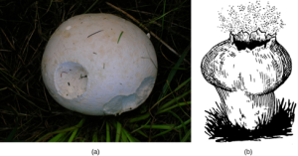
Reproduction
Asexual dominates sexual reproduction in good conditions.
Fungi reproduce via tiny spores in both sexual and asexual cycles.
Spores ride wind or animals.
On the underside of the cap of a mushroom are thin, blade-like structures called gills, which provide a large surface area for spore production and dispersal.
Photo (a) by Rosser, Roger Griffith, Public Domain, Image (b) by Pearson Scott Foresman, Public Domain

Slide 22
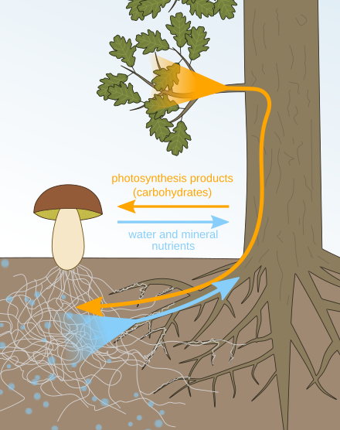
Importance of Fungi to Ecosystems
Break down dead organic matter and return carbon, nitrogen, and phosphorus to ecosystems.
Digest cellulose and lignin that few other organisms can, releasing locked-up carbon.
Form symbioses (mycorrhizae partnerships) with ~80 to 90% of plant species, extending root reach.
Deliver water and minerals to plants while plants supply photosynthetic sugars in return (mutual partnership).
Mycorrhizal mutualism, Image by Nefronus, CC BY-SA 4.0

Slide 23
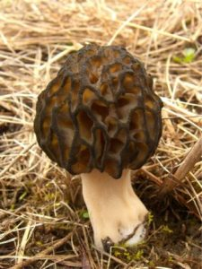
Food Production
Fungi have long been used in the production of food and beverages. Yeasts are single-celled fungi that help make bread rise and are essential in brewing beer and fermenting wine.
We also eat many types of fungi such as mushrooms - morels, shiitake mushrooms, chanterelles, and truffles, are even considered delicacies.
Photo by Jason Hollinger, CC BY 2.0

Slide 24
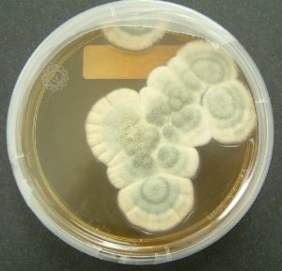
Medicine and Pharmaceuticals
The discovery of penicillin, the first widely used antibiotic, came from the fungus Penicillium Notatum and revolutionized the treatment of bacterial infections.
Since then, fungi have been utilized to develop a range of other important medications. Ongoing research continues to explore fungi as sources of new antibiotics and even as anti-cancer agents.
Photo by Crulina 98, CC BY-SA 3.0

Slide 25
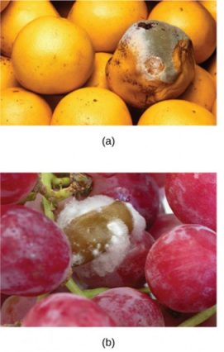
Plant Pathogens
Fungi cause many serious diseases in wild and cultivated plants (example: Dutch elm disease infects elm vascular tissue and is spread by elm bark beetles).
Most plant pathogens are fungi that decay tissues, kill hosts, and reduce crop yields.
Fungi also rot stored foods.
Examples include smuts, rusts, and powdery/downy mildews commonly afflict crops.
Photo (a) by Scott Bauer, USDA ARS, Photo (b) Joseph Smilanick, USDA ARS

Slide 26
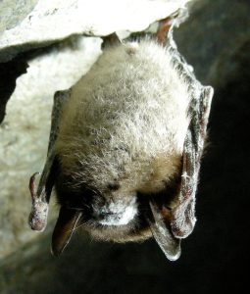
Animal Pathogens
Impacts to humans and animals include:
Tissue infections, poisoning from toxic mushrooms/contaminated food, and allergic reactions to moulds/spores.
Common skin infections such as athlete’s foot and ringworm.
White-nose syndrome in bats has caused major population declines in North America.
Photo by Marvin Moriarty/USFWS, Public Domain

Slide 27
Key Takeaways
Land plants evolved from green algae and gained key land traits.
Bryophytes lack vascular tissue and stay tied to moisture.
Seedless vascular plants added xylem/phloem, lignin, and true roots—taller but still water-dependent for fertilization.
Gymnosperms introduced pollen and seeds.
Angiosperms added flowers and fruits, enabling animal-aided pollination/dispersal and became the most diverse group.
Fungi aren’t plants- they’re absorptive heterotrophs that decompose matter, form mutualisms, and play major roles in food, medicine, and ecosystem health.

