Slide 1
Biology Essentials 2
Chapter 4: Microbial Life

Slide 2
Learning Objectives
Explain how life may have started on Earth through the process of abiogenesis.
Recognize the basic parts of prokaryotic cells and know the differences between Bacteria and Archaea.
Explore the helpful and harmful roles of prokaryotes in the environment and human health.
Learn how prokaryotes reproduce and how they can exchange genetic material in different ways.
Identify the main types of protists, what they look like, and how they live and move.

Slide 3
4.1 The Origins of Life

Slide 4
The Early Earth
Earth formed approximately 4.6 billion years ago
Conditions: hot, volcanic, lightning storms, simple molecules
This dynamic, energy-rich environment (primordial soup) may have provided the perfect lab for the chemistry that would eventually give rise to life

Slide 5
Chemical Evolution
Abiogenesis is the scientific term for the origin of life from non-living matter. It refers to the natural process by which simple chemical compounds gradually gave rise to more complex molecules, eventually leading to the first living organisms. The four stages of abiogenesis are:
Formation of organic molecules
Assembly into macromolecules
Formation of protocells
Self-replication

Slide 6
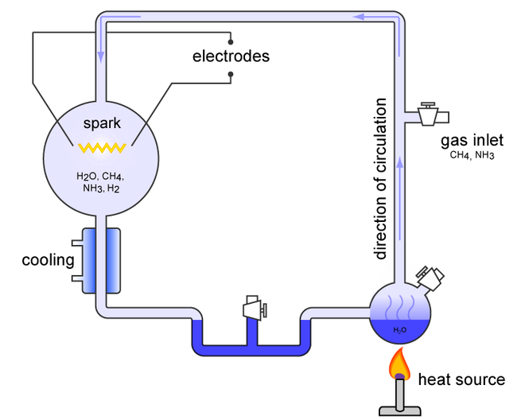
Step 1: Formation of Organic Molecules
Miller-Urey Experiment
Stanley Miller and Harold Urey simulated early Earth conditions
Produced organic molecules (compounds containing amino acids) from gases thought to be present in the atmosphere
Image by Carny, CC BY 2.5
Notes:
The diagram illustrates the Miller-Urey experiment setup, which simulated early Earth conditions to test the origin of organic molecules.
On the right, a heat source boils water (H₂O) in a flask, producing water vapour.
The vapour circulates upward through tubes, mixing with gases (CH₄ – methane and NH₃ – ammonia) supplied through a gas inlet, along with H₂ – hydrogen.
The mixture passes into a chamber containing electrodes that create a spark discharge, simulating lightning.
This spark chamber contains the gases (H₂O, CH₄, NH₃, H₂) where chemical reactions occur.
The system is connected to a cooling condenser, which cools the gases, causing water and dissolved compounds to condense and circulate back into the boiling flask.
The arrows indicate the direction of circulation, showing a continuous cycle of heating, sparking, cooling, and recirculation

Slide 7
Step 2: Assembly into macromolecules
Life requires macromolecules such as proteins and nucleic acids to carry out essential roles like catalyzing reactions and storing genetic information.
Natural catalysts, including clay minerals, may have helped small organic molecules link into larger chains, as shown in lab experiments with RNA nucleotides.
Environmental processes like waves splashing on hot rocks and water evaporation likely concentrated molecules, increasing the chances of bonding.

Slide 8
Step 3: Formation of Protocells
Protocells likely formed spontaneously from fatty acids, which can naturally assemble into spherical vesicles in water.
These vesicles could trap molecules like RNA and other macromolecules inside them and create a protected space where chemical reactions could occur more efficiently.

Slide 9
Step 4: Self-Replication
How did the first living systems reproduce before DNA and proteins existed? RNA likely came before DNA. Some types of RNA can do more than one job such as:
Store genetic information
Help chemical reactions happen
Help copy other RNA molecules

Slide 10
Chemistry to Biology
Protocells with better resource use, stability, and replication gained advantages and evolved into true cells
This marked the start of biological evolution, shaping life’s diversity
All modern life descends from the Last Universal Common Ancestor (LUCA), which lived 3.5 to 4 billion years ago
LUCA already had key cellular features and gave rise to prokaryotes (bacteria and archaea) and eventually eukaryotes

Slide 11
4.2 Prokaryotes

Slide 12
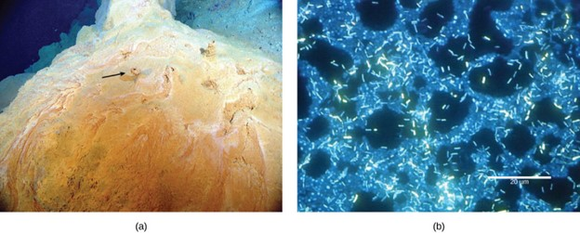
First Life Forms
What are Prokaryotes?
Bacteria and archaea
No nucleus or organelles
Small, simple, and ancient
Anaerobic (no oxygen needed)
Lived in oceans, evolved over millions of years
Image (a) by Dr. Bob Embly, CC BY 4.0, Image (b) by Ricardo Murga and Rodney Donlan, Public Domain

Slide 13
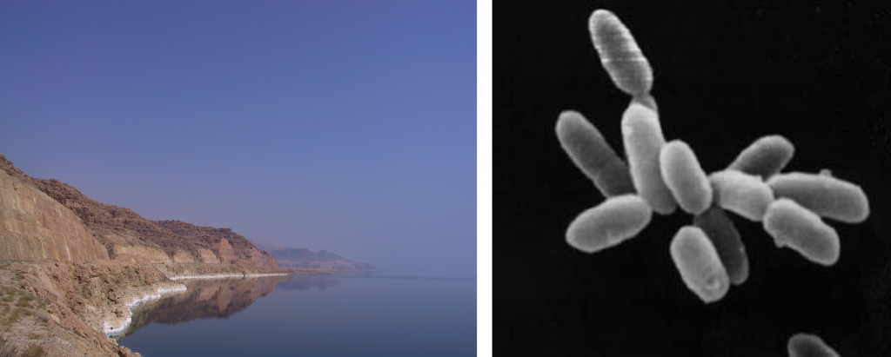
Prokaryotes in Extreme Environments
Thermophiles: Live in extreme heat conditions
Halophiles: Live in extremely salty conditions
Acidophiles: Live in extremely acidic conditions
Photo of the Dead Sea, Image (left) by Alexandermcnabb, CC BY-SA 4.0, and cluster of cells of Halobacterium sp. strain NRC-1 (halophiles), Image (right) by NASA, Public Domain

Slide 14
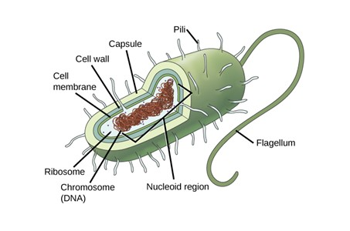
Structure of a Prokaryotic Cell
Core structures (present in most prokaryotes):
Plasma membrane
Cell wall
Nucleoid
Additional structures (present in some species):
Capsule
Flagella pili (pilus)
Plasmids
Image by CNX OpenStax, CC BY 4.0

Slide 15
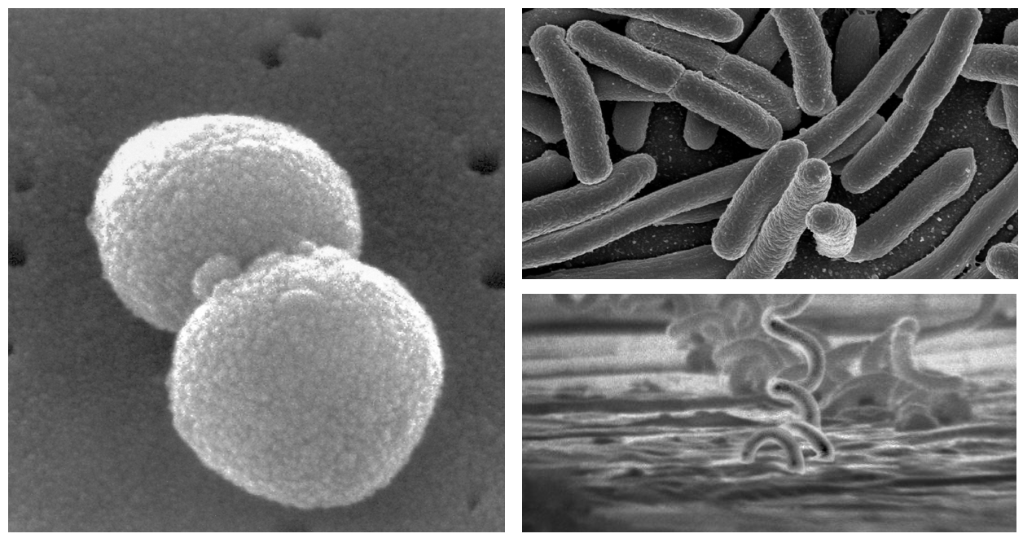
Prokaryotic Shapes
Coccus (spherical)
Bacillus (rod-shaped)
Spirillum (spiral)
“Streptococcus pneumoniae” by Janice Haney Carr, Public Domain. Image (top right): “E-Coli Bacteria”, by NIAID, Public Domain, Image (bottom right): “Treponema pallidum“, by CDC, Public Domain

Slide 16
Reproduction
Prokaryotes reproduce asexually by binary fission, producing identical clones without mitosis.
Genetic variation can occur through transformation (uptake of environmental DNA), transduction (DNA transfer via viruses), and conjugation (DNA transfer through a pilus).
Rapid binary fission cycles allow very short generation times, sometimes within minutes.
Combined with genetic recombination, this enables prokaryotes to evolve quickly and adapt to environmental changes.

Slide 17
Prokaryote Metabolism
Prokaryotes need energy and carbon. Energy metabolism in prokaryotes is classified as one of the following organisms:
Phototrophic: Capture light energy from the sun and convert it into chemical energy inside their cells.
Chemotrophic: Break down either organic or inorganic molecules to supply energy for the cell.
In terms of carbon metabolism, prokaryotes are classified as either:
Heterotrophic: Use organic compounds, usually from other organisms, as carbon sources.
Autotrophic: Use carbon dioxide (CO₂) as their only source or their main source of carbon.

Slide 18
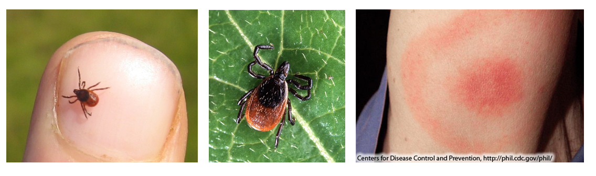
Harmful Bacteria
Some bacteria are pathogenic (disease-causing)
Transmitted via air, water, food, direct contact, or vectors
Antibiotics help, but resistance is rising
Prevention includes sanitation, vaccines, antibiotic use, public health education
In Canada, Lyme disease is increasing with expanding tick ranges—focus is on prevention, early recognition, and safe tick practices
“Deer Tick“, by Hill Walker, CC BY-SA 2.0, Image Middle: “Adult Deer Tick” by Scott Bauer, Public Domain, Image Right: “Classic Lyme Disease Rash“, by Anmol Pitliya, CC BY-SA 3.0

Slide 19
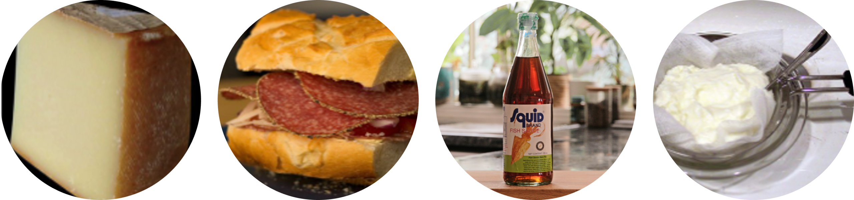
Beneficial Bacteria
Fix nitrogen for plants
Make fermented foods (yogurt, pickled vegetables, and cured meats)
Digest food (human microbiota)
“Kaïkou Cheese” by F.rodrigo, Public Domain, Sammich by Alisdair McDiarmid, CC BY 2.0, “Fish Sauce” by Addilyn Ragsdill, Unsplash License, “Yogurt being drained through cheesecloth“, Mom the Barbarian, CC BY 2.0

Slide 20
4.3 Protists

Slide 21
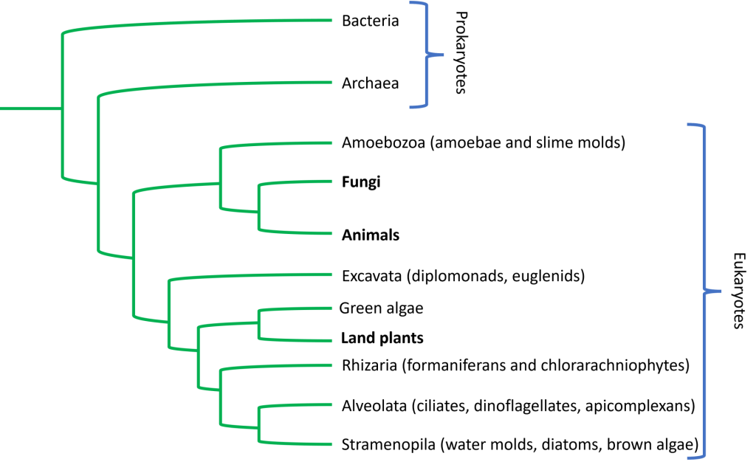
What are Protists?
First eukaryotes but not animals, plants or fungi
Mostly unicellular, very diverse
Can be autotrophs or heterotrophs
Simplified tree of life emphasizing evolutionary relationships among eukaryotic lineages. Image by Shana KerrImage, CC BY NC-SA

Slide 22
Characteristics of Protists
They inhabit aquatic environments, damp soil, snow, and can live as parasites or decomposers.
Protist cells are complex eukaryotes, mostly unicellular, though some form colonies or large multinucleated cells. Many are motile, moving with flagella, cilia, or pseudopodia, and some can sense and move toward light.

Slide 23
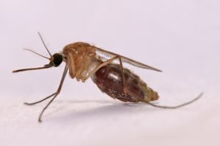
Human Pathogens
Many protists are parasitic and cause serious diseases in humans (e.g., malaria, sleeping sickness, giardiasis) and plants (crop damage)
Malaria is caused by Plasmodium parasites, which require both mosquitoes and vertebrates to complete their life cycle
Transmitted by Anopheles gambiae mosquitoes in Africa, malaria remains one of the deadliest diseases in history, responsible for millions of deaths
A Culex mosquito. Image by Muhammad Mahdi Karim, GNU Free Documentation License

Slide 24
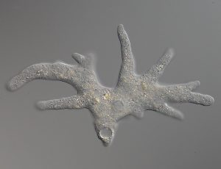
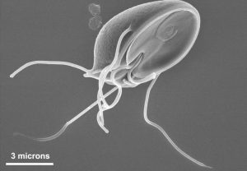
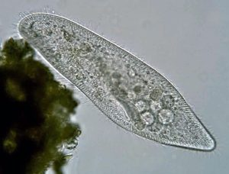
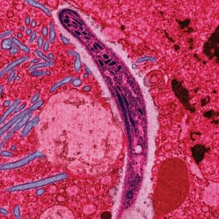
Animal-like Protists
Protozoa move to find food
Examples include amoebas, flagellates, ciliates, and apicomplexans
Amoeba proteus with pseudopodia“, by SmallRex, CC BY-SA 4.0
Giardia muris has four pairs of flagella “Giardiasis06” by Jesus Hernandez, CC BY-SA 3.0
“The ciliated protozoan Paramecium caudatum” by Deuterostome, CC BY-SA 3.0
Image by Ute Frevert; false colour by Margaret Shear, CC BY 2.5

Slide 25
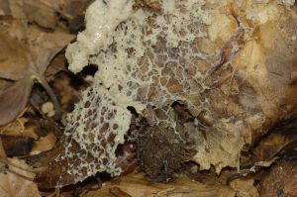
Fungus-like Protists
Fungus-like protists are heterotrophic organisms that absorb nutrients from decaying organic matter, similar to true fungi
Often found in moist habitats
Includes slime moulds that have a unique life cycle and exists as unicellular, amoeba-like organisms that engulf food particles
Under certain conditions they unite to form large, multicellular structures that reproduce collectively
Mucilago crustacea, “dog’s vomit slime mould” by Dietzel, CC BY-SA 3.0

Slide 26
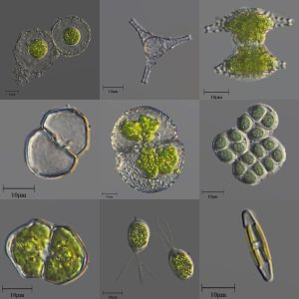
Plant-like Protists
Algae are autotrophic protists that perform photosynthesis, much like plants
Can be unicellular (e.g., phytoplankton) or multicellular (e.g., seaweed)
Seaweed classified as green, brown and red algae
Image by Alexander Klepnev, CC BY 4.0

Slide 27
Key Takeaways
Abiogenesis explains the origin of life from non-living matter, beginning with the formation of organic molecules.
Prokaryotes were the first forms of life on Earth, thriving in extreme environments and evolving into the diverse domains of bacteria and archaea, with key roles in ecosystems as decomposers and recyclers.
Some prokaryotes cause disease, including foodborne illnesses and antibiotic-resistant infections, but most are beneficial, supporting health, food production, and environmental processes such as bioremediation.
Protists are a diverse group of mostly single-celled eukaryotes, categorized into protozoa, algae, and fungus-like types, with important ecological roles and some causing serious diseases such as malaria and giardiasis.

