Slide 1
Biology Essentials 2
Chapter 3: Macroevolution

Slide 2
Learning Objectives
Explain how large-scale evolutionary changes, such as the emergence of new traits and mass extinctions, are recorded in the fossil record and interpreted using the geologic time scale.
Identify the four major divisions of the Geologic Time Scale—Precambrian, Paleozoic, Mesozoic, and Cenozoic.
Explain how continental drift and plate tectonics influence evolution by shaping global climates, ecosystems, and contributing to mass extinctions and the diversification of species.
Describe the major mechanisms of macroevolution, including gene duplication, homeotic gene changes, paedomorphosis, co-option, and advantageous intermediates.
Differentiate between taxonomy and phylogenetics.
Interpret phylogenetic trees to trace evolutionary relationships and explain the significance of branch points, common ancestors, and sister taxa in understanding the diversification of life.

Slide 3
3.1 Macroevolution and the Geologic Time Scale

Slide 4
Macroevolution and the Fossil Record
Macroevolution involves large-scale evolutionary changes above the species level.
Examples include mass extinctions and the evolution of major new traits (e.g., wings, flowers).
The fossil record provides a chronological archive of these large-scale changes.
Transitional forms and long-term trends can be studied using fossil evidence.
Fossils help identify when new species emerged and how traits evolved.

Slide 5
The Geologic Time Scale
The Geologic Time Scale organizes Earth’s 4.6-billion-year history.
Divides time into eons, eras, periods, and epochs for analysis.
Fossils placed in this timeline allow correlation with major global events.
Mass extinctions often define boundaries between time divisions.
Geological and biological history are interpreted together.

Slide 6
Continental Drift and Tectonic Plates
Earth’s lithosphere is divided into tectonic plates that move slowly.
Plate movement causes continental drift, reshaping Earth’s surface over millions of years.
Tectonic activity leads to geological events: earthquakes, volcanoes, mountain building.
Continental drift alters climate and ecosystems, influencing evolution.
Merging or splitting of continents can trigger mass extinction events.

Slide 7
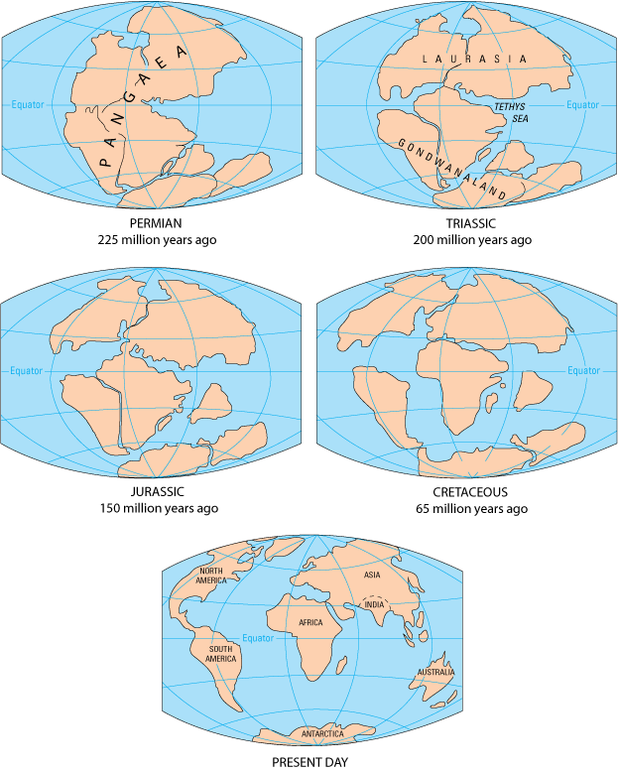
The Breakup of Pangaea
Image, by USGS Public Domain

Slide 8
Divisions of the Geologic Time Scale
Four major time divisions: Precambrian, Paleozoic, Mesozoic, Cenozoic.
Each era is defined by significant evolutionary and geological changes.
Transitions often marked by mass extinction events and new dominant species.
Understanding each division helps contextualize biodiversity over time.

Slide 9
Precambrian Era
Spans from Earth’s origin (4.6 bya) to 541 million years ago.
Life began with single-celled organisms like bacteria and archaea.
Photosynthesis by microbes led to oxygen accumulation in the atmosphere.
Later stages saw the emergence of simple multicellular and soft-bodied animals.
Ended with the appearance of more complex life.

Slide 10
Paleozoic Era
Began with the Cambrian Explosion (~541 mya), a burst of animal diversity.
First appearances of major animal phyla, fish, land plants, and early reptiles.
Life transitioned from oceans to land.
Trilobites were a key organism, later extinct.
Ended with the Permian-Triassic extinction—Earth’s most severe mass extinction.

Slide 11
Mesozoic Era
Known as the Age of Reptiles; dinosaurs, marine reptiles, and pterosaurs thrived.
First birds, mammals, and flowering plants appeared.
Continental drift continued; continents began moving to present locations.
Ended with the Cretaceous-Paleogene (K-Pg) extinction (likely caused by asteroid impact).

Slide 12
Cenozoic Era
Called the Age of Mammals, starting ~66 million years ago.
Mammals diversified and dominated land ecosystems.
Rise of birds, flowering plants, insects, and primates including humans.
Ice ages and formation of polar ice caps occurred.
Era continues today with significant human impact on the environment.

Slide 13
3.2 Mechanisms of Macroevolution

Slide 14
Mechanisms of Macroevolution: Overview
Macroevolution explains how large-scale traits and new body plans evolve.
Microevolutionary forces (e.g., mutation, drift, selection) accumulate over time.
Additional mechanisms contribute to major evolutionary innovations.
Key mechanisms include changes in developmental genes, co-option, and advantageous intermediates.

Slide 15
Evo-Devo and Developmental Genes
Evolutionary developmental biology (Evo-Devo) studies gene expression in development.
Small changes in developmental genes can lead to large body structure differences.
Timing, location, and amount of gene expression affect traits significantly.
Helps explain emergence of novel structures and major body plan changes.

Slide 16
Gene Duplication and Divergence
Gene duplication creates extra gene copies during DNA replication.
Duplicates can mutate and evolve new functions without disrupting the original.
Example: Hemoglobin and myoglobin evolved from a common ancestral gene.
This allows specialization and the emergence of novel traits.

Slide 17
Homeotic Genes and Body Plan Modifications
Homeotic genes determine body layout during development.
Highly conserved across diverse species (e.g., insects and vertebrates).
Changes in expression led to the evolution of limbs in tetrapods from fins.
Demonstrates how small gene shifts yield major structural innovations.

Slide 18
Paedomorphosis: Retention of Juvenile Traits
Paedomorphosis is the retention of juvenile traits into adulthood.
Caused by changes in developmental timing (e.g., delayed metamorphosis).
Example: Axolotl retains gills and aquatic traits throughout life.
New evolutionary paths emerge from these retained features.

Slide 19
Co-option (Exaptation)
Co-option repurposes existing structures for new functions.
Structures evolve for one function, then adapt to another (e.g., feathers for flight).
Feathers likely evolved for insulation/display before enabling flight in birds.
Genes can also be co-opted for new roles in different organisms.

Slide 20
Advantageous Intermediates
Complex traits often evolve through gradual, functional improvements.
Each intermediate form offers a survival or reproductive benefit.
Example: Eye evolution from light-sensitive patches to complex image-forming organs.
Selection favors improved versions of the same structure over time.

Slide 21
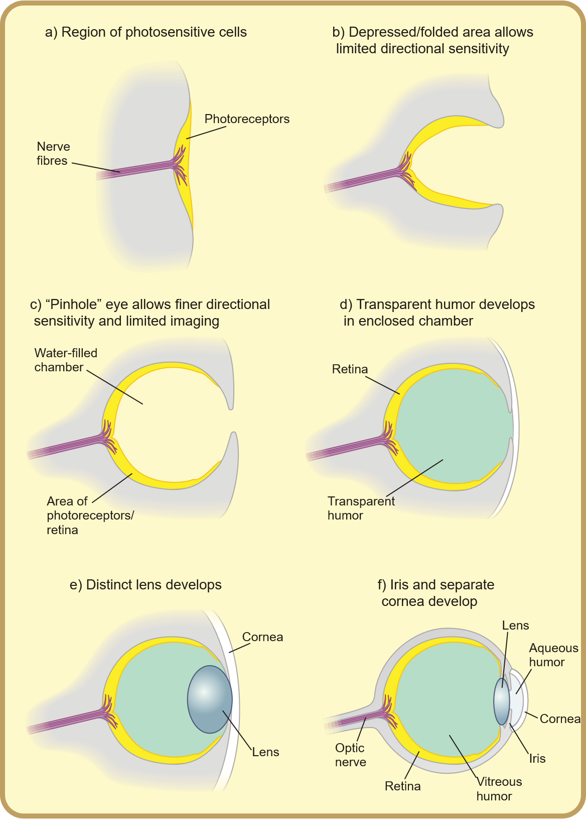
Advantageous Intermediates: Example
"Diagram of eye evolution" by Matticus78, CC BY-SA 3.0

Slide 22
Bird Flight: A Case Study in Macroevolution
Bird flight evolved through combined mechanisms: homeotic gene changes, co-option, and intermediates.
Forelimbs reshaped into wings via homeotic gene expression shifts.
Feathers co-opted for flight after evolving for other functions.
Each intermediate stage (e.g., gliding) offered fitness advantages.
Illustrates how multiple macroevolutionary processes drive innovation.

Slide 23
3.3 Organizing Life on Earth

Slide 24
Organizing Life on Earth: Systematics
Systematics is the study of organism diversity and evolutionary relationships.
It involves naming, classifying, and determining evolutionary connections.
Two main branches: Taxonomy and phylogenetics.
Systematics aims to reflect evolutionary ancestry in classifications.

Slide 25
Taxonomy: Hierarchical Classification
Taxonomy is the science of naming and grouping organisms.
Uses a hierarchical system: Domain, Kingdom, Phylum, Class, Order, Family, Genus, Species.
Each level is called a taxon; groups become more specific with each level.
Binomial nomenclature combines genus and species names (e.g., Canis lupus).

Slide 26
Taxonomy: Example of Dogs
Domestic dog: Canis lupus familiaris, a subspecies of the wolf (Canis lupus).
Taxonomic levels include shared traits: e.g., dogs and cats share Class Mammalia.
Levels such as Order (Carnivora) and Domain (Eukarya) include broader groups.
Taxonomy has evolved to reflect genetic and evolutionary data.

Slide 27
Phylogenetics: Evolutionary Relationships
Phylogenetics studies the evolutionary history of organisms.
Uses genetic, anatomical, and fossil evidence to build evolutionary trees.
Phylogenetic trees show how species evolved from common ancestors.
Reclassification occurs as new genetic data reveals relationships.

Slide 28
Phylogenetic Trees
Phylogenetic trees are branching diagrams of evolutionary lineages.
Start with a common ancestor; branches represent species divergence.
Branch point (node) = common ancestor; sister taxa = closely related species.
Revisions to trees are based on new evidence (e.g., birds as dinosaurs).

Slide 29
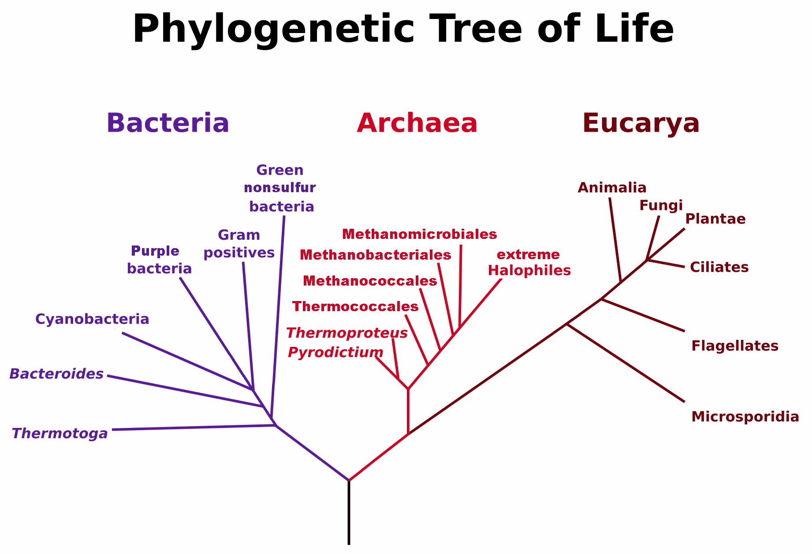
Phylogenetic Tree of Life
Image by Maulucioni , CC BY-SA 3.0

Slide 30
Interpreting Phylogenetic Trees
Sister taxa share a recent common ancestor but did not evolve from one another.
A branch point represents a divergence in evolutionary history.
The base of the tree represents the last universal common ancestor.
Tree topology helps trace lineage back through evolutionary history.

Slide 31
Key Takeaways
Macroevolution explains large-scale changes such as new traits and mass extinctions.
The fossil record and geologic time scale provide a framework for understanding evolutionary history.
Continental drift and plate tectonics influence climate, ecosystems, and speciation/extinction events.
Mechanisms of macroevolution include gene duplication, homeotic gene changes, paedomorphosis, co-option, and advantageous intermediates.
Systematics organizes life using taxonomy and phylogenetics to reflect evolutionary relationships.
Phylogenetic trees map species’ evolutionary relationships and common ancestry.

