Slide 1
Biology Essentials 2
Chapter 2: Microevolution and Speciation

Slide 2
Learning Objectives
Explain the historical development of evolutionary theory.
Define population genetics and describe how allele frequencies are used to measure evolutionary change within a population over time.
Identify and differentiate the sources of genetic variation—including mutation and sexual reproduction.
Apply the Hardy-Weinberg principle to calculate genotype and allele frequencies.
Interpret real-world examples of microevolution by analyzing shifts in allele frequencies and predicting genotype distributions using Hardy-Weinberg equations.
Evaluate how genetic structure and reproductive isolation contribute to the formation of new species.

Slide 3
2.1 Evolution of Populations

Slide 4
Historical Context
Darwin and Wallace lacked knowledge of genetics when proposing natural selection.
Blending inheritance was the prevailing (but incorrect) theory during their time.
Gregor Mendel’s1866 paper on inheritance was largely ignored until the 20th century.
Rediscovery of Mendel’s work led to integration with evolution theory.
Modern synthesis formed in the 1940s, combining natural selection and genetics.
It explains how genetic makeup changes in populations over time through evolutionary processes.

Slide 5
Population Genetics
Alleles are different versions of a gene, and each individual has two alleles per gene.
Population genetics studies how allele frequencies change over time in a population.
Evolution is defined as a change in allele frequency over generations.
Example: Blood type alleles in a Jordanian population showed microevolutionary shifts.
The gene pool includes all alleles in a population, and its composition changes with selection.
Beneficial alleles become more common, driving microevolutionary change.

Slide 6
Genetic Variation
Variation must have a genetic basis to drive evolutionary change.
Genetic diversity originates from mutation and sexual reproduction.
Mutations are random DNA changes introducing new alleles.
Sexual reproduction reshuffles alleles through crossing over and independent assortment.
Meiosis and genetic recombination produce diverse genotypes and phenotypes.
Variation enables populations to adapt to changing environments.

Slide 7
Hardy-Weinberg Principle
Hardy-Weinberg equilibrium: allele and genotype frequencies remain constant unless disturbed.
Assumptions: no mutation, migration, selection, or genetic drift; infinite population size.
Equation: p + q = 1 (allele frequencies); p² + 2pq + q² = 1 (genotype frequencies).
p² = homozygous dominant; 2pq = heterozygous; q² = homozygous recessive.
Used to detect whether evolution is occurring in a population.
Deviations from expected frequencies indicate evolutionary forces at work.

Slide 8
Hardy-Weinberg Example
Example 1: Crickets – 14 of 62 are soft chirpers (recessive trait).
q² = 0.225 → q = 0.474; p = 1 - q = 0.526.
2pq = 2 * 0.526 * 0.474 = 0.498 → ~50% heterozygous.
Example 2: Rabbits – 34 of 162 are recessive → q² = 0.21 → q = 0.46.
Predicted for 250 rabbits: 0.21 * 250 = 53 with recessive trait.
Hardy-Weinberg is a tool to model and predict genetic distributions.

Slide 9
2.2 What is a Species?

Slide 10
Biological Species Concept
Species definitions vary, and the biological species concept is widely used.
Defines a species as organisms that interbreed and produce fertile, viable offspring.
Focuses on reproductive isolation to distinguish species boundaries.
Effective for sexually reproducing organisms with known breeding patterns.
Example: Western vs. Eastern meadowlarks – do not interbreed due to different songs.
Limitation: does not apply to asexual organisms or fossils.

Slide 11
Appearance vs. Reproductive Compatibility
Physical appearance can be misleading for identifying species.
Example: Dogs vary in size and traits but can interbreed and produce fertile offspring.
True species distinction is based on gene flow and reproductive capability.
Phenotypic diversity within a species does not necessarily imply reproductive isolation.
Biological species concept highlights genetic compatibility over morphology.

Slide 12
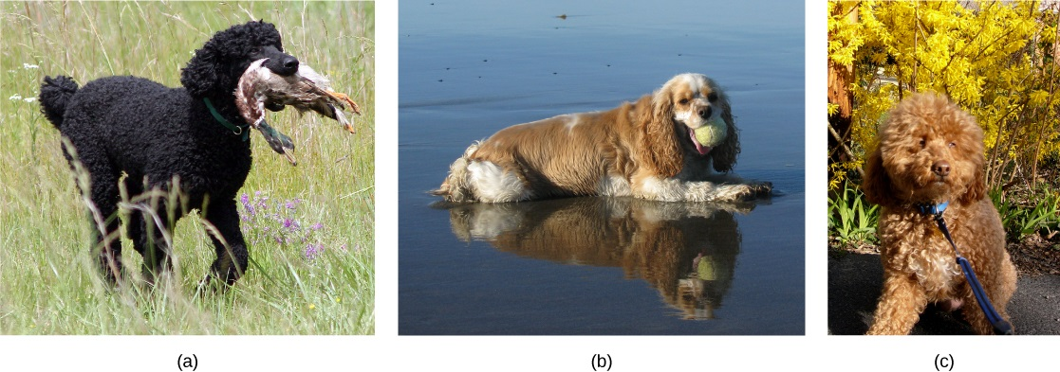
Appearance vs. Reproductive Compatibility
Species’ appearance can be misleading in suggesting an ability or inability to mate. The (a) poodle and (b) cocker spaniel can reproduce to produce a breed known as (c) the cockapoo. Image by Open Stax, CC BY 4.0

Slide 13
Reproductive Isolation
Reproductive barriers prevent gene flow and maintain species boundaries.
Two main categories: prezygotic and postzygotic barriers.
Prezygotic barriers act before fertilization (e.g., mating behaviors, timing, anatomy).
Postzygotic barriers act after fertilization (e.g., inviable or sterile offspring).
These mechanisms are essential in the speciation process.

Slide 14
Prezygotic Barriers
Temporal isolation: Different breeding times (e.g., two frog species).
Habitat isolation: Populations occupy different environments (e.g., divided crickets).
Behavioural isolation: Mating signals not recognized (e.g., firefly light patterns).
Mechanical isolation: Incompatible reproductive anatomy (e.g., damselfly genitalia).
Gametic isolation: Sperm and egg cannot fuse (e.g., sea urchins).

Slide 15
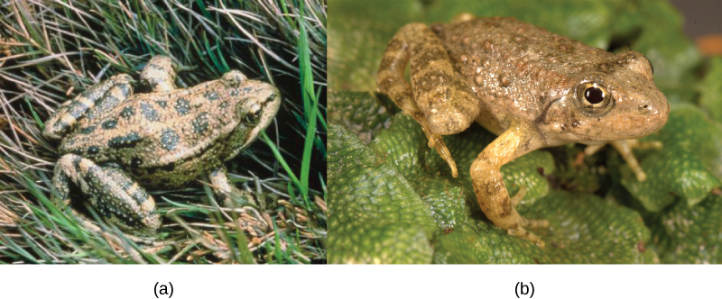
Prezygotic Barriers → Temporal Isolation
These two related frog species exhibit temporal reproductive isolation. (a) Rana aurora breeds earlier in the year than (b) Rana boylii. "Red Legged frog" by Mark R. Jennings, PD, Formation of new species: Figure 9 by OpenStax College, Biology, CC BY 4.0

Slide 16
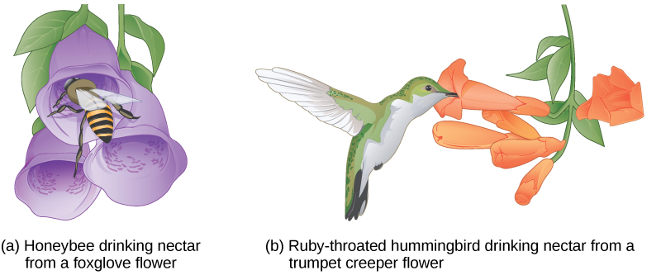
Prezygotic Barriers → Mechanical Isolation
Some flowers have evolved to attract certain pollinators. The (a) wide foxglove flower is adapted for pollination by bees, while the (b) long, tube-shaped trumpet creeper flower is adapted for pollination by hummingbirds. Image by Open Stax, CC BY 4.0

Slide 17
Reproductive Isolation: Postzygotic Barriers
Postzygotic barriers occur after zygote formation.
Hybrid inviability: Embryo fails to develop (e.g., interspecies frog embryos).
Hybrid sterility: Offspring survive but are infertile (e.g., mules).
Hybrid breakdown: Initial hybrids are viable, but their descendants are weak or sterile.
These barriers prevent gene flow even if fertilization occurs.

Slide 18
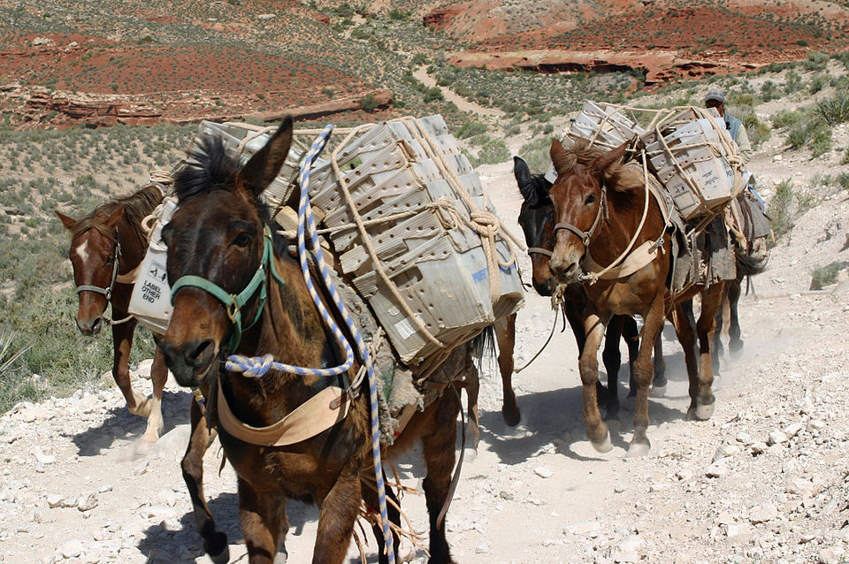
Reproductive Isolation: Postzygotic Barriers → Hybrid Sterility
Although mules are strong and capable animals, they are generally sterile because of differences in the number of chromosomes between their parents (horse and donkey), which disrupts normal gamete formation. "Mules from Supai, Arizona carrying U.S. Mail containers." by Elf, CC BY-SA 3.0

Slide 19
2.3 Speciation

Slide 20
Speciation: Overview
Speciation is the process by which populations evolve into distinct species.
Occurs when genetic divergence prevents interbreeding between populations.
Darwin illustrated speciation as a branching process of biological diversity.
Modern phylogenetic trees reflect this concept of evolutionary divergence.
Reproductive isolation is key to completing speciation.

Slide 21
Allopatric Speciation
Allopatric speciation occurs due to geographic separation (e.g., rivers, mountains).
Isolated populations evolve independently under different environmental pressures.
Over time, genetic differences accumulate, preventing interbreeding.
Example: Galápagos finches evolved into ~15 species with distinct traits.
If the barrier is removed, reproductive isolation often remains.

Slide 22
Sympatric Speciation
Occurs without geographic separation; populations share a habitat.
Reproductive isolation arises due to behavioral, ecological, or genetic differences.
Example: Lake Victoria cichlid fish evolved different morphologies and diets.
Chromosomal changes or mating preferences can initiate divergence.
Sympatric speciation is more common in plants, but can occur in animals too.

Slide 23
Comparing Speciation Types
Allopatric speciation involves physical barriers, and sympatric does not.
Cause of isolation: geographic vs. behavioural/ecological factors.
Allopatric is common in both plants and animals, and sympatric is more common in plants.
Examples: Squirrels (allopatric), fish in the same lake (sympatric).

Slide 24
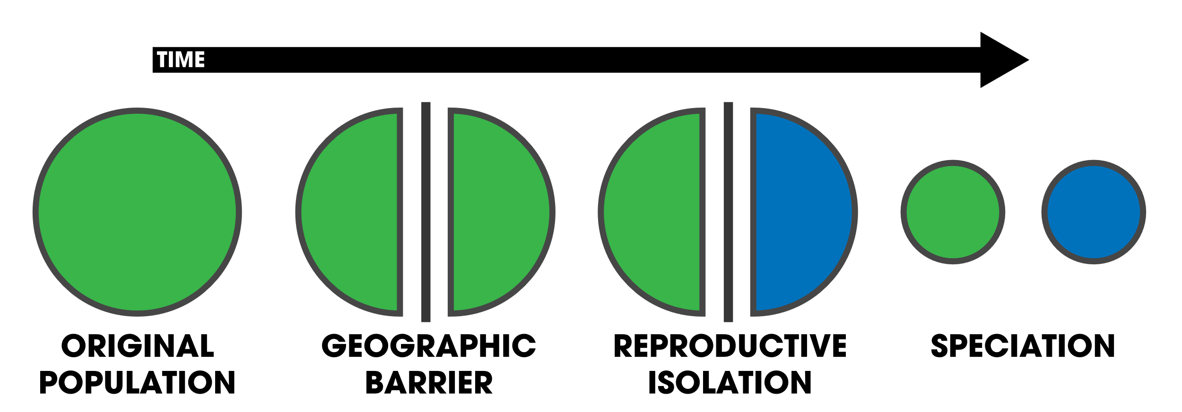
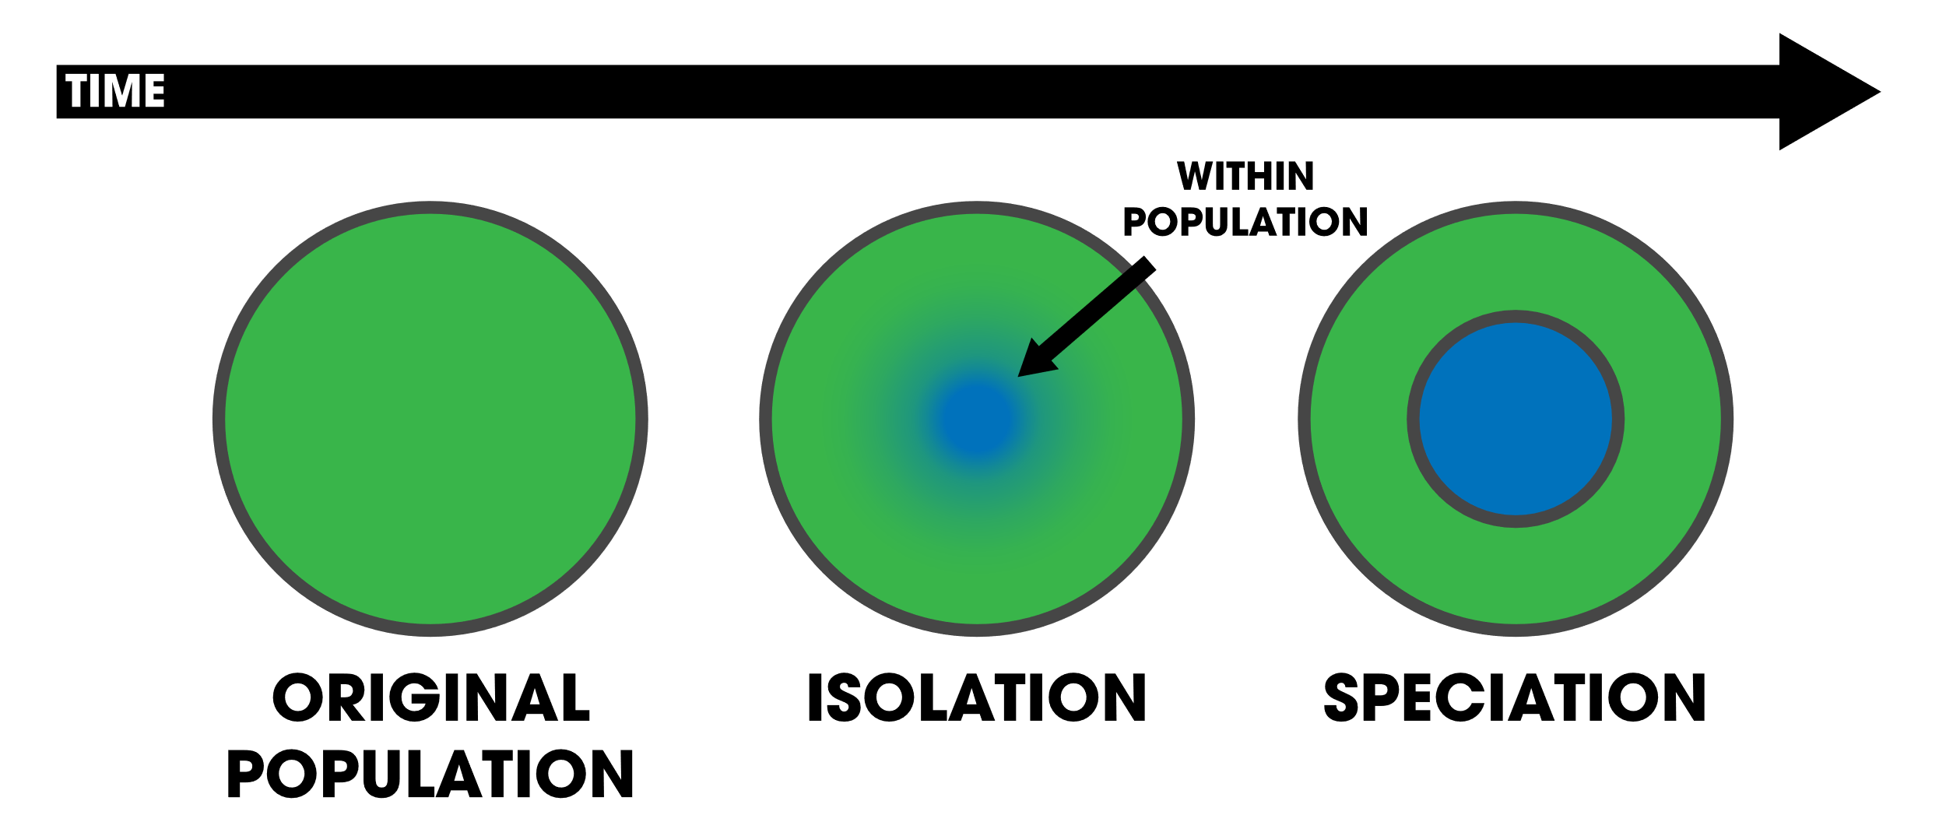
Allopatric vs. Sympatric
Allopatric
Sympatric
A population becomes separated by a geographic barrier; reproductive isolation develops, resulting in two separate species. Image by Andrew Z. Colvin CC BY-SA 4.0
In sympatric speciation, reproductive isolation evolves within a population without the aid of geographic barriers. Image by Andrew Z. Colvin CC BY-SA 4.0

Slide 25
Rate of Speciation
Gradualism: Species evolve slowly through continuous small changes.
Punctuated equilibrium: Rapid evolutionary change followed by stability.
Environmental shifts or new habitat colonization may trigger rapid speciation.
Fossil records sometimes show sudden appearance of new species.
Both patterns are observed in nature depending on the context.

Slide 26
Key Takeaways
Modern synthesis integrates Darwin’s natural selection with Mendelian genetics, defining evolution as a change in allele frequencies over time.
Hardy-Weinberg equilibrium is a model for understanding allele/genotype frequencies in stable populations: p² + 2pq + q² = 1.
The biological species concept defines species based on interbreeding and producing fertile offspring but has limitations.
Reproductive isolation includes prezygotic (e.g., temporal, behavioural) and postzygotic (e.g., hybrid sterility) barriers.
Speciation can occur through allopatric (geographic isolation) or sympatric (within the same area) mechanisms.
Speciation may follow gradualism (slow change) or punctuated equilibrium (rapid bursts of evolution).

