Slide 1
Biology Essentials 2
Chapter 11: Biodiversity and Conservation

Slide 2
Learning Objectives
By the end of this chapter, you will be able to:
Define biodiversity and explain its three levels—genetic, species, and ecosystem diversity.
Describe the importance of biodiversity in providing ecosystem services, cultural value, and human well-being.
Identify and explain the major drivers of biodiversity loss, including habitat destruction and fragmentation, overexploitation, pollution, climate change, and invasive species.
Explain key conservation strategies.
Demonstrate how individuals can contribute to biodiversity conservation Assess the potential for biodiversity recovery.

Slide 3
11.1 Biodiversity

Slide 4
Biodiversity
Biodiversity encompasses the variety of all life forms on Earth, highlighting the importance of understanding this diversity to appreciate the interconnectivity and balance of ecosystems.
Biodiversity can be broken into three levels:
Genetic
Species
Ecosystem diversity
Each level contributes to ecological resilience and adaptability

Slide 5
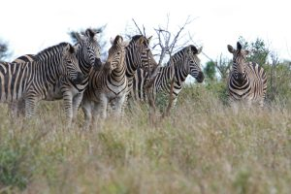
Genetic Diversity
Genetic diversity refers to the variety of genes within a species. It ensures survival by allowing adaptation to diseases and environmental changes.
For example, imagine a viral outbreak affecting a population of plants. If all the plants are genetically identical, the virus could wipe out the entire population. But in a genetically diverse population, some individuals might carry genes that make them naturally resistant to the virus.
Photo by Magda Ehlers, Pexels License

Slide 6
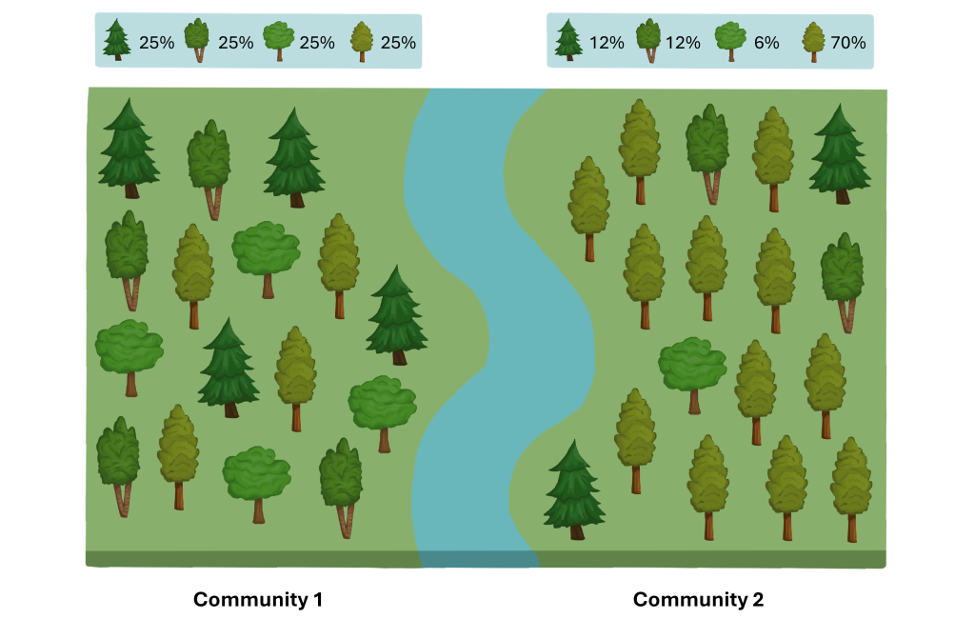
Species Diversity
Species diversity considers the number of different species (richness) and their population balance (evenness), contributing to ecosystem stability.
Image by Avery Audette, CC BY-NC-SA 4.0

Slide 7
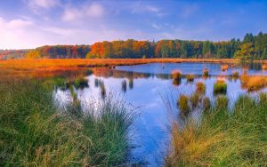
Ecosystem Diversity
Ecosystem diversity reflects the variety of ecosystems (e.g., forests, wetlands, deserts), each playing unique roles in supporting life and regulating the environment.
Photo by Pixnio, Pixnio License

Slide 8
Importance of Biodiversity
Biodiversity supports ecosystem services such as:
Pollination of crops by insects like bees and butterflies.
Purification of air and water by plants and wetlands.
Decomposition of waste and recycling of nutrients by fungi and bacteria.
Climate regulation through forests and oceans that absorb carbon dioxide.
Without biodiversity, these services would be less effective or could collapse entirely.

Slide 9
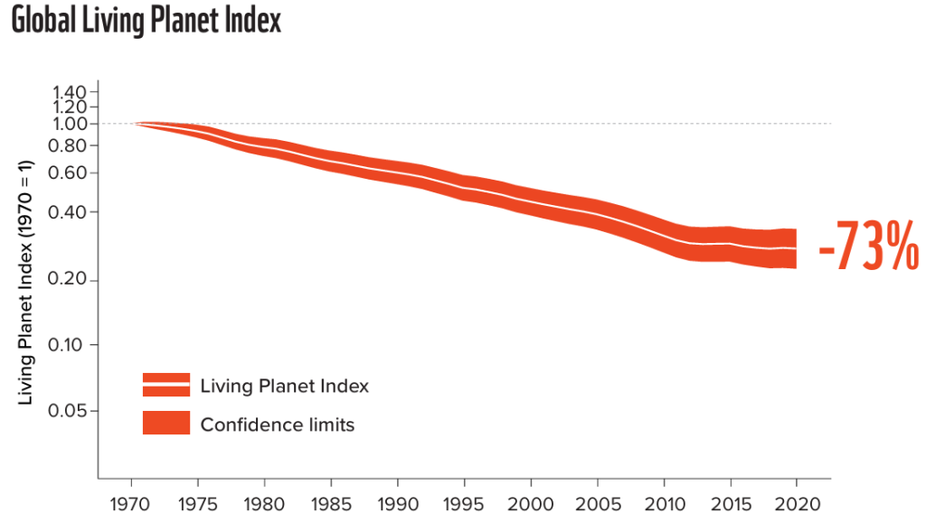
The Biodiversity Crisis
Species are declining at an alarming rate. The Living Planet Index reveals a 73% decrease in vertebrate populations since 1970, endangering ecosystem stability.
Image © 2024 WWF All rights reserved. Used under FDEd (CAN).

Slide 10
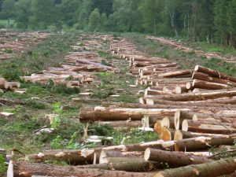
Habitat Destruction and Fragmentation
Human-driven habitat destruction and fragmentation (e.g., logging, urban sprawl) isolate populations and decrease biodiversity, seen in threats to Ontario’s wetlands and boreal forest.
For example Southern Ontario has lost about 72% of its original wetlands, with some areas in southwestern Ontario losing over 85%. These wetlands are being fragmented and drained for agricultural expansion and urban development.
Photo by H.-J. Sydow, CC BY-SA 3.0

Slide 11
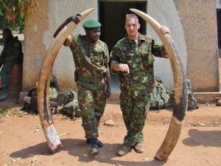
Overexploitation
Overuse of wildlife and natural resources (e.g., overfishing, poaching, deforestation) reduces population recovery rates and disrupts ecosystem balance.
In parts of the United States, such as California and Arizona, prolonged drought and overuse have led to severe water shortages. In Canada, parts of British Columbia and the Prairies are also experiencing increasing water stress due to drought and growing demand.
Photo by Enough Project, CC BY-NC-ND 2.0

Slide 12
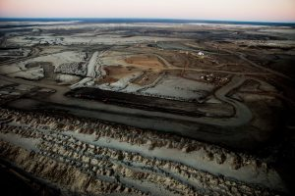
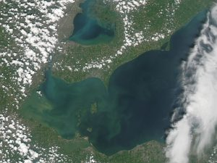
Pollution
Pollution harms ecosystems through chemicals, plastics, and waste. Having too many nutrients can also be harmful. Biomagnification and nutrient pollution (e.g., algal blooms) cause toxic build-up and oxygen depletion.
“Fort McMurray, Alberta” by Kris Krüg, CC BY-NC-ND 2.0
NASA image courtesy Jeff Schmaltz, LANCE/EOSDIS MODIS Rapid Response Team at NASA GSFC. Caption by Mike Carlowicz.

Slide 13
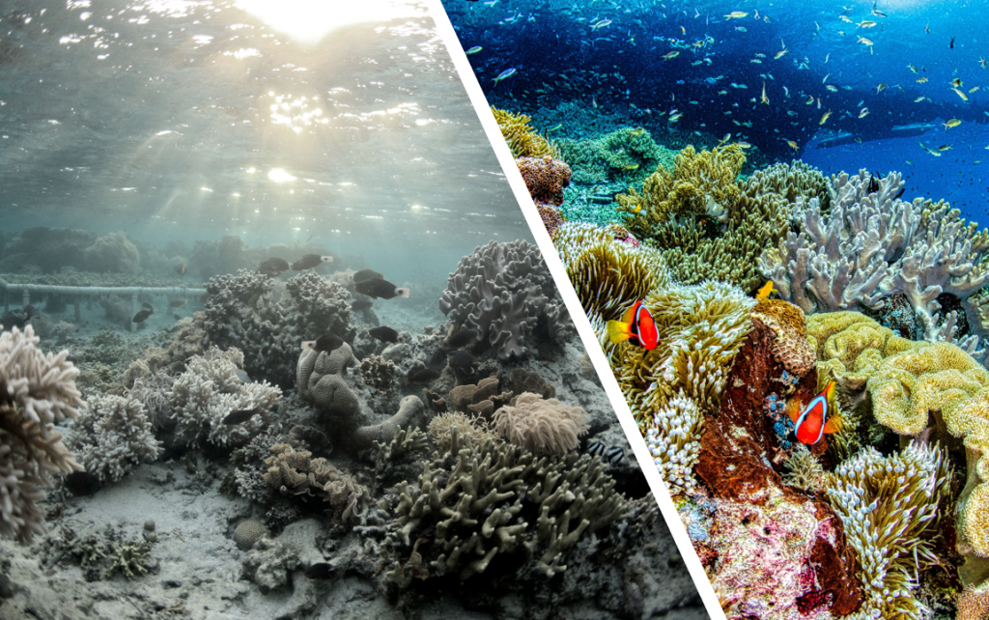
Climate Change
Climate change alters habitats and disrupts life cycles. The main driver is the increased concentration of greenhouse gases in the atmosphere, such as carbon dioxide (CO₂) and methane (CH₄). These gases trap heat from the sun, creating a “greenhouse effect” that warms the planet. Rising temperatures, droughts, and extreme weather events threaten species’ survival and drive habitat loss.
“Dying Coral Reef” (photo, left) by Cesar Jung-Harada, CC BY-NC-SA 2.0, “Vibrant-coloured coral reef” (photo right) by Tom Fisk, Pexels License

Slide 14
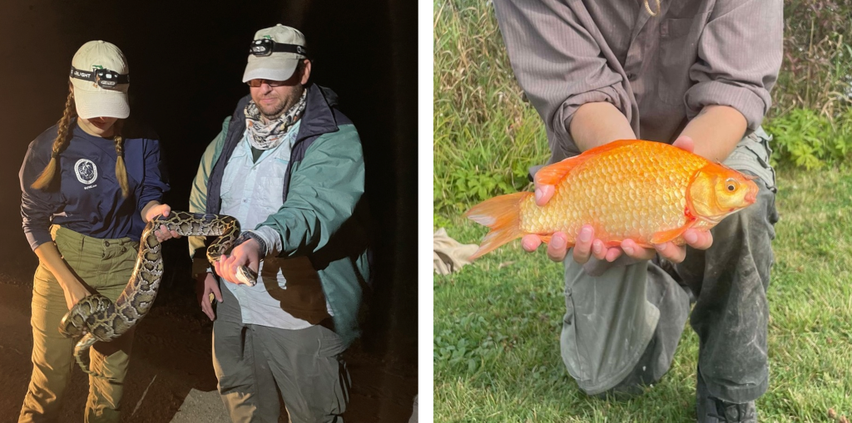
Invasive Species
Non-native species introduced by human activity often outcompete local species, causing ecological damage, as seen with pythons in Florida and goldfish in Ontario.
Burmese Python” by chloetheexplorer, CC BY-NC 4.0, “Goldfish” by Ioqan, CC BY-NC 4.0

Slide 15
11.2 Conservation

Slide 16
Conservation Strategies
Conservation biology works to protect biodiversity by addressing the imbalance caused by human activity. It focuses on sustaining ecosystems and their interactions
Conservation strategies include:
Legislation
Protected areas
Species-level conservation
Ecosystem restoration

Slide 17
Legislation
Key laws like Canada’s Species at Risk Act and global frameworks (e.g., CBD, Paris Agreement) set targets for habitat protection, restoration, and climate action.

Slide 18
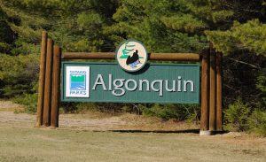
Protected Areas
Protected areas like national and provincial parks offer safe habitats, support ecological processes, and encourage conservation, research, and education.
Photo by Wladyslaw, CC BY-SA 3.0

Slide 19
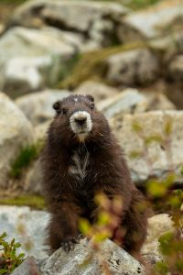
Species-Level Conservation
Efforts like captive breeding, reintroduction, and habitat restoration have helped recover species such as the Vancouver Island marmot and Canadian beaver.
“Vancouver Island Marmot” by marmota_taylor, CC BY-NC 4.0

Slide 20
Ecosystem Restoration
Restoration reverses ecosystem damage by replanting native species, restoring wetlands, and removing invasive species, exemplified by efforts on Pelee Island.

Slide 21

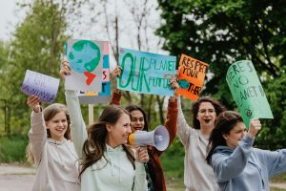

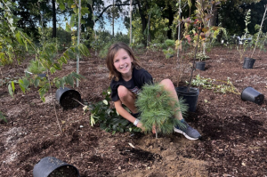
Everyday Actions for Biodiversity
Individuals can reduce impact through lifestyle choices, community science, advocacy, volunteering, and integrating environmental values into careers (career pathways.
Photo by Yaroslav Shuraev, Pexels License
Photo by Kaboompics.com, Pexels License
Photo by PNW Production, Pexels License
Photo by Kari Moreland, All Rights Reserved.

Slide 22
Hope for the Future
Nature is resilient. With informed action, ecosystems and species can recover. Across the globe, youth-led movements, Indigenous stewardship, and scientific innovation are driving meaningful change. These efforts remind us that conservation is not just a scientific challenge, but that it’s a human one, rooted in care, responsibility, and connection.
Every person has the power to make a difference. Whether through research, restoration, education, or everyday choices, our collective actions shape the future of life on Earth. The path ahead may be complex, but it is filled with possibilities.
No one can do everything, but everyone can do something for biodiversity.

Slide 23
Key Takeaways(1/2)
Biodiversity encompasses genetic diversity (variation within species that supports adaptation), species diversity (variety and distribution of species within ecosystems), and ecosystem diversity (range of distinct ecosystems and their ecological roles). Each level contributes to the resilience and stability of life on Earth.
Biodiversity underpins essential ecosystem services such as pollination, air and water purification, nutrient recycling, climate regulation, and food and medicine production. It also supports cultural, recreational, and mental health benefits, while enabling ecosystems to recover from disturbances
Global biodiversity is in sharp decline—wild vertebrate populations have dropped by an average of 73% since 1970—due to habitat destruction and fragmentation, overexploitation of species and resources, pollution (including biomagnification of toxins), climate change, and the spread of invasive species.

Slide 24
Key Takeaways (2/2)
Conservation biology employs legislative measures (e.g., Canada’s Species at Risk Act, global agreements like the CBD’s 30×30 target), establishment of protected areas, species-level interventions (captive breeding, reintroduction, habitat restoration), and ecosystem restoration to preserve and recover biodiversity.
Individuals can contribute through sustainable lifestyle choices (e.g., reducing plastic use, shifting toward plant-based diets), participating in community science, advocating for conservation policies, volunteering for habitat and species recovery, and integrating sustainability into careers.
Despite current challenges, biodiversity can recover through informed, coordinated action. Indigenous stewardship, youth movements, scientific innovation, and community engagement demonstrate that everyone can play a role—no single person can do everything, but everyone can do something.

