Slide 1
Biology Essentials 2
Chapter 10: Community and Ecosystem Ecology

Slide 2
Learning Objectives
By the end of this chapter, you will be able to:
Describe key interspecific interactions within biological communities and explain how they impact the survival and reproduction of species.
Analyze the role of coevolution in shaping species traits and behaviours.
Interpret the structure of trophic levels and food webs in an ecosystem.
Explain the concepts of energy flow and ecological pyramids.
Illustrate the processes and significance of biogeochemical cycles (water, carbon, nitrogen, and phosphorus).
Evaluate the ecological consequences of human activities.

Slide 3
10.1 Community Ecology

Slide 4
Interspecific Interactions
Community ecology explores the relationships between species coexisting in the same habitat, forming diverse communities. These interspecific interactions influence population dynamics and community structure:
Competition
Herbivory
Predation
Parasitism
Mutualism
Commensalism

Slide 5
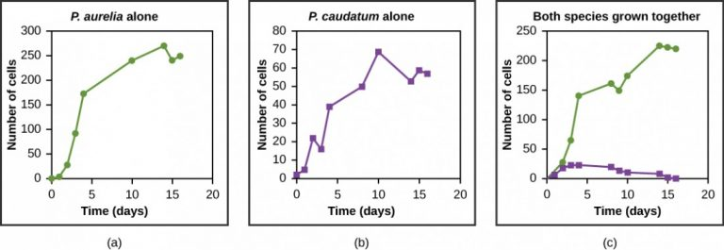
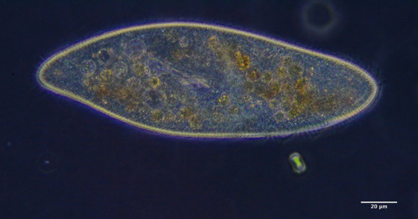
Competition (-/-)
Species compete for limited resources, negatively affecting both. This can lead to niche differentiation or exclusion if they compete for the exact same resources.
Image by OpenStax, CC BY 4.0
“Paramecum caudatum” by Don Loarie, CC BY 4.0

Slide 6
Herbivory (+/−)
Animals feed on plants, benefiting the herbivore while harming the plant, making it a positive/negative interaction. Examples include deer and rabbits that feed on leaves and stems. Plants, in turn, have evolved a wide range of defences to reduce damage from herbivores:
Mechanical defences (i.e., thorns, spines).
Chemical defences (i.e., toxins, bitter-tasting chemicals).
Indirect defences (i.e. strategies that attract predators or parasites of herbivores).

Slide 7
Predation (+/-)
Predation is an interaction in which one species, the predator, kills and eats another species, the prey. This relationship benefits the predator but harms the prey, making it a positive/negative interaction. At the same time, prey species have developed defences to avoid being eaten:
Behavioural defences: Avoid detection or escape attacks (i.e., living in herds).
Mechanical defences: Physical structures that make prey hard to eat (i.e., shell of a turtle).
Camouflage: Blends into surroundings (i.e., a walking stick looks like a twig).

Slide 8
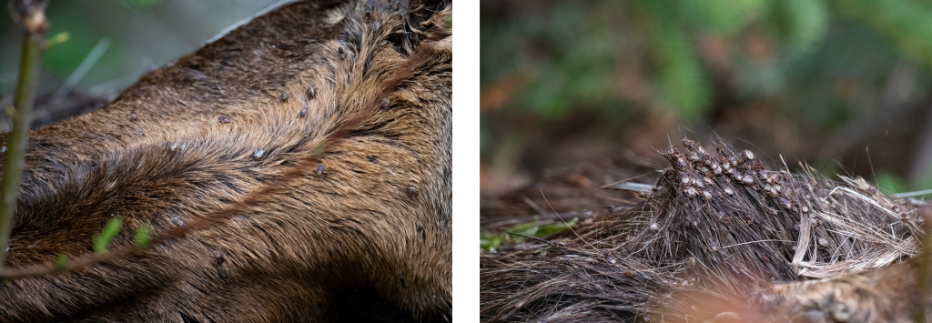
Parasitism (+/−)
Parasites benefit by harming a host but often avoid killing it quickly. Parasites can be internal or external, with adaptations to exploit hosts effectively.
Winter Ticks” Photos by hereinthewild, CC BY-NC 4.0

Slide 9
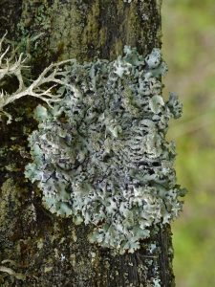
Mutualism (+/+)
Both species benefit. Examples include flowering plants and their pollinators and the mutualistic relationship between lichen and photosynthetic algae or cyanobacteria. These relationships support survival and reproduction.
“Powder-headed Tube Lichen” by hansritter, CC BY-NC 4.0

Slide 10
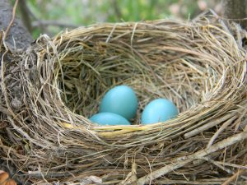
Commensalism (+/0)
Commensalism is an interspecific interaction in which one species benefits while the other is neither helped nor harmed. This makes it a positive/neutral interaction. Examples include barnacles on whales and birds nesting in trees.
“American Robin Nest with Eggs” by Laslovarga, CC BY SA 3.0

Slide 11
Coevolution
Long-term interspecific interactions lead to reciprocal evolutionary changes.
In positive/negative interactions, such as predation, herbivory, or parasitism, one species evolves new ways to exploit another, prompting the other to evolve defences in response. For example plants may develop toxins or tougher leaves, while herbivores evolve resistance.
Mutualistic relationships also drive coevolution. For example, wild bergamot, a native Canadian wildflower with a tubular shape, has coevolved with Beebalm Shortface bees which have long tongues that can reach the nectar.

Slide 12
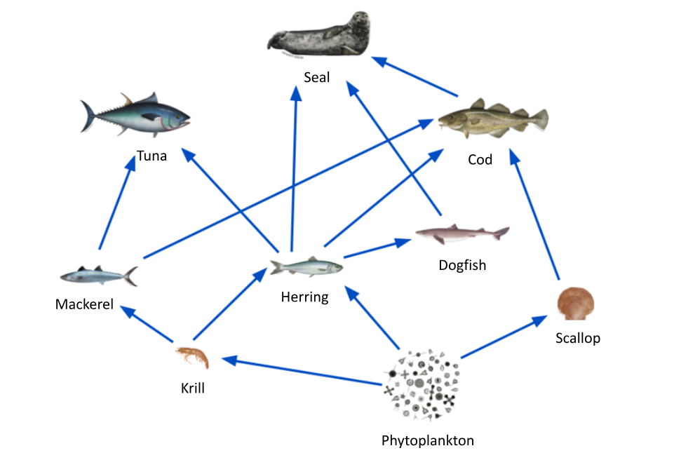
Trophic Structure
Describes the feeding relationships in a community. Energy flows from producers to herbivores and carnivores, forming food chains and webs.
While food chains show linear feeding relationships, food webs reveal how species often occupy multiple trophic levels, emphasizing the interconnectedness and resilience or vulnerability of ecosystems.
Food Web Diagram for the Monterey Bay Habitat. Image by NOAA, License

Slide 13
10.2 Energy Flow Through Ecosystems

Slide 14
Primary Productivity and Energy Budgets
Ecosystems function via energy flow and nutrient cycling. Energy enters via sunlight, is converted by producers, and flows through trophic levels before dissipating as heat.
Primary productivity is the amount of energy that producers make available to the rest of the ecosystem. This energy forms the base of the food web and determines how much life an ecosystem can support.
Understanding primary productivity helps ecologists estimate how much energy is available to support life and how ecosystems respond to changes in the environment.

Slide 15
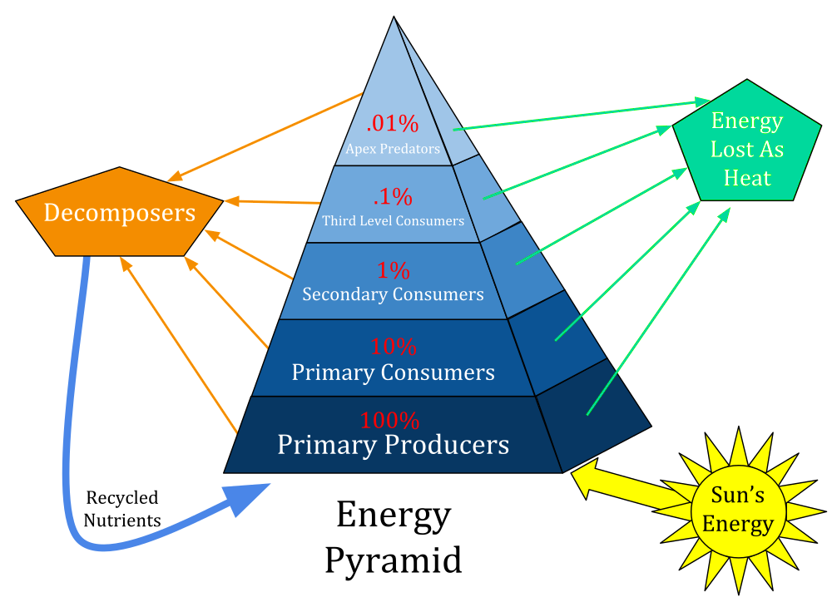
Energy Transfer and Ecological Pyramids
As energy flows through an ecosystem, it moves from one trophic level to the next – from producers to herbivores, then to carnivores and eventually to decomposers. But this transfer is not very efficient. On average, only ~10% of energy transfers between trophic levels. Ecological pyramids illustrate this loss, explaining why food chains are short.
Image by Swiggity.Swag.YOLO.Bro, CC BY-SA 4.0

Slide 16
10.3 Nutrient Cycles in Ecosystems

Slide 17
Nutrient Cycles in Ecosystems
Matter recycles through biogeochemical cycles linking biotic and abiotic systems. Major elements include water, carbon, nitrogen, and phosphorus.

Slide 18
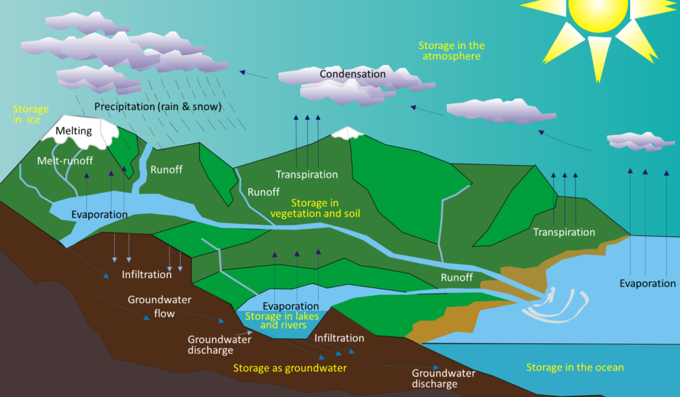
The Water Cycle
Water is essential for all living things. It plays a critical role in biological processes such as digestion, circulation, and temperature regulation. The average adult human body is about 60% water.
Water cycles via evaporation, transpiration, condensation, precipitation, and runoff. Surprisingly, only a small fraction of freshwater is usable.
Image by Ingwik, CC BY-SA 3.0, Modifications: Text added

Slide 19
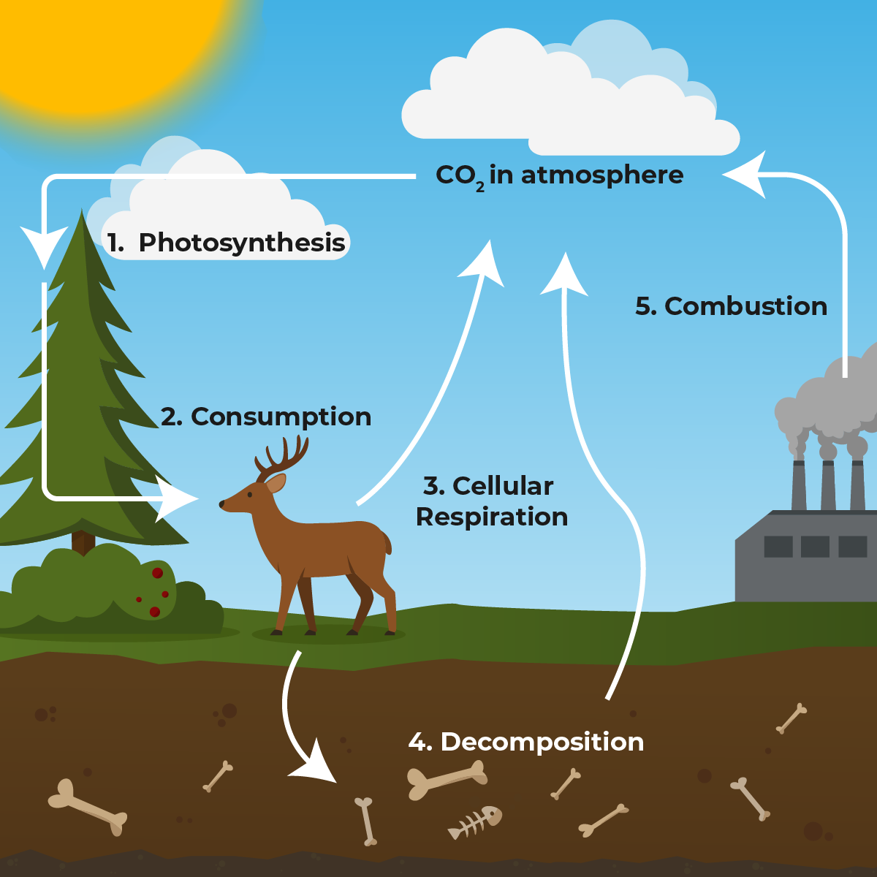
The Carbon Cycle
Carbon enters the ecosystem through photosynthesis, when plants absorb carbon dioxide (CO₂) from the atmosphere and use it to build organic molecules. These molecules are then passed through the food web as organisms eat plants and each other. When organisms release energy, they return CO₂ to the atmosphere. When organisms die, decomposers break down their bodies, releasing carbon back into the soil and air. Human activity (e.g., fossil fuel use) disrupts the balance, contributing to climate change.
“Carbon Cycle” by Koen Liddiard CC BY-NC-SA 4.0

Slide 20
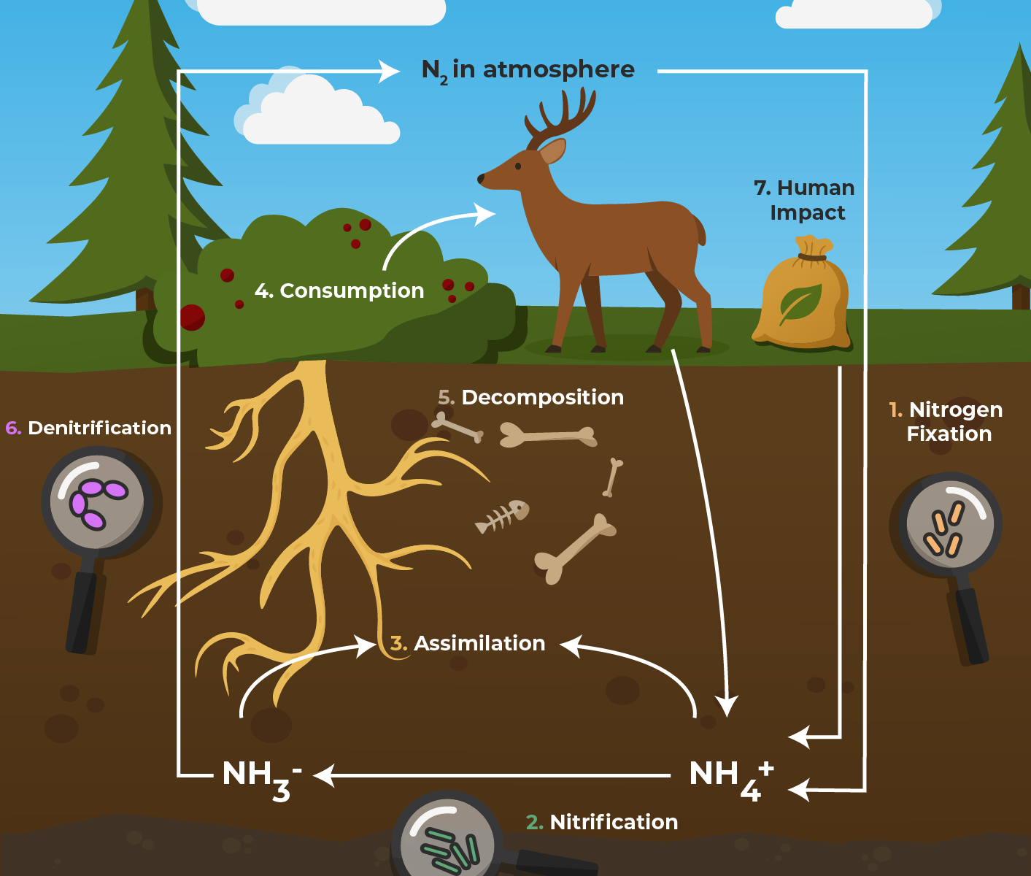
The Nitrogen Cycle
Nitrogen is an essential element for all living things. It is a key component of amino acids, proteins, and DNA. Although nitrogen gas (N₂) makes up about 78% of Earth’s atmosphere, most organisms cannot use it in this form. The nitrogen cycle describes how nitrogen moves via fixation, assimilation, consumption, decomposition, and denitrification. Human impacts (e.g., fertilizers) can cause ecological imbalance.
“Nitrogen Cycle” by Koen Liddiard & Stephanie Audette CC BY-NC-SA 4.0

Slide 21
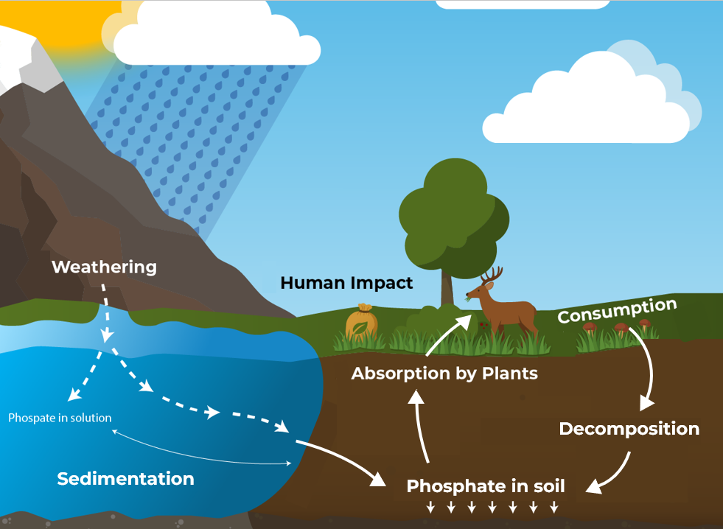
The Phosphorus Cycle
The phosphorus cycle begins when phosphate-containing rocks are broken down by weathering. This releases phosphate ions (PO₄³⁻) into the soil and water, where they can be absorbed by plants. Animals eat the plants and excrete waste or die, returning the phosphorus to the soil. It does not enter the atmosphere.
“Phosphorus Cycle” by Koen Liddiard CC BY-NC-SA 4.0

Slide 22
Key Takeaways (1/2)
Species within a community interact in diverse ways—such as competition, predation, herbivory, parasitism, mutualism, and commensalism—which influence population dynamics, biodiversity, and evolutionary adaptations
Through niche differentiation and the competitive exclusion principle, species adapt to avoid direct competition. Coevolution further drives reciprocal adaptations between interacting species, from predators and prey to mutualistic partners.
Energy enters ecosystems via producers through photosynthesis and flows to herbivores, carnivores, and decomposers. Due to the 10% rule, only a small fraction of energy is passed on at each level, limiting food chain length and top predator populations.

Slide 23
Key Takeaways (2/2)
While food chains show linear feeding relationships, food webs reveal how species often occupy multiple trophic levels, emphasizing the interconnectedness and resilience or vulnerability of ecosystems.
The carbon, nitrogen, phosphorus, and water cycles move matter through living and non-living components of ecosystems. These cycles sustain life by replenishing nutrients that organisms need to grow, reproduce, and function.
Practices like burning fossil fuels, deforestation, and overuse of fertilizers introduce excess nutrients or pollutants, leading to ecosystem imbalances such as climate change, eutrophication, and biodiversity loss.

