Slide 1
Biology Essentials 2
Chapter 1: Evolution

Slide 2
Learning Objectives
By the end of this chapter, you will be able to:
Explain the scientific theory of evolution.
Interpret fossil evidence that supports evolutionary change.
Describe Darwin’s contributions and contrast with earlier theories.
Summarize five categories of evidence for evolution.
Differentiate mechanisms of evolution.
Compare types of natural selection.

Slide 3
1.1 Introduction to Evolution

Slide 4
Early Naturalists & Fossil Evidence
Fossils like mastodons, ammonites, and ichthyosaurs challenged fixed species.
Lamarck proposed early evolutionary theory (inheritance of acquired traits).
Charles Lyell argued for slow geological change, influencing Darwin.

Slide 5
Darwin's Voyage & Observations
Darwin's voyage on the HMS Beagle led to observations of finches, tortoises, and iguanas in the Galápagos.
These species had adaptations to their environments, suggesting descent with modification.

Slide 6
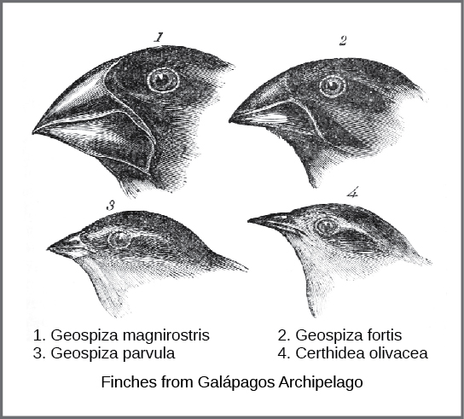
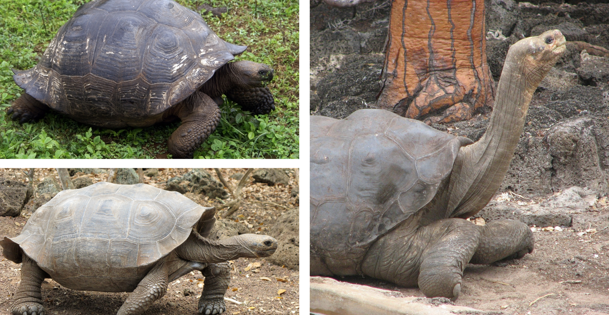
Darwin’s Voyage & Observations
Image by OpenStax, CC BY 4.0
Top left: "Domed (porteri)" by putneymark, CC BY-SA 2.0, bottom left: "Intermediate (chathamensis)" by mtkopone, CC BY-SA 2.0, and right: "Saddleback (abingdoni)" by Mike Weston, CC BY 2.0

Slide 7
Theory of Natural Selection
Darwin's theory proposed that organisms with advantageous traits are more likely to survive and reproduce.
Natural selection acts on heritable variation, leading to evolutionary change.

Slide 8
1.2 Evidence of Evolution

Slide 9
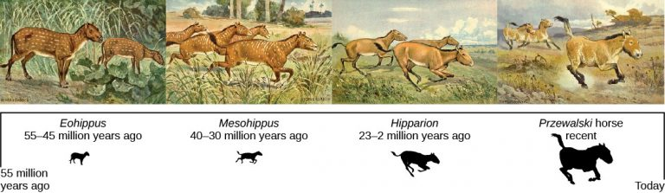
Evidence for Evolution: Fossils
Fossil records show gradual changes over time, like horse evolution.
Transitional fossils help trace evolutionary pathways.
Image by OpenStax, CC BY 4.0

Slide 10
Comparative Anatomy
Homologous structures suggest common ancestry (e.g., tetrapod limbs).
Vestigial structures (e.g., goosebumps) reflect evolutionary history.
Analogous structures arise from convergent evolution.

Slide 11
Biogeography
Study of species distribution shows patterns explained by continental drift.
Marsupials' distribution aligns with plate tectonics and fossil history.

Slide 12
Embryonic Development
Similar embryo structures across species suggest shared ancestry.
Developmental similarities provide clues to evolutionary relationships.

Slide 13
Genetic Evidence
All life uses DNA and genetic similarities reflect common ancestry.
Humans share ~99% DNA with chimpanzees and even share genes with bananas.

Slide 14
1.3 Mechanisms of Evolution

Slide 15
Mechanisms of Evolution
Evolution occurs via multiple mechanisms:
Mutation: Random DNA changes
Genetic Drift: Random allele frequency shifts
Gene Flow: Migration of alleles
Natural Selection: Adaptive trait increase

Slide 16
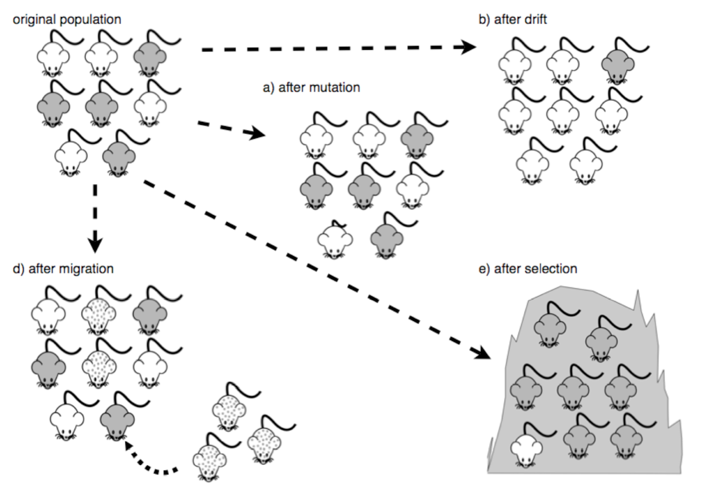
Mechanisms of Evolution

Slide 17
Natural Selection Explained
Requires variation, heritability, and differential reproduction.
Traits that improve survival or reproduction become more common.

Slide 18
Types of Natural Selection
Stabilizing: Favours average traits
Directional: Favours one extreme
Disruptive: Favours extremes, not average
Frequency-dependent: fitness depends on trait frequency
Sexual Selection: traits favoured for mating success

Slide 19
Key Takeaways
Evolution is a scientific theory explaining life’s diversity and common ancestry.
Fossil discoveries disproved static species beliefs, showing extinct transitional forms.
Darwin’s theory of natural selection, influenced by Wallace and Malthus, explains adaptation.
Five key types of evidence support evolution: fossil record, anatomy, biogeography, embryology, and genetics.
Mechanisms of evolution include mutation, genetic drift, gene flow, and natural selection.
Natural selection takes several forms: stabilizing, directional, disruptive, frequency-dependent, and sexual selection.

