Slide 1
Facilities Management for Foodservice Managers
Chapter 9: Infection Prevention and Control

Slide 2
9.0 Learning Objective
Recognize the key elements required to manage a successful infection control program.

Slide 3
9.1 Infection Prevention and Control
An infectious disease is “caused by the entrance into the body of pathogenic agents or microorganisms, such as bacteria, viruses, protozoans, or fungi, which grow or multiply there” (Merriam-Webster, n.d.).
Common infectious diseases include the common cold, influenza, COVID, hepatitis, respiratory syncytial virus (RSV), norovirus, strep throat, and pneumonia.
The Ministry of Health and Long-Term Care Act requires every facility to have an infection prevention and control (IPAC) program.
Image by Kelly Sikkema, Unsplash License.

Slide 4
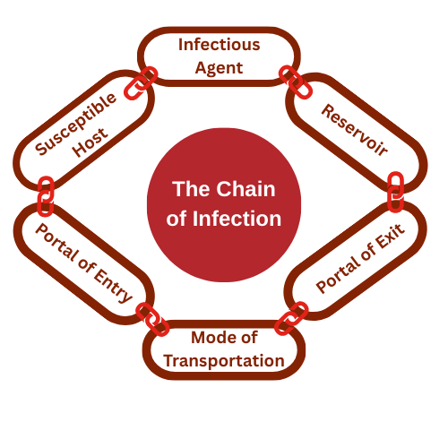
9.2 The Chain of Infection
The chain of infection explains how infections can spread.
The chain has six links: the infectious agent (germs), reservoir, portal of exit, mode of transmission, portal of entry, and susceptible host. The chain can be broken at each link to prevent the spread of infection.
"The Chain of Infection" by Shauna Roch CC BY-NC-SA

Slide 5
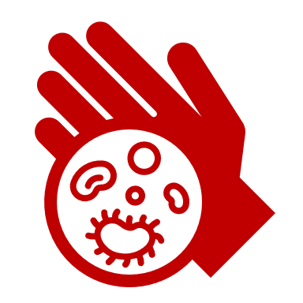
9.2 The Chain of Infection Described
Infectious agents are germs, such as bacteria, viruses, and parasites.
Reservoirs are where germs live. Germs can live on people, animals, food, soil, and water.
The portal of exit is how germs get out of the current host where they have been living.
The mode of transmission is how germs travel around.
The portal of entry is how germs get into the new host.
A susceptible host is the next person who gets sick.

Slide 6
9.3 Infection Prevention Processes
Proper hand washing can reduce the spread of infection.
Standards for handwashing have been developed by the World Health Organization.
Studies have confirmed that twenty seconds of lather (soapy water contact) time is optimal.
Data: Israel & Li, 2020.

Slide 7
9.3 Stanards for Hand Hygiene
Wet hands with water and apply soap.
Rub hands palm to palm
Rub left hand over right hand with interlaced fingers. Repeat with the right hand over the left hand.
Rub again palm to palm with fingers interlaced.
Rub the back of fingers opposing the palm with fingers interlocked. Repeat for each hand.
Rub holding right thumb and then left thumb.
Clean the tips of the fingers by rubbing them against the opposing palm
Rinse with running water.

Slide 8
9.3 Infection Prevention
Masking can reduce the spread of transmission.
Gloves provide a barrier between infectious pathogens and any openings that they might find on the skin.
Gowns provide an additional layer of protection by keeping infectious pathogens from travelling on clothing.
Image by Luke Jones, Unsplash License.

Slide 9
9.4 Infection Prevention and Control Program
Objectives of the Infection Prevention and Control (IPAC) program are to prevent the spread of infections, resulting in reduced morbidity (sickness) and mortality (death).
Surveillance Audit tools are used to observe the surroundings to ensure that set standards are being followed to prevent and manage the spread of infectious diseases.

Slide 10
9.4 Outbreak Investigation and Management
Step 1: Conduct an investigation to confirm the existence of an outbreak and confirm the diagnosis (WHO, n.d.).
Step 2: Implement control measures. Control measures, as defined by public health, are put in play to prevent the spread of the disease and could include increased cleaning and sanitizing, personal protective equipment, and isolation (WHO, n.d.)
Step 3: Track data. Keep records of cases (WHO, n.d.)
Step4: Communicate key information to stakeholders and the public. (WHO, n.d.)

Slide 11
9.4 Infection Prevention and Control
Critical Incident Reporting: A process will be established for reporting new cases and tracking data.
Staff Training: Each department manager will be responsible for education and training on outbreak procedures.
Routine Practices: “Routine practices are a set of infection control strategies designed to protect workers from exposure to potential sources of infectious diseases” (CCOHS, 2023, para. 1).
Continuous quality improvement is a method for process review that aims to refine and improve processes through continuous review and incremental improvements.

Slide 12
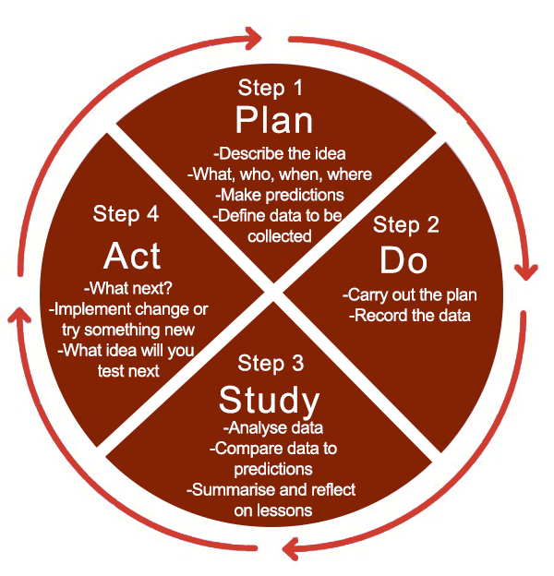
9.4 Continuous Quality Improvement Practices
“Practice Incentives Program Quality Improvement (PIP QI)” by Sydney North Health Network. Used under FDEd (CAN). Mods: recoloured.
Notes:
Step 1: Plan
Describe the idea
What, who, when, where
Make predictions
Define data to be collected
Step 2: Do
Carry out the plan
Record the data
Step 3: Study
Analyse data
Compare data to predictions
Summarise and reflect on lessons
Step 4: Act
What next?
Implement change or try something new
What idea will you test next

Slide 13
9.5 Key Takeaways
Infections Spread Easily Without Control Measures: Infectious diseases are caused by microorganisms like bacteria, viruses, and fungi. In shared environments like healthcare and long-term care facilities, infections can spread quickly, which is why facilities are required to have an Infection Prevention and Control (IPAC) program.
The Chain of Infection Explains How Germs Spread: The chain includes six links: infectious agent, reservoir, portal of exit, mode of transmission, portal of entry, and susceptible host. Breaking any link in the chain can stop the spread of infection.
Personal Protective Practices Reduce Infection Risk: Proper hand hygiene, masking, glove use, and gowns play a vital role in stopping transmission by blocking portals of entry or exit. For example, 20 seconds of hand lathering is key for effectiveness, and masking can reduce spread by up to 79%.
IPAC Programs are Required for Prevention and Safety: An IPAC program aims to reduce illness and death by preventing infections. Key components include surveillance, outbreak response, hand hygiene, incident reporting, training, and maintaining facility cleanliness and standards.
Outbreak Management is Systematic and Coordinated: Effective outbreak management includes confirming the outbreak, implementing control measures, tracking data, and communicating with stakeholders. Nutrition and food service policies must also support infection control during outbreaks.
Continuous Quality Improvement Keeps Practices Effective: Routine practices protect workers and clients from infection, and quality improvement strategies ensure that infection control processes are constantly reviewed and i

