Slide 1
Facilities Management for Foodservice Managers
Chapter 8: Protected Mealtimes and Pleasurable Dining

Slide 2
6.0 Learning Objectives
Explain the rationale behind the pleasurable dining initiative and protected mealtimes.
Discuss Accessibilities for Ontarians with Disabilities Act (AODA).
Outline the principles of universal design.

Slide 3
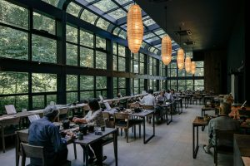
8.1 Pleasurable Dining
Pleasurable dining is a holistic approach to food service in long-term care homes that supports residents’ psychological, social, and nutritional well-being.
It emphasizes that the ability to eat independently is tied to self-worth (Dietitians of Canada, 2019).
The initiative promotes comfort, autonomy, safety, and choice, encouraging a relaxed and social dining environment.
The goal is to help residents feel at ease, enjoy meals, and engage in conversation during mealtime.
Image by Kristian Angelo, Unsplash License.

Slide 4
8.2 Physical Space for Adapted Devices
Table design: Adjustable tables, like the “Titan Series Adjustable Butterfly Table,” support comfort and independence by accommodating different mobility needs.
Accessibility: Dining rooms should allow a minimum of 52 inches between tables for wheelchair access and include storage space for walkers to prevent trip hazards.
Seating: Remove conventional chairs from spaces designated for wheelchair users.
Lighting: Soft, warm, or natural lighting is preferred to reduce confusion and create a calming, home-like environment.
Colour choice: Cool colours like blues and greens foster calmness and conversation, while stimulating colours like red should be avoided in dining spaces.
Noise control: Use music strategically to reduce ambient noise, while being mindful of individual preferences.
Table setting: High-contrast colours (e.g., blue plates on white tablecloths) help those with vision challenges eat independently.
Adaptive tools: Use specialized cutlery (e.g., palm grips, contoured handles) and dishware (e.g., suction bowls, lipped plates) to support clients with mobility or dexterity difficulties.

Slide 5
8.2 The Clients & Staff Education
Client engagement: Host monthly residents’ food committees to incorporate client feedback on menus, cultural and religious preferences, and special occasions.
Personalized meals: Theme meals and special occasion menus can boost joy and make clients feel valued.
Cleanliness matters: A clean dining environment encourages food intake and improves the overall experience.
Staff training: Educate staff on sanitation, customer service, and dementia care to enhance interactions and support positive health outcomes.
Holistic care: Quality nutrition, hydration, and a pleasurable dining environment contribute significantly to clients' quality of life and care.

Slide 6
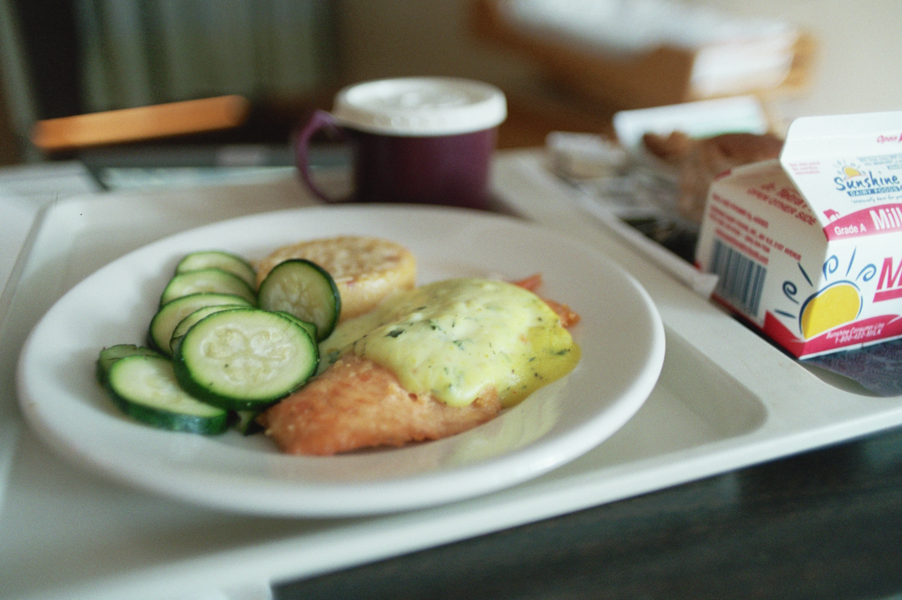
8.3 Protected Mealtimes
Protected mealtimes are times over lunch and dinner when all non-urgent clinical activity stops, ensuring that the patient can consume their meal in peace.
This includes the restriction of visitors during mealtimes.
The results of protected mealtimes have been an increase in patient food intake and a decrease in malnutrition.
Did you know that a malnourished patient is three times more likely to suffer a complication from surgery and five times more likely to die than a nourished patient?
"hospital food" by Sarah Gilbert CC BY-NC-SA 2.0

Slide 7
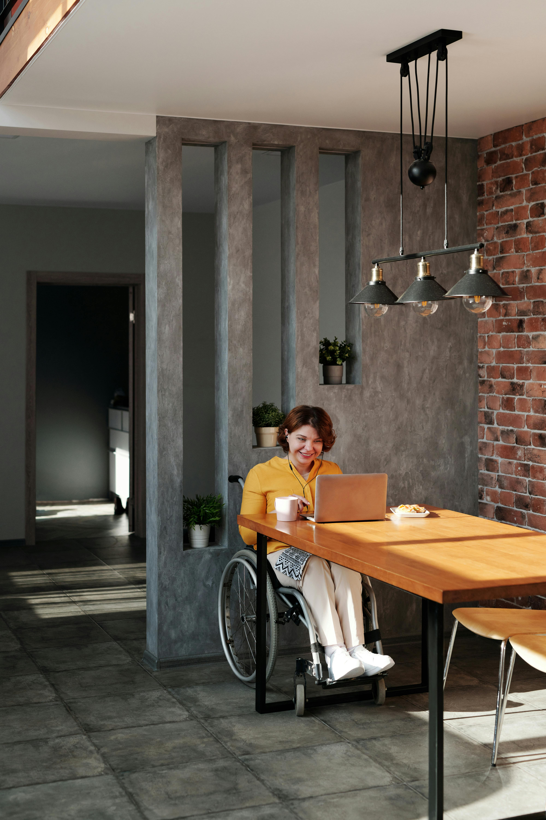
8.4 Universal Design and Accessibility for Ontarians with Disabilities AODA
While much focus is on food service in long-term care and hospitals, dining environments should be considered in all workplaces.
Accessibility legislation seeks to remove barriers for individuals with disabilities and promote inclusivity.
Universal design promotes creating environments and services usable by everyone, without needing adaptations or specialized designs.
Photo by Marcus Aurelius, Pexels License

Slide 8
8.4 Principles of Universal Design
Equitable Use: Usable and appealing to all, avoiding stigma or segregation.
Flexibility in Use: Accommodates different preferences, abilities, and paces (e.g., left- or right-handed use).
Simple and Intuitive: Easy to understand and use, regardless of user experience or cognitive ability.
Perceptible Information: Communicates effectively to users with varying sensory abilities.
Tolerance for Error: Minimizes risks and unintended consequences.
Low Physical Effort: Requires minimal energy to use comfortably.
Size and Space for Use: Ensures comfortable access and use for all users.

Slide 9
8.5 Key Takeaways
Pleasurable Dining Enhances Well-Being: A holistic dining approach supports mental, social, and nutritional health by emphasizing autonomy, dignity, and enjoyment.
Importance of Physical Environment: Comfortable, accessible dining spaces with soft lighting, calming colors, and reduced noise create a home-like atmosphere that supports mobility and relaxation.
Adaptive Tools Foster Independence: Contrasting table settings and specialized dishware help clients with impairments feed themselves, promoting independence.
Client-Centred Engagement: Involving residents in food-related decisions, such as themed menus and planning, promotes cultural relevance, satisfaction, and inclusivity.
Protected Mealtimes Improve Nutrition: Staff training and minimizing interruptions during meals enhance intake and reduce malnutrition, especially for clients with special care needs.
Universal Design Increases Accessibility: Applying Universal Design principles ensures dining spaces are inclusive and barrier-free, supporting users of all abilities.

