Slide 1
Facilities Management for Foodservice Managers
Chapter 7: Legislation

Slide 2
7.0 Learning Objective
Identify legislation related to health and safety, and building codes related to food service.

Slide 3
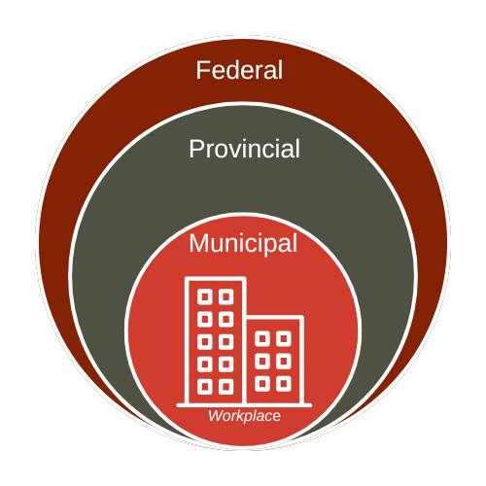
7.1 Workplace Legislation
Municipal Legislation:
Managed by local governments (cities/townships).
Covers water/sewage, property use, fire/police services, waste & recycling.
Reflects community needs and values.
Provincial Legislation:
Governs education, healthcare, environment, civil rights, transportation, and workplace safety.
Tailored to the population within each province.
Federal Legislation:
Oversees national and international matters like immigration, defence, postal services, and criminal law.
Applies to all Canadians.

Slide 4
7.2 Legislation impacting Facilities Management
Federal Level
National Building Code: Requires use of licensed professionals (architects, electricians, plumbers).
Important during new construction or facility relocation.
Provincial Level
Ministry of Health and Long-Term Care Act: Mandates safe, secure environments for residents.
Occupational Health and Safety Act: Ensures safety for staff in the workplace.
Municipal Level
Enforces building codes related to construction and facility features.
Oversees public health, potable water, sewage, garbage, and recycling.
Fire safety programs, including regular drills, must be maintained.
Nutrition and Food Service Managers play a key role in meeting these standards daily.

Slide 5
7.3 Meeting Legislative Requirements via Inspections and Processes
A few of the basic processes required by legislation that influence food services:
Booking a water test
Booking a fire safety inspection
Booking a gas inspection
Managing waste collection

Slide 6
7.3 Booking a Water Test
Potable water must meet safety standards for human consumption.
Required for all food preparation and production activities.
Drinking water systems must be regularly inspected to reduce health risks.
Water testing is mandatory to confirm safety—arranged through the local public health unit.
Ontario Drinking Water Quality Standards

Slide 7
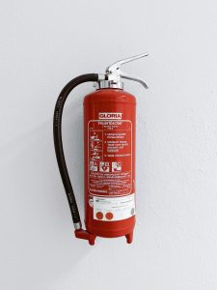
7.3 Booking a Fire Safety Inspection
Municipal Fire Departments are funded and operated by local municipalities, and they provide fire education, safety inspections, and training.
Facilities should coordinate with local departments for inspections and fire drills.
Types of Fire Extinguishers
Class A – Ordinary combustibles (wood, paper, cloth)
Class B – Flammable liquids and gases
Class C – Energized electrical equipment
Class D – Combustible metals
Class K – Cooking oils and fats (Required in kitchens)
Kitchens require class K fire extinguishers.
Image by Ploegerson, Unsplash Licence.

Slide 8
7.3 Booking a Gas Inspection
A licensed gas fitter must inspect all gas appliances.
Gas fitters are trained and regulated by the Technical Standards and Safety Authority (TSSA).
They ensure the safe use of natural gas, propane, and liquid fuels.
Inspections must be scheduled through a licensed gas fitter.
Gaseous Fuels

Slide 9
7.3 Managing Waste Collection
Waste, compost, and recycling are removed weekly or bi-weekly by a contracted company.
Process begins with a Request for Proposal (RFP) to gather service quotes.
Collaboration with the company determines sorting practices and pickup schedules.
Environmental Services or Maintenance usually manage the contract.
Nutrition and Food Service Manager trains staff on proper waste sorting and binning.

Slide 10
7.5 Key Takeaways
Federal legislation covers national concerns like criminal law, immigration, defence, and employment insurance; provincial legislation manages areas like healthcare, education, workplace safety, and public health; municipal legislation governs local matters such as water systems, waste collection, fire safety, and building codes.
Legislation Impacting Facilities Management: At the federal level, the National Building Code requires licensed professionals for new construction, the provincial level enforces safety for residents and staff through health and safety acts, and the municipal level involves daily responsibilities like water safety, fire drills, waste management, and building maintenance.
Facilities must schedule and pass inspections for potable water, fire safety, and gas systems through appropriate local or licensed authorities.
Construction and Facility Standards: Materials must resist bacteria and be easy to clean; proper flooring, lighting, plumbing, ventilation, and storage are required to prevent contamination and ensure safety. Facilities must follow building and health codes and provide sufficient restrooms, sinks, and storage areas.

