Slide 1
Facilities Management for Foodservice Managers
Chapter 6: Emergency Preparedness

Slide 2
6.0 Learning Objectives
Summarize the standards for emergency preparedness for the following situations: power outage, boiled water advisory, shelter in place, violence in the workplace.
Prepare a plan of action for a workplace emergency.

Slide 3
6.1 Emergency Preparedness in the Workplace
A workplace emergency is a circumstance that exposes workers, clients, and other members of the community to a dangerous situation; it can disrupt operations and cause damage to the facility
These emergencies are often unexpected and require an immediate response.
Emergency preparedness includes planning and staff training for effective response.
The main goals are to ensure safety, minimize operational downtime and property damage, and maintain legal compliance.
PREPARED

Slide 4
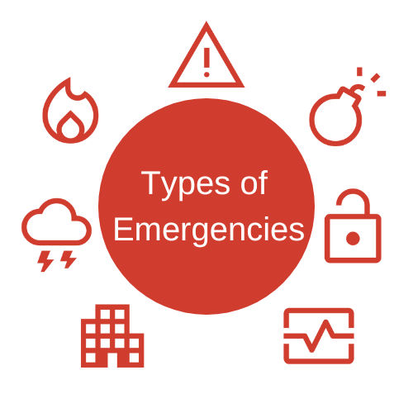
6.2 Types of Emergencies
Fire
Hazardous Materials Spill
Severe Weather
Bomb Threat
Security Threat
Infrastructure problems
Medical Emergency
Notes:
Depending on where the facility is located, you may be at a lesser or greater risk of different types of emergencies. For example, you are more likely to experience a wildfire while working in northern Alberta or an incidence of severe weather in northern Ontario. It is wise to be prepared and have a plan to address many different types of emergencies that could possibly happen in the workplace.
Fire: Rapidly spreading flames that produce heat and deadly smoke; governed by Ontario’s Fire Protection and Prevention Act, 1997.
Hazardous Material Spill: Involves the accidental release of harmful chemicals; identified using WHMIS.
Severe Weather: Includes snowstorms, floods, or tornadoes; may require sheltering in place or evacuation; warnings issued by the Government of Canada.
Bomb Threat: A verbal or written threat of an explosive device that poses serious danger, including risk of death.
Security Threat: Involves potentially violent or unlawful behavior such as aggression, weapons, altercations, or hostage situations.
Infrastructure Problem: Issues with building structures, like burst pipes, roof collapses, or gas leaks.
Medical Emergency: Serious, unexpected health incidents needing immediate care, such as heart attacks or injuries.
4o

Slide 5
6.3 Creating an Emergency Preparedness Plan
Step 1 – Set Objectives
Step 2 – Identify Assumptions
Step 3 - Identify Resources
Step 4 - Communication and Delegation in an Emergency Response Situation
Notes:
Objectives are goals that you and your staff intend to accomplish by following the directions provided by the emergency preparedness plan.
Assumptions are things that are accepted as true.
Make a list of resources available on-site at the workplace that can be used to deal with the emergency.
Think about what needs to be done to manage the emergency

Slide 6
6.4 Implementing Action
Training
Staff training
Test
Test the plan by running a training exercise
Evaluate
Evaluate the drill and debrief
Make
Make improvements to the plan

Slide 7
6.5 Key Takeaways
Emergency preparedness is essential in maintaining a safe and functional workplace. It includes proactive planning, clear communication, and regular staff training to handle unexpected events.
A workplace emergency can take many forms, such as fires, hazardous material spills, medical emergencies, severe weather, bomb threats, or infrastructure failures. Each requires a tailored response plan.
An Emergency Preparedness Plan should include defined objectives, assumed conditions and available resources, communication strategies, clear delegation of roles, and a documented and easily accessible action plan.
Types of emergencies must be identified based on geographic risk and organizational context (e.g., wildfires in Alberta vs. snowstorms in Ontario).
Training and drills help staff prepare for emergencies by allowing them to rehearse roles and responsibilities.
Collaboration with external resources (e.g., emergency responders, public health inspectors, property restoration companies) is key for effective response and recovery.
Communication during emergencies must be timely and clear, both internally and with the public or clients affected by the event.

