Slide 1
Facilities Management for Foodservice Managers
Chapter 5: Sustainable Practices

Slide 2
5.0 Learning Objectives
Recognize types of energy conservation and waste management systems available for use in food service.
Prepare a presentation that supports the implementation of an energy conservation or waste management program.

Slide 3
5.1 What is Sustainability?
Sustainability is meeting present needs without compromising future generations' ability to meet theirs (Brundtland Commission, 1987).
Social Sustainability: Ensures universal human rights, access to resources, and community well-being.
Economic Sustainability: Supports global communities' independence and access to financial and material resources.
Environmental Sustainability: Maintains ecological balance by consuming natural resources at a replenishable rate.
“Sustainability and its 3 Dimensions” by B. Purvis, Y. Mao, & D. Robinson, CC BY-SA 4.0. Mods: Cropped & recoloured

Slide 4
5.2 Sustainability in Food Service
In food services, there are many opportunities to engage in sustainable practices:
Energy conservation
Managing and reducing food waste
Composting
Water conservation
Recycling
Reducing packaging organic chemicals
Purchasing locally to reduce the carbon footprint of transportation of goods.
Recycle renew, CC BY 4.0

Slide 5
5.2 Energy Conservation
Food service facilities use five times more energy per square foot than other commercial buildings, presenting opportunities for energy conservation.
Benefits of Energy Conservation: Reduces costs, lowers carbon footprint, conserves natural resources, and aligns with sustainability principles.
Lighting Efficiency: Switching to LED lighting can cut energy use by up to 90%; occupancy sensors help reduce unnecessary energy consumption.
Energy-Efficient Equipment: Upgrading to Energy Star-rated appliances ensures lower energy use and reduced emissions.
HVAC Optimization: Since HVAC accounts for up to 35% of energy costs, regular maintenance, smart thermostats, proper airflow, and heat pumps can improve efficiency.
Additional Energy-Saving Strategies: Use window shades, keep thermostats away from heat sources, and install demand hoods that activate ventilation only when needed.

Slide 6
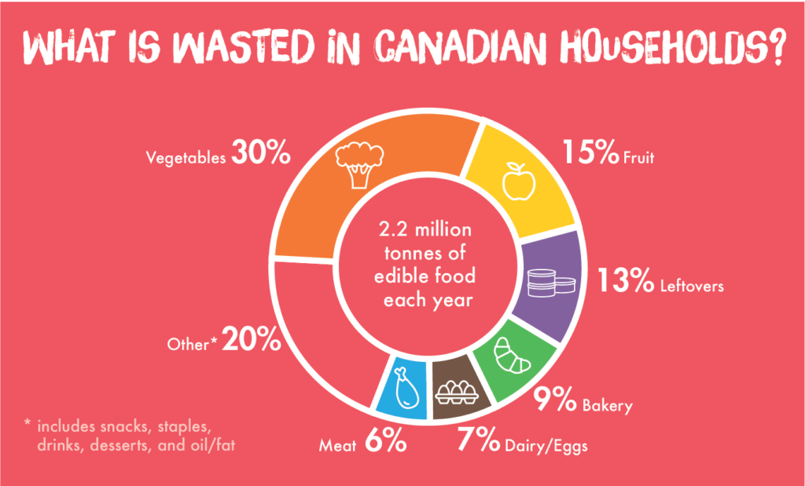
5.2 Managing and Reducing Food Waste
Notes:
Food waste is food that is discarded instead of consumed even though the food meets the standard for human consumption. This includes food that is left on plates served to clients, food leftover from service that was not served to clients and food that spoils in storage before it can be used in production.

Slide 7
5.2 Strategies for Food Waste Prevention
Prevention strategies include preparing appropriate portions, proper food storage, and demand-based purchasing, while management focuses on repurposing leftovers.
Forecasting for Accurate Preparation
Proper Storage & Demand Purchasing
Menu Flexibility & Leftover Utilization
Staff Training & Engagement
Notes:
Forecasting for Accurate Preparation: Using past data, such as cyclic menus, helps predict food demand, reducing waste while ensuring sufficient portions with a small margin for error.
Proper Storage & Demand Purchasing: First In/First Out (FIFO) rotation, labeling, and purchasing only necessary amounts prevent spoilage while ensuring compliance with emergency food stock regulations.
Menu Flexibility & Leftover Utilization: Adapting menus to use available ingredients and repurposing untouched leftovers for staff meals or donations can further reduce waste.
Staff Training & Engagement: Educating staff on sustainability, waste management, and efficient practices fosters a culture of food conservation and responsible management.

Slide 8
5.3 Implementing a Sustainability Program
Step 1 – Identify the Current Baseline
Step 2 – Research Best Practices and Engage Stakeholders
Step 3 -Define the Goals of the Project
Step 4 -Develop the Plan
Step 5 -Create a Road Map
Step 6 -Communicate and Gain Approval to Launch Program
Step 7 – Monitor and Evaluate the New Sustainability Program

Slide 9
5.4 Key Takeaways
Pillars of Sustainability: Sustainability is defined by the Brundtland Commission as meeting present needs without compromising future generations. It is built on three pillars: Social Sustainability, Economic Sustainability, and Environmental Sustainability.
Sustainability in Food Services: Food service operations can contribute to sustainability by conserving energy, reducing waste, composting, recycling, minimizing packaging, using organic products, and purchasing locally.
Energy Conservation and Management: Food services consume five times more energy per square foot than other commercial buildings and strategies for conservation include upgrading to ENERGY STAR equipment, improving HVAC efficiency, using LED lighting, and implementing smart thermostats and demand hoods.
Food Waste Reduction Strategies: Food waste prevention methods include accurate forecasting, proper storage, demand purchasing, and menu flexibility.
Reducing Carbon Footprint through Local Purchasing: Transporting food contributes significantly to greenhouse gas emissions, so buying local food reduces transportation emissions and supports sustainability goals.

