Slide 1
Facilities Management for Foodservice Managers
Chapter 4: Equipment Maintenance

Slide 2
4.0 Learning Objectives
Identify Standard Operating Procedures (SOPs), safety and Hazard Analysis Critical Control Point (HACCP) procedures for common kitchen equipment.
Differentiate between corrective maintenance and preventative maintenance.
List the elements of a preventative maintenance program.

Slide 3
4.1 Common Equipment in Food Service Production
Ranges
Walk-in Cooler
Rational iCombi Oven
Steamer
Convection oven
Stand mixers
Conveyor Dishwashers
Ice machines
Meat slicer
Blixer
Steam table
Notes:
Ranges combine a stovetop cooking surface,which could be an open flame or solid griddle surface, and an oven.
Walk-in Cooler is a large enclosed insulated and refrigerated storage space. Most facilities will have walk-in coolers and walk-in freezers.
Rational iCombi Oven functions as a steamer, convection or conventional oven. The unit is fully sealed so the humidity levels, air speed and temperature can be controlled during cooking. This oven has a computer interface which allows cooking programs to be preset. For example, a preset could be set up for cooking Creme Brule.
Steamer uses high temperature steam as the cooking method for foods. Great for cooking vegetables quickly.
Convection Oven use a fan-forced hot air circulation to decrease the required cooking time and promote consistent even heat distribution.
Stand Mixers has a large capacity bowl and different attachments, whisk, paddle and dough hook, that can be used to mix large quantities of doughs, mousses, and puddings.
Conveyor Dishwashers allow multiple racks of dishes to be washed and sanitized efficiently.
Ice Machines make ice cubes.
Meat Slicer used to slice meats and cheeses.
Blixer used to texturize foods.
Steam Table provides heat to keep hot foods hot for service.

Slide 4
4.1 Standard Operating Procedures (SOPs)
Guidance for Staff: SOPs provide clear, step-by-step instructions for operating equipment safely and efficiently.
Training & Communication Tool: They serve as a key resource for staff training and preventative maintenance planning.
Facility Management Support: Written SOPs help maintain safety, cleanliness, and overall maintenance standards.
Workplace Safety & Business Continuity: Proper training on SOPs reduces injuries and accidents, ensuring consistent operations and quality service.

Slide 5
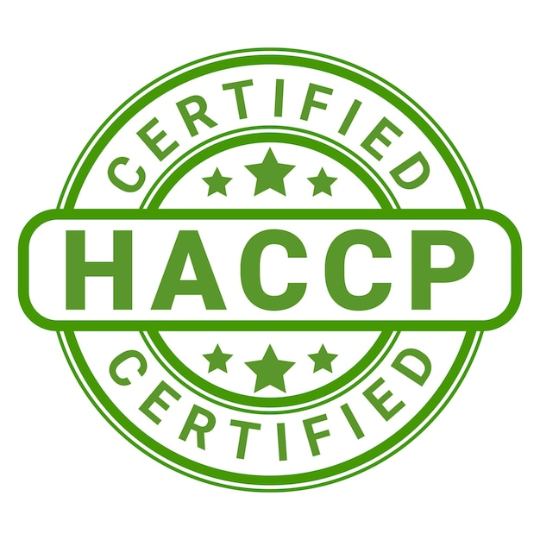
4.2 Hazard Analysis Critical Control Point (HACCP)
Purpose of HACCP: Identifies and controls hazards in food production to ensure safety.
Types of Hazards: Physical (e.g., broken glass), chemical (e.g., contamination), and biological (e.g., harmful microorganisms).
Nutrition and Food Service Managers should reference HACCP in the preventative maintenance plan.
Image by AbundanceGuy, Freepik License

Slide 6
How HACCP Works
Identify
Identify hazards.
Establish
Establish Critical Control Points (CCPs).
Set
Set CCP limits to prevent, remove, or reduce hazards.
Monitor
Monitor processes to ensure compliance.
Take
Take corrective action if needed.
Document
Document all actions taken

Slide 7
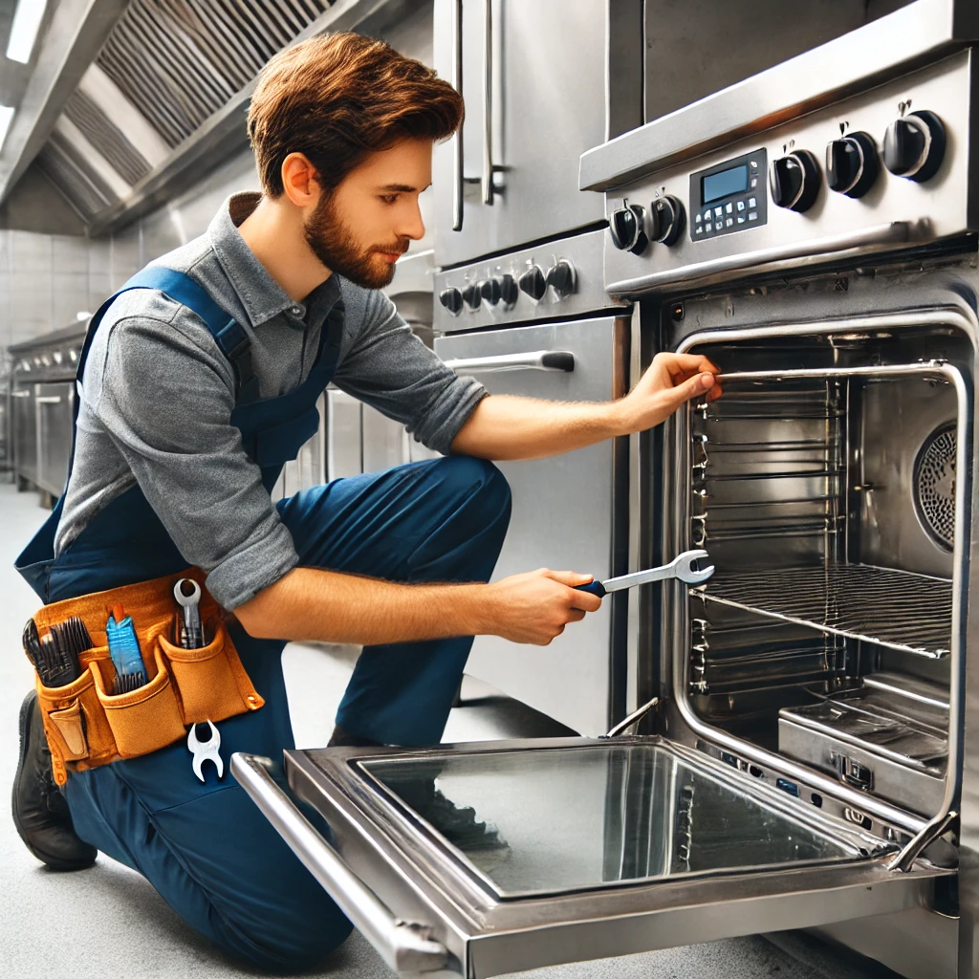
4.3 Corrective Maintenance versus Preventative Maintenance
Corrective Maintenance: Fixes equipment after it breaks down, preventing safety issues and operational disruptions.
Preventative Maintenance: Regular inspections, cleaning, lubrication, and part replacements to avoid breakdowns and extend equipment life.
Facilities Management Support: A proactive maintenance plan ensures business continuity, safety, cleanliness, and effective equipment management.
Open AI. (2025). ChatGPT 4o.
Notes:
Prompt: please create an image of someone fixing a commercial kitchen oven

Slide 8
4.4 Developing and Maintaining a Preventative Maintenance Program
Step 1: Identify Assets
Step 2: Document Standard Operational Procedures for each piece of equipment
Step 3: Establish Maintenance Routines and Schedules
Step 4: Identify contact information for outside contractors
Step 5: Audit and Corrective Actions
Notes:
Identify assets to be included in the preventative maintenance program by taking a physical inventory of the equipment in the facility. Include the following information in the physical inventory: Equipment Name, Serial No., Description and Location.

Slide 9
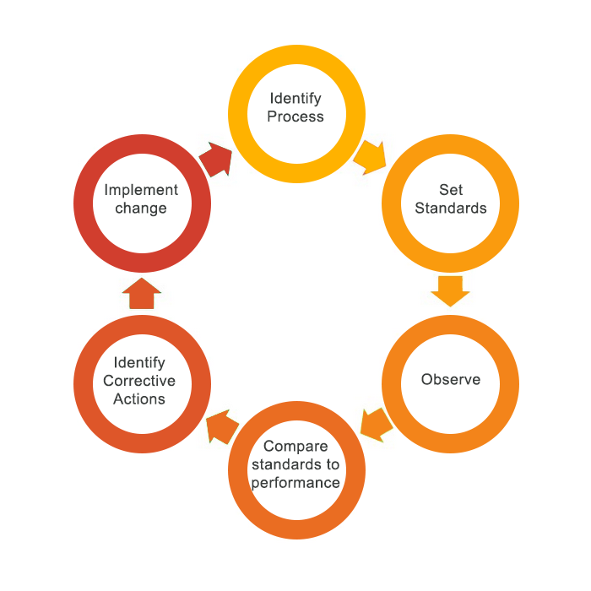
Step 5: Audit and Corrective Actions

Slide 10
4.5 Staff Training on the use of Equipment
Importance of Training: Proper staff training on commercial equipment reduces accidents, improves efficiency, enhances product quality, and ensures compliance with health and safety regulations.
Training Plan: Should cover standard operation, cleaning, maintenance, emergency procedures, and required personal protective equipment (PPE).
Implementation: Training can be as simple as senior staff demonstrating equipment use to new employees.
Lock-Out/Tag-Out Awareness: Staff should understand these procedures and their role in workplace safety.

Slide 11
4.6 Key Takeaways
Commercial Kitchen Equipment consists of various specialized appliances, such as ranges, convection ovens, steamers, and mixers, which are essential for efficient food service production.
Standard Operating Procedures (SOPs) are clear, step-by-step instructions that help staff operate equipment safely and effectively, reducing workplace injuries and ensuring consistency.
Hazard Analysis Critical Control Point (HACCP) is a food safety system that identifies and controls physical, chemical, and biological hazards at critical points in food production.
Developing a Preventative Maintenance Program should include identifying assets, documenting SOPs, scheduling maintenance, contracting certified professionals, and conducting audits.
Employees must be trained on equipment operation, safety procedures, and lockout/tagout protocols to ensure compliance with health and safety standards.
Proper maintenance and safety protocols support operational efficiency, minimize disruptions, and ensure regulatory compliance in food service establishments.

