Slide 1
Facilities Management for Foodservice Managers
Chapter 3: Housekeeping and Laundry

Slide 2
Learning Objectives
Recognize the key elements required to manage a successful custodial program.
Discuss Personal Protective Equipment and the use of Chemicals in the workplace.
Evaluate a cleaning and sanitation program.

Slide 3
3.1 Housekeeping and Laundry
Importance of Housekeeping & Laundry:
Critical for maintaining cleanliness and safety in healthcare and food service environments.
Plays a key role in infection prevention and control.
Infection Prevention & Control:
Defined by Public Health Ontario as evidence-based practices to reduce microorganism transmission in healthcare settings.
Laundry Operations & Disease Prevention:
Involves collecting, washing, drying, folding, and distributing linens.
Essential for removing dirt and bacteria to prevent infections.
Notes:
Nutrition and Food Service Managers may oversee housekeeping, laundry, and custodial operations, especially in smaller facilities.

Slide 4
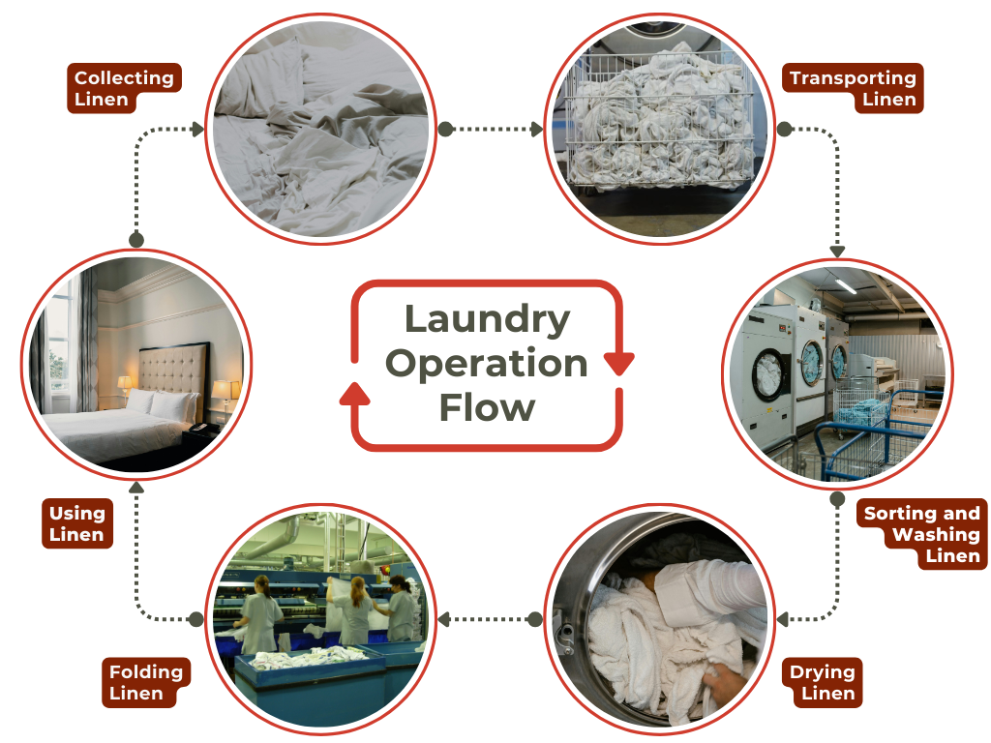
3.1 Laundry Operation Flow
Collecting Linen
Transporting Linen
Sorting and Washing Linen
Drying Linen
Folding Linen
Using Linen
Notes:
Cleaning refers to physical removal of dirt and debris. This is accomplished with water, detergents and mechanical action, such as scrubbing which requires mechanical force from the person’s hands and shoulders.
Sanitizing is the application of a disinfectant to surfaces whose purpose is to kill harmful microorganisms, like Influenza (the flu) and Staphylococcus (staph infections).

Slide 5
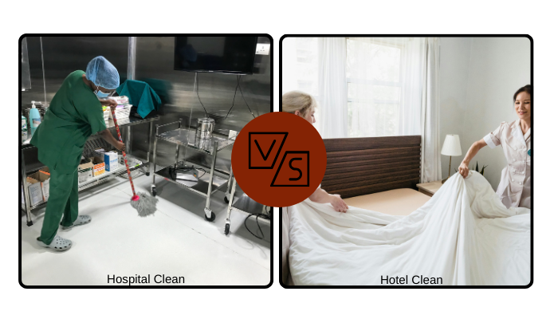
3.2 Hotel Clean vs Hospital Clean
Health care facilities may require two different levels of clean depending on what is happening in the area: hotel clean and hospital clean.
Hospital clean (disinfected) is not achievable unless there has already been a hotel clean (tidy) established.
Notes:
Hotel Clean
Floors and baseboards are free of stains, visible dust, spills and streaks.
Walls, ceilings and doors are free of visible dust, gross soil, streaks, and handprints.
All horizontal surfaces are free of visible dust or streaks (including furniture, window ledges, overhead lights, phones, picture frames, and carpets).
Bathroom fixtures, including toilets, sinks, tubs, and showers, are free of streaks, soil, stains, and soap scum.
Mirrors and windows are free of dust and streaks.
Dispensers are free of dust, soiling, and residue and replaced/restocked when empty.
Appliances are free of dust, soiling and stains
Waste is disposed of appropriately
Items that are broken, torn, cracked or malfunctioning are replaced.
Hospital Clean is Hotel Clean Plus…
High-touch surfaces in patient care areas are cleaned and disinfected with a hospital-grade disinfectant (product has a DIN number).
Medical equipment is cleaned and disinfected between patients.
Clean first and then disinfect: organic material deactivates disinfectant solutions.
Proper contact time: different products require varying ‘wet’ times to kill microorganisms.
Proper mixture: the concentration is strong enough to clean but not so strong to be harmful to staff and patients.
Frequent changes in cleaning equipment and solutions.
Use of the proper Personal Protective Equipment (PPE) to protect health care workers.

Slide 6
3.3 Chemicals and Personal Protective Equipment
Common disinfectant chemicals:
Disinfectant | Expectations
Alcohols – 60-90% ethyl or isopropyl alcohol | Lengthy contact time
Chlorines – most common Bleach | Harmful in terms of human exposure
Phenolics | Can also be used as a sterilization agent
Quaternary Ammonium Compounds (QUATS) | Safe Choice in terms of human exposure / short contact time
Iodophors: Iodine, detergent and water | Water temperature sensitive. Leaves an orange/brown residue
Accelerated Hydrogen Peroxides | Cost-effective, environmentally friendly

Slide 7
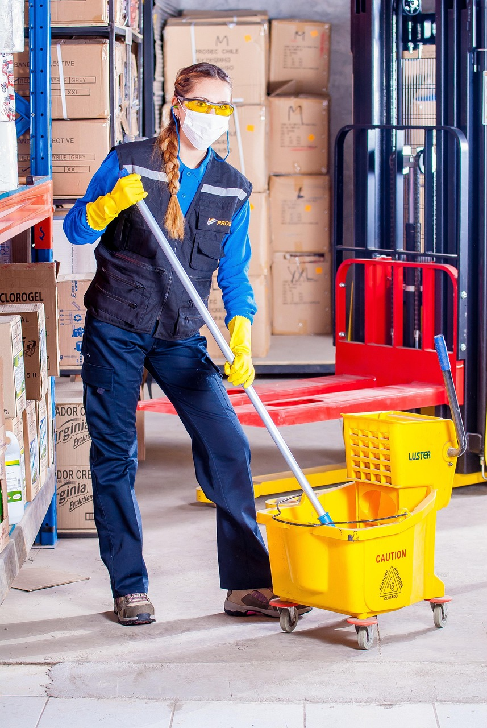
3.3 Personal Protective Equipment (PPE)
Reduces exposure to physical, chemical, ergonomic, and biological hazards but does not eliminate them.
PPE minimizes injury risk when used correctly but does not remove hazards
Common PPE in laundry and housekeeping includes gloves, aprons, eyewear, and masks to protect workers from chemicals and contaminants.
Image by voltamax, Pixabay License.

Slide 8
3.4 Managing a Custodial Program
Managing a custodial program includes three steps:
Step 1
The plan
Step 2
Step 3
Quality Assurance
Education and staff training

Slide 9

3.4 Step 1: The Plan
Evaluate facility size, floor types, room types, fixtures, and cleaning equipment.
Determine staffing needs and task assignments based on net cleanable square footage.
Share the finalized plan with staff for effective implementation.
Image by Mohamed Hassan , Public Domain

Slide 10
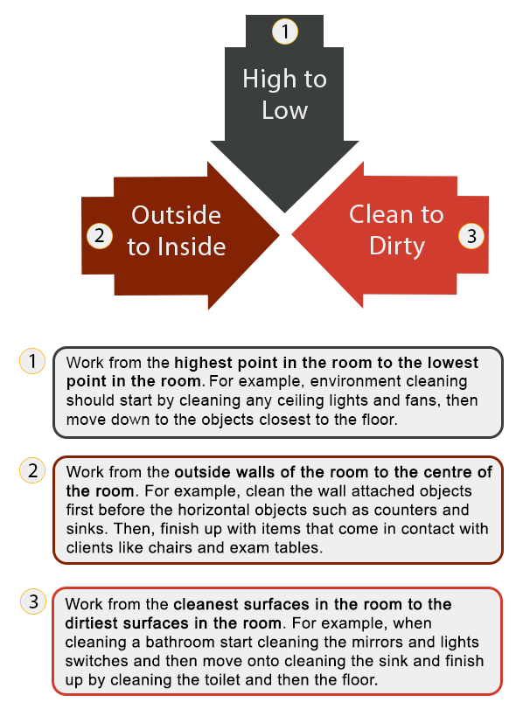
3.4 Step 2: Education and Staff Training
Train staff on cleaning procedures (top-to-bottom, clean-to-dirty approach).
Provide WHMIS training for handling chemicals and disinfectants.
Ensure proper use of personal protective equipment (PPE).

Slide 11
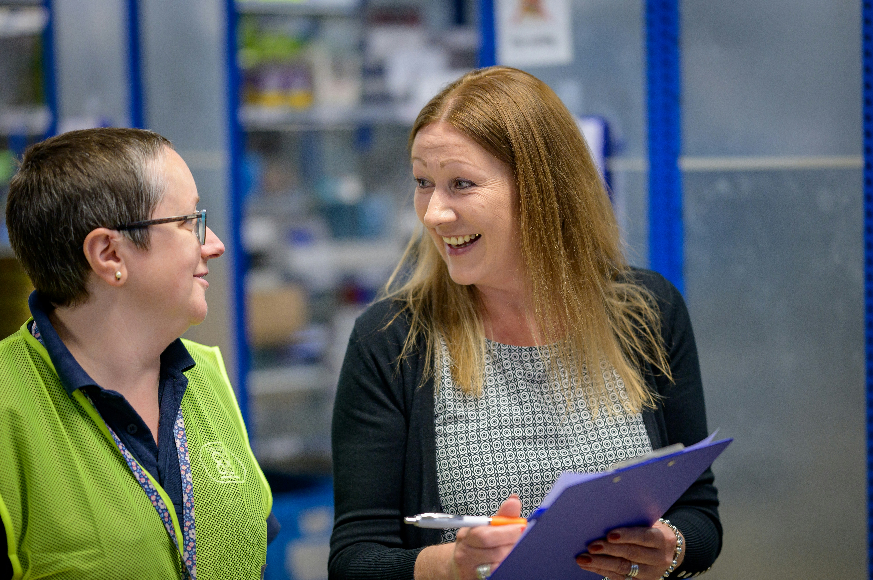
3.4 Step 3: Quality Assurance
A quality assurance process ensures standards are met through auditing and corrective actions.
Auditing: establishes expectations, inspects outcomes, and ensures staff compliance.
Corrective Actions: Identify and address issues, such as workload adjustments or process improvements.
Decision-Making: Audits may reveal underlying problems that require investigation and strategic solutions.
Photo by Centre for Ageing Better, Unsplash License

Slide 12
3.5 Managing a Laundry Program
Step 1
The Collection Process
Step 2
Partition the Laundry Room
Step 3
Use Hot Water Washes
Step 4
Label Chemicals
Step 5
Distribution of Clean Linens
Notes:
Step 1 The Collection Process
Step 2: Partition the Laundry Room
Step 3: Use Hot Water Washes
Step 4 Label Chemicals
Step 5 Distribution of Clean Linens

Slide 13
3.6 Key Takeaways
Nutrition and Food Service Managers often oversee housekeeping and laundry services in smaller facilities, and housekeeping ensures cleanliness and sanitation, while laundry prevents infection by properly handling linens.
Infection Prevention and Control follows evidence-based practices to reduce disease transmission in healthcare settings.
Hotel Clean is basic tidying and general cleaning while hospital clean is a more thorough disinfection process necessary for healthcare environments.
Proper contact time and dilution are crucial for cleaner effectiveness.
Personal Protective Equipment (PPE) (e.g., gloves, masks, eyewear) is essential when handling chemicals and contaminated materials.
Custodial programs require planning (e.g., assessing square footage, equipment, and staff needs), and operations follow protocols. For example, laundry operations have protocols like sorting contaminated linens, using correct wash temperatures and maintaining equipment for efficiency.

