Slide 1
Facilities Management for Foodservice Managers
Chapter 2: Production Systems, Design, and Workflow

Slide 2
Learning Objectives
Explain the concept of workflow analysis.
Describe the importance of facility design in maintaining a safe, sanitary, and secure environment.
Evaluate the positive and negative aspects of each type of food production system.
Discuss strategies or ideas on how to improve ergonomics in the workplace.

Slide 3
2.1 What is Workflow?
Workflow is the “sequence of steps involved in moving from the beginning to the end of a working process”.
Workflow analysis is the evaluation of processes through observation of the tasks.
“Food Service Workflow” by Martin Torres, CC BY-NC-SA 4.0
Notes:
The big picture of food service workflow involves the series of tasks involved in meal service, from receiving raw food products to cleaning up and disposing of waste after the meal has been served to the client.
To make workflow analysis more manageable, observations can be compartmentalized into smaller tasks, such as receiving food and storing it or making soup.

Slide 4
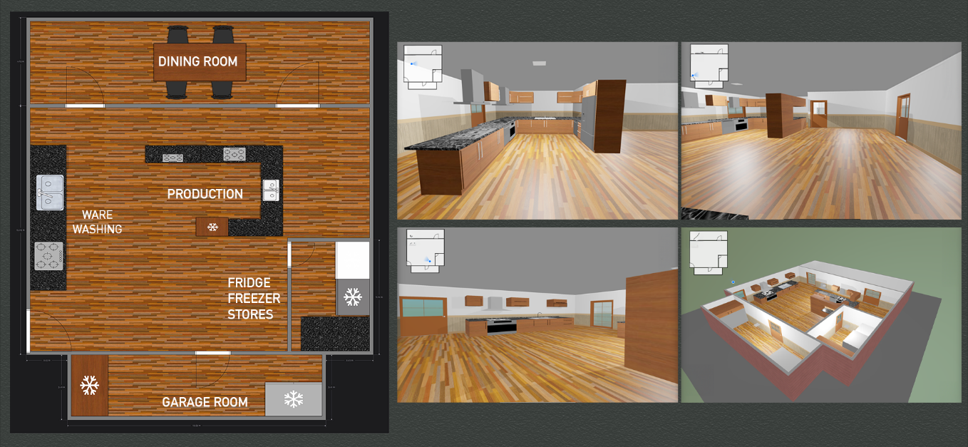
2.2 Facility Design
Facility Design involves “the process of planning and creating the physical features and architectural elements of a building or structure, with the aim of improving functionality and aesthetic appeal”.
Image by Martin Torres, CC BY-NC-SA 4.0
Notes:
Facility Design has an impact on other facilities management goals, such as security, and safety. Design also impacts efficiency. The ability of the staff to navigate the physical structure and complete tasks in a timely manner without excess waste is often dictated by facility design.

Slide 5
2.3 Food Production Systems
Food productions systems consist of: Inputs (equipment, food, skilled staff) are used to create outputs (meals).
There are four main types:
Conventional
Ready-Prepared (Cook-Chill)
Commissary (Centralized Kitchen)
Assembly/Serve (Tray Line)

Slide 6
2.3 Conventional
Process Overview:
Menu items are prepared in the same facility where they are served, often starting from raw ingredients.
Advances in food production have introduced some ready-prepared components.
Perception & Quality:
Familiarity with this system leads to a perception of higher quality.
Actual quality depends on staff skill level, ingredient quality, and process efficiency.

Slide 7
2.3 The Pros and Cons of a Conventional Kitchen
Advantages | Disadvantages
Quality Control over raw ingredients and recipe Unique to operation (your kitchen) Flexibility – not dependant on commercially prepared items, can make changes to recipe or substitutions Economical – Can purchase seasonally, take advantage of sales Requires less freezer space Adaptable to regional, ethnic, or individual preferences | Stressful workday due to peak demand periods / uneven workload Difficult to schedule because it requires skilled staff for specific tasks

Slide 8
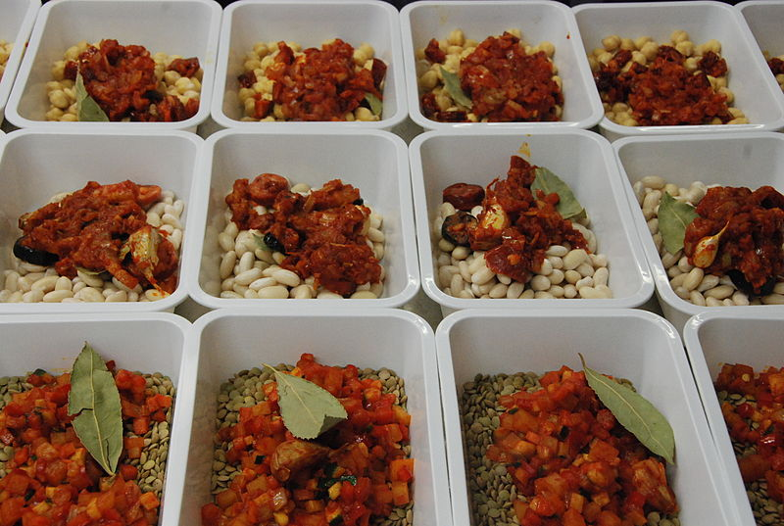
Ready-Prepared or Cook-Chill
Process Overview:
Menu items are prepared in large quantities, chilled, stored, and later rethermalized (heated to a safe serving temperature).
Separation between preparation and service is the key characteristic of Cook-Chill.
Steps in Cook-Chill Food Preparation:
Procurement → Preparation & Initial Heating → Chilling & Storage → Portioning & Assembly → Cold Holding & Distribution → Rethermalization & Service.
Photo by Jorge de Andrés, CC BY 3.0

Slide 9
2.3 The Pros and Cons of a Ready-Serve/Cold-Chill Kitchen
Advantages | Disadvantages
Control over workload – reduction in peak stressful periods Easier to schedule Decreased employee turnover due to less stress Improved nutrient retention | Increased cost due to increased need for fridge and freezer space and cost of Rethermalization equipment Food safety concerns and an increase in Critical Control Points (CCP) in processing Recipes need to be scaled up and modified

Slide 10
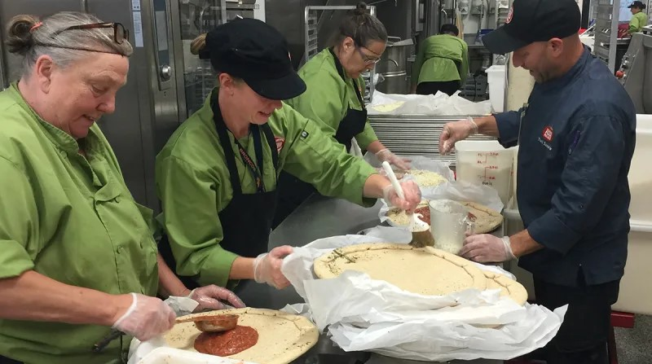
2.3 Commissary Centralized Kitchen
Process Overview:
Menu items are prepared in a centralized kitchen and transported to multiple sites for final preparation and service.
Example: Boulder Valley School District in Colorado, serving over 40 schools from a central kitchen.
Photo by Randy Barber, Boulder Valley School District,

Slide 11
2.3 The Pros and Cons of a Commissary Centralized Kitchen
Advantages | Disadvantages
Cost savings due to large volume production and reduced labour cost Less skilled labour required | Food safety concerns to an increase in Critical Control Points (CCP) in processing and transportation Requires additional vehicles for transportation/delays in deliveries due to traffic or weather Recipes need to be scaled up and modified

Slide 12
2.3 Assembly/Serve
Process Overview:
Also called the "cookless kitchen" as most food is pre-prepared and procured from commercial food companies (e.g., Nestlé, Kraft Heinz).
Food service resembles a factory assembly line, with staff assembling trays rather than cooking.

Slide 13
2.3 The Pros and Cons of an Assembly/Serve Kitchen
Advantages | Disadvantages
Economical – saves on skilled labour cost Lower procurement costs Less waste Better portion control Decreased equipment cost/space cost Control over workload – reduction in peak stressful periods Easier to schedule | Limited selection and flexibility for substitutions and change Higher cost of menu items, soup is a good example Requires consistent evaluation of quality, portion sizes and customer satisfaction Additional freezer space required Managing materials, packaging

Slide 14
2.4 Ergonomics in Food Service
Ergonomics is the study and design of physical spaces to ensure safe and efficient human interaction.
Poor ergonomics can lead to work-related musculoskeletal disorders (WMSDs), such as those outlined by the Canadian Centre for Occupational Health and Safety.
Prevention of WMSDs:
Eliminate hazards at the source by reducing repetitive work patterns.
Implement job design strategies like mechanization, job rotation, and teamwork.
Improve workplace layout, tool and equipment design, and work practices when repetitive tasks cannot be avoided.

Slide 15
2.4 Job & Workplace Design
Job Design | Workplace Design
Mechanization | Tools and Equipment Design
Job Rotation | Work Practices and Training
Job Enlargement and Enichment
Teamwork
Notes:
Mechanization
Automating repetitive tasks can help reduce strain and prevent WMSDs.
Where mechanization is not feasible, alternative solutions should be considered.
Job Rotation & Enlargement
Job Rotation: Workers switch tasks to engage different muscle groups, preventing strain.
Job Enlargement & Enrichment: Increases task variety and worker autonomy, reducing monotony and strain.
Teamwork
Encourages task variety and distributes physical workload more evenly.
Teams share planning and task allocation to minimize repetitive strain.
Workplace Design
The workspace should be designed to fit the worker, reducing physical effort.
Adjustable workstations allow for sitting, standing, or a mix of both to improve ergonomics.
Tools & Equipment Design
Well-designed tools reduce the force needed to complete tasks.
Proper maintenance and use of jigs or fixtures can decrease muscle strain.
Work Practices & Training
Workers should receive training on workstation adjustments, rest breaks, and posture awareness.
Supportive work environments with good communication enhance job satisfaction and reduce WMSD risks.
4o

Slide 16
2.5 Key Takeaways
Workflow is the process of steps made to move from the start to the end of work.
Workflow Analysis is the task-based analysis of workflows to understand and improve them.
Facility Design makes use of workflow analysis to improve the functionality and aesthetic appeal of a workspace.
Food Production Systems differ in their inputs (equipment, food, staffing, transportation requirements) and have different requirements, benefits, and drawbacks.
Ergonomics aims to analyze and improve the efficiency and safety of a workspace.

