Slide 1
Facilities Management for Foodservice Managers
Chapter 1: Introduction to Facilities Management

Slide 2
Learning Objectives
Define Facilities Management
Understanding the concept and scope of facilities management
Match Tasks with Professionals
Identifying the right professionals for specific facilities management tasks in food service
Impact of Strategic Planning
Recognizing the role of strategic planning in effective facilities management
Responsibilities of Nutrition and Food Service Manager
Summarizing key elements managed by a Nutrition and Food Service Manager
Notes:
In this chapter, learners will define facilities management, match tasks with professionals, recognize the impact of strategic planning, and summarize the responsibilities of a Nutrition and Food Service Manager.
Original Content:
1.0 Introduction
Learning Objectives
At the end of this chapter, learners should be able to:
● Define facilities management
● Match the facilities management tasks with the professional responsible for the execution of the task in food service.
● Recognize how strategic planning impacts facilities management.
● Summarize elements of facilities management that would be the responsibility of a Nutrition and Food Service Manager in the workplace.

Slide 3

1.1 Facilities Management
What is facilities management?
  Maintenance and efficient operation of buildings.
  Ensures comfort, safety, security, and efficiency.
  Focuses on place, processes, and people.
Photo by MJ Idzerda CC BY-NC-SA
Notes:
Facilities management involves maintaining and operating buildings efficiently. It ensures comfort, safety, security, and efficiency for the place, processes, and people.
Hard services refer to physical infrastructure that needs management and maintenance. This includes equipment, building systems like HVAC, utilities such as lighting, and physical structures like windows and roofs.
Soft Services include non-physical elements which focus on creating a productive, safe and comfortable environment for the staff. These services include security, custodial, catering, and waste management.

Slide 4
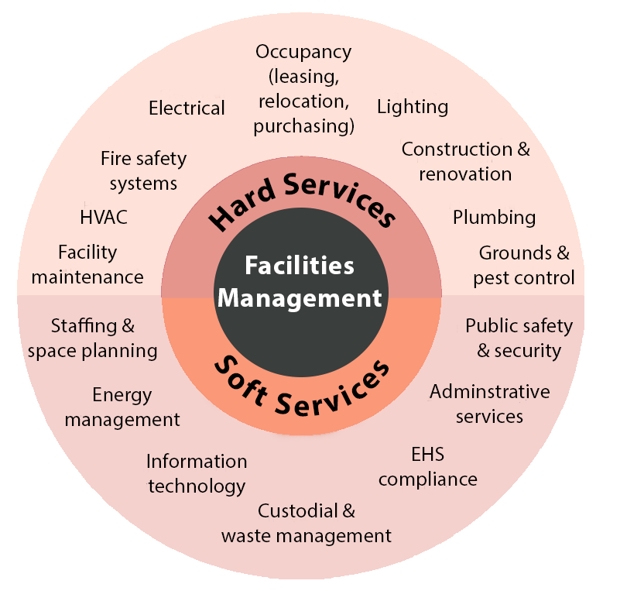
1.1 Facilities Management
Hard Services​:
  Physical infrastructure requiring management​
  Includes equipment and building systems​
Soft Services:
  non-physical elements
  include security, custodial, catering, and waste management.
Notes:
Definition of Hard Services
Physical infrastructure requiring management
Includes equipment and building systems
Examples of Hard Services
Heating, Ventilation, and Air Conditioning (HVAC)
Utilities such as lighting
Physical structures like windows and roofs

Slide 5
1.1 FM Chart of Services
FM Service | Example of Service Task
Property Services | Building Maintenance, Repairs to Infrastructure or Preventative Maintenance Activities
Security Services | Security Guards, Closed-Circuit Television CCTV, Fire Protection Systems, Locked Entrance or Code Systems for Entrance
Health and Safety | Joint Health and Safety Committee, Ergonomic Equipment, Safety Policy and Protocols for Equipment Use such as Lock Out /Tag Out
Cleaning / Housekeeping | Routine Cleaning, Deep Cleaning, Special Cleaning such as Hood Vents
Contract Services Management | Plumbers, Heating, Ventilation and Air Conditioning, Electricians, Waste Management, Hood Cleaning, Grease Trap Cleaning,
Strategic Planning | Participating in the Process that determines Objectives (tasks) to be completed with a specific timeline in the future (usually a five-year plan)
Notes:
This slide presents the Facilities Management Chart of Services, as referenced in a YouTube video by the International Facility Management Association.

Slide 6

1.2 FM Professionals
Core Daily Interactions
  Custodians
  Security personnel
  Maintenance team members
  Waste disposal workers
Specialized Professionals (Less Frequent Interactions)
  Architects
  Engineers
  Skilled trades (plumbers, electricians, gasfitters, millwrights, HVAC)
  Interior designers
Photo by Cottonbro Studio, Pexels License.
Notes:
Facilities management involves various professionals. Daily interactions include custodians, security personnel, maintenance team, and waste disposal workers. Less frequent interactions involve architects, engineers, skilled trades, interior designers, and service contractors.
Core Daily Interactions:
Custodians: Maintain cleanliness and disinfect high-touch surfaces.
Security Personnel: Monitor building access, provide emergency response, and ensure safety.
Maintenance Team: Conduct safety inspections, installations, and repairs.
Waste Disposal Workers: Manage garbage, recycling, composting, and septic waste.
Specialized Professionals (Less Frequent Interactions):
Architects & Interior Designers: Design functional, aesthetically pleasing spaces.
Engineers: Focus on structural integrity, electrical, and sewage systems.
Skilled Trades (Plumbers, Electricians, HVAC Technicians, Gasfitters, Millwrights): Provide essential maintenance and repairs, often as external contractors.

Slide 7
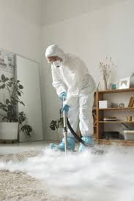
1.2 Contract Services
Pest Control Services
  Educate and inspect premises
  Create long-term pest control plans
  Prevent infestation of rodents, bugs, and insects
Hood Vent Cleaning
  Remove grease and debris from exhaust systems
  Essential for routine maintenance
Grease Trap Cleaning
  Routinely contracted out to professionals
Photo by Michelangelo Buonarroti, Pexels License
Notes:
Other contract services include pest control, hood vent cleaning, and grease trap cleaning. Pest control professionals inspect and create long-term plans. Hood vent cleaning removes grease from exhaust systems. Grease trap cleaning is routinely contracted out.
Original Content:
Other contract services include pest control, hood vent cleaning and grease trap cleaning. Pest control professionals educate, inspect and create a plan for long term pest control at the premise. Long term pest control supports food safety by preventing the infestation of rodents, bugs and other insects. Hood vent cleaning services work to remove grease and debris from the exhaust system. An important part of routine maintenance that may need to be contracted out. Grease trap cleaning is a service that is routinely contracted out to service professionals.

Slide 8
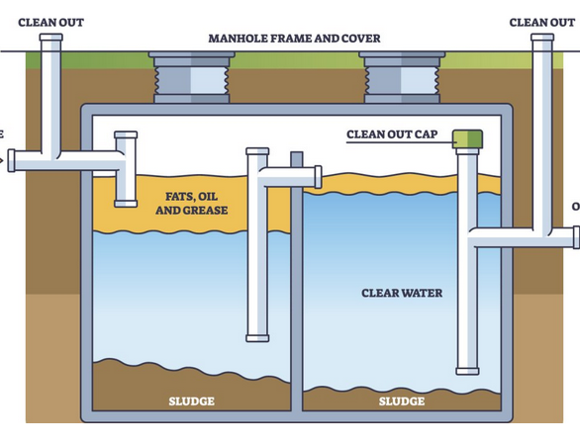
1.2 Grease Trap Cleaning
Location of Grease Trap
  Typically found under the floor
  Unusually located by the dishwasher
Function of Grease Trap
  Collects fats, oils, and grease
  Prevents these substances from entering sewage or septic systems
Importance of Cleaning
  Maintains a clean work environment
  Ensures safety for staff
Grease Trap Image by Andersons Waste Management. Used under FDEd (CAN).
Notes:
The grease trap, usually located under the floor by the dishwasher, collects fats, oils, and grease before water disposal. Regular cleaning is crucial for maintaining a clean and safe work environment for staff.

Slide 9
1.3 Strategic Planning
Definition of Planning
  Act or process of making or carrying out plans
Strategic Planning
  Leadership team looks towards the future
  Awareness of current environment and likely future events
  Determines best way to achieve organizational objectives
Strategic Plan Document
  Communicates organizational objectives
  Actions required to achieve goals
Purpose of Strategic Plan
  Guides employee actions
  Aims for achievement of stated goals
Notes:
Strategic planning involves the leadership team looking towards the future, considering the current environment and future events to achieve organizational objectives. The strategic plan document communicates these objectives and guides employee actions towards achieving the goals.
Original Content:
1.3 Strategic Planning
The Merriam-Webster dictionary defines planning as ‘the act or process of making or carrying out plans’ (Merriam-Webster) Strategic planning is when the leadership team looks towards the future, with an awareness of the current environment and likely future events in mind, to determine the best way to achieve organizational objectives in the upcoming years. The strategic plan is the document used to communicate organizational objectives and the actions required to achieve the goals. A strategic plan’s job is to guide the employee actions towards the achievement of the stated goals.

Slide 10

1.4 Role Perception and Clarity
Clearer Role Perception for Employees
  Provides direction in terms of expectations
  Staff are aware of the goals
  Encourages teamwork to achieve goals
Impact of Role Perception Clarity
  Employees with clarity perform better
  Includes understanding duties and consequences
Notes:
A strategic plan is crucial as it provides employees with clearer role perception, guiding them towards organizational goals. It impacts organizational behaviour, particularly through the MARS model, and enhances performance by clarifying duties, expectations, and procedures.

Slide 11
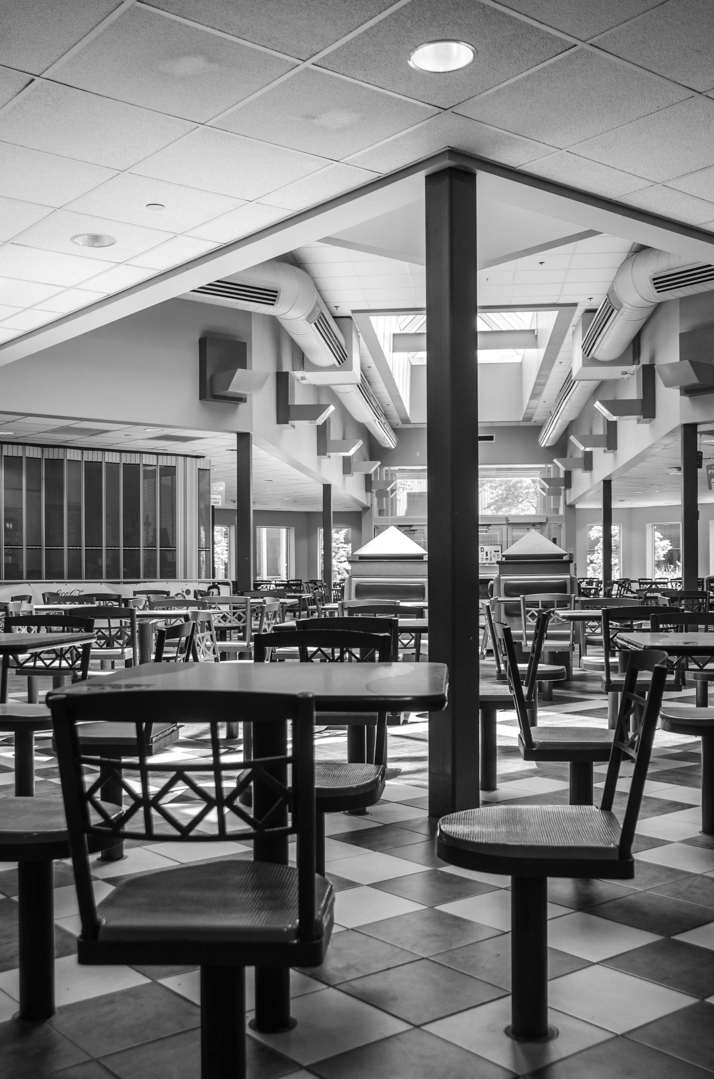
1.4 Examples of Strategic Goals
Ensure Clean and Safe Environment
  Provide a clean and safe environment for residents
  Maintain safety standards for staff
Proactive Preventative Maintenance
  Engage in preventative maintenance programs
  Ensure business continuity through proactive measures
Design Functional Dining Room
  Create a new dining room for residents
  Ensure functionality for both residents and staff
Photo by MJ Idzerda CC BY-NC-SA
Notes:
Our strategic goals in facilities management include ensuring a clean and safe environment, engaging in proactive preventative maintenance, and designing a functional new dining room for residents and staff.

Slide 12
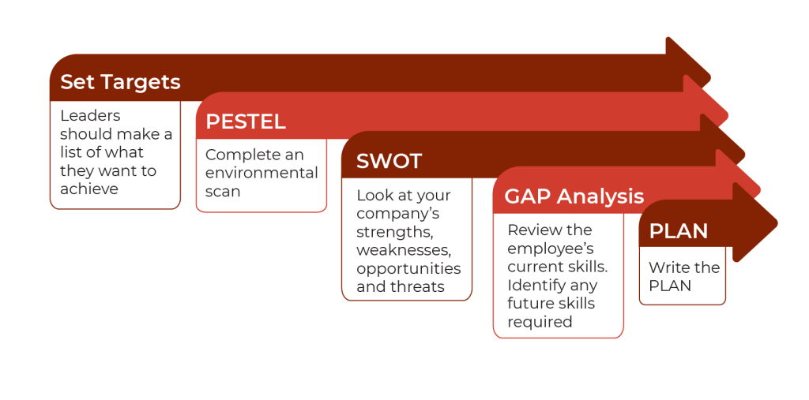
1.3 Steps in the Strategic Planning Process
Notes:
A series of arrows from right to left, each with a step of the strategic planning process.
Set Targets: Leaders should make a list of what they want to achieve.
PESTEL: Complete an environmental scan.
SWOT: Look at your company’s strengths, weaknesses, opportunities and threats.
GAP Analysis: Review the employee’s current skills. Identify any future skills required.
PLAN: Write the plan.
PESTEL analysis examines external factors—Political, Economic, Social, Technological, Environmental, and Legal—that may impact a company's business goals and processes.
SWOT analysis evaluates an organization's internal strengths and weaknesses, along with external opportunities and threats, to assess its competitive position and strategic direction.

Slide 13
1.4 Role of Nutrition in FM
Responsibilities:
Identifying specific tasks required to complete the project.
Contracting or assigning the work to the correct skilled worker.
Being aware of communication tools and resources required to ensure that FM goals are met.
Contributing to the creation of the strategic plan.
Make decisions regarding your service area, which can include the kitchen, the dining room, housekeeping, laundry services, or other support services.
Notes:
The Nutrition and Food Service Manager is responsible for identifying tasks for project completion, ensuring food safety, and maintaining equipment. They must evaluate the physical space regularly and identify necessary maintenance tasks.
A Nutrition Manager assigns work to skilled workers, manages facilities tasks, communicates with other departments for repairs, and secures services from outside professionals. They should proactively research and keep a list of vetted local service professionals.
Communication tools are essential for achieving FM goals. They ensure clear information sharing and involve everyone in the process. Examples include policies for tasks, formal work orders, and service contracts like garbage removal policies and dishwasher repair contracts.
To integrate FM goals into the strategic plan, ensure they are included. Be aware of tasks supporting a safe environment, evaluate physical space, identify necessary projects, and communicate with leadership.
As a facilities management leader, make decisions for various service areas. Communicate with your staff often and educate yourself to ensure a clean, safe, and secure work environment.

Slide 14
1.5 Key Takeaways
Facilities Management (FM) involves maintaining and efficiently operating buildings and infrastructure to ensure comfort, safety, security, and efficiency for the place, processes, and people working on the property.
FM includes managing physical infrastructure (hard services) like HVAC systems, utilities, and building structures, as well as non-physical elements (soft services) such as security, custodial services, catering, and waste management.
Successful facilities management requires a diverse team of professionals, including custodians, security personnel, maintenance team members, and waste disposal workers, who ensure the comfort, safety, security, and efficiency of the property and its operations.
Strategic planning involves the leadership team looking toward the future, considering the current environment and likely future events, to determine the best way to achieve organizational objectives over the next three to five years. The strategic plan is a document that communicates these objectives and guides employee actions toward achieving the stated goals

