Slide 1
Biology Essentials
Chapter 9: Molecular Biology

Slide 2
Learning Objectives
By the end of this chapter, you will be able to:
Explain the historical significance of the discovery of DNA as the genetic material and identify key scientists involved in uncovering DNA’s structure.
Describe the molecular structure of DNA, including the role of nucleotides, sugar-phosphate backbone, nitrogenous bases, and the double helix formation.
Differentiate between purines and pyrimidines and identify the rules of complementary base pairing (A-T and G-C).
Define antiparallel strands and explain the significance of the 3′ and 5′ ends of DNA.
Summarize the process of DNA replication, including where and when it occurs in the cell cycle and how the structure of DNA allows it to be copied during DNA replication.
Identify the roles of key enzymes involved in DNA replication, such as DNA polymerase, and describe their function.
Describe how replication bubbles form and expand during the process of DNA replication.
Relate the importance of accurate DNA replication to growth, development, and cellular function in multicellular organisms.

Slide 3
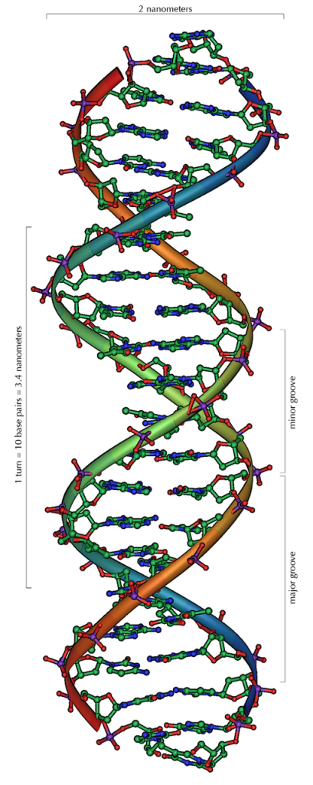
9.1 DNA Structure and Replication
Proving that DNA is the genetic material was a major breakthrough in understanding heredity.
This discovery resulted from decades of experiments by many scientists.
In the 1950s, James Watson and Francis Crick identified the double helix structure of DNA.
Their work was made possible by the critical contributions of Rosalind Franklin and Maurice Wilkins.
Image by Michael Ströck, CC BY-SA 3.0

Slide 4
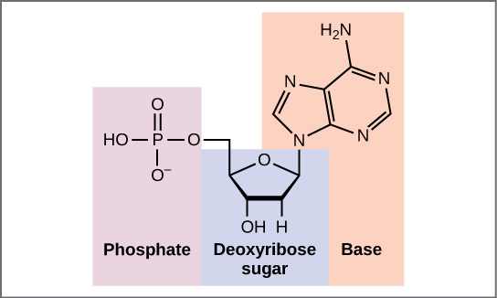
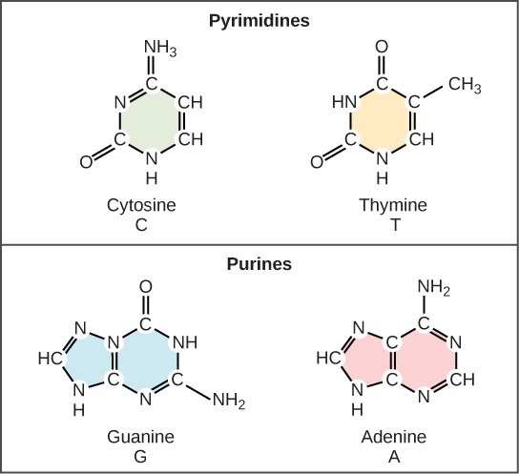
9.1 Structure of DNA I
Each DNA nucleotide is made of three parts: a deoxyribose sugar, a phosphate group, and a nitrogenous base.
DNA contains four bases: adenine (A) and guanine (G) (purines), and cytosine (C) and thymine (T) (pyrimidines).
Nucleotides are named based on the nitrogenous base they contain.
DNA strands are formed by covalent bonds between the phosphate of one nucleotide and the sugar of the next, creating a sugar-phosphate backbone.
Image by OpenStax, CC BY 4.0
Image by OpenStax, CC BY 4.0

Slide 5
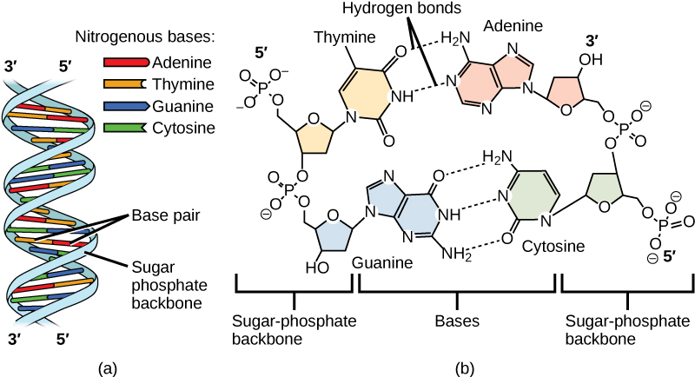
9.1 Structure of DNA II
The DNA backbone has directionality, labelled 5′ to 3′, depending on the position of carbon atoms in the sugar.
DNA consists of two strands held together by hydrogen bonds between complementary bases: A–T and G–C.
The strands twist into a right-handed double helix, with strands running in opposite directions (antiparallel).
Base pairing between a purine and a pyrimidine keeps the DNA helix diameter consistent, maintaining structural stability.
Image by OpenStax, CC BY 4.0

Slide 6
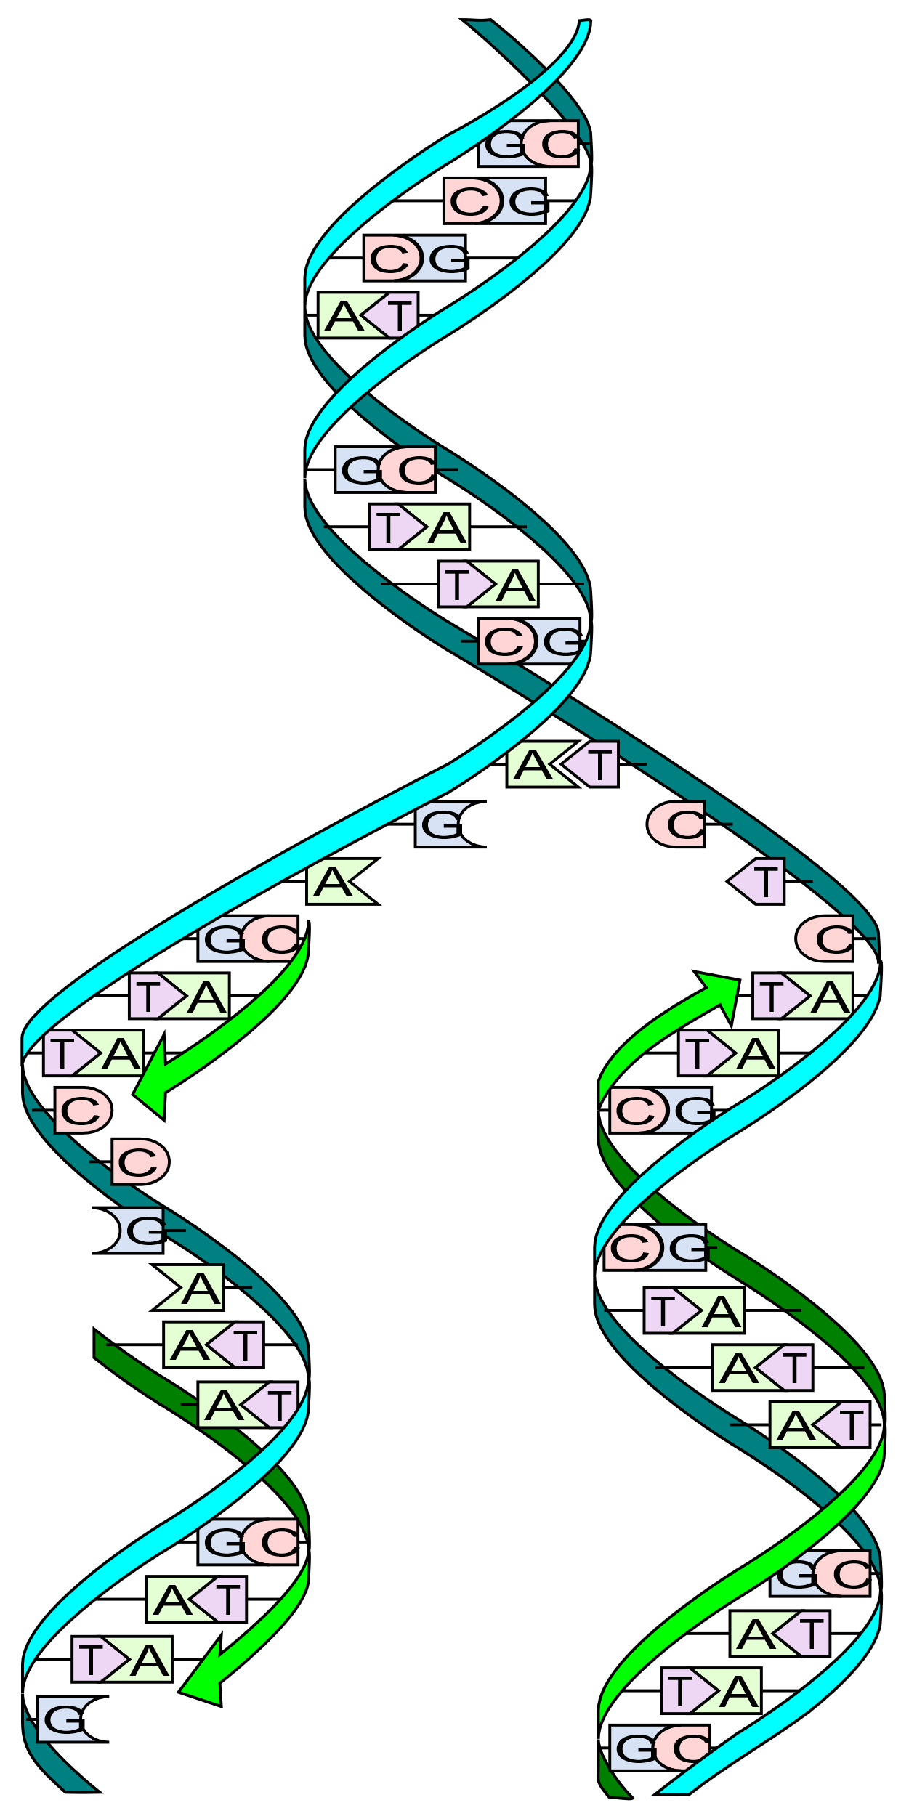
9.1 DNA Replication I
DNA replication is essential for an organism’s growth and reproduction, ensuring all cells have identical genetic information.
Every one of the ~37 trillion cells in the human body contains the same copy of DNA, thanks to accurate replication.
DNA replication happens during the S (synthesis) phase of the eukaryotic cell cycle.
It ensures that each daughter cell receives a complete set of chromosomes after cell division.
Image by Madprime, CC0 1.0

Slide 7
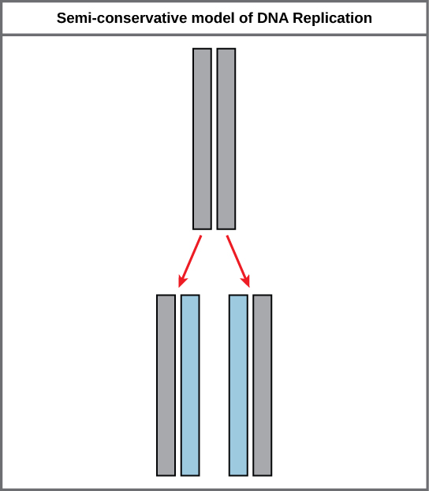
9.1 DNA Replication II
DNA strands are complementary—A pairs with T and C pairs with G—allowing each strand to serve as a template for replication.
The sequence of one DNA strand determines the sequence of its complementary strand during replication.
DNA replication is semi-conservative, meaning each new DNA molecule includes one original strand and one new strand.
The process produces two identical DNA molecules, each preserving half of the original DNA.
Image by OpenStax, CC BY 4.0

Slide 8
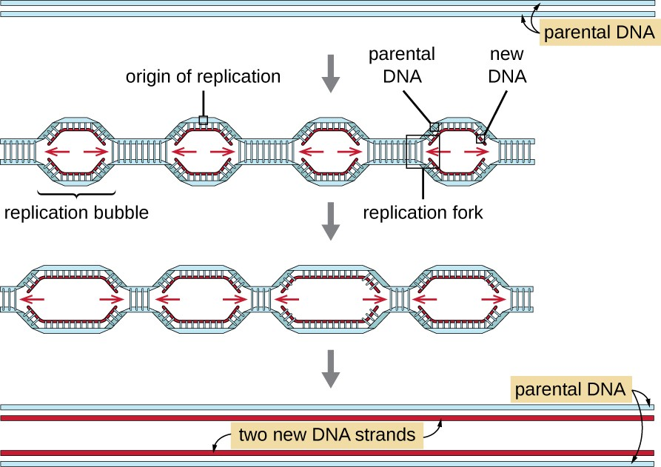
9.1 DNA Replication III
DNA polymerases are essential enzymes that form covalent bonds between nucleotides to build new DNA strands.
Replication begins at specific sites called origins of replication, where the DNA unwinds, forming replication bubbles.
Once bases are exposed, complementary nucleotides pair with the template strand, and DNA polymerase extends the new strand.
All replication bubbles eventually merge, producing two identical double-stranded DNA molecules.
Image by OpenStax, CC BY 4.0

Slide 9
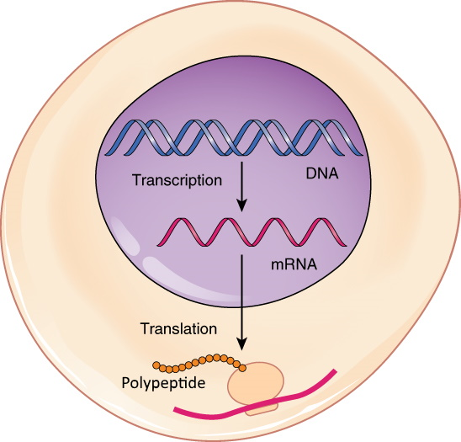
9.2 Transcription
Protein synthesis is the process by which cells produce proteins using instructions from DNA.
In eukaryotic cells, DNA stays in the nucleus, while proteins are made at ribosomes in the cytoplasm.
RNA (specifically messenger RNA, or mRNA) carries genetic instructions from the DNA in the nucleus to the ribosome.
Protein synthesis involves transcription (DNA to mRNA) and translation (mRNA to protein).
Central Dogma: This process is summarized by the central dogma of molecular biology: DNA → RNA → Protein.
Image by OpenStax, CC BY 4.0

Slide 10
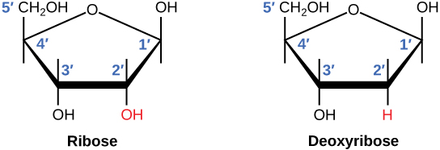
9.2 Structure of RNA
DNA alone cannot direct protein synthesis; it relies on RNA to carry out the instructions.
RNA is a single-stranded nucleic acid made of nucleotides, similar to DNA but with key differences.
RNA contains ribose sugar instead of deoxyribose and uses uracil (U) in place of thymine (T).
Image by OpenStax, CC BY 4.0

Slide 11
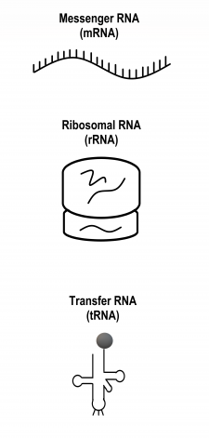
9.2 Functions of RNA
The main function of RNA is to help make proteins.
There are three main types of RNA involved in protein synthesis:
Messenger RNA (mRNA) copies (or transcribes) the genetic instructions from DNA in the nucleus and carries them to the cytoplasm.
Ribosomal RNA (rRNA) helps form ribosomes, where proteins are assembled. Ribosomes also contain proteins.
Transfer RNA (tRNA) brings amino acids to ribosomes, where rRNA catalyzes the formation of chemical bonds between them to form a protein.
The diversity of roles that RNA molecules play has led to their being called the Swiss Army knives of the cellular world.
Image by Christine Miller, CC BY-NC 4.0

Slide 12
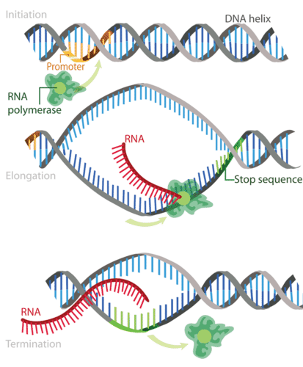
9.2 Transcription Process
Transcription is the first part of the central dogma of molecular biology: DNA → RNA.
It is the transfer of genetic instructions in DNA to mRNA.
During transcription, a strand of mRNA is made to complement a strand of DNA.
Transcription occurs in three main stages:
mage by Mariana Ruiz Villarreal, CC BY-NC 3.0

Slide 13
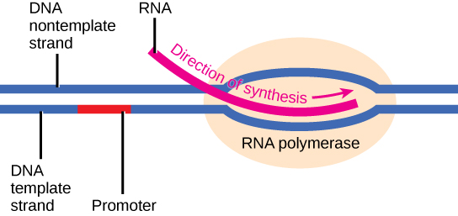
9.2 Phase 1 - Initiation
Transcription begins when RNA polymerase binds to a promoter, causing the DNA to unwind and form a transcription bubble.
Promoters are usually located upstream of the genes they control.
The sequence of the promoter determines how frequently a gene is transcribed—constantly, occasionally, or rarely.
Image by OpenStax, CC BY 4.0

Slide 14
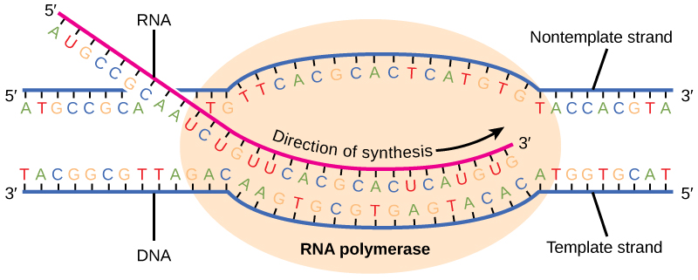
9.2 Phase 2 - Elongation
RNA polymerase moves along the template strand of DNA, adding RNA nucleotides to the growing mRNA strand through complementary base pairing.
Image by OpenStax, CC BY 4.0

Slide 15
9.2 Phase 3 - Termination
RNA polymerase reaches a special region in the DNA called the terminator sequence that signals the end of the gene.
RNA polymerase stops, detaches from the DNA template, and releases the mRNA transcript.
The result is a strand of mRNA that is nearly identical to the coding strand DNA – the only difference being that DNA uses the base thymine, and the mRNA uses uracil in the place of thymine

Slide 16
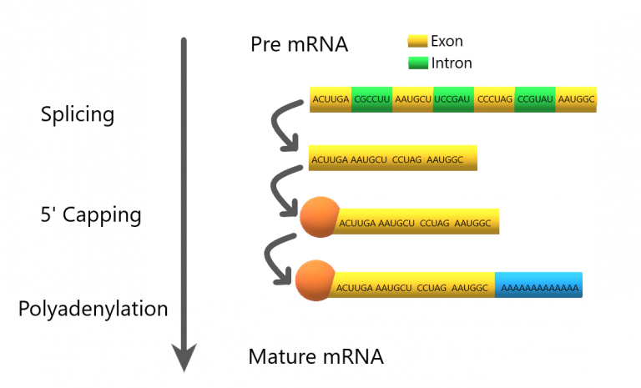
2.3 Water is Polar
Newly transcribed mRNA in eukaryotic cells must undergo several modifications before it can be translated into protein.
These processing steps make eukaryotic mRNA more stable than prokaryotic mRNA, allowing it to last hours instead of seconds.
Introns are removed and exons are joined to ensure the correct coding sequence; any error can render the resulting protein nonfunctional.
A protective cap is added to the 5′ end of the mRNA to prevent degradation and help ribosomes recognize where to bind.
A poly-A tail (about 200 adenines) is added to the 3′ end, aiding in nuclear export, stability, and translation efficiency.
Image by Christine Miller, CC BY-NC-SA 4.0

Slide 17
9.3 Translation
Translation is the process by which a ribosome reads mRNA and assembles amino acids to form a protein.
Translation is like converting a message from one language (nucleotides) to another (amino acids), using the genetic code as a dictionary.
The genetic code is made up of four nitrogen bases (A, C, G, U in RNA) arranged in three-base sequences called codons.
Each codon specifies one amino acid or a start/stop signal during protein synthesis.
With 64 possible codons and only 20 amino acids, the code has built-in redundancy, allowing multiple codons to code for the same amino acid.

Slide 18
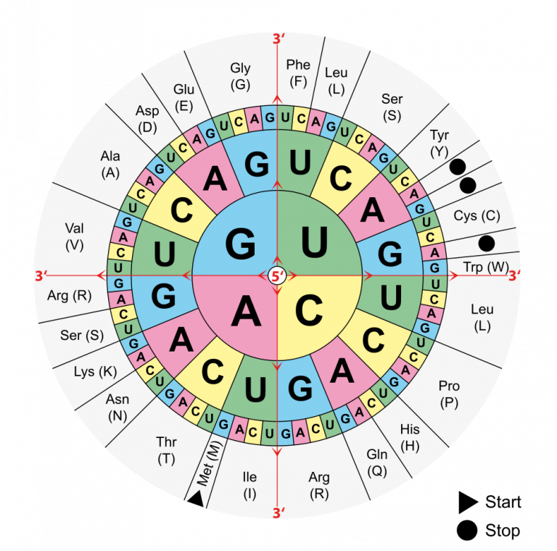
9.3 Genetic Code
To identify the amino acid a codon codes for, use a codon chart by finding the first base in the center, the second base in the middle ring, and the third base in the outer ring (e.g., CUG = leucine).
The codon AUG codes for methionine and acts as the start codon, signalling where translation should begin.
After the start codon, the mRNA sequence is read in sets of three bases (codons), one after another, to build the protein.
Codons UAG, UGA, and UAA are stop codons that signal the end of translation and do not code for any amino acids.
Image by Mouagip, Public Domain

Slide 19
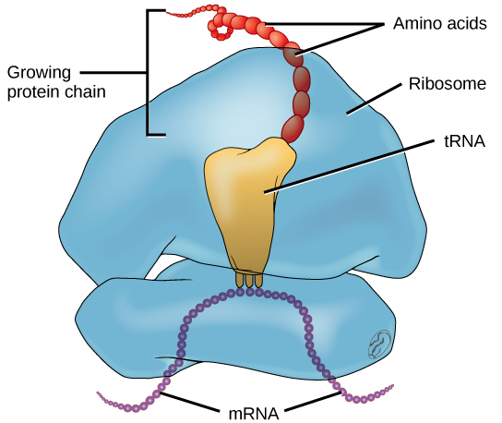
9.3 Translation Process
Translation is the second part of the central dogma of molecular biology: RNA → Protein.
It is the process in which the genetic code in mRNA is read to make a protein.
After mRNA leaves the nucleus, it moves to a ribosome, which consists of rRNA and proteins.
The ribosome reads the sequence of codons in mRNA, and tRNA molecules bring amino acids to the ribosome in the correct sequence.
Translation occurs in three stages:
Image modification of work by NIGMS, NIH, CC BY 4.0

Slide 20
9.3 Phases 1 & 2: Initiation & Elongation
1. Initiation
2. Elongation
After transcription, mRNA exits the nucleus through a pore and enters the cytoplasm.
The ribosome's small and large subunits bind to the mRNA at the cap and start codon region.
A tRNA with the matching anticodon binds to the start codon, forming the initiation complex with the mRNA and ribosome.
tRNA molecules bring amino acids to the ribosome by matching their anticodons with the codons on the mRNA.
Each tRNA’s amino acid is added to the growing polypeptide chain, after which the tRNA exits the ribosome.
The ribosome moves along the mRNA one codon at a time, allowing the cycle to repeat and the polypeptide to grow.

Slide 21
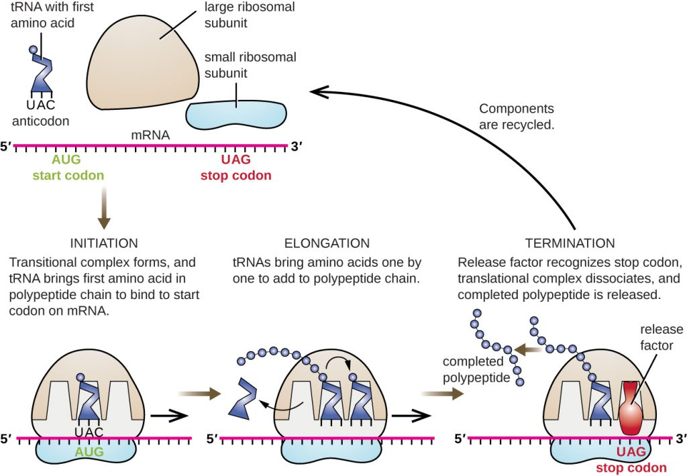
9.3 Phase 3: Termination
Translation ends when the ribosome reaches a stop codon on the mRNA.
Instead of a tRNA, a release factor protein binds to the stop codon.
The release factor triggers the release of the polypeptide and causes the disassembly of the entire translation complex.
Image by CNX OpenStax, CC BY 4.0

Slide 22
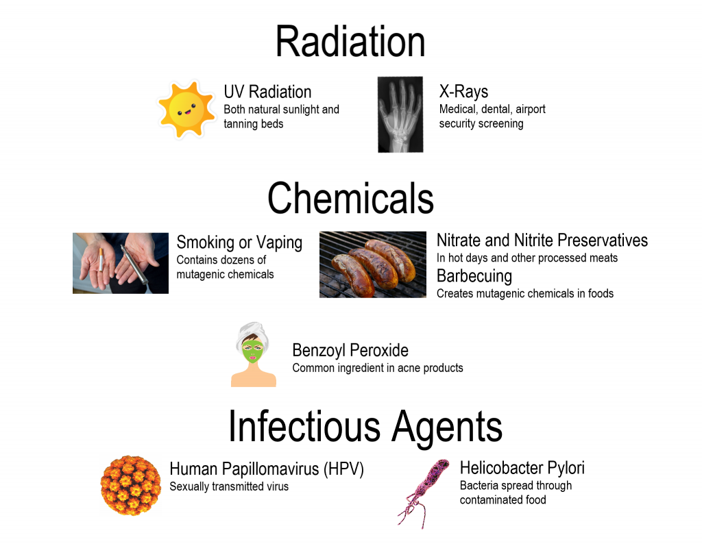
9.3 Mutations
Mutations are random changes in the sequence of DNA or RNA bases.
Some occur naturally, due to errors in DNA replication or transcription.
Others are caused by environmental factors known as mutagens, which increase the likelihood of mutations.
Image by Christine Miller, CC BY SA 4.0

Slide 23
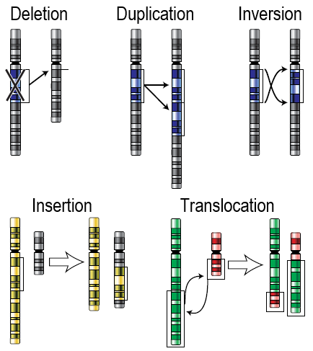
9.3 Chromosomal Alterations
Chromosomal alterations are mutations that change the structure of a chromosome.
They occur when a chromosome segment breaks off and either rejoins incorrectly or fails to rejoin.
These alterations are often severe, frequently leading to organismal death.
Image by unknown, Public Domain.

Slide 24
9.3 Point Mutation
A point mutation is a change in a single nucleotide and is typically less severe than a chromosomal alteration.
Point mutations can be silent, missense, or nonsense, and their effects vary depending on how they alter the genetic code.
Type | Description | Example | Effect
Silent | Mutated codon codes for the same amino acid | CAA (glutamine) → CAG (glutamine) | None
Missense | Mutated codon codes for a different amino acid | CAA (glutamine) → CCA (proline) | Variable
Nonsense | Mutated codon is a premature stop codon | CAA (glutamine) → UAA (stop) | Usually serious

Slide 25
9.3 Frameshift Mutation
A frameshift mutation occurs when nucleotides are inserted or deleted, altering the reading frame of the genetic sequence.
Insertions add nucleotides, while deletions remove them from the sequence.
Frameshift mutations change the grouping of nucleotides into codons, affecting all codons downstream of the mutation.
Adding an "A" after the start codon shifts the reading frame, creating entirely different codons and amino acids.
Even if the rest of the sequence remains unchanged, a frameshift can lead to a completely different and potentially nonfunctional protein.
Frameshift mutations often have drastic effects on protein structure and function, more so than point mutations.

Slide 26
9.3 Effects of Mutations
All people carry dozens to hundreds of mutations in their DNA, and these are a normal part of genetic variation.
Mutations are the ultimate source of genetic variation, making them essential for evolution.
Many mutations are neutral, meaning they have no effect on the organism, such as silent mutations or those repaired before protein synthesis.
Some mutations are advantageous, helping organisms adapt to their environment (e.g., antibiotic resistance in bacteria).
Random mutations can produce nonfunctional proteins, potentially leading to genetic disorders or cancer.
Cells have repair mechanisms to fix many mutations, reducing their impact before they affect protein production.

Slide 27
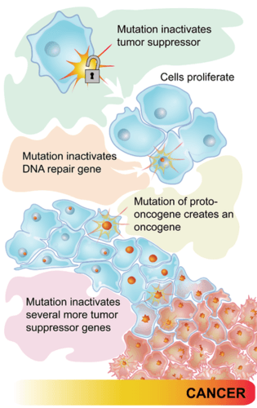
9.3 Mutations and Cancer
Some cancers are caused by mutations in genes that regulate the cell cycle, especially proto-oncogenes and tumor-suppressor genes.
These genes normally promote cell division, but when mutated into oncogenes, they cause uncontrolled cell division—like a car stuck at full throttle.
These genes normally inhibit cell division, but mutations disable their function—like a car with no brakes, leading to uncontrolled growth.
Mutations in either gene type can lead to unchecked cell division, contributing to the development of cancer.
Image by CK-12 Foundation, CC BY-NC 3.0

Slide 28
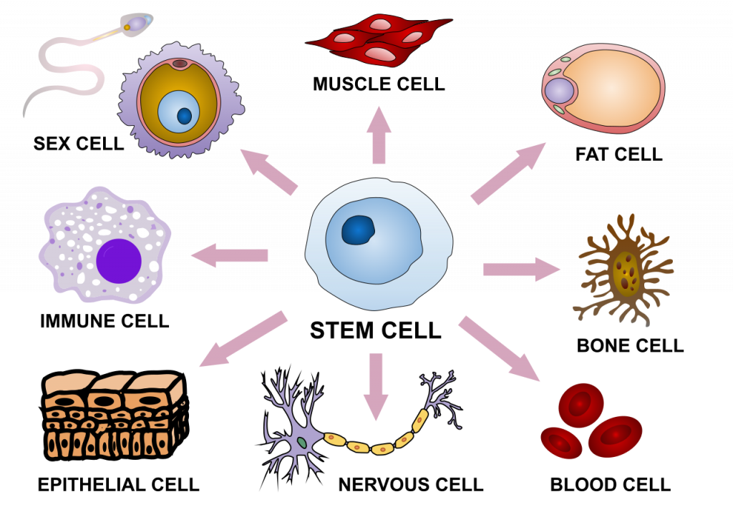
9.4 Regulation of Gene Expression
Human cells vary in shape and function based on the proteins they produce.
All cells contain the same genetic material, but they express different genes.
The specific proteins a cell makes determine its unique structure and role in the body.
Image by Haileyfournier, CC BY-SA 4.0

Slide 29
9.4 Gene Expression
Cells regulate gene expression to ensure proteins are produced at the right time and in the right amount for proper functioning.
Gene expression refers to the process of activating a gene to produce RNA and protein.
Cells control when a gene is expressed, how much protein is made, and when to stop production once the protein is no longer needed.
Regulating gene expression conserves energy and space, avoiding the waste of producing unnecessary proteins.
Only activating specific genes allows cells to avoid constantly unwinding DNA, which would require more space and make cells excessively large.
Gene expression is highly complex, and malfunctions in its regulation can lead to diseases and cellular dysfunction.

Slide 30
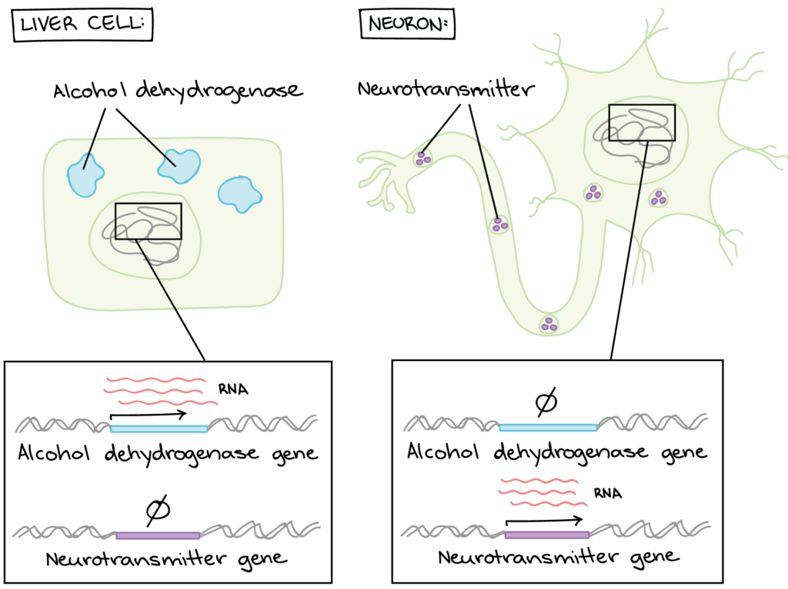
9.4 Gene Regulation
Gene regulation is the process by which cells control which genes are expressed, or "turned on," at any given time.
All cells in the body contain the same DNA, but different gene expression patterns make each cell type unique.
These patterns lead to different proteins being produced in different cells, allowing them to perform specialized functions.
Example – Liver vs. Neurons: Liver cells express genes for enzymes that detoxify substances like alcohol, while neurons do not, and vice versa for neurotransmitter-related genes.
Each cell type expresses only the genes it needs, keeping other genes inactive to maintain its specific role.
Image by Lumen Learning, CC BY 4.0

Slide 31
9.4 Prokaryotic & Eukaryotic Gene Regulation
Prokaryotic Gene Regulation
Eukaryotic Gene Regulation
Prokaryotes are single-celled organisms without a nucleus, so their DNA is located in the cytoplasm.
Transcription and translation occur almost simultaneously, allowing quick protein synthesis.
Protein production is controlled by regulating transcription—it increases when more protein is needed and stops when it's not.
Eukaryotic cells have organelles, including a nucleus that separates DNA from the cytoplasm.
Transcription occurs in the nucleus, while translation takes place in the cytoplasm, due to the nuclear membrane.
Gene expression is regulated at multiple stages, from transcription to post-protein processing.
This regulation ensures the right proteins are produced at the right time and place within the cell.

Slide 32
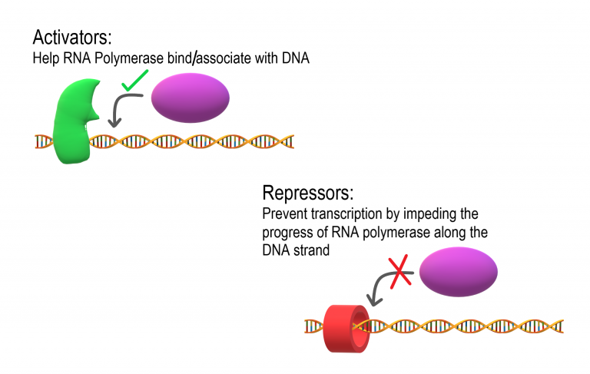
9.4 Epigenetic & Transcriptional Regulation
Epigenetic Regulation
Epigenetic markers are chemical signals that attach to DNA or histone proteins to make certain genes more accessible.
Epigenetic markers flag certain genes, making them easier to access for transcription.
Transcriptional Regulation
Transcription is controlled by regulatory proteins which bind to DNA regions near promoters.
Activators are regulatory proteins that promote transcription by enhancing the interaction of RNA polymerase with the promoter.
Repressors are regulatory proteins that prevent transcription by impeding the progress of RNA polymerase along the DNA strand, so the DNA cannot be transcribed to mRNA.
Image by Christine Miller, CC BY-SA 4.0

Slide 33
9.4 Post-Transcriptional Regulation
After transcription, mRNA is processed, and the introns are removed by splicing.
Alternative RNA splicing is a mechanism that allows different protein products to be produced from one gene when different combinations of introns (and sometimes exons) are removed from the transcript.
Image by Lumen Learning, CC BY 4.0

Slide 34
9.4 Translational & Post-Translational Regulation
Translational Regulation
Once RNA is in the cytoplasm, its lifespan can be controlled.
Each RNA molecule decays at a specific rate.
This decay rate, known as RNA stability, determines how long RNA remains active in the cytoplasm.
If the RNA is stable, it will be available for longer periods of time, allowing more protein to be made.
Faster decay means less time for translation, resulting in less protein production.
Post-Translational Regulation
After a protein is synthesized, it may undergo folding or chemical modifications to activate the protein.
Controlling these modifications can deactivate proteins.
Proteins that are no longer needed or are damaged can be tagged for degradation.

Slide 35
Key Takeaways
Hereditary Information.
Nucleotides are the building blocks of DNA.
DNA Structure.
DNA Replication.
Replication Process.

