Slide 1
Biology Essentials
Chapter 6: Cellular Respiration

Slide 2
Learning Objectives
By the end of this chapter, you will be able to:
Explain the role of redox reactions in cellular respiration.
Identify the locations of the three main stages of cellular respiration.
Describe the process of aerobic respiration.
Discuss the fundamental difference between anaerobic cellular respiration and fermentation.
Describe the type of fermentation that readily occurs in animal cells and the conditions that initiate that fermentation.

Slide 3
6.1 Overview of Cellular Respiration
Cellular respiration breaks down glucose in living cells to release energy.
Most of the energy is stored in high-energy electrons, which are gradually transferred through reactions to release energy.
Redox Reactions: These reactions involve the transfer of electrons—oxidation removes electrons from a molecule, while reduction adds them to another.
The step-by-step transfer of electrons allows energy to be released in small, manageable amounts for ATP production.
Collage by Fanshawe College, CC BY-NC-ND 2.0

Slide 4
6.1 Stages of Cellular Respiration
Cellular respiration uses glucose and oxygen to produce carbon dioxide, water, and energy and is considered an aerobic process because it requires oxygen.
The chemical equation is: C₆H₁₂O₆ + 6O₂ → 6CO₂ + 6H₂O + Chemical Energy (in ATP)
This process releases a large amount of energy from glucose, which is stored as ATP and used by most organisms, including animals and plants.
Cellular respiration consists of glycolysis, the citric acid cycle, and the electron transport chain (ETC), with energy transfer tracked by the movement of electrons.

Slide 5
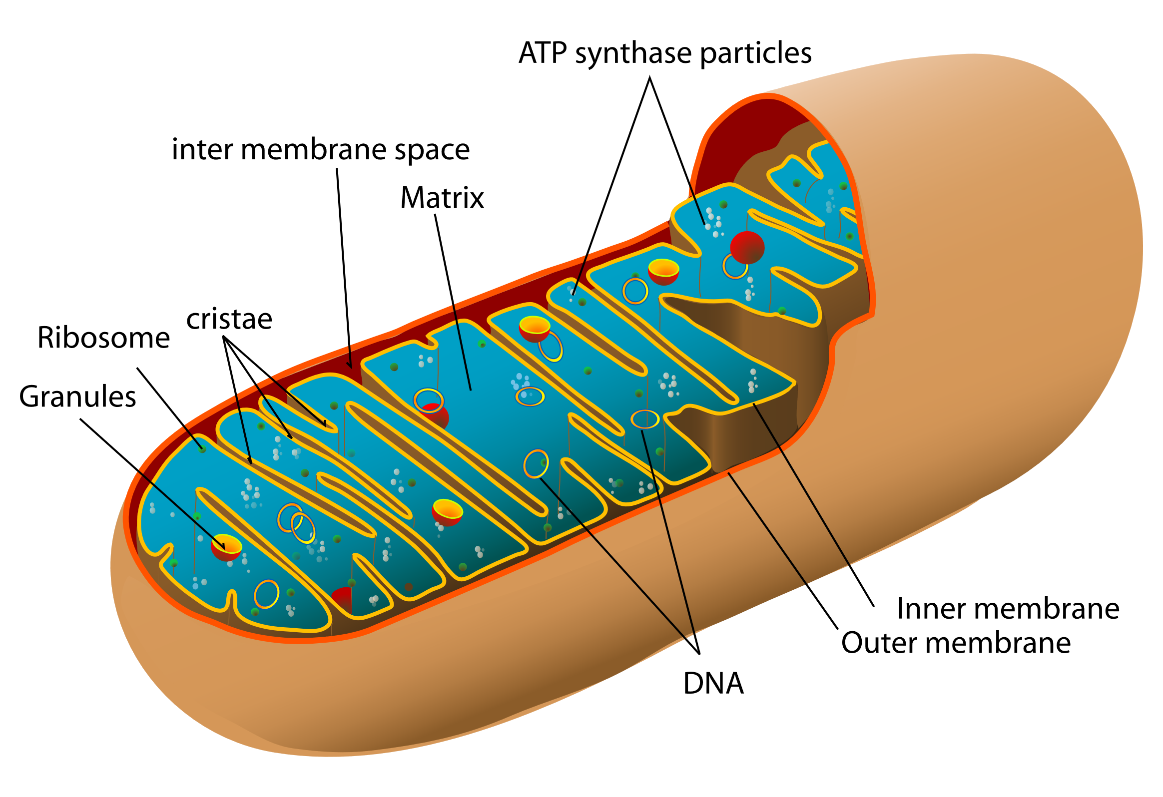
6.1 Location of Cellular Respiration
Glycolysis, the first stage of cellular respiration, occurs in the cytosol of the cell.
The mitochondrion has two membranes—inner and outer—with the intermembrane space between them and the matrix inside the inner membrane.
The citric acid cycle occurs in the matrix, while the electron transport chain takes place on the inner membrane.
Image by Mariana Ruiz Villarreal, Public Domain

Slide 6
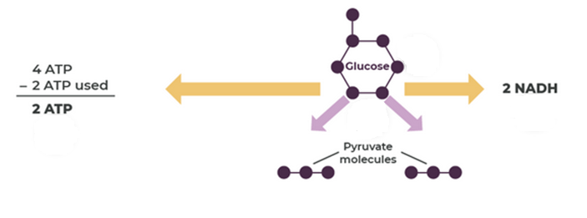
6.2 Aerobic Respiration: Stage 1 - Glycolysis
Glycolysis means “glucose splitting” and involves breaking down one glucose molecule into two pyruvate molecules through a ten-step enzymatic process.
This process occurs in the cytosol and releases energy that is used to produce ATP and NADH.
Two ATP molecules are used to start glycolysis (energy investment), and four ATP are produced (energy harvesting), resulting in a net gain of two ATP.
High-energy electrons are transferred to NAD⁺, forming two NADH molecules that carry electrons to stage III of cellular respiration for further ATP production.
Image by Kari Moreland, CC BY-NC-SA 4.0

Slide 7
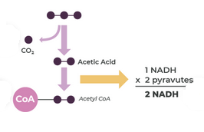
6.2 Transition Reaction
This short step modifies pyruvate into acetyl CoA so it can enter the citric acid cycle.
Each pyruvate is converted into one acetyl CoA and one carbon dioxide molecule, producing two NADH molecules from NAD⁺.
No ATP is made, but high-energy electrons are transferred to NADH, which will be used in the electron transport chain.
Image by Kari Moreland, CC BY-NC-SA 4.0

Slide 8
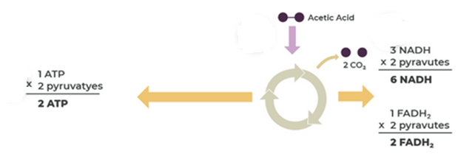
6.2 Aerobic Respiration: Stage 2 -The Citric Acid Cycle
Pyruvate from glycolysis is converted into acetyl CoA, which enters the mitochondrion to begin the Citric Acid Cycle (Krebs cycle).
The cycle starts and ends with oxaloacetate (OAA), a four-carbon molecule that combines with acetyl CoA to form citric acid.
Each acetyl CoA results in the production of two carbon dioxide molecules, totalling four CO₂ molecules per glucose molecule.
The cycle generates energy-rich molecules—NADH, ATP, and FADH₂—used in later stages of cellular respiration.
Since glycolysis produces two pyruvate molecules from one glucose, the Citric Acid Cycle must turn twice for each glucose molecule broken down.
Image by Kari Moreland, CC BY-NC-SA 4.0

Slide 9
6.2 Results of Glycolysis, Transition Reaction & Citric Acid Cycle
By the end of glycolysis, the transition reaction, and the citric acid cycle, all six carbon atoms from glucose have been released as carbon dioxide.
These stages produce 16 energy-carrier molecules: 4 ATP, 12 NADH, and 2 FADH₂.
The reactions so far are exergonic, meaning they release energy stored in glucose's chemical bonds.
The released energy will be used in the endergonic electron transport chain, demonstrating energy coupling—using energy from one process to power another.

Slide 10
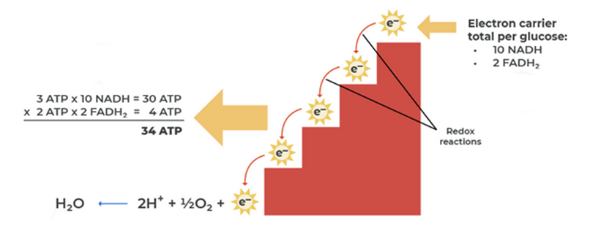
6.2 Aerobic Respiration: Stage 3 - Electron Transport Chain
The Electron Transport Chain (ETC) is the final stage of cellular respiration and produces 32 ATP molecules.
Energy carried by NADH and FADH₂ is used to generate ATP during this stage.
Oxygen serves as the final electron and proton acceptor, combining with hydrogen to form water.
Image by Kari Moreland, CC BY-NC-SA 4.0

Slide 11
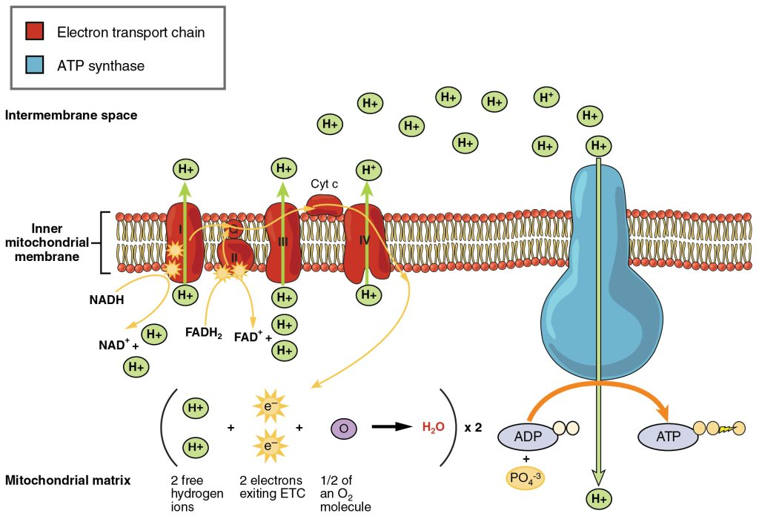
6.2 Transporting Electrons
High-energy electrons from NADH and FADH₂ move through the electron transport chain on the inner mitochondrial membrane.
Energy from the electrons is used to pump H⁺ ions into the intermembrane space, creating an electrochemical gradient.
The electrochemical gradient powers ATP synthesis as H⁺ ions flow back into the matrix through ATP synthase.
Image by OpenStax, CC BY 3.0

Slide 12
6.2 Making ATP
Hydrogen ions are pumped into the intermembrane space, creating a concentration gradient that drives ions back into the mitochondrial matrix.
ATP synthase serves as both a channel for hydrogen ions and an enzyme that synthesizes ATP from ADP and inorganic phosphate in a process called oxidative phosphorylation.
After electrons pass through the electron transport chain, they combine with oxygen to form water, the final step of aerobic respiration.
Aerobic respiration can produce up to 38 ATP molecules from one glucose molecule—2 from glycolysis, 2 from the citric acid cycle, and up to 34 from the electron transport chain.
The actual number of ATP molecules produced can vary depending on the species or type of tissue.
Use of Other Molecules: In addition to glucose, other food molecules like carbohydrates, proteins, and fats can also enter cellular respiration at different stages to be used for ATP production.

Slide 13
6.3 Fermentation
Anaerobic respiration allows energy production without oxygen, yielding only 2 ATP per glucose molecule, compared to up to 38 ATP in aerobic respiration.
Anaerobic respiration begins with glycolysis, which does not require oxygen and produces 2 ATP and NADH.
For glycolysis to continue, NADH must be converted back to NAD⁺ since the electron transport chain cannot function without oxygen.
Different organisms regenerate NAD⁺ through fermentation by transferring electrons from NADH to an organic molecule, enabling glycolysis to continue.

Slide 14
6.3 Lactic Acid Fermentation
Animals and certain bacteria, like those in yogurt, use lactic acid fermentation to produce energy without oxygen.
During intense exercise, muscle cells temporarily switch to lactic acid fermentation when oxygen delivery can't keep up with ATP demand.
In this process, NADH transfers electrons to pyruvate, converting it into lactic acid.
This reaction regenerates NAD⁺, allowing glycolysis to continue and produce more ATP.

Slide 15
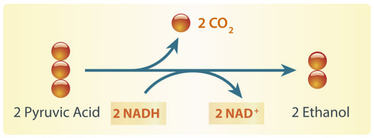
6.3 Alcohol Fermentation
Yeasts and some bacteria carry out alcohol fermentation to produce energy without oxygen.
Pyruvate is broken down, releasing carbon dioxide and forming acetaldehyde, which then accepts electrons from NADH to become ethanol.
This process regenerates NAD⁺, allowing glycolysis to continue producing ATP.
Image by Hana Zavadska/ CK-12 Foundation, CC BY-NC 3.0

Slide 16
6.3 Aerobic vs Anaerobic Respiration
Feature | Aerobic Respiration | Anaerobic Respiration
Requires oxygen? | Yes | No
Glucose breakdown | Complete | Incomplete
End products | CO₂ and H₂O | Animal cells: lactic acid Plant cells and yeast: carbon dioxide and ethanol
ATP produced | About 38 | 2

Slide 17
6.3 Anaerobic Cellular Respiration in Prokaryotes
Ancient prokaryotes likely relied solely on glycolysis for ATP production before oxygen was present in Earth’s atmosphere.
The universality of glycolysis among organisms suggests it is a very early and conserved metabolic pathway.
Some prokaryotes have evolved unique ways to regenerate NAD⁺, allowing glycolysis to continue without oxygen.
Methanogens reduce carbon dioxide to methane while sulphate-reducing organisms convert sulphate to hydrogen sulphide to oxidize NADH and regenerate NAD⁺.

Slide 18
Key Takeaways
Cellular respiration.
Aerobic Respiration.
Fermentation.

