Slide 1
Biology Essentials
Chapter 5: Photosynthesis

Slide 2
Learning Objectives
By the end of this chapter, you will be able to:
Explain how plants absorb energy from sunlight.
Describe how the wavelength of light affects its energy and colour.
Describe how and where photosynthesis takes place within a plant.
Describe the Calvin cycle.
Define carbon fixation.
Explain how photosynthesis works in the energy cycle of all living organisms.

Slide 3
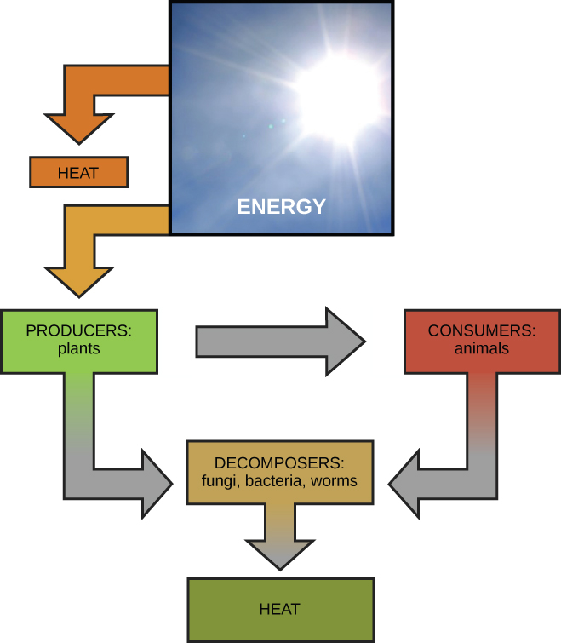
5.1 Energy
Biochemical reactions occur in living organisms, and the total of these reactions is called metabolism.
Catabolic Reactions: These are exothermic reactions that break down molecules and release energy, such as the breakdown of glucose in cellular respiration.
Anabolic Reactions: These are endothermic reactions that build larger molecules from smaller ones and absorb energy, like forming proteins from amino acids.
Image by OpenStax, CC BY 4.0

Slide 4
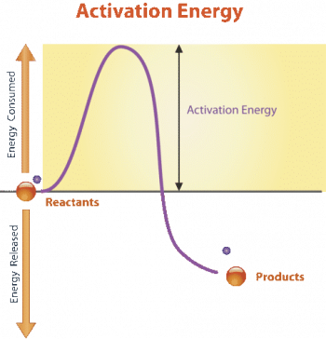
5.1 Activation Energy
All chemical reactions require a starting boost of energy, called activation energy, even those that release energy (exothermic reactions).
Activation energy allows reactant molecules to begin moving and collide with enough force to initiate a reaction.
Energy is needed to overcome the repelling intermolecular forces between reactant molecules so they can interact and form new substances.
Image by CK12, CC BY-NC 3.0

Slide 5
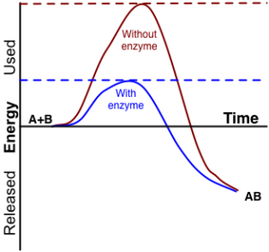
5.1 Enzymes I
Biochemical reactions in living organisms often need help because body temperatures and reactant concentrations are too low for reactions to occur quickly on their own.
Enzymes are proteins that act as biological catalysts, speeding up reactions by lowering the activation energy required.
With the help of enzymes, reactions require less activation energy to start, making them more efficient.
Enzymes bind to reactant molecules (substrates) and hold them in a way that makes it easier for chemical bonds to break and form.
Enzymes are not changed or used up in the reactions they catalyze and can be reused for multiple reactions.
Image by G. Andruk, CC BY-SA 3.0

Slide 6
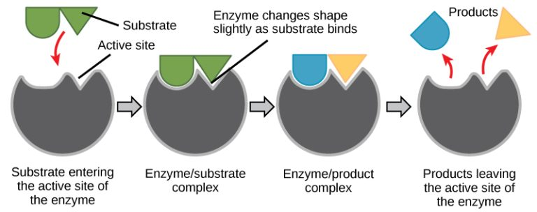
5.1 Enzymes II
Enzymes can dramatically speed up biochemical reactions—from days or centuries to just seconds—making life possible.
Each enzyme is specific to a particular substrate and binds at a special region called the active site, which has a unique chemical environment based on its amino acid composition.
When an enzyme and substrate bind, the enzyme slightly changes shape to create an ideal fit, forming an enzyme-substrate complex for the reaction to occur.
Image by OpenStax, CC BY 4.0

Slide 7
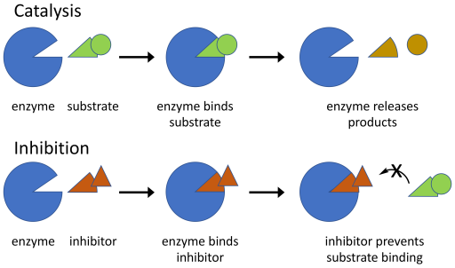
5.1 Enzyme Inhibitors
Enzymes can be regulated to reduce enzyme activity.
An enzyme inhibitor is a molecule that binds to an enzyme and blocks its function.
In competitive inhibition, a substrate binds to the active site and blocks the substrate from binding.
In allosteric inhibition (non-competitive inhibition), an inhibitor molecule binds to a site on the enzyme that is not the active site, altering the enzyme’s overall shape and preventing the substrate from binding to the active site.
Image by Boghog, CC BY-SA 4.O

Slide 8
5.1 Energy Transformations
In science, energy is the ability to do work, and living organisms constantly use energy to perform life processes, even at the cellular level.
Energy is essential for building and breaking down molecules, as well as transporting substances across cell membranes.
Kinetic Energy: This is the energy of motion seen in moving objects like flowing water, walking animals, or vibrating molecules.
Potential Energy: This is stored energy based on an object’s position or state, such as water behind a dam or a compressed spring.
Energy cannot be created or destroyed, only transformed from one form to another or transferred between places.
Energy Transformation Example: A lifted wrecking ball stores potential energy, which converts into kinetic energy as it falls—demonstrating how energy changes form while remaining conserved.

Slide 9
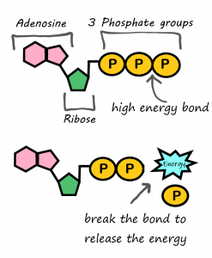
5.1 Energy in Living Organisms
Living cells use chemical energy, stored in the bonds of molecules like food, to power cellular processes when those bonds are broken.
Organisms primarily rely on glucose and ATP as sources of chemical energy.
Glucose Function: Glucose is a simple, stable carbohydrate (C₆H₁₂O₆) that circulates in the blood and serves as a universal energy source for cells, produced through photosynthesis.
ATP Function: ATP (adenosine triphosphate) is the direct energy source for most cellular activities, often called the cell's energy currency.
ATP consists of adenosine and three phosphate groups; it releases energy by losing one phosphate group, becoming ADP (adenosine diphosphate).
Image by Lady Of Hats, CC BY-NC 3.0

Slide 10
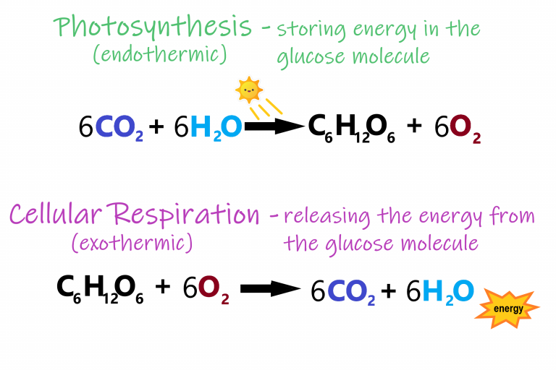
5.2 Overview of Photosynthesis
Most ecosystems get this energy from photosynthesis.
Photosynthesis stores energy from sunlight in the chemical bonds of glucose.
Cellular respiration is then used to break the chemical bonds in glucose to release energy and make ATP.
Photosynthesis and respiration by Christine Miller, CC BY 4.0

Slide 11
5.2 Autotrophs & Heterotrophs
Autotrophs
Heterotrophs
Autotrophs are organisms that produce their own food, typically through photosynthesis using sunlight; examples include plants, algae, and certain bacteria.
Also known as producers, autotrophs create food not only for themselves but also for all other living organisms.
Heterotrophs cannot make their own food and must consume other organisms for energy.
All animals, fungi, and many single-celled organisms are heterotrophs, and their food sources ultimately depend on autotrophs.
Plant by Ren Ran, Unsplash License, Green Algae by Tristan Schmurr, CC BY 2.0, and, Cyanobacteria by Argon National Laboratory, CC BY-NC-SA 2.0

Slide 12
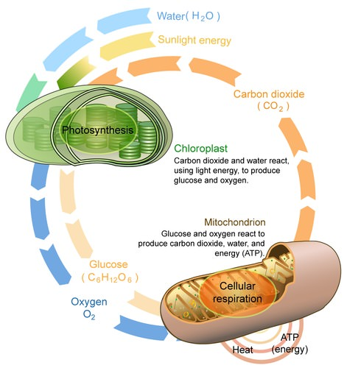
5.2 Energy Flow
Energy enters ecosystems as sunlight and leaves as heat, while chemical elements like carbon and water are recycled.
Photosynthesis: Plants use sunlight, carbon dioxide, and water to produce glucose and release oxygen as a by-product.
Cellular Respiration: Organisms use oxygen to break down glucose, releasing energy for ATP production and producing carbon dioxide and water as by-products.
Image by LadyofHats; CK-12, CC BY-NC 3.0

Slide 13
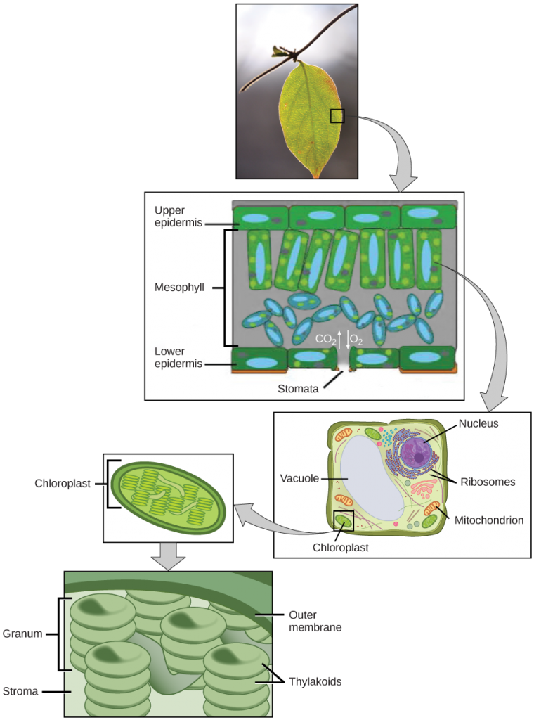
5.2 Location of Photosynthesis
Photosynthesis mainly occurs in the mesophyll layer of plant leaves, not on the surface, where cells are specialized for this function.
Carbon dioxide and oxygen enter and exit the leaf through small openings called stomata, which are regulated by the plant.
In autotrophic eukaryotes, photosynthesis occurs in chloroplasts—organelles found in the mesophyll cells of plant leaves.
Chloroplasts have an inner and outer membrane and contain stacks of disc-shaped thylakoids that house chlorophyll, the pigment that begins the photosynthesis process.
Thylakoid stacks (grana) contain chlorophyll, the primary pigment responsible for capturing light energy and giving plants their green colour; the surrounding fluid is called the stroma.
Image by OpenStax, based on a work by Cory Zanker, CC BY 4.0

Slide 14
5.2 Stages of Photosynthesis
Photosynthesis consists of light-dependent reactions and the Calvin cycle.
These occur in the thylakoid membrane, where chlorophyll absorbs sunlight and uses water to produce chemical energy, releasing oxygen as a byproduct.
Calvin Cycle: This takes place in the stroma, using the chemical energy from the light-dependent reactions to capture carbon dioxide and build sugar molecules.
Special carriers transport energy between the two stages, cycling between “full” (energized) and “empty” (used) states.

Slide 15
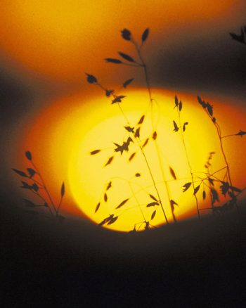
5.3 Light-Dependent Reactions
Light is a form of energy that can travel, transform, and be used to perform work, not just something that enables vision.
During photosynthesis, autotrophs convert specific components of sunlight into chemical energy to produce carbohydrates.
Image modification of work by Gerry Atwell, U.S. Fish and Wildlife Service, CC BY 4.0

Slide 16
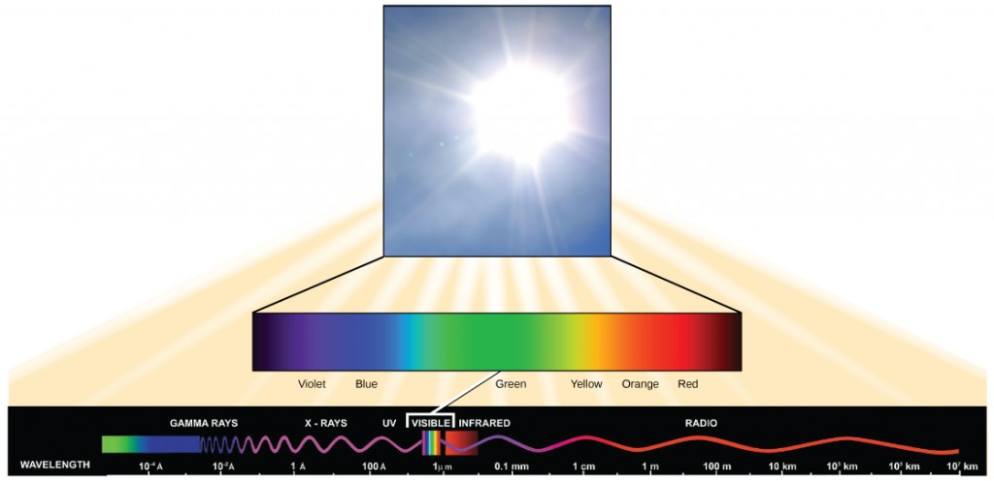
5.3 What is Light Energy?
The sun emits a vast amount of electromagnetic radiation, but humans can only see a small portion known as visible light.
Solar energy travels in waves, and the energy of each wave is determined by its wavelength—the distance between repeating points like crests or troughs.
Visible light is just one part of the full electromagnetic spectrum, which includes all wavelengths of radiation, each carrying different amounts of energy.
Image by OpenStax, CC BY 4.0

Slide 17
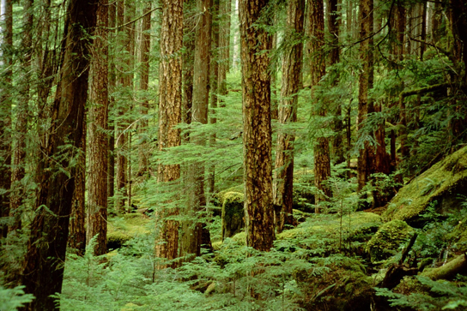
5.3 Absorption of Light
Different pigments absorb specific wavelengths of visible light and reflect the wavelengths they do not absorb, which determines their colour.
Chlorophyll, the main pigment in photosynthetic organisms, absorbs blue and red light but reflects green, making plants appear green.
Other pigments like chlorophyll b and carotenoids absorb different wavelengths, each with a unique absorption spectrum.
Photosynthetic organisms often contain multiple pigments to absorb a wider range of light, helping them survive in varied environments such as underwater or shaded forest floors.
Image by Jason Hollinger, CC BY 4.0

Slide 18
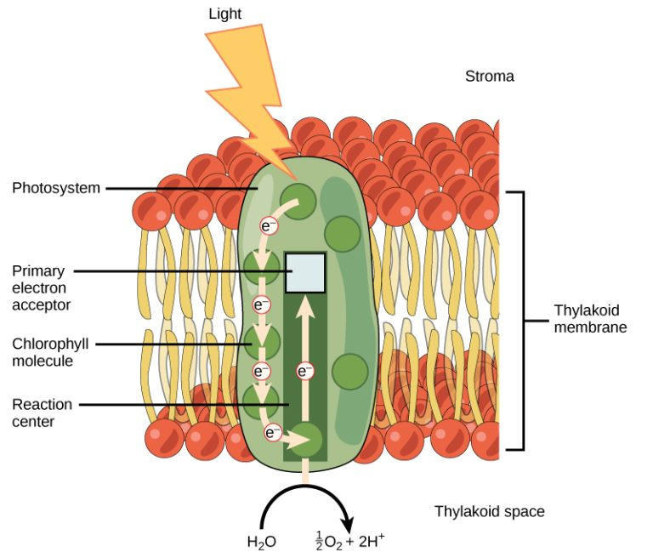
5.3 How Light-Dependent Reactions Work I
These reactions convert light energy into chemical energy to power the Calvin cycle for sugar production.
Light-dependent reactions start in photosystems—clusters of pigments and proteins—embedded in the thylakoid membranes.
A pigment in the photosystem absorbs a photon (light energy packet), which excites an electron in chlorophyll.
The excited electron breaks free from chlorophyll, which “donates” the electron to the photosynthetic pathway.
To replace lost electrons, water molecules split, releasing electrons, hydrogen ions (H⁺), and oxygen (O₂) as byproducts.
Image by OpenStax, CC BY 4.0

Slide 19
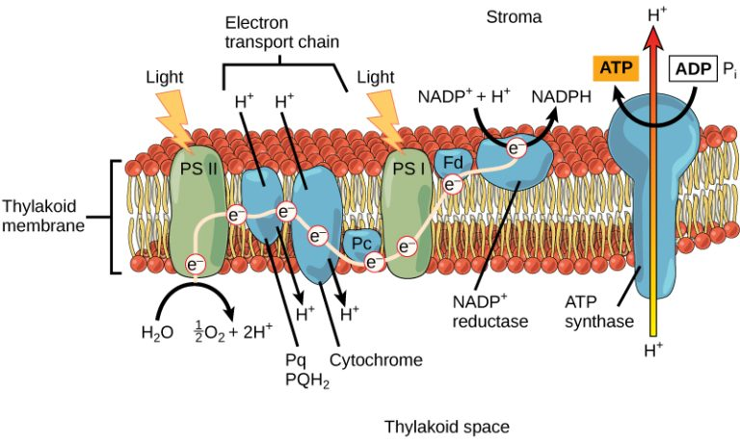
5.3 How Light-Dependent Reactions Work II
Photosystem II passes the excited electron to the electron transport chain—a series of proteins in the thylakoid membrane.
As the electron moves through the chain, its energy powers pumps that move hydrogen ions into the thylakoid space, forming an electrochemical gradient.
The electron, now lower in energy, is accepted by photosystem I to continue the light-dependent process, similar to how mitochondria generate energy.
Image by OpenStax, CC BY 4.0

Slide 20
5.3 Generating an Energy Carrier: ATP
Light-dependent reactions store energy in ATP and NADPH, which carry energy in the form of chemical bonds (phosphate for ATP, hydrogen for NADPH).
ATP and NADPH release their stored energy in the Calvin cycle, becoming the lower-energy molecules ADP and NADP⁺.
A high concentration of hydrogen ions (H⁺) builds up in the thylakoid space, creating an electrochemical gradient across the membrane.
Hydrogen ions flow through the ATP synthase enzyme down their gradient, powering the conversion of ADP to ATP in a process called photophosphorylation.

Slide 21
5.3 Generating Another Energy Carrier: NADPH
The remaining function of the light-dependent reaction is to generate the other energy-carrier molecule, NADPH.
As the electron from the electron transport chain arrives at photosystem I, it is re-energized with another photon captured by chlorophyll.
The energy from this electron drives the formation of NADPH from NADP⁺ and a hydrogen ion (H⁺).
Now that the solar energy is stored in energy carriers, it can be used to make a sugar molecule.

Slide 22
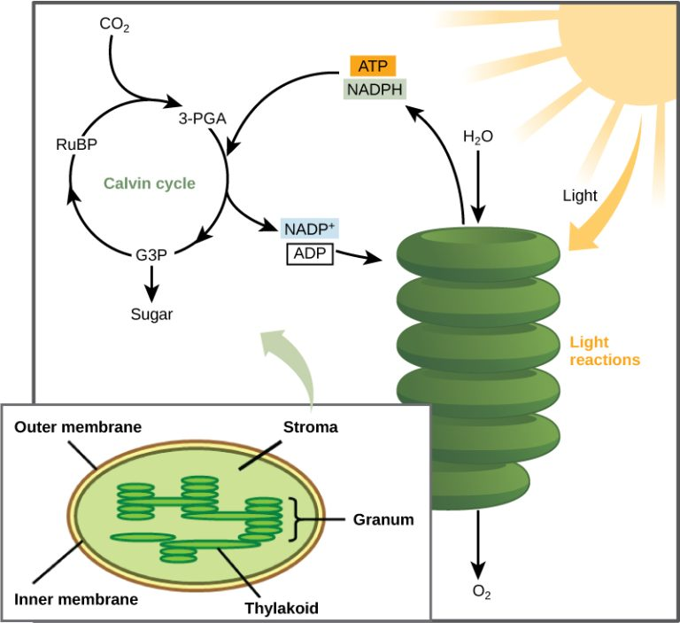
5.4 The Calvin Cycle I
The Calvin cycle uses the energy stored in ATP and NADPH (from the light-dependent reactions) to build carbohydrate molecules like glucose.
The carbon atoms used to make carbohydrates come from carbon dioxide (CO₂), which enters the plant through the stomata.
The Calvin cycle occurs in the stroma of the chloroplast.
The Calvin cycle is also known as the Calvin-Benson cycle and consists of three main stages: carbon fixation, reduction, and regeneration.
Image by OpenStax, CC BY 4.0

Slide 23
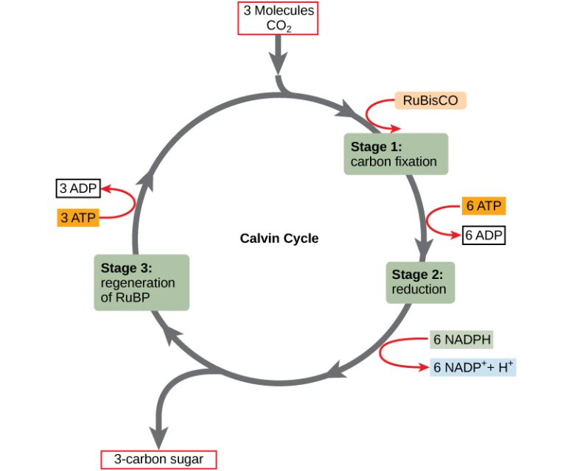
5.4 The Calvin Cycle II
Fixation: The enzyme RuBisCO binds carbon dioxide (CO₂) to a five-carbon molecule called RuBP, forming an unstable six-carbon compound that quickly splits into two three-carbon molecules. This process captures inorganic carbon and incorporates it into organic molecules.
Reduction: ATP and NADPH (from the light-dependent reactions) are used to convert the three-carbon molecules (3-PGA) into a higher-energy three-carbon compound called G3P. One G3P molecule may exit the cycle to help form glucose or other carbohydrates.
Regeneration: The remaining G3P molecules are used to regenerate RuBP, with the help of additional ATP, allowing the cycle to continue and accept more CO₂ for fixation.
Image by OpenStax, CC BY 4.0

Slide 24
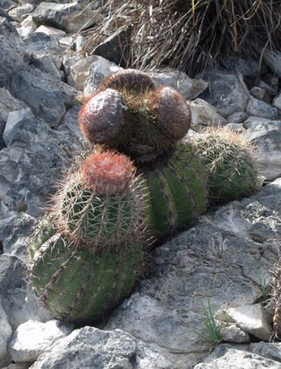
5.4 Evolution Connection
All photosynthetic organisms share a common evolutionary history, with the core process—using water as an electron donor and assembling carbohydrates via the Calvin cycle—remaining largely unchanged.
Across species, photosystems absorb light and use electron transport chains to generate the energy needed for the Calvin cycle.
Plants in arid environments have evolved specialized adaptations to conserve water while maintaining photosynthesis.
One adaptation improves CO₂ efficiency during limited availability, while another shifts Calvin cycle reactions to nighttime, reducing water loss by keeping stomata closed during hot days.
Image by Piotr Wojtkowski, CC BY 4.0

Slide 25
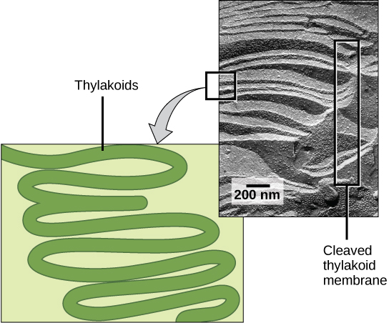
5.4 Photosynthesis in Prokaryotes
The two parts of photosynthesis—the light-dependent reactions and the Calvin cycle—have been described as they take place in chloroplasts.
However, prokaryotes, such as cyanobacteria, lack membrane-bound organelles.
Prokaryotic photosynthetic autotrophic organisms have infoldings of the plasma membrane for chlorophyll attachment and photosynthesis
It is here that organisms like cyanobacteria can carry out photosynthesis.
scale-bar data from Matt Russell, CC BY 4.0

Slide 26
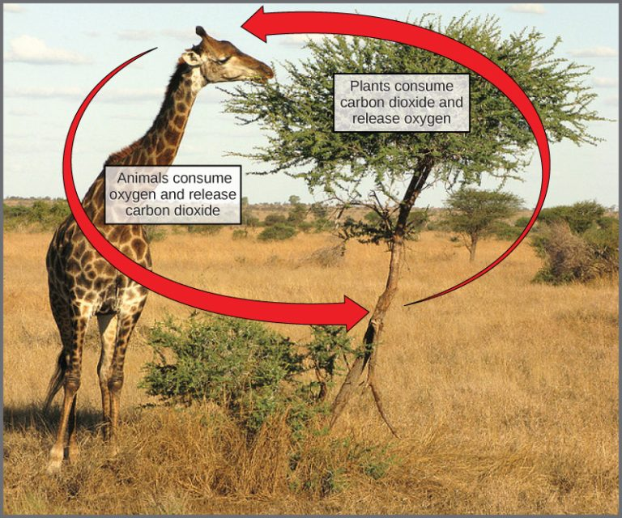
5.4 The Energy Cycle
Although plants produce carbohydrates through photosynthesis, they must break them down via cellular respiration to access the stored energy for cellular functions.
Carbohydrates are more stable and efficient for long-term energy storage than ATP, making them ideal energy reservoirs.
The chemical equation for photosynthesis is the reverse of that for cellular respiration, highlighting their interconnected roles.
Oxygen is a byproduct of photosynthesis, and carbon dioxide is a byproduct of respiration—yet neither is waste, as they are continually reused in nature.
Both chloroplasts and mitochondria use electron transport chains to generate energy—chloroplasts build carbohydrates, and mitochondria break them down.
Photosynthesis and respiration form a biological cycle that conserves matter and recycles energy, ultimately powered by sunlight.
Image OpenStax, modification of work by Stuart Bassil, CC BY 4.0

Slide 27
Key Takeaways
Energy and Its Role in Living Organisms.
Metabolism and Enzymes in Biochemical Reactions.
Photosynthesis and Cellular Respiration.
Light-Dependant Reactions.
The Calvin Cycle.

