Slide 1
Biology Essentials
Chapter 3: Biological Molecules

Slide 2
Learning Objectives
By the end of this chapter, you will be able to:
Identify and describe the four major classes of biological macromolecules—carbohydrates, lipids, proteins, and nucleic acids—and explain their roles in living organisms.
Explain the significance of carbon in biological molecules, including its bonding properties that contribute to molecular diversity and complexity.
Differentiate between dehydration synthesis and hydrolysis, describing how these processes contribute to the formation and breakdown of macromolecules in living systems.
Analyze the structure and function of carbohydrates, lipids, and proteins, including the role of monomers, polymers, and specific examples such as glucose, triglycerides, and enzymes.
Compare and contrast the structure, components, and functions of DNA and RNA, explaining their roles in genetic information storage and protein synthesis.

Slide 3
3.1 Organic Compounds
Food provides essential nutrients needed for survival, many of which come from biological macromolecules—large molecules necessary for life.
The four major classes of biological macromolecules are:
Carbohydrates
Lipids
Proteins
Nucleic acids
Macromolecules are organic compounds composed primarily of carbon, hydrogen, oxygen, nitrogen, phosphorus, and sulphur.
Macromolecules are held together by strong covalent bonds, ensuring structural integrity. Weaker bonds like hydrogen or ionic bonds would cause them to break apart more easily, especially in water.
Image by Bengt Nyman, CC BY 4.0

Slide 4
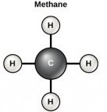
3.1 Carbon
Life is considered carbon-based because carbon atoms form the backbone of most biological molecules.
Carbon has four electrons in its outer shell, allowing it to form four covalent bonds with other atoms, enabling the creation of complex molecular structures.
The simplest organic carbon molecule is methane (CH4), in which four hydrogen atoms bind to a carbon atom.
Carbon can form long chains, branched structures, and rings, often bonding with elements like nitrogen, oxygen, and phosphorus.
The ability of carbon to form multiple bonds and varied structures directly influences the function and complexity of biological macromolecules, supporting life’s diverse processes.
Image by OpenStax, CC BY 4.0

Slide 5
3.1 Dehydration Synthesis
Most macromolecules are made of monomers, which are small building blocks that combine through covalent bonds to form larger molecules called polymers.
Monomers join together by dehydration synthesis, a chemical reaction where a water molecule is released as monomers bond, forming a polymer chain.
Different monomers can combine in various ways to create a wide range of macromolecules.
Even the same monomer, like glucose, can form multiple polymers such as starch, glycogen, and cellulose.
Image by OpenStax, CC BY 4.0

Slide 6
3.1 Hydrolysis
Polymers are broken down into monomers through hydrolysis.
A reaction where a water molecule is used to split the polymer, with one part gaining a hydrogen (H⁺) and the other gaining a hydroxyl group (OH⁻).
Enzymes catalyze both dehydration synthesis and hydrolysis—dehydration requires energy to form bonds, while hydrolysis releases energy by breaking bonds.
Hydrolysis is essential for digesting macromolecules into absorbable nutrients, with specific enzymes breaking down carbohydrates, proteins, and lipids to provide energy and building blocks for the body.
Image by OpenStax, CC BY 4.0

Slide 7
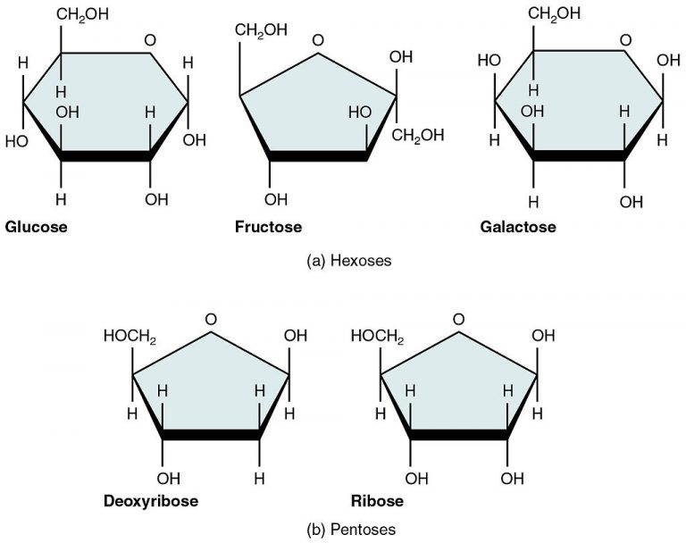
3.2 Carbohydrates
Carbohydrates are macromolecules with which most consumers are somewhat familiar
Carbohydrates provide energy to the body, particularly through glucose, a simple sugar.
Carbohydrates can be represented by the formula (CH2O)n, where n is the number of carbon atoms in the molecule.
The carbon to hydrogen to oxygen ratio is 1:2:1 in carbohydrate molecules.
Carbohydrates are classified into three subtypes:
Monosaccharides,
Disaccharides
Polysaccharides.
Image by OpenStax, CC BY 4.0

Slide 8
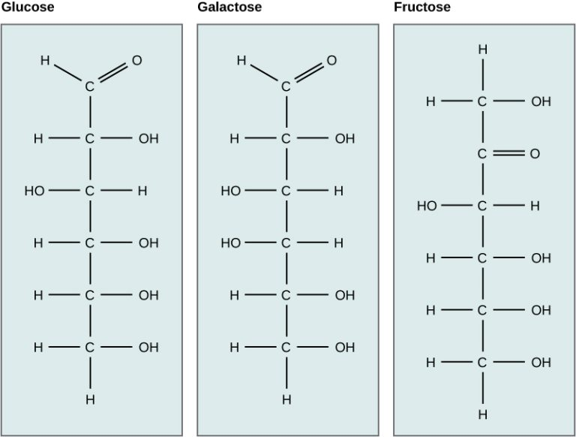
3.2 Monosaccharides
Monosaccharides are simple sugars (ending in -ose) that typically contain 3 to 6 carbon atoms.
They can exist as linear chains or ring-shaped molecules.
Glucose, (C₆H₁₂O₆), is a primary source of energy in living organisms, playing a central role in cellular respiration to produce ATP.
Although monosaccharides like glucose, galactose, and fructose share the same chemical formula, they are isomers—structurally different due to the varied arrangement of atoms in their carbon chains, which influences their chemical properties and functions.
Image by OpenStax, CC BY 4.0

Slide 9
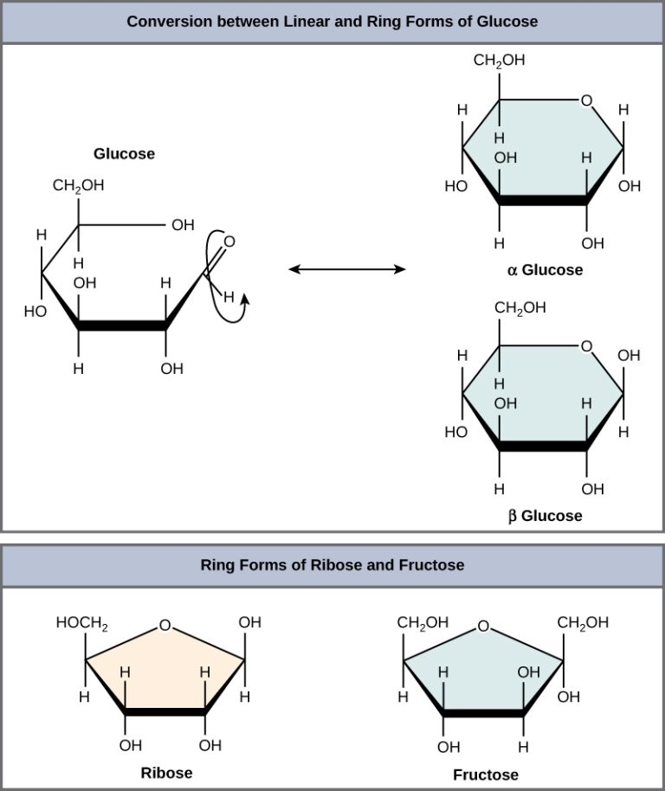
3.2 Disaccharides
Disaccharides are formed when two monosaccharides undergo a dehydration reaction, where a water molecule is removed, and a covalent bond is created between the sugar molecules.
Examples of disaccharides include:
Lactose (glucose + galactose) – found in milk
Maltose (glucose + glucose) – known as malt sugar
Sucrose (glucose + fructose) – table sugar, the most common disaccharide
Disaccharides serve as important energy sources and are commonly found in foods, contributing to nutrition and metabolism in living organisms.
Image by OpenStax, CC BY 3.0

Slide 10
3.2 Polysaccharides I
Polysaccharides, also known as complex carbohydrates, consist of long chains of monosaccharides bonded together, sometimes numbering in the hundreds or thousands.
Common polysaccharides in living organisms include starch, glycogen, cellulose, and chitin.
They generally serve two main purposes: energy storage or structural support.
Starch
Plants store energy as starch, which consists of repeated glucose units.
When starchy foods are consumed, digestive enzymes like amylase break down starch into simple sugars, which provide energy for cellular functions.
Starches are easily and quickly digested with the help of digestive enzymes such as amylase, which is found in the saliva.

Slide 11
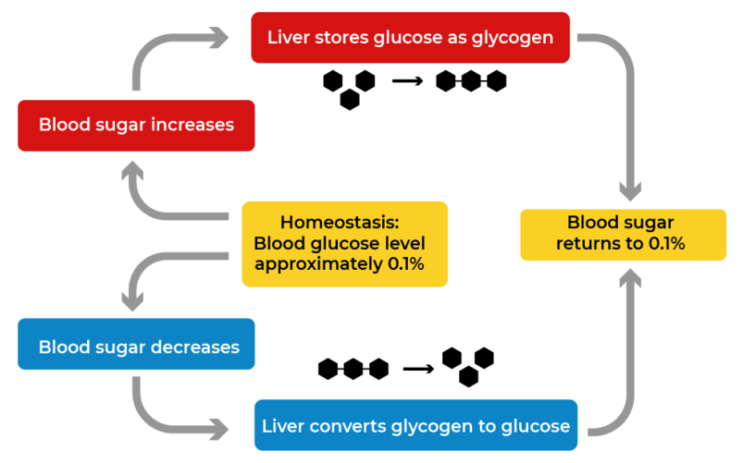
3.2 Polysaccharides II
Glycogen
Unlike plants that store energy as starch, animals store extra energy as glycogen, a polysaccharide of glucose.
Glycogen is primarily found in the liver and muscles and serves as a quick energy reserve.
When energy is needed, muscle glycogen provides glucose for muscle cells, while liver glycogen supplies glucose to the rest of the body. Glycogen can be rapidly broken down to meet sudden energy demands.
Glycogen helps maintain blood glucose homeostasis. When blood sugar is too high, excess glucose is stored as glycogen in the liver. When blood sugar is too low, stored glycogen is converted back into glucose and released into the bloodstream.
Image by Christine Miller [christinelmiller], CC0 1.0

Slide 12
3.2 Polysaccharides III
Cellulose
Cellulose is a polysaccharide composed of long chains of glucose units and serves as a structural component in the cell walls of plants and algae.
Humans use cellulose primarily for manufacturing paper, cardboard, and cotton-based products, as it is a major component of wood and cotton fibres.
While humans cannot digest cellulose, it is essential in the diet as dietary fibre.
Chitin
Chitin is a long-chain polymer derived from glucose, with a structure similar to cellulose.
Chitin is a key structural component in various organisms, including the cell walls of fungi, the exoskeletons of arthropods (e.g., crustaceans and insects), and the beaks and internal shells of cephalopods (e.g., squids and octopuses).
Both insects (e.g., ladybugs) and fungi (e.g., mushrooms) contain chitin as part of their protective structures.

Slide 13
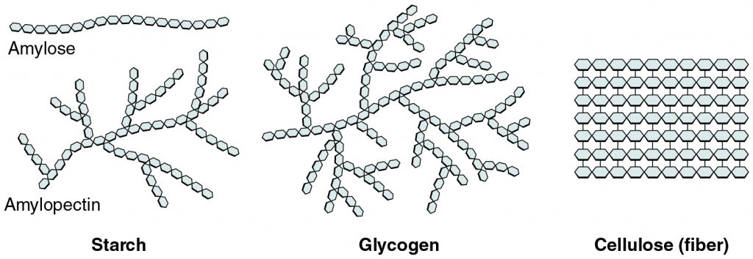
3.2 The Right Molecule for the Job
Starch, glycogen, cellulose, and chitin are all made from glucose monomers, but their structure differs based on how the glucose units are linked.
Starch has long chains with slight branching.
Glycogen has many branches.
Cellulose and chitin form long, tightly packed chains.
Starch and glycogen have many exposed chain ends, allowing glucose to be easily removed for quick energy use.
Cellulose forms a strong mesh, making it ideal for cell walls but unsuitable for energy storage.
Image by OpenStax, CC BY 4.0

Slide 14
3.2 My Human Biology
Dietary fibre consists mainly of cellulose and is found in plant-based foods like fruits, vegetables, whole grains, and legumes. It cannot be broken down or absorbed by the digestive system and helps maintain gut health.
Soluble fibre dissolves in water, forming a gel that helps lower cholesterol and blood sugar. Sources include oats, peas, beans, and apples.
Insoluble fibre does not dissolve in water and adds bulk to feces, aiding digestion and preventing constipation. Sources include whole wheat, wheat bran, beans, and potatoes.
Fibre intake recommendations vary by age and gender, with a general guideline of a 3:1 ratio of insoluble to soluble fibre. Most fibre-rich foods contain both types, making it easy to maintain balance.
Fibre promotes digestive health, regulates blood sugar and cholesterol levels, and prevents constipation, making it a crucial component of a healthy diet.
Image by Milada Vigerova,
Unsplash License

Slide 15
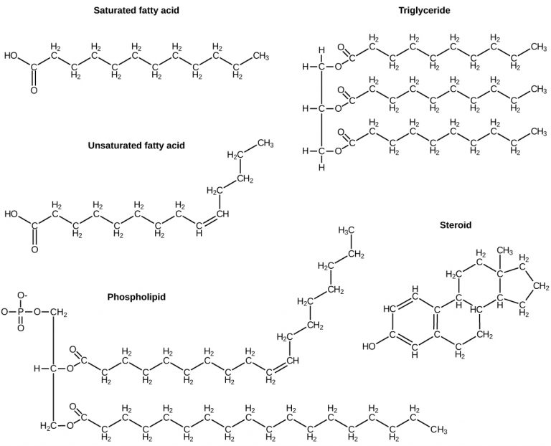
3.3 Lipids
Lipids are nonpolar and hydrophobic, meaning they do not dissolve in water. This is due to their structure, which consists mainly of carbon-carbon and carbon-hydrogen bonds.
Lipids serve multiple roles, including long-term energy storage (fats), insulation, and water-repellency in plants and animals.
They act as building blocks for hormones and are essential components of cell membranes.
The main categories of lipids include fats, phospholipids, and steroids, each with distinct functions in biological systems.
Image by OpenStax, CC BY 4.0

Slide 16
3.3 Fats I
A fat molecule (triglyceride) consists of glycerol and three fatty acids, which are attached via covalent bonds, releasing three water molecules during the process.
Fatty acids are hydrocarbon chains that can vary in length (typically 12–18 carbons) and may be similar or different within a triglyceride.
Saturated fatty acids have only single bonds between carbon atoms, meaning they are fully saturated with hydrogen.
Unsaturated fatty acids contain at least one double bond, altering their structure and properties.
Image by OpenStax, CC BY 4.0

Slide 17
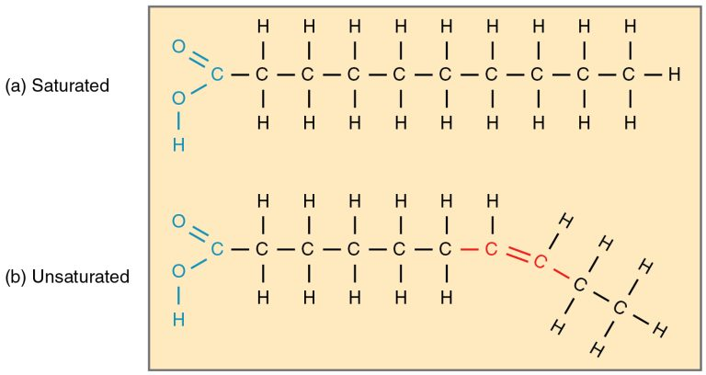
3.3 Fats II
Saturated vs. Unsaturated Fatty Acids
Saturated fatty acids have only single bonds between carbons and are solid at room temperature (e.g., animal fats, butter).
Unsaturated fatty acids contain one or more double bonds, creating kinks in their structure that keep them liquid at room temperature (e.g., olive oil, canola oil).
Mammals store fats in adipocytes (fat cells) for long-term energy storage.
Plants store fats in seeds, which provide energy during embryonic development.
Image by OpenStax, CC BY 4.0

Slide 18
3.3 Fats III
Saturated fats can contribute to plaque buildup in arteries, increasing the risk of heart disease.
Unsaturated fats help improve cholesterol levels and reduce cardiovascular risks.
The body cannot synthesize omega-3 and omega-6 fatty acids, so they must be obtained through diet (e.g., salmon, tuna, trout).
Omega-3s are crucial for brain function, growth, and disease prevention.
Despite negative publicity, fats serve important functions in the body, including long-term energy storage, insulation, and overall health. Healthy unsaturated fats should be consumed in moderation.

Slide 19
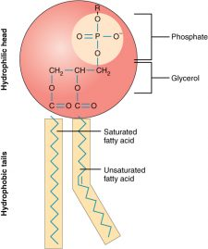
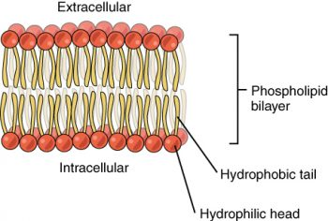
3.3 Phospholipids
A phospholipid molecule consists of a hydrophilic head (phosphate group and glycerol) and hydrophobic tails (two fatty acids), giving it unique water-attracting and water-repelling properties.
Phospholipids arrange themselves into a bilayer, with hydrophilic heads facing outward toward water and hydrophobic tails facing inward, creating a stable membrane structure.
The phospholipid bilayer is a major component of cell membranes, helping to protect the cell and regulate what enters and exits, maintaining cellular function.
Images by OpenStax, CC BY 4.0

Slide 20
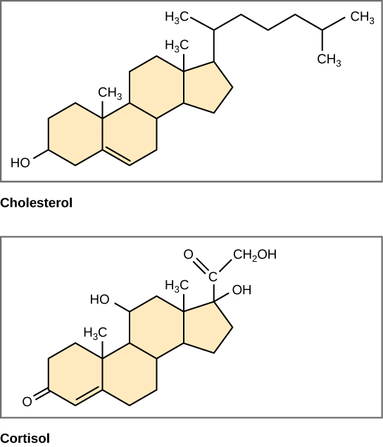
3.3 Steroids
Steroids are lipids with a four-ring structure made up of 17 carbon atoms. Their differences come from the various components attached to this core.
Steroids serve two main biological functions: some, like cholesterol, are essential for cell membrane structure, while others act as hormones that regulate body functions.
In humans, steroid hormones include cortisone (a fight-or-flight hormone) and sex hormones like estrogen, progesterone, and testosterone, which influence reproductive functions.
Image by OpenStax, CC BY 4.0

Slide 21
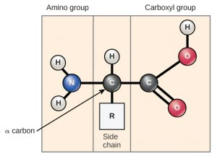
3.4 Proteins I
Proteins are abundant and highly diverse macromolecules with roles in structure, regulation, contraction, protection, transport, storage, membranes, enzymes, and toxins.
Proteins are polymers of amino acids, arranged in a linear sequence and connected by covalent bonds, giving them unique structures and functions.
Amino acids are the monomers that makeup proteins.
Each amino acid shares a fundamental structure, including a central carbon (α-carbon), an amino group (-NH₂), a carboxyl group (-COOH), and a hydrogen atom.
Each amino acid has a unique R group attached to its central carbon, which determines its properties and role in protein function.
Image by OpenStax, CC BY 4.0

Slide 22
3.4 Proteins II
The chemical nature of the side chain (R group) determines whether an amino acid is acidic, basic, polar, or nonpolar, influencing its role in proteins.
Amino acids are linked by covalent peptide bonds through a dehydration reaction, where the carboxyl group of one amino acid bonds with the amino group of another, releasing a water molecule.
A polypeptide is a chain of amino acids, whereas a protein is one or more polypeptides that have folded into a specific shape to perform a unique function.

Slide 23
3.4 Protein Function
The functions of proteins can be very diverse because the function depends on the protein’s shape.
The order of the amino acids determines the shape of a protein.
Type | Examples | Functions
Digestive Enzymes | Amylase, lipase, pepsin, trypsin | Help in the digestion of food by catabolizing nutrients into monomeric units.
Transport | Hemoglobin, albumin | Carry substances in the blood or lymph throughout the body
Structural | Actin, tubulin, keratin | Construct different structures, like the cytoskeleton
Hormones | Insulin, thyroxine | Coordinate the activity of different body systems
Defence | Immunoglobulins | Protect the body from foreign pathogens
Contractile | Actin, myosin | Effect muscle contraction
Storage | Legume storage proteins, egg white (albumin) | Provide nourishment in the early development of the embryo and the seedling

Slide 24
3.4 Protein Structure I
Primary Protein Structure
A protein’s primary structure is the unique sequence of amino acids in a polypeptide chain, determined by the gene encoding the protein.
Even a single amino acid change can alter protein structure and function.
Example: In sickle cell anemia, a single amino acid substitution in the hemoglobin β chain changes the protein’s structure, significantly affecting its function and leading to serious health consequences.
Secondary Protein Structure
The secondary structure of a protein arises from folding patterns due to interactions between the non-R group portions of amino acids.
The two most common secondary structures are the alpha (α)-helix, which forms a twist due to hydrogen bonds, and the beta (β)-pleated sheet, which forms parallel pleats stabilized by hydrogen bonds.
Both the α-helix and β-pleated sheet are found in globular and fibrous proteins, contributing to their overall shape and function.

Slide 25
3.4 Protein Structure II
Tertiary Protein Structure
The tertiary structure of a protein is its unique three-dimensional shape, determined by interactions between amino acid R groups within the polypeptide chain.
Tertiary structure is stabilized by ionic bonds, hydrogen bonds, and hydrophobic interactions between different R groups.
During protein folding, hydrophobic (nonpolar) R groups are positioned inside the protein, while hydrophilic (polar) R groups remain on the outer surface, interacting with the surrounding environment.
Quaternary Protein Structure
In nature, some proteins are formed from several polypeptides, also known as subunits, and the interaction of these subunits forms the quaternary structure.
Weak interactions between the subunits help to stabilize the overall structure.
For example, hemoglobin is a combination of four polypeptide subunits.

Slide 26
3.4 Protein Structure III
Each protein has a specific sequence and shape, maintained by chemical interactions, which are essential for its function.
Proteins can lose their shape through denaturation when exposed to changes in temperature, pH, or chemicals, affecting their function.
Denaturation is sometimes reversible if the primary structure remains intact and the denaturing agent is removed, allowing the protein to regain its shape and function.
Example:
Irreversible denaturation occurs when an egg is cooked, turning the albumin protein from clear to opaque.
Some bacteria in hot springs have proteins that remain stable and functional at high temperatures.

Slide 27
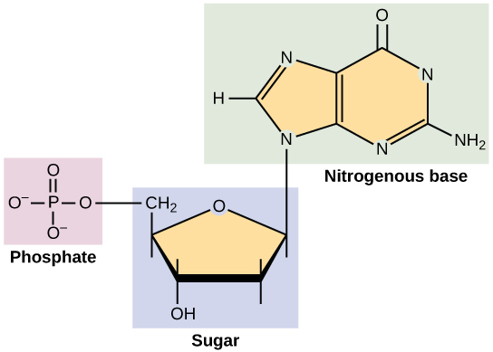
3.5 Nucleic Acids
Nucleic acids are essential macromolecules that carry genetic information and provide instructions for cell function.
Nucleotides are the monomers of nucleic acids, each consisting of a nitrogenous base, a five-carbon (pentose) sugar, and a phosphate group.
Nucleotides link together to form polynucleotides, creating the two main types of nucleic acids, DNA and RNA, which store and transmit genetic information.
Image by OpenStax, CC BY 4.0

Slide 28
3.5 Types of Nucleic Acids
DNA
DNA is the genetic material found in all living organisms, from bacteria to mammals. Its sequence of nitrogenous bases (A, T, G, C) determines genetic information and directs protein synthesis.
DNA consists of two nucleotide strands forming a double helix, held together by covalent bonds in the backbone (sugar-phosphate) and hydrogen bonds between base pairs.
The nitrogenous bases pair specifically: A pairs with T, and G pairs with C, maintaining a consistent spacing between the DNA strands.
RNA
RNA is primarily involved in protein synthesis, acting as an intermediary between DNA and the rest of the cell since DNA remains in the nucleus.
Different types of RNA play roles in protein synthesis and regulation, including messenger RNA (mRNA), ribosomal RNA (rRNA), transfer RNA (tRNA), and microRNA.
RNA nucleotides contain adenine (A), guanine (G), cytosine (C), and uracil (U) instead of thymine (T), distinguishing it from DNA.

Slide 29
3.5 DNA versus RNA
Feature | DNA | RNA
Function | Carries genetic information | Involved in protein synthesis
Location | Remains in the nucleus | Leaves the nucleus
Structure | DNA is a double-stranded “ladder”: sugar-phosphate backbone, with base rungs. | Usually single-stranded
Sugar | Deoxyribose | Ribose
Nitrogenous Bases | Adenine, Guanine, Cytosine, Thymine | Adenine, Guanine, Cytosine, Uracil

Slide 30
Key Takeaways
Biological Macromolecules and Their Importance.
Carbon’s Role in Molecular Diversity.
Formation and Breakdown of Macromolecules.
Structure and Function of Carbohydrates, Lipids, and Proteins.
Nucleic Acids as Genetic Blueprints.

