Slide 1
Biology Essentials
Chapter 2: Chemistry of Life

Slide 2
Learning Objectives
By the end of this chapter, you will be able to:
Describe matter and elements.
Describe the interrelationship between protons, neutrons, and electrons and how electrons can be donated or shared between atoms.
Describe how the arrangement of electrons in an atom determines the formation and type of chemical bonds, including ionic, covalent, and hydrogen bonds.
Describe the properties of water that are critical to maintaining life.

Slide 3
2.1 Atoms and Elements I
Matter consists of elements, which cannot be chemically broken down or transformed into other substances.
Elements are made of atoms, each with a unique number of protons. Of the 118 known elements, only 92 occur naturally, and fewer than 30 are found in living cells, while the rest are unstable or theoretical.
Each element has a unique chemical symbol and properties that determine how it bonds with others. The four essential elements in all living organisms are oxygen (O), carbon (C), hydrogen (H), and nitrogen (N).

Slide 4
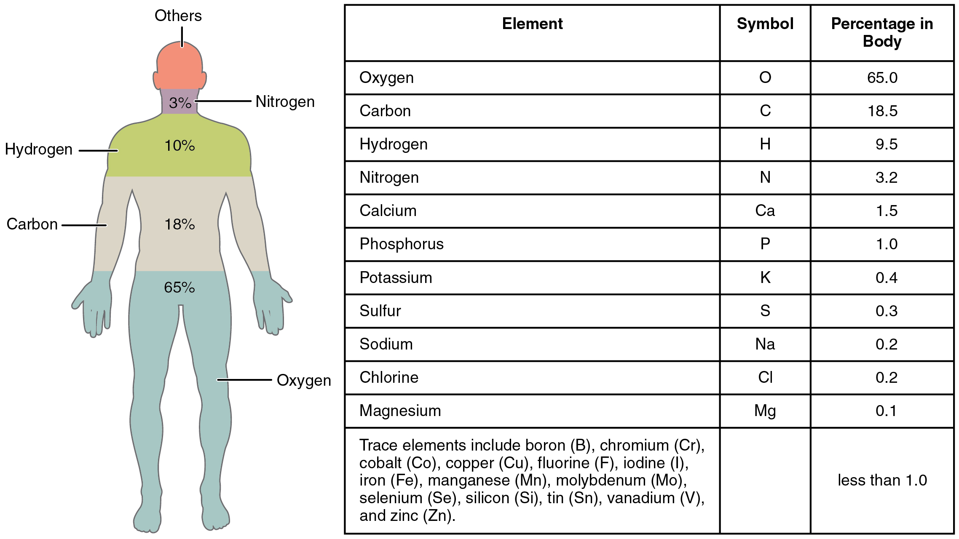
2.1 Atoms and Elements II
The human body’s main elements are shown from most to least abundant.
Image by OpenStax, CC BY 4.0

Slide 5
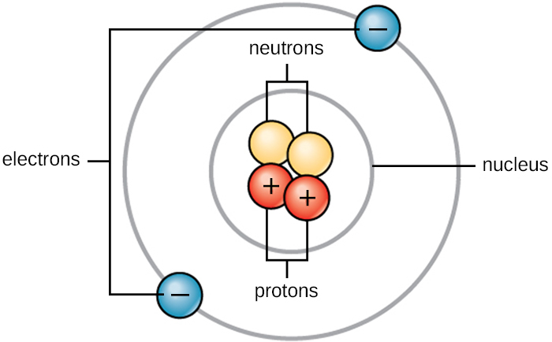
2.1 Atoms I
An atom is the smallest unit of an element that retains its chemical properties. Breaking an atom into subatomic particles removes these properties.
Atoms consist of protons, neutrons, and electrons.
Protons have a mass of 1 and +1 charge
Neutrons have a mass of 1 and no charge
Electrons have negligible mass and -1
The mass of an atom is equal to the number of protons and neutrons.
The positive and negative charges of the protons and electrons balance out in a neutral atom with a net zero charge.
Image by OpenStax, CC BY 4.0

Slide 6
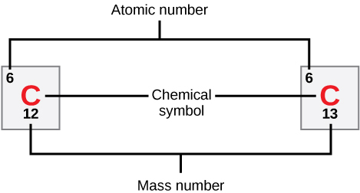
2.1 Atoms II
All organisms are composed of elements, which consist of atoms with the same number of protons.
These atoms combine to form molecules, which build cells, tissues, organs, and entire multicellular organisms.
Each element has unique properties based on its number of protons and neutrons, which define its atomic and mass numbers.
The atomic number represents the number of protons in an element.
The mass number is the sum of protons and neutrons.
Elements have unique properties, including different melting and boiling points and states (solid, liquid, or gas) at room temperature.
Some elements form specific types of bonds, the way they bond is influenced by their electron configurations.
Image by OpenStax, CC BY 4.0

Slide 7
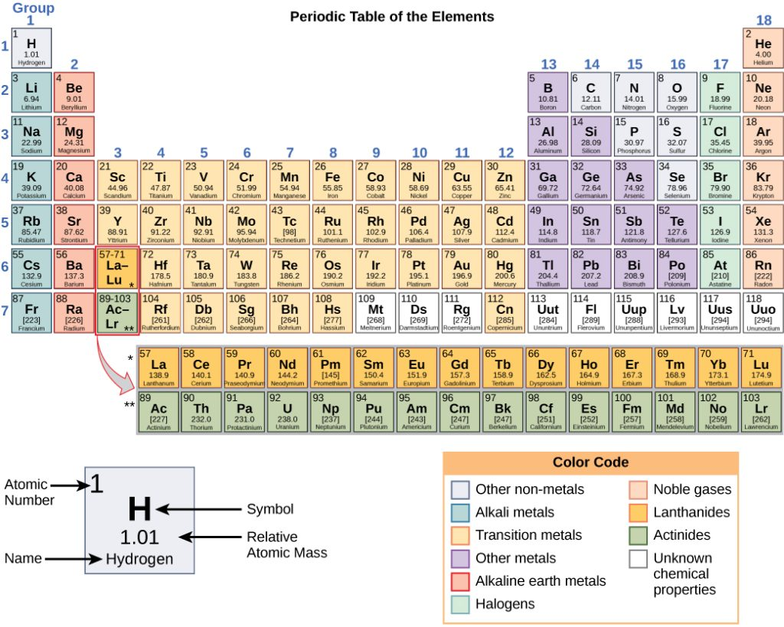
2.1 The Periodic Table
The periodic table arranges elements by atomic number and relative atomic mass.
The atomic number provides key information about elemental properties, often using colour coding, and helps predict how elements interact.
The structure of the periodic table reflects how electrons are organized in each element, which determines how atoms react to form molecules.
Isotopes are variations of the same element that have the same number of protons but a different number of neutrons. Naturally occurring isotopes exist for elements like carbon, potassium, and uranium.
Some isotopes are unstable and release particles or energy to become more stable elements. These are called radioactive isotopes or radioisotopes.
Image by OpenStax, CC BY 4.0

Slide 8
2.2 Electrons
Electrons exist in energy levels or shells around the nucleus.
The closest shell holds up to two electrons and fills first before any others.
Hydrogen and helium are the only elements with electrons in the first shell.
The second and third energy levels can each hold up to eight electrons, arranged in four pairs.
Elements in the same row of the periodic table have the same number of electron shells but an increasing number of electrons from left to right.
The periodic table's rows correspond to the number of electron shells. Elements in the second row, such as lithium to neon, have electrons in only the first two shells, with increasing electrons in their outermost shell.
Image by Danmarks Nationalleksikon, PMD 1.0

Slide 9
2.2 Chemical Bonds
The outermost electron shell, or valence shell, determines an element's stability. Atoms are most stable when their valence shell is full, driving them to form bonds with other atoms to achieve this stability.
Atoms with low atomic numbers (up to calcium) follow the octet rule.
They strive to have eight electrons in their valence shell.
They achieve this by sharing, accepting, or donating electrons, leading to chemical bond formation.
Images by OpenStax, CC BY 4.0

Slide 10
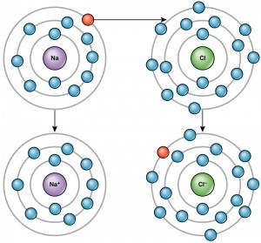
2.2 Ions
An atom becomes an ion when it has an unequal number of protons and electrons, resulting in a net charge.
Cations are positively charged by losing electrons.
Anions are negatively charged by gaining electrons.
Example:
Sodium (Na) has one electron in its outer shell, so it loses this electron to achieve stability, leaving it with 11 protons and 10 electrons, creating a +1 charge and forming a sodium ion (Na⁺).
Chlorine (Cl) has seven electrons in its outer shell, so it gains one electron to complete its shell, resulting in 17 protons and 18 electrons, creating a -1 charge and forming a chloride ion (Cl⁻).
The movement of electrons between elements, called electron transfer, allows atoms to achieve full outer shells, satisfying the octet rule—as seen when sodium donates an electron to chlorine, forming stable Na⁺ and Cl⁻ ions.
Image by OpenStax, CC BY 4.0

Slide 11
2.2 Types of Chemical Bonds
Ionic Bonds
An ionic bond is a chemical bond formed when one atom donates an electron to another, creating positively and negatively charged ions that are attracted to each other due to electrostatic forces.
Covalent Bonds
A covalent bond is a chemical bond formed when two atoms share one or more pairs of electrons to achieve stability in their valence shells.
Nonpolar Covalent Bonds occur when electrons are shared equally between atoms of the same or similar elements, for example, O₂, N₂, and CH₄.
In a Polar Covalent Bond, the electrons shared by the atoms spend more time closer to one nucleus because of the unequal distribution of electrons a slightly positive (δ+) or somewhat negative (δ–) charge develops.
Hydrogen Bonds
A hydrogen bond is a weak attraction between a partially positive hydrogen atom in one molecule and a partially negative atom (such as oxygen or nitrogen) in another molecule, commonly found in water and DNA structures.

Slide 12
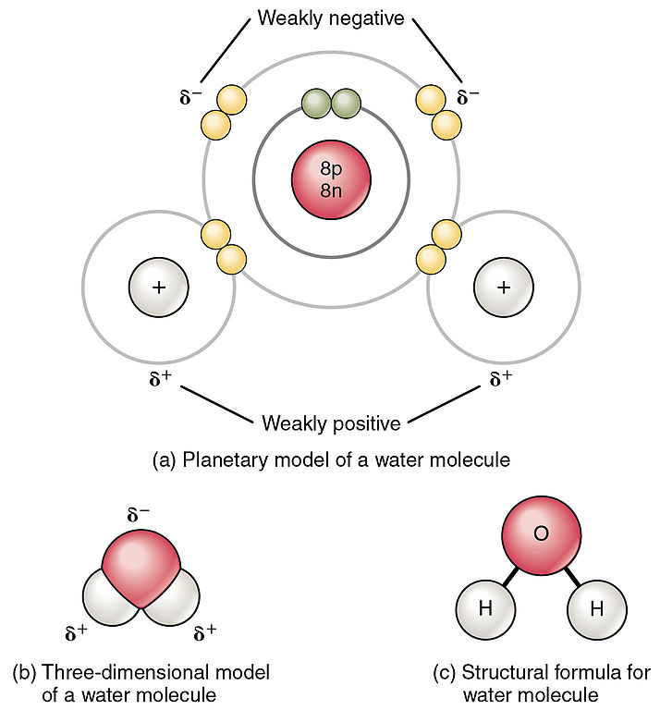
2.3 Water is Polar
Water molecules form polar covalent bonds, where shared electrons spend more time around the oxygen atom, giving oxygen a slight negative charge and hydrogen atoms a slight positive charge, creating a unique molecular shape.
The partial charges in water molecules cause them to attract each other and other polar molecules through hydrogen bonds, contributing to water’s cohesive and adhesive properties.
Hydrophilic substances, like sugars, readily form hydrogen bonds with water and dissolve.
Hydrophobic substances, like oils and fats, do not form hydrogen bonds and do not dissolve in water.
Image by OpenStax, CC BY 4.0

Slide 13
2.3 Water Stabilizes Temperature
Water absorbs and releases heat energy slowly due to hydrogen bonding, which helps moderate temperature changes in organisms and their environments.
As energy input increases, hydrogen bonds break, allowing individual water molecules to evaporate, which helps cool organisms (e.g., through sweating) by removing heat from the body.
As temperatures drop, hydrogen bonds remain intact and form a rigid, lattice-like structure, making ice less dense than liquid water, which allows it to float.
Floating ice insulates the water below, preventing entire bodies of water from freezing solid, ensuring that aquatic life can survive in cold environments.
Image by OpenStax, CC BY 4.0

Slide 14
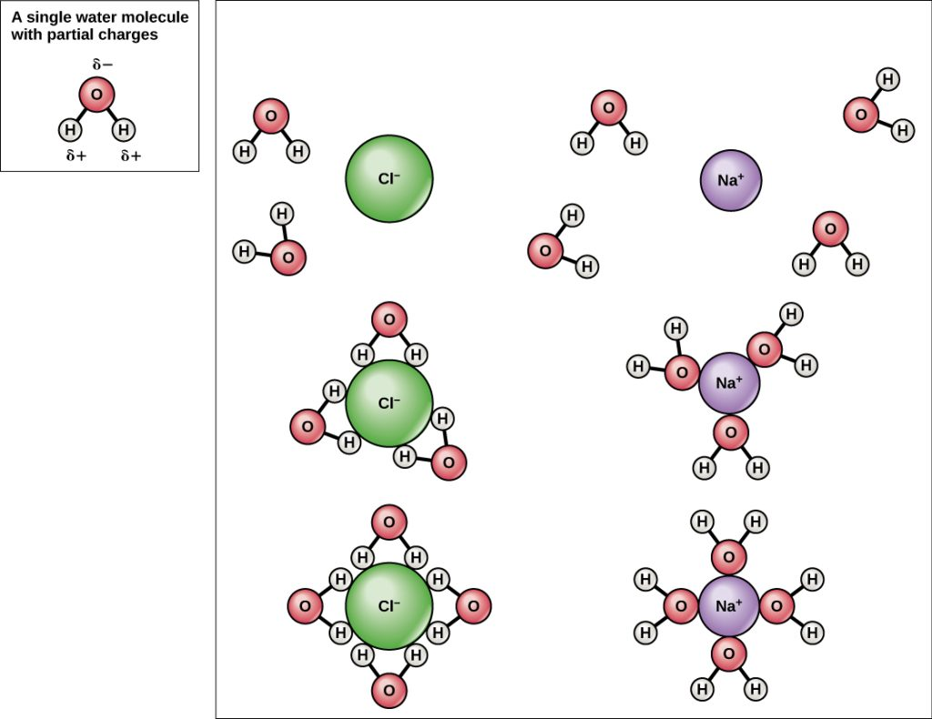
2.3 Water is an Excellent Solvent
Due to its polarity, water can dissolve ionic compounds and polar molecules, making it an essential solvent in biological systems.
When substances dissolve in water, charged particles form hydrogen bonds with surrounding water molecules, creating a sphere of hydration (hydration shell) that keeps them dispersed.
Example:
Dissolution of Salt (NaCl) – In water, sodium (Na⁺) and chloride (Cl⁻) ions dissociate, with Na⁺ surrounded by oxygen atoms (partially negative) and Cl⁻ surrounded by hydrogen atoms (partially positive), demonstrating water’s role in dissolving substances.
Image by OpenStax, CC BY 4.0

Slide 15
2.3 Water is Cohesive
Water molecules are attracted to each other through cohesion, creating surface tension.
Surface tension allows water to form a dome shape above a glass and enables objects to float if the surface tension remains unbroken.
Adhesion, the attraction between water molecules and other substances, allows water to cling to surfaces.
Cohesion keeps water molecules together.
The combined effects of cohesion and adhesion enable various natural phenomena, including capillary action and allowing water to move through plant roots to the leaves.
Image by OpenStax, CC BY 4.0

Slide 16
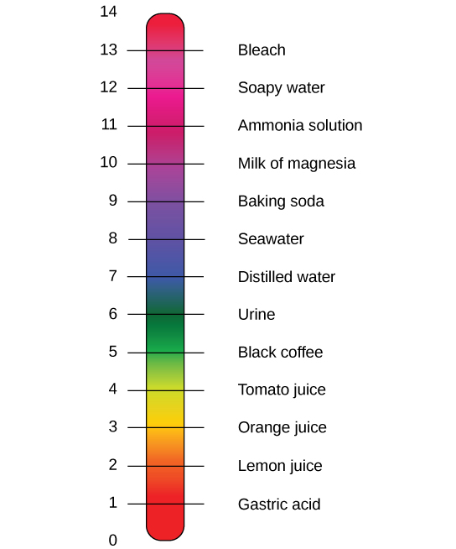
2.3 Buffers, pH, Acids, and Bases I
The pH of a solution measures its acidity or alkalinity, determined by the concentration of hydrogen ions (H⁺); more hydrogen ions result in a lower pH, while fewer hydrogen ions lead to a higher pH.
The pH scale ranges from 0 to 14, where each unit change represents a tenfold difference in hydrogen ion concentration, meaning small pH changes indicate significant shifts in acidity or alkalinity.
Neutral, Acidic, and Alkaline Substances
Pure water is neutral (pH 7.0)
Substances with pH below 7.0 are acidic
Those with pH above 7.0 are alkaline (basic).
Examples from daily life:
Stomach acid: pH 1-2 (highly acidic)
Orange juice: pH ~3.5 (mildly acidic)
Blood: pH 7.4 (slightly alkaline)
Baking soda: pH 9.0 (basic)

Slide 17
2.3 Buffers, pH, Acids, and Bases II
Acids release hydrogen ions (H⁺) and lower pH
Bases release hydroxide ions (OH⁻) and raise pH
Stronger acids donate H⁺ more readily, while strong bases donate OH⁻, which combines with the H⁺ to form water.
pH Balance in the Human Body
Most cells function within a narrow pH range (7.2–7.6), and deviations can disrupt organ function, protein stability, and even lead to coma or death.
Buffers, like the carbonic acid (H₂CO₃) and bicarbonate (HCO₃⁻) system, help maintain stable pH by absorbing excess H⁺ or OH⁻, preventing dangerous fluctuations, with carbon dioxide playing a key role in regulating this balance.

Slide 18
Key Takeaways
Basic Composition of Matter.
Chemical Bonds and Stability.
Properties of Water.
Isotopes and Ions.
The Periodic Table’s Role.
pH, Acids, Bases, and Buffers.

