Slide 1
Biology Essentials
Chapter 10: Biotechnology

Slide 2
Learning Objectives
By the end of this chapter, you will be able to:
Define biotechnology and genetic engineering and describe their development from traditional practices to modern molecular techniques.
Explain recombinant DNA technology, including the roles of vectors, restriction enzymes, and gene cloning in producing genetically modified organisms (GMOS).
Describe how CRISPR-Cas9 gene editing works and how it differs from traditional recombinant DNA methods in precision and application.
Identify key applications of genetic engineering in medicine (e.g., insulin production, gene therapy), agriculture (e.g., transgenic crops), and the environment (e.g., bioremediation).
Distinguish between embryonic, adult, and induced pluripotent stem cells (iPSCs) and discuss their roles in regenerative medicine, drug testing, and disease modelling.
Describe reproductive cloning and evaluate its uses in conservation, agriculture, research, and potential de-extinction efforts.
Evaluate the ethical, legal, and social implications of biotechnology, including genetic privacy, gene editing, and designer babies.
Explain how gene therapy and CRISPR technologies are applied to treat genetic diseases, cancers, and viral infections.

Slide 3
10.1 Genetic Engineering
Biotechnology involves using artificial methods to modify the genetic material of organisms to create new compounds or perform new functions.
Its origins lie in ancient practices like fermentation and selective breeding in agriculture and livestock.
Modern biotechnology began in the 20th century with the discovery of DNA’s structure and the creation of tools to manipulate DNA.
It includes genetic engineering, stem cell research, and reproductive cloning, each with specialized applications.
Genetic engineering has transformative potential in medicine, agriculture, and sustainability, but also carries risks and ethical concerns.
Key methods in genetic engineering include recombinant DNA technology and gene editing, allowing precise manipulation of genetic material.

Slide 4
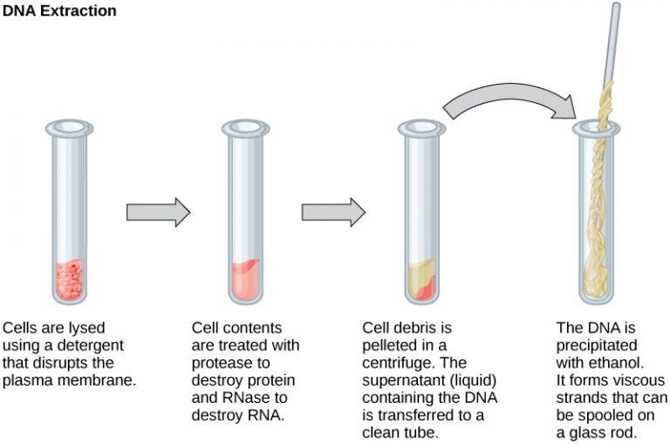
10.1 Isolation of Nucleic Acids
DNA extraction begins by breaking open cells using a detergent solution.
Enzymes are added to remove proteins and RNA that could interfere with the DNA.
Alcohol is added to the solution, causing the DNA to precipitate out as a jelly-like substance.
Image by OpenStax, CC BY 4.0

Slide 5
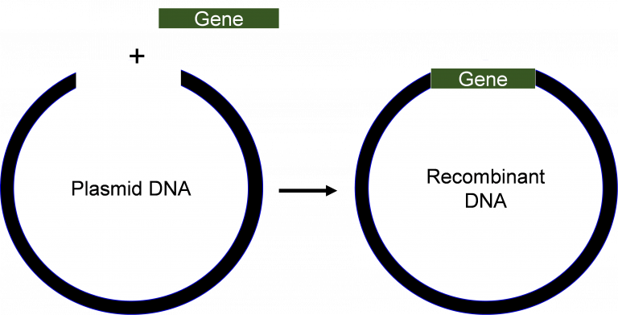
10.1 Recombinant DNA Technology I
Recombinant DNA technology involves combining DNA from different sources to create new genetic combinations.
A vector, usually a bacterial plasmid, is used to transport and replicate the target DNA fragment inside a host cell.
As the bacteria divide, the plasmid (with the inserted DNA) is copied, enabling gene cloning or molecular cloning.
Image by Walter Suza. CC BY-NC-SA 4.0

Slide 6
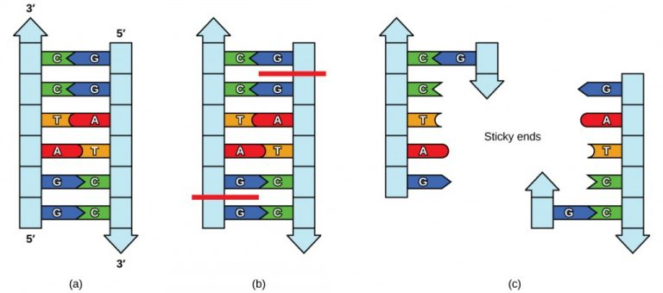
10.1 Recombinant DNA Technology II
These enzymes act like molecular scissors, cutting DNA at specific sites and creating sticky ends for easy insertion.
The sticky ends of the plasmid and target gene bond together, allowing the new gene to be inserted into the plasmid.
DNA ligase seals the inserted gene into the plasmid, forming recombinant DNA, which is then introduced into host cells and cultured to produce the desired gene product.
Image by OpenStax, CC BY 4.0

Slide 7
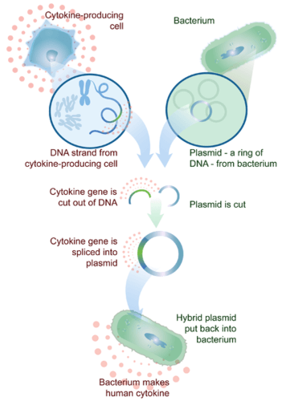
10.1 Insulin Production
Human genes can be inserted into bacteria, enabling them to produce human proteins for medical use.
Insulin was the first human protein made this way, helping treat type 1 diabetes, where patients cannot produce insulin naturally.
Recombinant DNA technology allowed scientists to clone the insulin gene and engineer bacteria to produce it in large amounts.
This method is now used to produce other proteins like Human Growth Hormone and cytokines for therapeutic purposes.
Image by CK-12 Foundation, CC BY-NC 3.0

Slide 8
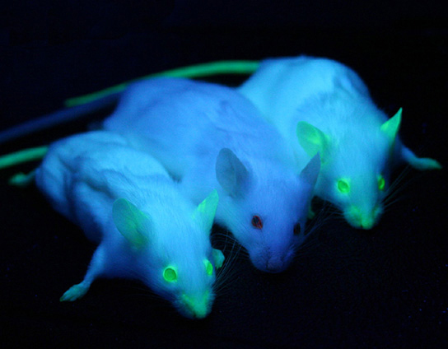
10.1 Transgenic Animals
Some human proteins require eukaryotic animal systems for proper processing, so genes are expressed in animals like sheep, goats, chickens, and mice.
Animals modified to carry and express recombinant DNA are called transgenic animals.
Transgenic goats and sheep have been used to produce human proteins in milk, such as an FDA-approved anticoagulant.
The AquAdvantage salmon, approved in Canada in 2016, is a transgenic fish engineered to grow faster using a growth hormone gene from another salmon species.
Image by Ingrid Moen et al., CC BY 4.0

Slide 9
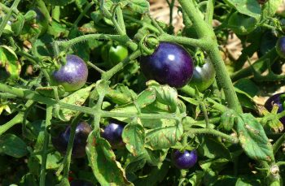
10.1 Transgenic Crops
Transgenic crops, or GMOs, are genetically modified with genes that provide traits beneficial to humans.
These crops may have traits such as higher yield, better taste, and resistance to drought, pests, and disease.
Example – Bt Corn: Bt corn contains a gene from Bacillus thuringiensis that produces a protein toxic to insect pests, reducing the need for chemical insecticides.
Scientists have developed crops like a purple tomato enriched with antioxidants that may help fight cancer.
Image by F Delventhal, CC BY 2.0

Slide 10
10.1 Production of Vaccines
Traditional vaccines use weakened or inactive microorganisms or viruses to trigger an immune response.
Modern vaccines use specific genes from pathogens, which are cloned and mass-produced in bacteria to create large quantities of specific proteins that stimulate the immune system.
These proteins are then used as the vaccine.
Traditionally, flu vaccines (aka flu shots) were made by growing the virus in chicken eggs, which was a time-consuming and labour-intensive process.
With recombinant DNA technology, flu vaccines can be produced faster and quickly adapted to respond to emerging flu strains.

Slide 11
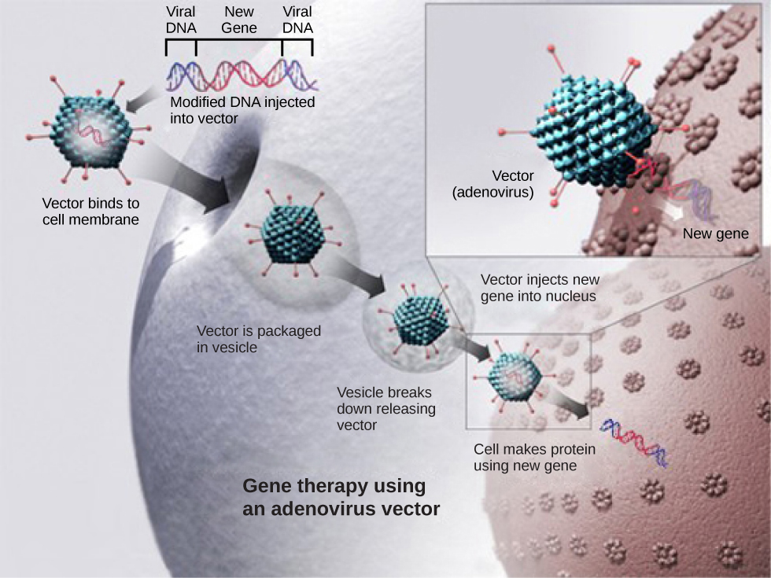
10.1 Gene Therapy
Gene therapy aims to treat or cure genetic diseases by introducing a healthy gene to replace or compensate for a faulty one.
The new gene is delivered into cells using a vector, often a virus, which integrates the DNA into the patient’s genome.
Though mostly experimental, some therapies like Hemgenix for hemophilia have been approved in Canada.
As technology improves, gene therapy offers great promise for curing a broader range of genetic disorders.
Image modification of work by NIH, CC BY 4.0

Slide 12
10.1 Gene Editing
Gene editing allows for precise changes within an organism’s DNA, including adding, deleting, or substituting bases—unlike recombinant DNA, which only adds genes.
CRISPR-Cas9, discovered in 2012 by Jennifer Doudna and Emmanuelle Charpentier, revolutionized gene editing by enabling efficient and accurate targeting of DNA.
CRISPR is a natural bacterial immune system that captures and reuses viral DNA to recognize and destroy future infections.
The system uses Cas9 (a DNA-cutting enzyme) and a guide RNA (gRNA) to target and cut specific DNA sequences.
After cutting, the cell’s repair enzymes may randomly insert or delete bases, disrupting the gene and effectively knocking it out.
Scientists can provide a DNA template during repair, allowing accurate corrections or insertions to fix mutations or add new genes.

Slide 13
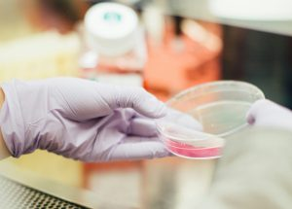
10.1 Medical Applications of Gene Editing
CRISPR-Cas9 can precisely edit genetic mutations to treat diseases; in 2024, Canada approved its use for sickle cell disease and beta-thalassemia.
The therapy involves editing hematopoietic stem cells to correct mutations that affect blood cell development.
CRISPR is being explored to modify cancer-related genes, offering potential for more effective and personalized cancer therapies.
Researchers are using CRISPR to target and remove viral DNA (e.g., HIV and hepatitis B) from infected cells, aiming for long-term cures.
Image by Drew Hays, Unsplash License

Slide 14
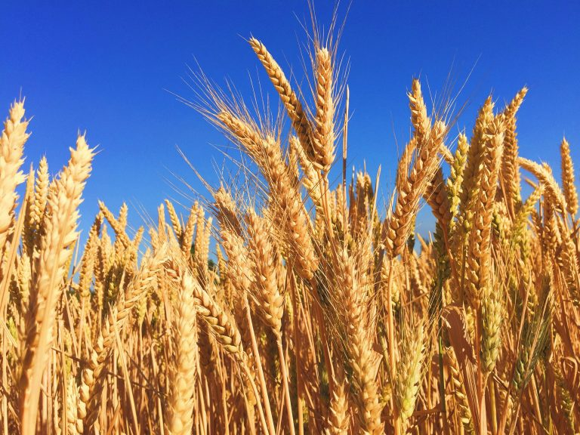
10.1 Agricultural Applications of Gene Editing
CRISPR is used to enhance disease, pest, and drought resistance in crops, such as fungus-resistant wheat.
It can also be applied to increase vitamins and minerals, improving the nutritional value of crops.
In Canada, gene-edited crops are regulated similarly to traditionally bred crops, unlike GMOs with foreign DNA, which face stricter evaluations.
CRISPR is being explored in livestock to improve disease resistance, growth, and productivity.
Image by Melissa Askew, Unsplash License

Slide 15
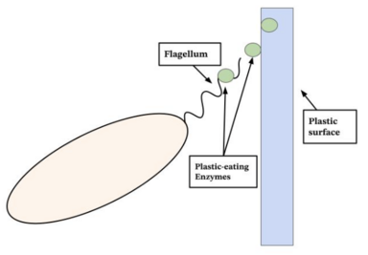
10.1 Environmental Applications of Gene Editing
CRISPR is used to enhance microorganisms that can break down pollutants and toxins, including efforts to degrade plastic waste.
Researchers are modifying bacteria like Ideonella sakaiensis to more efficiently break down PET plastics.
CRISPR may help protect endangered species by increasing genetic diversity and resilience to disease and environmental change.
Future applications may include using CRISPR to disrupt genes in invasive species, limiting their survival or reproduction to restore ecosystem balance.
Image by Jessicaniezwicki, CC BY-SA 4.0

Slide 16
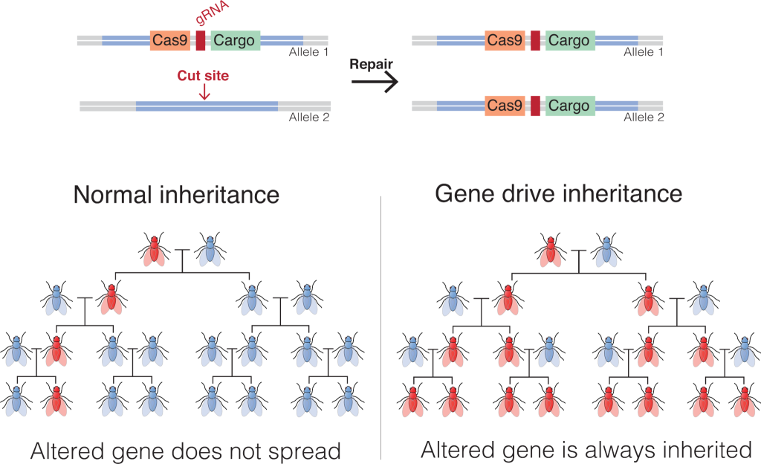
10.1 Potential Application –CRISPR-Cas 9 Gene Drives
A gene drive ensures a desired gene is passed to nearly all offspring, spreading it through a population faster than normal inheritance.
It uses CRISPR-Cas9 to cut DNA and insert the gene along with CRISPR components, enabling self-propagation of the trait.
Gene drives could help combat vector-borne diseases (e.g., malaria) and control invasive species or resistant pests in agriculture.
Gene drives are not yet used in the wild, but are being researched in controlled environments to assess safety and effectiveness.
They carry ecological risks and may be difficult to reverse, raising concerns about unintended consequences.
Image by Mariuswalter, CC BY-SA 4.0

Slide 17
10.2 Stem Cell Research
Stem cell research investigates the properties and applications of undifferentiated cells in biotechnology.
A stem cell is an unspecialized cell that can divide indefinitely and differentiate into specialized cells under certain conditions.
Their ability to become various cell types makes them valuable for regenerative medicine, disease modelling, and drug development.
Stem cells are classified by their origin and their potential to differentiate into different cell types.

Slide 18
10.2 Embryonic Stem Cells (ESCs)
Embryonic stem cells (ESCs) are pluripotent, meaning they can become almost any cell type in the body.
ESCs are used to study cell differentiation and develop therapies for various diseases.
They are derived from early-stage embryos, typically created through in vitro fertilization (IVF) but not implanted.
The use of embryos raises ethical debates, as critics view it as destroying potential human life.
Supporters highlight the medical potential, while the controversy continues to influence public policy and opinion.

Slide 19
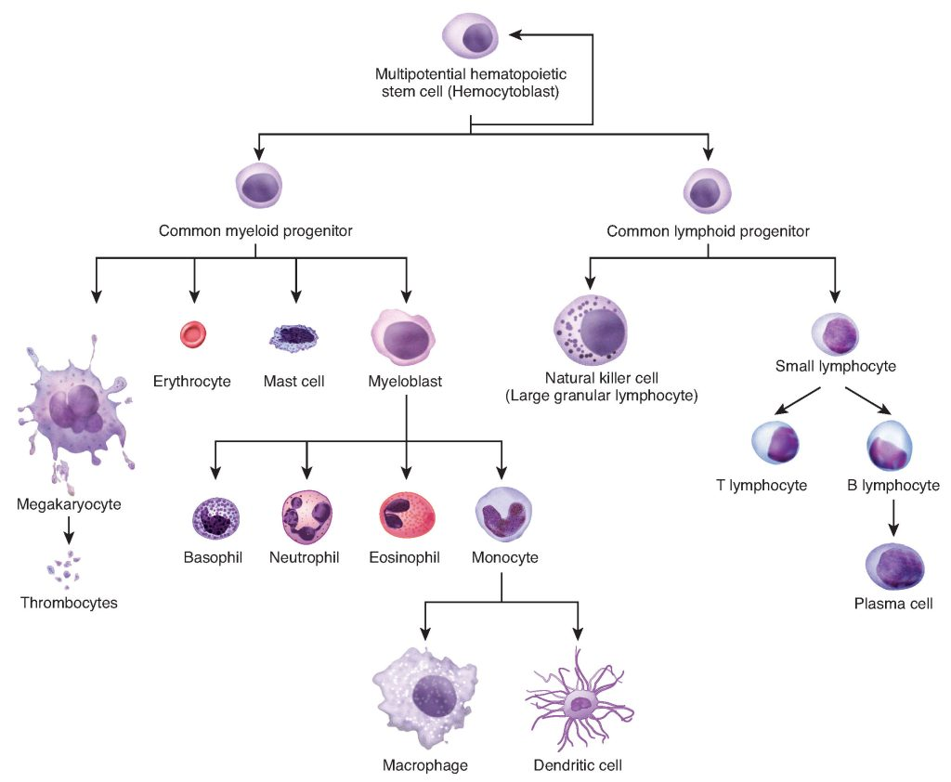
7.3 Phase 4: Telophase
Adult stem cells are multipotent, meaning they can differentiate into a limited range of cell types related to their tissue of origin.
They are less controversial than ESCs and can be harvested from the patient’s body, reducing the risk of immune rejection.
Adult stem cells are commonly used in treatments for blood-related diseases, such as leukemia, through bone marrow transplants.
Image by OpenStax, CC BY 4.0

Slide 20
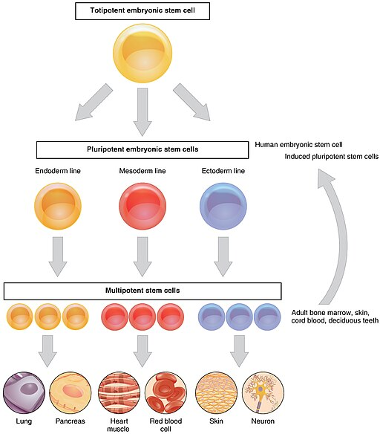
10.2 Induced Pluripotent Stem Cells (iPSCs)
iPSCs are reprogrammed adult cells with embryonic-like pluripotency, offering an ethical alternative to embryonic stem cells.
Discovered in 2006 by Shinya Yamanaka, iPSCs are widely used in disease modelling, drug testing, and personalized medicine.
Image by OpenStax, CC BY 4.0

Slide 21
10.2 Applications
Regenerative Medicine: Stem cells are used to repair or replace damaged tissues and treat diseases like leukemia, heart disease, and spinal cord injuries.
Disease Modelling: Stem cells help model disease development and progression, providing insights into conditions like Parkinson’s and Alzheimer’s.
Drug Testing: Stem cells enable drug testing on human-like cells, improving safety and accuracy before clinical trials.
3D Bioprinting with Stem Cells: Stem cells are used in 3D bioprinting to create tissues and organoids for disease study and drug testing, with hopes of printing full-size organs in the future.
Advances in stem cell research support personalized medicine, which tailors treatments to an individual’s biology for greater effectiveness and fewer side effects.
Researchers aim to use a patient’s own stem cells or iPSCs to bioprint customized tissues or organs, reducing immune rejection and improving recovery.

Slide 22
10.3 Reproductive Cloning
Reproductive cloning creates a genetically identical copy of a multicellular organism, unlike sexual reproduction which combines DNA from two parents.
In normal reproduction, haploid sperm and egg unite to form a diploid zygote, which then divides and develops into an organism.
The cytoplasm of the egg cell contains essential components for early development, making it critical for embryo formation.
Reproductive cloning involves removing the egg's nucleus, inserting a diploid nucleus from a donor body cell, and stimulating division.
The process is complex and inefficient, requiring many attempts to achieve success at each step.

Slide 23
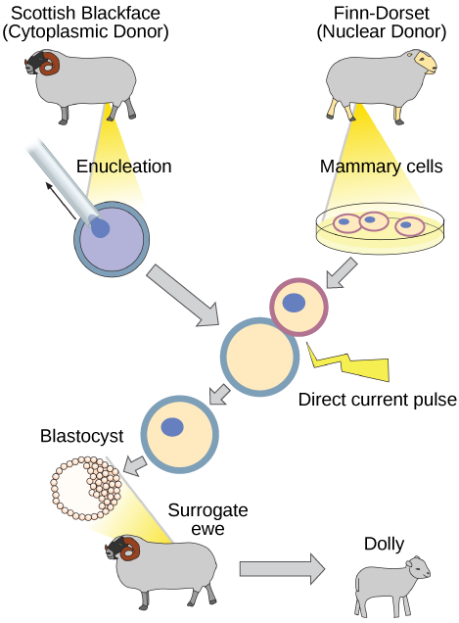
10.3 Reproductive Cloning - Dolly
First Success – Dolly: The first cloned animal, Dolly the sheep, was born in 1996, marking a major breakthrough in biotechnology.
Since Dolly, various animals such as dogs, cattle, and monkeys have been successfully cloned.
Image by OpenStax, CC BY 4.0

Slide 24
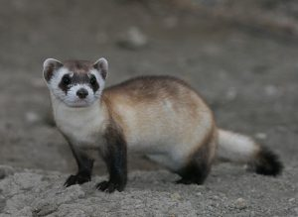
10.3 Applications – Conservation of Endangered Species
Reproductive cloning can help preserve endangered species by restoring lost genetic diversity.
In 2024, a black-footed ferret was successfully cloned using cells from a long-deceased wild animal.
This marked the first cloning of a native endangered species in the United States.
Image by USFWS Mountain Prairie, CC BY 2.0

Slide 25
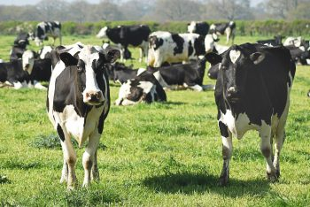
10.3 Applications – Agriculture
Reproductive cloning can be used to replicate elite livestock with desirable traits like high milk yield or quality meat.
While not used widely in production, cloning helps preserve valuable genetics in breeding programs.
Cloned animals ensure trait consistency across generations in herds.
Image by Monika Kubala, Unsplash License

Slide 26
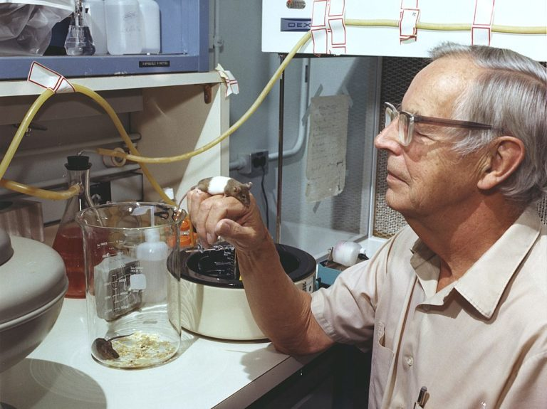
10.3 Applications – Medical Research
Cloned animals offer genetically uniform models, which are ideal for studying diseases.
Cloned mice are commonly used to test treatments due to their consistent genetic makeup.
This genetic uniformity leads to more controlled and reliable experiments in biomedical research.
Image by Oak Ridge National Laboratory, CC BY 2.0

Slide 27
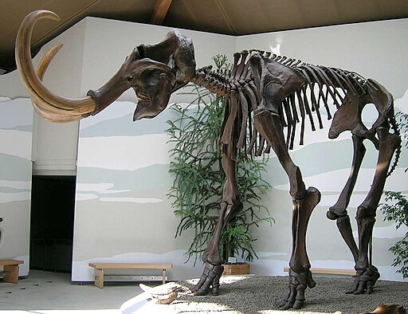
10.3 Applications – De-extinction
Researchers are exploring de-extinction by using preserved DNA to recreate extinct species like the woolly mammoth, using Asian elephants as surrogates.
Critics question whether efforts should instead prioritize protecting endangered species and raise concerns about interfering with nature.
Reintroducing extinct species could have unpredictable effects on modern ecosystems, potentially causing ecological disruption.
De-extinction might offer environmental advantages, such as helping to restore ecosystems and combat climate change through species like the woolly mammoth.
Image by Lou.gruber, Public Domain

Slide 28
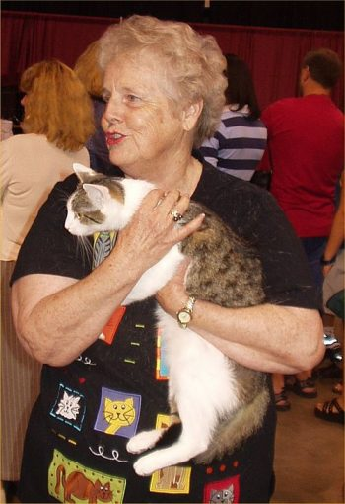
10.3 Applications – Pet Cloning
Companies now offer pet cloning services to produce genetically identical copies of animals.
Cloned pets may have different behaviours or personalities, and the process is costly.
Despite challenges, pet cloning is increasing in popularity due to strong emotional bonds with pets.
Image by Pschemp, CC BY-SA 3.0

Slide 29
10.4 Ethical, Legal, and Social Issues
The use of biotechnology has raised several ethical, legal, and social issues. Here are just a few:
Are genetically modified foods safe to eat? Might they have harmful effects on the people who consume them?
Are genetically engineered crops safe for the environment? Might they harm other organisms – or even entire ecosystems?
Who controls a person’s genetic information? What safeguards ensure that the information is kept private?
How far should we go to ensure that children are free of mutations?
Should parents be allowed to select or enhance traits in their children (“designer babies”) with gene editing?
How can we ensure equitable access to the various biotechnology tools?
How can we ensure that biotechnological research is conducted ethically and transparently?
Are there ethical concerns with using biotechnology to enhance human abilities beyond natural limits? What are the limits?
Is reproductive cloning of humans ever justifiable, and under what circumstances?
Who decides what extinct species to bring back to life? What are the limits? Should we bring back dinosaurs?

Slide 30
10.4 Case Study: The First Gene-Edited Babies
In 2018, Chinese scientist He Jiankui announced the birth of Lulu and Nana, the first babies with CRISPR-edited genomes designed to resist HIV by disabling the CCR5 gene.
The announcement triggered widespread condemnation from the scientific and bioethics communities, citing premature use, safety risks, and lack of oversight.
Jiankui was sentenced to 3 years in prison for violating medical regulations.
Germline Editing alters the DNA of reproductive cells or embryos, making the changes heritable by future generations.
While germline editing could prevent inherited genetic disorders, it poses unknown long-term risks and ethical concerns, including effects on genetic diversity and evolution.
Lulu and Nana’s edits are present in all their cells, including germline cells, meaning their descendants may inherit the modified genes—raising serious questions about human gene pool alteration.

Slide 31
10.4 Ethical Questions to Consider
Was it ethical for He Jiankui to proceed with gene editing on human embryos?
Did the parents of Lulu and Nana fully understand the risks and implications of the gene-editing procedure? How can informed consent be ensured in such cases?
What are the potential long-term health effects on Lulu and Nana, and how should they be monitored and supported throughout their lives?
What regulatory framework should be in place to oversee gene-editing experiments on humans? How can we ensure that regulations stay ahead of technological advances?
How can we ensure transparency in gene-editing experiments to prevent secret and unauthorized research?
How can society prevent the use of gene editing technology for non-therapeutic enhancements, such as selecting for intelligence or physical traits?
How can we ensure that gene editing technologies are accessible and do not exacerbate existing social inequalities?
What are the ethical implications of making heritable changes to the human genome? How might this affect future generations?
How should diverse cultural and religious views be considered in the debate over gene editing?
Put yourself in this situation. Would you allow gene editing on your own child to protect them from a disease? What about to cure them of a disease? What if the disease was fatal?

Slide 32
Key Takeaways
Biotechnology and Genetic Engineering Fundamentals.
Recombinant DNA Technology.
Applications in Medicine.
Agricultural and Environmental Benefits.
CRISPR-Cas9 Gene Editing.
Ethical and Social Considerations.

