Slide 1
The Art & Science of Personal Wellness: How to Thrive in the Modern World
Chapter 7: Personality and Behaviour

Slide 2
7.0 Learning Objectives
At the end of this chapter, you will be able to:
Distinguish personality from behaviour.
Identify the four DISC colours (Red, Yellow, Green, and Blue) and list their core traits.
Reflect on your own dominant DISC colour(s) and potential blind spots when interacting with others.
Recognize which colour pairings complement and/or challenge one another.
Explain how each DISC colour typically responds to stress and manages anger.
Identify targeted communication strategies for each DISC colour.
Explain how understanding and adapting to different DISC styles can promote personal wellness.

Slide 3
7.1 “Surrounded by Idiots”
You are part of a five-person team working on a major project worth 25% of your grade, prioritizing efficiency and results.
You take charge, setting a clear plan, assigning tasks, and pushing forward—until Karen constantly derails the discussion with off-topic chatter.
Tara and Tom contribute little, whispering on the side, making you wonder if they even care.
Dexter fixates on minor details, slowing progress with endless nitpicking.
The meeting drags on far longer than planned, leaving you frustrated and feeling like you must carry the entire project alone.
You question why you’re surrounded by inefficiency and chaos.
People approach work differently, leading to misunderstandings and tension.
Recognizing and adapting to these differences can improve teamwork, communication, and overall success.

Slide 4
7.2 Personality vs Behaviour
Personality is a combination of traits, behaviours, thoughts, and emotions that shape how individuals interact with the world.
Personality is influenced by genetics, life experiences, cultural background, and psychological factors.
Behaviour is an individual's outward actions and responses, shaped by both personality and situational factors.
Erikson’s formula BEHAVIOUR = f (P × Sf) explains that behaviour is a function (f) of personality traits (P) and situational factors (Sf), meaning both influence how a person acts in different contexts.
Understanding personality differences helps improve communication, relationships, and collaboration in personal and professional settings.
While no model can fully capture human personality, various frameworks exist to help interpret and assess personality traits.

Slide 5
7.3 The DISC Assessment
The DISC Assessment, introduced by William Moulton Marston in 1928, helps improve self-awareness and communication.
The model evolved into a widely used questionnaire-based assessment and influenced books like Surrounded by Idiots
Most people exhibit a mix of two dominant colours (80%), while 5% have one dominant colour, 15% are influenced by three, and none possess all four equally.
Red – Dominant: Reds are the least common of the four DISC personalities. They are driven, results-oriented, and value efficiency.
Yellow – Influential: Yellows are enthusiastic, sociable, and optimistic. They excel at communication and derive energy from interacting with others.
Green – Steady: Greens are the most common of the four DISC personalities. They are calm, dependable, and supportive, prioritizing stability and consistency.
Blue – Conscientious: Blues are analytical, detail-oriented, and precise. They value accuracy, quality, and structure and generally prefer to work independently.

Slide 6
7.3 The DISC Strengths and Drawbacks
Dominant (Red):
Thrives on challenges, takes charge, and prefers swift action with a strong focus on outcomes.
Can appear overly assertive, impatient, and struggle to delegate or integrate others' ideas.
Influential (Yellow):
Energetic, creative, and great at motivating others with a lively presence.
Prone to distraction, disorganization, and often overlooks details due to big-picture thinking.
Steady (Green):
Patient, empathetic, and excellent at maintaining harmony and structure in groups.
Avoids conflict, resists change and may prioritize others' needs to the point of burnout.
Conscientious (Blue):
Detail-oriented, analytical, and excels in research, planning, and precision.
Can be overly critical, perfectionistic, and struggles with flexibility in fast-changing situations.

Slide 7
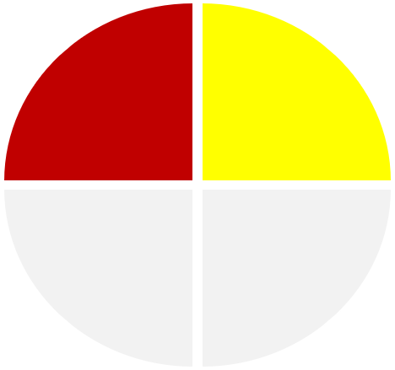
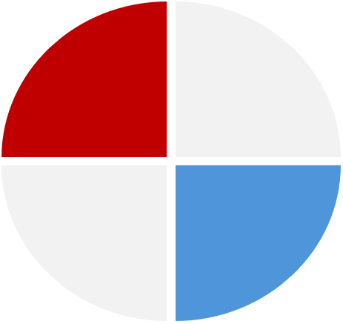
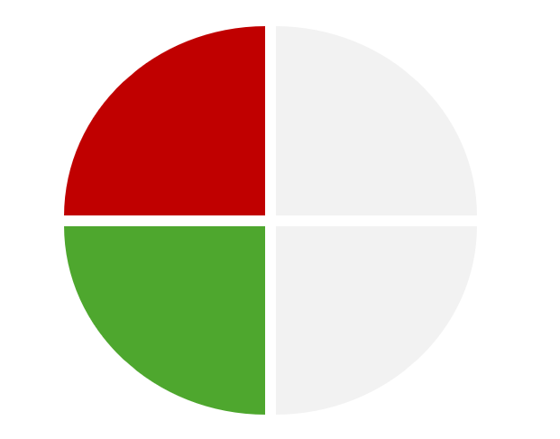
7.4 Colour Combinations: Complimentary
Red & Yellow (Extroverted):
Fast-paced duo combining Red’s drive with Yellow’s enthusiasm.
Red sees Yellow as unfocused. Yellow finds Red too forceful—clear communication helps.
Green & Blue (Introverted):
Thoughtful pair excelling in reflective decision-making.
Blue’s critiques may feel harsh. Green’s slow pace may frustrate—mutual respect is key.
Red & Blue (Task-Oriented):
Productive team valuing efficiency and logic.
Red wants quick action. Blue needs details—balancing speed with accuracy is crucial.
Yellow & Green (Relationship-Oriented):
Social Yellow meets Green’s steady support.
Green prefers stability. Yellow thrives on spontaneity—creativity needs structure.

Slide 8
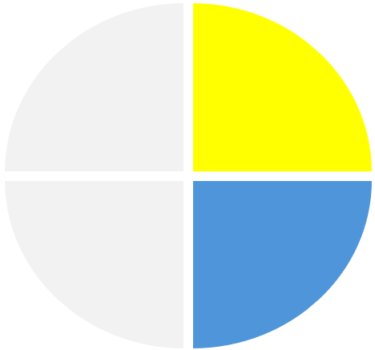
7.4 Colour Combinations: Challenging
Red & Green: Direct Red clashes with harmony-seeking Green.
Red wants quick decisions; Green seeks consensus and emotional security.
Red prioritizes efficiency, while Green values relationships and comfort.
Green may feel overwhelmed by Red’s blunt approach, leading to disengagement.
Solution: Red should slow down and show empathy, while Green should express concerns assertively.
Blue & Yellow: Detail-focused Blue contrasts with spontaneous Yellow.
Blue is structured and cautious; Yellow is instinctive and people-driven.
Blue values accuracy, while Yellow prefers big-picture thinking.
Yellow may resist Blue’s strict rules, while Blue may find Yellow too scattered.
Solution: Blue should appreciate Yellow’s creativity, while Yellow should respect Blue’s need for structure.

Slide 9
7.5 How Each Colour Manages Stress
Red:
Becomes more controlling and impatient, pushing for swift results.
Prolonged delays or indecision intensify stress reactions.
Yellow:
Becomes scattered and overcommitted, struggling with organization.
Tries to maintain optimism but may take on more than they can handle.
Green:
Withdraws and avoids confrontation to maintain harmony.
Internalizes worries, struggling to voice concerns in volatile situations.
Blue:
Overanalyzes and becomes overly critical, striving for perfection.
Meticulous scrutiny can stall decision-making and drain energy.

Slide 10
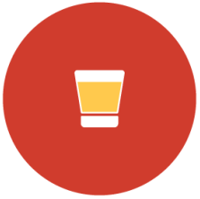
7.6 How Each Colour Manages Anger
Red (Shot Glass)
Short Fuse: Quick to anger with little provocation.
Anger Expression: Direct, forceful, and confrontational, often raising their voice.
Aftermath: Cools down quickly, acting as if nothing happened.
Analogy: Fills up fast and spills suddenly, but is easy to clean up.
Yellow (Pint Glass)
Moderate Fuse: Takes longer to anger than a Red.
Anger Expression: Expresses frustration emotionally, sometimes dramatically.
Aftermath: Moves on once they feel heard and acknowledged.
Analogy: Fills slower than a shot glass, but the spill is more noticeable.

Slide 11
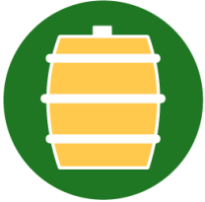
7.6 How Each Colour Manages Anger (continued)
Green (Barrel)
Long Fuse: Bottles up emotions to avoid conflict.
Anger Expression: Shows frustration through passive-aggression.
Aftermath: Suppressed anger lingers and may eventually explode.
Analogy: A sealed barrel stores everything inside, leading to a big mess if it bursts.
Blue (Barrel with Tap)
Controlled Fuse: Holds in anger, keeping it measured.
Anger Expression: Uses sarcasm, sharp criticism, or cold remarks.
Aftermath: Tension builds gradually if not properly released.
Analogy: A barrel with a tap allows slow release, but pressure can still build over time.

Slide 12
7.7 Speaking Each Colour’s “Language”
Social wellness is about effective interaction with others. Adapting communication to different DISC styles enhances connections without losing personal identity. It’s about balancing authenticity with respect for others, aligning with Erikson’s concept of integrity and social harmony.
Red – Be direct, confident, and efficient. Offer quick solutions and respect their time.
Yellow – Encourage creativity, engage positively, and help them stay focused.
Green – Be patient, listen actively, and provide reassurance without pressure.
Blue – Use logic, data, and clear evidence. Give them time for analysis.

Slide 13
7.8 Summary
Key Takeaways:
There is no such thing as a “normal” personality.
Understanding different personality types can help you navigate communication challenges, foster empathy, and build stronger personal and professional relationships.
There is no single way to categorize every nuance of human personality.
The DISC Assessment, consisting of four traits represented by colours, stands out for its ease of use and broad applicability, especially in workplace and personal development settings.
Certain colour pairings naturally align in terms of task or relationship focus, whereas others may struggle unless both sides adapt.
Each colour exhibits unique coping strategies under stress and when feeling anger.
Tailoring your approach to another person’s DISC style doesn’t mean betraying your own identity. Rather, it’s about meeting people where they are and fostering mutual respect and cooperation.

Slide 14
7.8 Key Terms
Personality: Refers to the combination of characteristics, behaviours, thoughts, and emotional patterns that influence how an individual interacts with the world. This encompasses a broad range of factors—such as gender, cultural background, psychological influences, and age.
Behaviour: Refers to an individual’s outward actions and responses. These responses are a function of one’s personality traits and situational factors.
DISC: According to this model, personalities are grouped into four main types – Dominant, Influential, Steady, and Conscientious.

