Slide 1
The Art & Science of Personal Wellness: How to Thrive in the Modern World
Chapter 5: Stress

Slide 2
5.0 Learning Objectives
At the end of this chapter, you will be able to:
Define stress as it pertains to wellness and discuss its historical roots.
List and describe the three phases of the General Adaptation Syndrome (GAS) model.
Explore how stress can impact all dimensions of wellness.
Identify common stressors in daily life.
Apply stress management techniques that align with the principles of wellness.
Compare and contrast eustress and distress.

Slide 3
5.1 “Late Night on the Edge”
It's nearly midnight, and you're buried in textbooks and coffee cups, desperately trying to prepare for tomorrow's midterms.
Your heart races and your mind jumps between topics as you push through with caffeine and determination, hoping to cover everything.
You continue a cycle of memorizing and problem-solving, but the stress weighs on you, causing physical tension and self-doubt.
Exhaustion sets in, and despite feeling sluggish and overwhelmed, you keep going, hoping to power through.
Eventually, fatigue takes over, and you fall asleep at your desk, missing your exam without caring.
Stress is a universal force that disrupts our well-being and acts as a major barrier to achieving high-level wellness.

Slide 4
5.2 Defining Stress
The term "stress" was borrowed from physics to describe internal pressure, similar to how the body reacts to stressors.
Stress is the body's and mind's response to threats or challenges, disrupting daily life and balance.
Stressors can be external (e.g., deadlines) or internal (e.g., self-criticism), triggering physical and mental changes.
Hans Selye's General Adaptation Syndrome (GAS) model explains how the body responds to prolonged stress in three phases: Alarm, Resistance, and Exhaustion.
Phases of GAS:
Alarm: The body’s fight-or-flight response is triggered, releasing hormones like adrenaline and cortisol to increase heart rate, blood pressure, and alertness.
Resistance: The body remains on high alert, with hormone levels elevated to handle prolonged stress, though it requires significant energy to maintain.
Exhaustion: The body’s energy reserves are depleted, leading to fatigue and increased vulnerability to physical and mental health issues if stress is not managed.

Slide 5
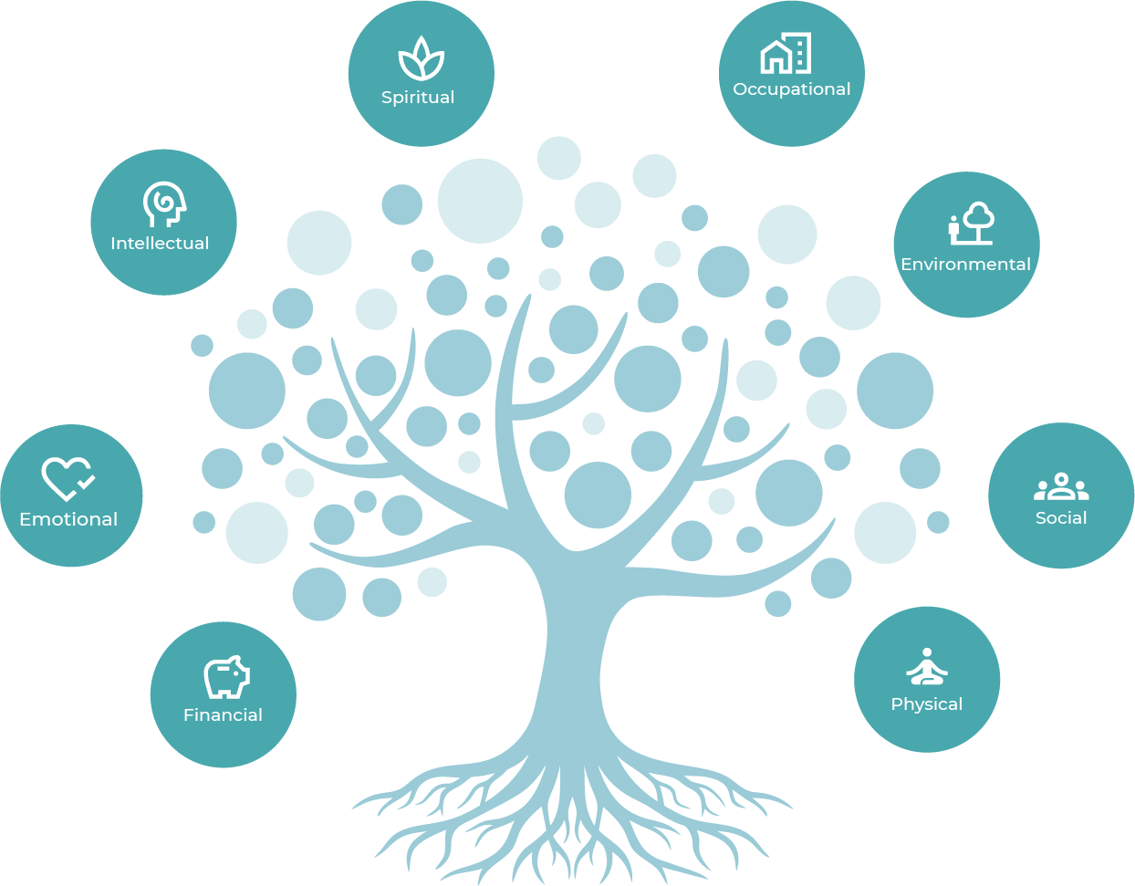
5.3 Impact on Wellness
Physical: Causes headaches, muscle tension, weight changes, sleep issues, and weaker immunity.
Emotional: Leads to irritability, anxiety, mood swings, and difficulty managing emotions.
Spiritual: Disconnects from practices and beliefs that provide peace and meaning.
Intellectual: Impairs concentration, memory, and decision-making.
Environmental: Reduces motivation to maintain a clean, organized space.
Financial: Results in poor decisions and avoidance of financial planning.
Occupational: Decreases productivity, job satisfaction, and increases conflicts.
Social: Damages relationships by causing withdrawal or irritability.
Wellness Tree by Freddy Vale, CC BY-NC-SA 4.0

Slide 6
5.4 Common Stressors
Major Life Changes: Events like marriage, divorce, job changes, moving, or having a child disrupt routines and balance.
Work or Academic Pressure: Tight deadlines, heavy workloads, and procrastination impact both students and professionals.
Financial Strains: Debt, unexpected expenses, or job insecurity create significant stress.
Relationship Conflicts: Disagreements, family tensions, or loneliness cause emotional strain.
Health Concerns: Chronic illness or caring for a loved one adds emotional and logistical challenges.
Environmental Factors: Noise, crowding, and unsafe living conditions increase stress.
Internal Pressure: Negative self-talk, perfectionism, and unrealistic expectations worsen stress.
Technology Overload: Constant connectivity and social media comparisons drain mental and emotional energy.

Slide 7
5.5 Stress Management: Recognition
Recognizing stress involves identifying its presence and determining which GAS stage applies by noticing physical, emotional, cognitive, and behavioural cues.
Alarm Phase: Symptoms include rapid heartbeat, muscle tension, anxiety, racing thoughts, and restlessness, lasting a few minutes.
Resistance Phase: Symptoms include persistent tension, fatigue, frustration, difficulty concentrating, and changes in behaviour, lasting hours or days.
Exhaustion Phase: Symptoms include chronic fatigue, illness, sadness, irritability, memory issues, and extreme behavioural changes.
Physical Cues: Alarm phase has a surge in energy, resistance phase has persistent tension, and exhaustion phase shows constant fatigue and frequent illness.
Emotional, Cognitive, and Behavioural Cues: Emotional instability, memory lapses, and unhealthy coping increase as stress progresses through the phases.

Slide 8
5.5 Stress Management: Action
Effective stress management addresses both immediate concerns and long-term well-being, avoiding quick fixes that may harm health. Consider the following techniques, which promote optimal being over the long term:
Mindfulness & Relaxation: Practices like meditation, deep breathing, and muscle relaxation help manage stress effectively.
Physical Activity: Engaging in movement-based activities like walking, yoga, or gardening improves overall well-being.
Setting Personal Boundaries: Learning to say "no" protects time, energy, and mental health.
Social Support: Connecting with supportive friends, family, or community groups provides emotional relief.
Cognitive Restructuring: Replacing negative thought patterns with balanced perspectives reduces stress.
Professional Help: Therapy, counselling, or coaching can offer personalized strategies when stress persists.

Slide 9
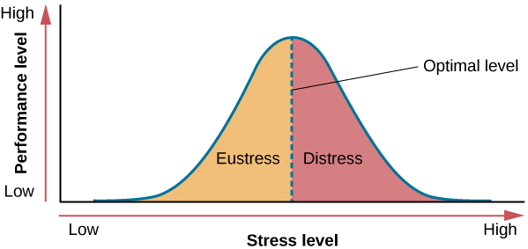
5.6 Optimal Stress
Eustress: Some stress can be beneficial, providing motivation and excitement, such as before a presentation or starting a new job. Recognizing this helps harness its benefits while minimizing harm.
As the stress level increases from low to moderate, so does performance (eustress). At the optimal level (the peak of the curve), performance has reached its peak. If stress exceeds the optimal level, it will reach the distress region, where it will become excessive and debilitating, and performance will decline (Everly & Lating, 2002).
“Stress and Performance” (Everly & Lating, 2002). Used under FDEd (CAN).

Slide 10
5.7 Summary
Key Takeaways:
Stress is a concept borrowed from physics to describe how forces (stressors) can strain our mental and physical “elasticity.”
Hans Selye’s General Adaptation Syndrome (GAS) model outlines three phases (Alarm, Resistance & Exhaustion) to explain how the body responds to stress.
Stress affects all eight dimensions of wellness.
Identifying which phase of the GAS model one is in can help implement tailored coping strategies.
Practices that contribute to both present and future well-being can help manage stress levels low and bolster resilience.
Stress can be motivating or harmful.

Slide 11
5.7 Key Terms
Stress: The body and mind’s response to any threat, demand, or challenge—referred to as a stressor—that disrupts one’s daily life and sense of balance.
General Adaption Syndrome (GAS): A model developed by endocrinologist Hans Selye that explains how the body responds to prolonged stress using three distinct and sequential phases – alarm, resistance, and exhaustion
Eustress: This is known as beneficial, motivating stress resulting in peak performance, such as the excitement before a presentation or when starting a new job
Distress: When stress exceeds the optimal level and becomes excessive and debilitating, resulting in declining performance

