Slide 1
The Art & Science of Personal Wellness: How to Thrive in the Modern World
Chapter 3: Freedom, Responsibility, and Goal Setting

Slide 2
3.0 Learning Objectives
At the end of this chapter, you will be able to:
Identify the major rights and freedoms listed in the Canadian Charter of Rights & Freedoms.
Discuss how freedoms differ from rights.
Discuss examples of misuse and understand how Canadian laws seek to address this.
Describe circumstances where one may be a victim versus adopting a victim mentality.
Describe how taking ownership of one’s actions, thoughts, and consequences fosters empowerment, accountability, and progress toward optimal being.
Contrast proactive behaviours with reactive behaviours.
Identify concerns in Covey’s circles.
Understand the importance of setting specific, measurable, realistic, and time-sensitive goals.

Slide 3
3.1 “It’s Not My Fault!”
A student used to easy success in high school struggles in college due to poor study habits and a lack of preparation.
After failing a course and barely passing others, they blame professors, classmates, and the system instead of reflecting on their own actions.
They feel excluded from study groups but make no effort to join, expecting others to invite them.
Stress and anxiety make academic challenges harder, and they expect professors to notice and intervene.
Instead of taking responsibility, they believe success is based on favoritism, leaving them frustrated and stuck.
Avoiding responsibility leads to repeated mistakes, hindering growth, self-awareness, and long-term success.

Slide 4
3.2 Rights and Freedoms
Rights are legal guarantees protected by law, carrying responsibilities that society or the government must uphold. They are enforceable, allowing individuals to appeal if violated. Let’s explore the major rights listed in the Canadian Charter of Rights and Freedoms:
Equality: Protection from discrimination based on race, religion, sex, disability, and other traits.
Legal: Rights to life, liberty, fair trials, and protection from unreasonable searches, detention, or cruel treatment.
Mobility: Freedom to enter, leave, and move within Canada for residence or work.
Language: Rights to communicate and receive services in English or French and access education in these languages where applicable.
Democratic/Voting: Right to vote and run for office at 18, with democratic governance ensured through regular parliamentary sessions.

Slide 5
3.2 Fundamental Freedoms
Freedoms allow individuals to act, speak, or think within legal limits, encouraging advocacy, diverse perspectives, and questioning authority. They are broader and less explicitly enforced than rights. Consider the following:
Conscience & Religion: Freedom to practice, teach, and observe one’s religion or beliefs.
Peaceful Assembly: Freedom to gather peacefully for protests, demonstrations, or other purposes.
Association: Freedom to join or form groups, unions, or organizations for any lawful purpose.
Thought, Belief, Opinion & Expression: Freedom of speech, the press, and other media of communication.

Slide 6
3.2 Misuse of Freedom
Freedoms may be misused when individuals exploit them in ways that intentionally harm others or violate societal laws and norms. Canada’s laws set limits to foster a fair, safe, and respectful society. Consider the following examples of misuse:
Harassment: Repeated actions that intimidate or offend; must cause reasonable fear to be criminal.
Threats of Physical Harm or Violence: Illegal under all circumstances, and immediate danger should be reported to law enforcement.
Hate Speech: Speech inciting hatred or violence based on protected traits; difficult to prove legally.
Reckless Speech: Speech that poses immediate harm, like false bomb threats or yelling “fire” in a crowded space.

Slide 7
3.3 Victim Discourse
Adversity is an inevitable part of life, and individuals may identify as victims of circumstances if one or more of the following criteria are met:
Rights or Freedoms Violated: Victimhood applies when fundamental rights, like equality or mobility, are infringed.
Crime Committed Against Them: Theft, assault, fraud, or other criminal offences can classify someone as a victim.
Diagnosed with an Illness: Medical conditions place individuals in circumstances beyond their control.
No Role in Preventing Harm: Victims of unforeseeable disasters or events beyond their influence are not responsible for the harm.
Victim Blaming: Shifting blame onto victims for crimes or misfortunes discourages justice and perpetuates harm.

Slide 8
3.3 Victim Mentality
Victim Mentality: Adopting a victim mindset leads individuals to blame external factors for their struggles, preventing accountability and personal growth.
Individuals with a victim mentality often exhibit the following patterns of thought and behaviour:
A World Centered Around Obstacles: They see life as uniquely unfair, believing their challenges are greater than others’.
A Negative and Fatalistic Outlook: They view life as inherently negative and beyond their control, expecting constant misfortune.
Seeking Sympathy Over Solutions: They seek validation through sympathy rather than taking action to improve their situation.
A Sense of Powerlessness: They believe the system is rigged, making efforts to change their circumstances feel pointless.
Excusing Personal Responsibility: They justify harmful behaviors by blaming circumstances instead of taking accountability.

Slide 9
3.4 Self-Responsibility
Self-Responsibility: Embracing accountability empowers individuals to take ownership of their actions, choices, and circumstances, fostering growth and well-being.
Elements of Self-Responsibility:
All Choices Are Personal: While external factors may influence decisions, individuals ultimately control their own choices.
Thoughts and Actions Are Intentional: Both thinking and acting are deliberate processes within an individual’s control.
All Actions Have Consequences: Every action leads to positive, negative, or neutral outcomes that must be acknowledged.
Accepting Responsibility for Consequences: True accountability means owning the results of one’s actions, whether intended or not.
Unforeseen Consequences Still Matter: Individuals remain responsible for their impact even when unaware of all possible outcomes.

Slide 10
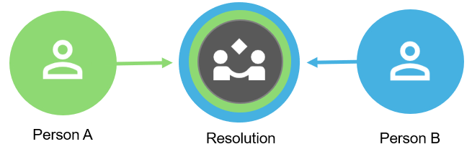
3.4 Who is Ultimately Responsible?
In any conflict between two or more individuals or groups (assuming there are no victims), three principles remain true:
Shared Responsibility: Both parties contribute to a conflict, even if one bears more responsibility.
No Absolute Right or Wrong: Disagreements are rarely black and white, as most conflicts involve complexity and nuance.
Resolution Requires Compromise: Conflict resolution relies on mutual effort, with both sides working toward reconciliation.
“Resolution,” by Stephanie Audette, CC BY-NC-SA 4.0

Slide 11
3.5 Proactivity Versus Reactivity
Proactivity: Involves making intentional decisions focused on long-term goals, taking responsibility, and planning ahead to anticipate challenges.
Future-oriented: Focuses on long-term goals and values, ensuring present actions benefit future outcomes.
Ownership: Takes responsibility for choices and anticipates challenges with solutions.
Intentional Action: Makes deliberate decisions based on what can be controlled.
Reactivity: Involves responding impulsively to situations, often without considering long-term effects or planning ahead.
Short-Term Focus: Prioritizes immediate relief without considering long-term consequences.
Lack of Control: Often feels powerless, leading to impulsive responses to challenges.
Dependence on External Factors: Decisions are influenced by outside forces rather than intentional planning.

Slide 12
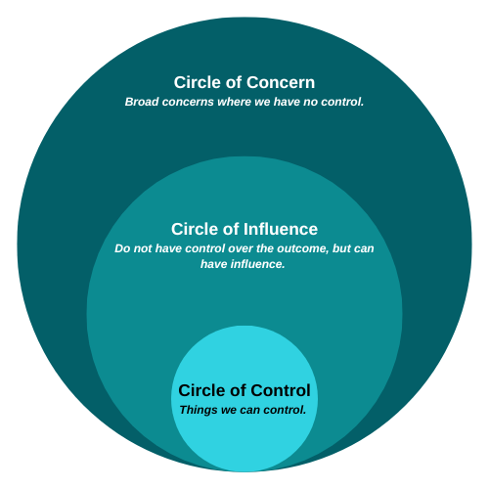
3.5 Covey’s Circles
Circle of Concern:
Covers things you care about but cannot directly control (e.g., global events, others' opinions).
Spending too much time here can lead to frustration or helplessness.
Circle of Influence:
Represents areas where you can influence outcomes, like through actions or words.
Focusing here allows you to make a positive impact without stressing over things beyond your control.
Circle of Control:
Encompasses things you have direct control over, like your responses, thoughts, and feelings.
Focusing on this circle empowers you to take responsibility and act in alignment with your values.
“Circles of Concern”, by Shauna Roch, CC BY-NC-SA 4.0. Adapted from The 7 Habits of Highly Effective People, by Stephen Covey, used under Fair Dealing for Educational Purposes (Canada).

Slide 13
3.6 Goal Setting
Why Set Goals?
Goals provide direction, focus, and motivation, helping break down long-term aspirations into manageable steps.
They give clarity, accountability, and a sense of accomplishment as milestones are achieved.
Traits of Effective Goals:
Specific: Goals should clearly define what you aim to achieve, making them easy to understand and actionable.
Measurable: Progress should be trackable with clear metrics or milestones to gauge success.
Realistic: Goals should be challenging but achievable to avoid frustration or lack of progress.
Time Sensitive: Deadlines create urgency, helping prioritize tasks and avoid procrastination.

Slide 14
3.7 Summary
Key Takeaways:
Canadians have fundamental rights, including equality, legal protection, mobility, language, and democratic rights.
Freedoms allow individuals to think, speak, and act freely within legal boundaries, including religion, assembly, association, and expression.
Misusing freedoms (e.g., hate speech, threats) harms society, so it limits the balance of individual rights with collective well-being.
While rights violations can make one a victim, adopting a victim mentality hinders personal growth and self-responsibility.
Self-responsibility fosters accountability, empowerment, and growth by owning actions and consequences.
Proactive individuals plan and focus on goals, while reactive individuals act impulsively, often leading to poor outcomes.
Effective decision-making focuses on what can be controlled rather than external worries.
Setting clear, measurable, and realistic goals provides direction, motivation, and long-term success.

Slide 15
3.7 Key Terms
Key Terms:
Victim: Someone who suffers harm, loss, or disadvantage due to external forces they could not control or prevent.
Victim blaming: When a victim of a crime, illness, or other harmful act is held entirely or partially responsible for the harm they experienced.
Victim mentality: An acquired personality trait where a person tends to see themselves (or others) as a victim of negative actions by others, in the absence of evidence or when circumstances suggest otherwise.
Self-responsibility: The state or fact of being responsible, answerable, or accountable for something(s) within one’s power, control, or management.

Slide 16
3.7 Key Terms Continued
Key Terms:
Proactivity: Making intentional and deliberate decisions with a focus on both present and future outcomes.
Reactivity: Responding to situations as they occur, often without preparation or consideration of future outcomes.
Circle of Concern: Includes everything one might care about or worry about in life.
Circle of Influence: Represents the areas where you can have an impact, even if you can’t fully control the outcomes.
Circle of Control: Includes everything you have direct control over, such as how you respond to your thoughts and feelings.

