Slide 1
The Art & Science of Personal Wellness: How to Thrive in the Modern World
Chapter 2: Meaning and Purpose

Slide 2
2.0 Learning Objectives
At the end of this chapter, you will be able to:
Define and differentiate meaning and purpose.
Explain how meaning and purpose serve as foundational elements of wellness.
Explore theories on the origin of meaning.
Identify potential sources of meaning and purpose.
Examine potential barriers to finding meaning and purpose.
Explore how meaning and purpose may evolve over the course of one’s lifespan.

Slide 3
2.1 “The Happiest Man on Earth”
Eddie Jaku, a Holocaust survivor, endured three years of brutal conditions in a concentration camp, facing starvation, forced labour, and dehumanization.
Despite immense suffering, he survived a death march and was eventually liberated, though he lost his family, identity, and years of his life.
His story reflects the broader human experience of extreme cruelty and suffering, seen in survivors of war, residential schools, and domestic violence.
Such experiences can lead to despair and a loss of meaning, even for those who haven’t faced extreme hardships.
Stories like Eddie Jaku’s demonstrate that meaning and purpose can be rebuilt despite suffering and injustice.
Finding meaning and purpose can serve as a foundation for resilience and healing after hardship.

Slide 4
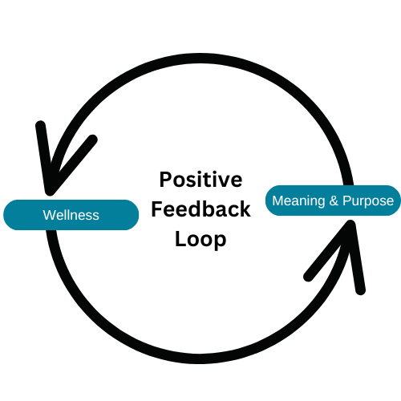
2.2 Are Meaning And Purpose Truly Necessary?
Wellness Needs a Foundation: Pursuing health without meaning is like building a house without a base—it won’t hold up.
Meaning Fuels Well-Being: It gives life purpose, motivation, and fulfillment, making wellness worthwhile.
People Seek Wellness Despite Uncertainty: Even without clear meaning, they may hope to find it through the journey.
Purpose Boosts Health: Research shows it leads to greater happiness, stronger immunity, and a longer life.
Wellness and Meaning Reinforce Each Other: Each strengthens the other, creating a cycle of deeper fulfillment.
The connection between wellness, meaning, and purpose. “Positive Feedback Loop” by Shauna Roch, CC BY-NC-SA 4.0.

Slide 5
2.2 Meaning: Understanding Life’s Significance
Meaning Gives Value: It helps us interpret our experiences, shaping our understanding of the past and guiding our future.
Personal or Shared: Meaning can come from close relationships, lifelong passions, or broader causes like social justice and science.
Creates Connection: It strengthens our sense of belonging, linking us to a greater purpose or community.
Discovered Meaning: Frankl believed meaning is found through life experiences, culture, and shared traditions.
Created Meaning: Nietzsche argued we define meaning through personal values, independence, and self-expression.
Key to Wellness: Whether found or created, meaning provides direction, fulfillment, and a foundation for well-being.
“Tree Reflection“, by photoeightyeight, Pixabay License

Slide 6
2.2 Purpose: The Driving Force Behind Our Actions
Purpose as Motivation: Purpose drives us to pursue meaningful experiences, guiding our actions and shaping our journey in life.
Future-Focused: It helps navigate life by transforming meaning into specific, actionable goals for growth and fulfillment.
Actionable Meaning: Purpose turns abstract meaning into concrete actions, whether large goals or small daily steps.
Varied Purpose: It can be expressed through career ambitions or smaller actions like volunteering or mentoring.
Building Resilience: Purpose encourages a growth mindset, helping individuals learn from challenges and persevere.
Growth and Fulfillment: Purpose promotes personal development and the desire to positively impact others.

Slide 7
2.2 The Relationship Between Meaning and Purpose
Definition
Meaning: The significance or value we assign to our lives and experiences.
Purpose: The reason or intention behind our actions; what we aim to achieve.
Focus
Meaning: Understanding the "why" behind our existence and experiences.
Purpose: The concrete and specific actions and goals that make life meaningful and fulfilling.
Nature
Meaning: Subjective: varies based on individual beliefs and values.
Purpose: Goal-oriented and action-driven; involves setting and pursuing objectives.
Outcome
Meaning: Provides a sense of fulfillment and understanding of one’s "place" in the world.
Purpose: Provides direction, motivation, and a sense of mission during daily activities

Slide 8
2.3 Possible Sources of Meaning and Purpose
Serving Others: Volunteering and caregiving enhance the giver’s sense of purpose and well-being.
Learning & Achievement: Meaningful work and achieving goals foster fulfillment and self-efficacy.
Religion & Spirituality: Faith and spiritual practices help connect with a greater purpose and offer insight.
Relationships, Community & Legacy: Strong bonds and community involvement create belonging and lasting impact.
Creativity, Play & Self-Expression: Creative outlets and play promote self-expression, balance, and connection.
Beauty, Nature & Adventure: Nature and new experiences foster awe, mindfulness, and appreciation.
Self-Responsibility: Taking responsibility for actions promotes growth, agency, and control.
Suffering: Facing struggles leads to resilience and finding meaning in challenges.

Slide 9
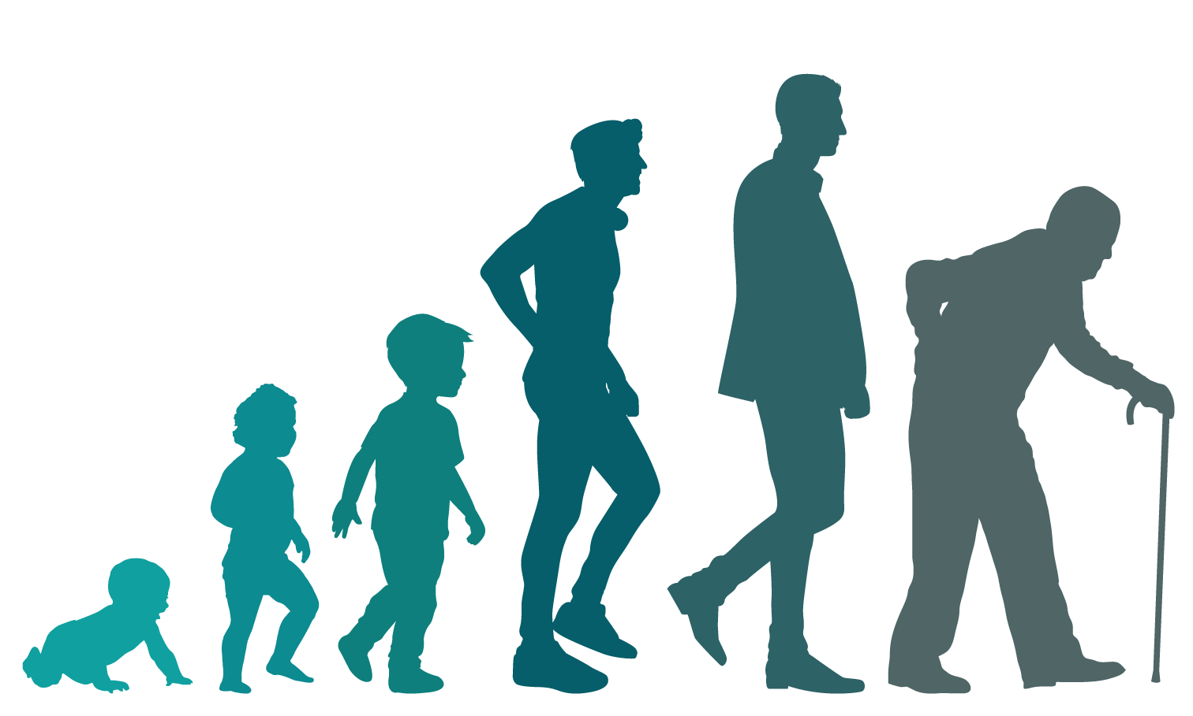
2.4 Across the Lifespan
Meaning and purpose evolve over life stages, offering unique opportunities and challenges for growth.
Adolescence (<18 years): Identity exploration through education, hobbies, friendships, and career interests, with guidance playing a crucial role.
Adulthood (18-65): Balancing career, relationships, and personal growth while reevaluating goals and contributing to the community.
Older Adulthood (>65): Reflecting on achievements, leaving a legacy, and finding purpose through family, volunteering, and social connections.
“Generations”, by Freddy Vale, CC BY-NC-SA 4.0

Slide 10
2.5 Possible Barriers to Meaning and Purpose
Societal Pressure: Cultural norms and social media can push individuals toward paths misaligned with their true values.
Lack of Self-Reflection: Without reflection and clear goals, it’s harder to understand passions, strengths, and values.
Fear: Fear of failure or judgment can lead to procrastination, perfectionism, and avoidance of meaningful goals.
Unresolved Trauma: Trauma can disrupt identity and relationships, making it difficult to engage meaningfully in life.
Disconnection & Loneliness: Isolation weakens a sense of belonging, which is essential for meaning and well-being.
Life Transitions: Major changes like retirement, parenthood, or loss can challenge identity and purpose.

Slide 11
2.6 Summary
Key Takeaways:
Meaning and purpose are fundamental to practicing wellness.
Meaning is the significance we attach to our experiences and understanding of why life matters.
Purpose is the direction and motivation that drives our actions toward meaningful goals.
Meaning can emerge through experiences or can be actively created.
A strong sense of purpose fosters resilience, helping individuals grow from adversity and persist through challenges.
Relationships with family and community, personal growth, meaningful work, spirituality, helping others, creative expression, and overcoming challenges can foster meaning and purpose.
Meaning and purpose may evolve depending on which stage of life an individual is in.
Barriers to meaning and purpose can hinder personal growth but also offer opportunities for reflection, resilience, and transformative action.

Slide 12
2.6 Key Terms
Key Terms:
Meaning: The significance or value we assign to our lives and experiences (the “why”).
Purpose: The reason or intention behind our actions; what we aim to achieve (the “how”).
Positive Psychology: Understanding and promoting positive emotions, meaningful experiences, resilience, personal growth, and optimal functioning, factors that contribute to individual and collective well-being with the goal of helping individuals and communities thrive by enhancing happiness, life satisfaction, and overall quality of life.
Flow: When a person becomes so focused and engaged in a challenging yet fulfilling activity that they lose track of time. (Csikszentmihalyi, 1990)
Mindfulness: Focusing one’s attention on the present moment by being fully aware of thoughts, feelings, bodily sensations, and the surrounding environment without trying to change them.
Resilience: Adapting and growing stronger in the face of adversity, stress, or trauma by developing the capacity to cope effectively and move forward in a positive way.

