Slide 1
The Art & Science of Personal Wellness: How to Thrive in the Modern World
Chapter 10: Longevity, Healthspan and Physical Activity

Slide 2
10.0 Learning Objectives
At the end of this chapter, you will be able to:
Compare and contrast lifespan and healthspan.
Recognize the "Four Horsemen" of chronic disease along with major risk factors.
Understand why a proactive approach is key to improving both healthspan and lifespan.
Differentiate between physical activity, physical exercise, and physical fitness.
Explore how physical activity influences multiple dimensions of wellness.
Describe the purposes and benefits of cardiovascular, resistance, and mobility/balance/stability exercise.
Identify common obstacles to regular exercise and propose realistic strategies to overcome them.

Slide 3
10.1 “Into the Future”
You wake up slowly, joints aching, and feel unsteady—stairs are no longer manageable, and daily tasks require assistance.
Your independence fades as your world shrinks to your home, limited not by age alone, but by preventable physical decline and chronic illness.
This decline could have been avoided through consistent physical activity—one of the most powerful predictors of health and longevity.
The choices you make today, especially how you move, directly shape the life and freedom you'll have in the decades to come.
In this chapter, we will examine lifespan and healthspan, explore four common chronic diseases that drive mortality and diminish the quality of life, and look at the role of physical exercise as a potent “drug” for not only living longer but also living well.

Slide 4
10.2 Living Longer vs Living Well
Lifespan represents the total number of years a person lives, a measure most people think of when they consider longevity. A person who lives to 80 has a longer lifespan than someone who lives to 78.
Healthspan, however, refers to the number of years one remains in good physical and mental health, active, and free from serious disease or disability. An individual who lives to 80 but spends the last 5 years in chronic pain or incapacitated will likely have a shorter healthspan than someone who lives to 78 and passes away suddenly with minimal decline in function.
"Smiling man and woman" by Tristan Le, Pexels

Slide 5
10.3 The Four Horsemen of Chronic Disease
Over time, these conditions slowly cause irreversible damage to the body, which often takes the form of reduced energy levels, making everyday activities far more challenging.
Metabolic Disease: Impacts our metabolic processes such as maintaining stable blood sugar and insulin levels, healthy blood pressure, and favourable cholesterol and triglyceride levels (i.e., Type 2 Diabetes).
Heart Disease: Includes a variety of conditions affecting the heart and blood vessels (i.e., Coronary Artery Disease).
Cancer: Is marked by abnormal cells growing uncontrollably, sometimes spreading (metastasizing) to other parts of the body (Lungs, colon, skin, etc).
Neurodegenerative Disease: A decline in cognitive ability (Alzherimer’s Disease).
“The Four Horsemen” “The Four Horsemen” image: OpenAI. (2025). ChatGPT.

Slide 6
10.4 Preventing the Horsemen
“Those who do not find time for exercise will have to make time for illness”.
- Edward Stanley, 14th Earl of Derby, Great Britain
One of the most effective ways to combat chronic disease, improve daily function, and enhance quality of life is regular physical activity. It benefits every system in the body, making it a cornerstone of long-term health and well-being.
Physical Activity: Includes any movement, spontaneous or planned, that causes your muscles to move and consume energy (walking, carrying groceries or dancing).
Physical Exercise: a type of physical activity that is planned, structured, and done with the specific goal of improving or maintaining fitness (running, lifting weights, workout routine).
Physical Fitness: Refers to your body’s ability to perform daily tasks or exercise with strength, endurance, and flexibility, while minimizing the risk of injury or disease.

Slide 7
10.5 Physical Exercise and the Dimensions of Wellness
Emotional
Regulates stress hormones, boosting mood-enhancing chemicals, feel less anxious
Social
Builds meaningful connections through group fitness
Occupational
Improves concentration and boosts productivity
Intellectual
Enhances cognitive function, contributing to greater brain health
Environmental
Outdoor exercise exposes the body to natural sunlight and reduces carbon footprint
Spiritual
Promotes mindfulness, staying present, and a deeper sense of peace
Financial
Potentially reduces costly medical expenses and longer, healthier careers

Slide 8
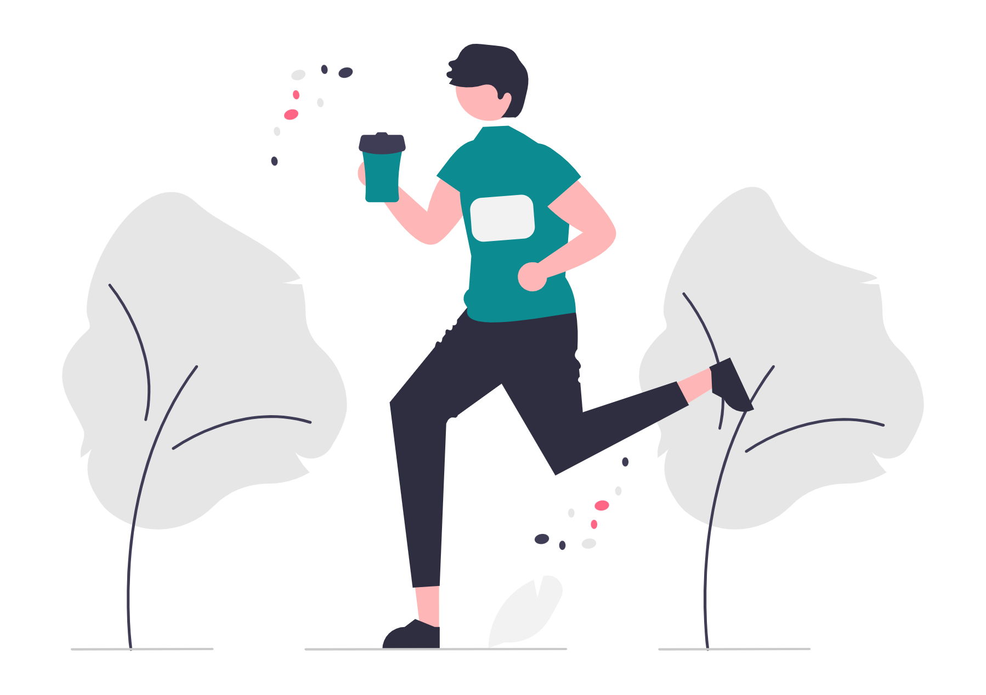
10.6 Types of Physical Exercise
Cardiovascular (Aerobic)Training
Often referred to as “cardio,” this involves any planned activities that raise your heart rate and breathing while engaging large muscle groups. Activities like rowing, running, swimming, cycling, and even brisk walking all fall under this category.
Key benefits: Stronger heart, lower blood pressure, better stamina, weight management, improved immunity, higher energy and less fatigue
Heart Rate Zones:
“Zone 2” Training: A steady pace where your heart is working harder than normal, but you can still speak in short sentences (i.e., brisk walk for 30 mins)
“Zone 5” Training: Very intense – can barely get words out). Example: 4x4 workout
"Jogging" by Undraw, Undraw License

Slide 9
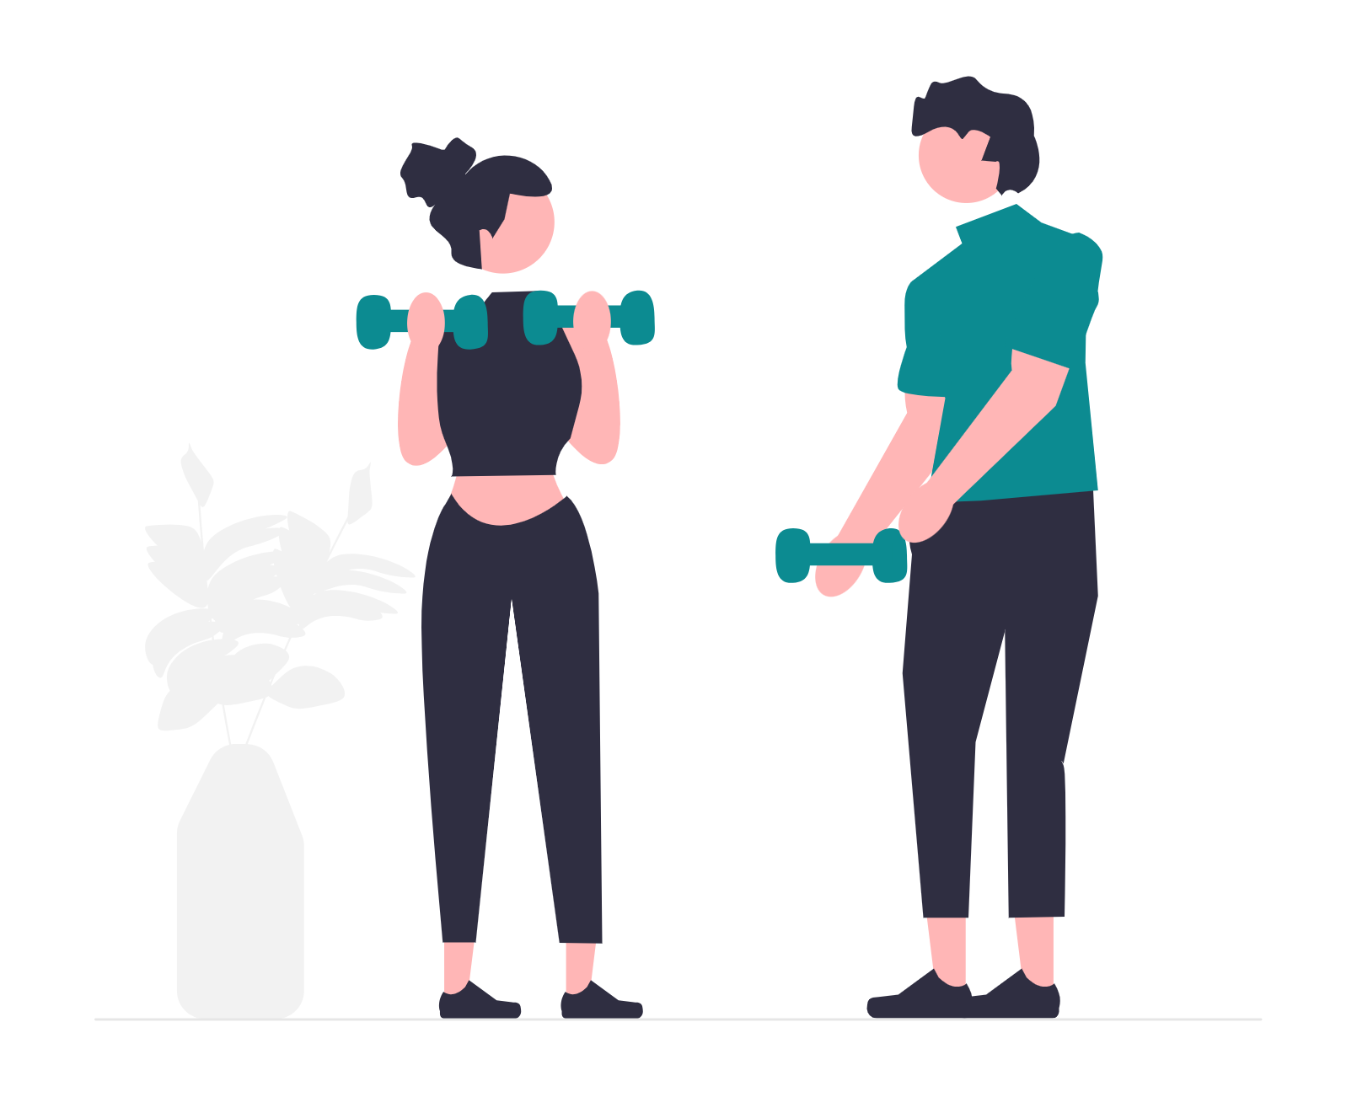
10.6 Types of Physical Exercise (2)
Resistance Training
Any exercise where you push or pull against some form of resistance. This may include free weights, machines, resistance bands, or even your own body weight. The main goal is to build muscle strength, size, and endurance.
Key Benefits: Muscle mass, strength, bone health, metabolism boost, confidence, and appearance.
Repetitions and Sets: A repetition (or rep) is one complete movement of an exercise (i.e., one squat). A set is a group of reps.
Low Reps (1 to 5 per set): Builds raw strength/power (lifting heavier weights)
Medium Reps (6 to 12 per set): Add muscle mass (three sets of 10 squats)
High Reps (12+ per set): Builds muscular endurance (resistance band exercises)
“Personal trainer" by Undraw, Undraw License

Slide 10
10.6 Types of Physical Exercise (3)(2)
Mobility, Balance, & Stability
These three elements are all about how well your body can move through its full range of motion while staying controlled and injury-free.
Key Benefits: Better posture and alignment, fewer injuries and falls, smoother movements, enhanced performances in other exercises.
How to train:
Mobility work: Exercises that focus on flexibility and range of motion
Balance training: Exercises that challenge your body’s stability
Stability drills: Movements that strengthen your core and stabilize muscles
“Workout" by Undraw, Undraw License

Slide 11
10.6 Summary
Key Takeaways:
Living longer does not necessarily mean living better. Prioritizing healthspan ensures as many years as possible are spent in good health and independence.
Metabolic disease, heart disease, cancer, and neurodegenerative disease can be delayed and even mitigated by early lifestyle interventions.
Regular physical activity is essential for preventing chronic disease, boosting immune response, and preserving mental acuity.
Regular physical activity, both directly and indirectly, positively influences all dimensions of wellness.
Cardiovascular and resistance training, along with mobility and balance work, each offer unique benefits to improve healthspan.
Using zones (such as zone 2 for endurance and zone 5 for high-intensity work) helps tailor workouts and maximize training outcomes.
Building muscle and bone density lowers the risk of fractures, improves posture, and supports healthy metabolism.
Adequate rest, mindful eating, and progress tracking are vital to preventing burnout and ensuring continuous improvement in fitness.

Slide 12
10.7 Key Terms
LIfespan: Represents the total number of years a person lives; a measure most people think of when they consider longevity.
Healthspan: Refers to the number of years one remains in good physical and mental health, active, and free from serious disease or disability.
Metabolic disease: This is an umbrella term for a handful of related illnesses that impact our metabolic processes, such as maintaining stable blood sugar and insulin levels, healthy blood pressure, and favorable cholesterol and triglyceride levels.
Heart disease: Also known as cardiovascular disease, this includes a variety of conditions affecting the heart and blood vessels (arteries and veins). Heart disease develops over many years without noticeable symptoms, which is the reason why it is a leading cause of death globally.
Cancer: Cancer is marked by abnormal cells growing uncontrollably, sometimes spreading (metastasizing) to other parts of the body. It can begin in almost any part of the body, leading to a diverse range of types and outcomes. Early detection and getting the proper treatment can make an enormous difference in survival.

Slide 13
10.7 Key Terms (2)
Neurodegenerative disease: A decline in cognitive ability severe enough to affect everyday life that primarily impairs memory, thinking, and behaviour. This leads to confusion, mood swings, and difficulty with basic tasks like speaking or recognizing faces. Over time, conditions progressively worsen, eventually leading to complete dependence on others for care.
Physical activity: This includes any movement, spontaneous or planned, that causes your muscles to contract and use energy.
Physical exercise: This is a subset of physical activity that is planned, structured, and done with the specific goal of improving or maintaining fitness.
Physical fitness: Refers to your body’s ability to perform daily tasks or exercise with strength, endurance, and flexibility while minimizing the risk of injury or disease. People with high fitness are often described as having a high capacity for functional movement and recovery.

Slide 14
10.8 Reflection
Reflect on the following questions:
What deep personal values or life experiences inspire you to stay physically active, and how might you reconnect with those values when your motivation fades?
Reflect on the biggest barriers (e.g., time, self-confidence, or previous injuries) that have stopped you from exercising regularly. How do these obstacles shape your mindset about physical health?
How do you feel (emotionally and mentally) right after a workout, and in what ways could these feelings influence other areas of your life, like relationships or academic/work performance?
Who in your life (e.g., friends, family, mentors) do you trust for encouragement or accountability when it comes to health goals, and how do you see their influence shaping your long-term habits?
If you had to choose just one daily habit to support your health span in the next six months, what would it be, and why does that habit feel most important to you personally?

