Slide 1
The Art & Science of Personal Wellness: How to Thrive in the Modern World
Chapter 12: Navigating Finances

Slide 2
12.0 Learning Objectives
At the end of this chapter, you will be able to:
Explain the Micawber Principle and how it relates to financial well-being.
Describe key factors that influence one’s financial well-being.
Distinguish between saving and investing and identify their respective benefits.
Distinguish between fixed and non-fixed expenses.
Understand the role of borrowing and compare loans and credit cards.
List the advantages and disadvantages of credit card usage and develop strategies for responsible credit management.
Develop a personal financial plan incorporating budgeting, saving, investing, and debt management strategies.

Slide 3
12.1 “The Unexpected Expense”
You believe you're good with money—tracking expenses and avoiding unnecessary purchases—until an unexpected expense exposes financial gaps.
A sudden laptop failure reveals a lack of savings, a maxed-out credit card, and no emergency fund, leaving you without options.
You scramble for quick fixes—borrowing from friends, taking out a loan, and working extra shifts—while stress and financial strain take a toll.
Emotional and Social Impact: Financial mismanagement leads to stress, declining academic performance, strained relationships, and a loss of confidence.
Learning from Mistakes: Seeking help from parents provides temporary relief but comes with disappointment, reinforcing the need for better financial planning.
Financial Wellness Matters: Managing money wisely supports overall well-being, enabling you to invest in physical, emotional, and mental health without financial anxiety.

Slide 4
12.2 The Micawber Principle
The Micawber Principle states that consistently spending more than you earn leads to financial misery, while living within your means brings stability and happiness.
Financial well-being depends on balancing income and expenses, ensuring both present security and future financial freedom.
Since financial well-being is personal, each individual’s approach to achieving it may differ based on their unique circumstances.
Security Benefits:
Present: Having control over daily and monthly finances ensures stability and reduces financial stress.
Future: The ability to handle unexpected financial shocks provides long-term resilience and peace of mind.
Freedom of Choice:
Present: Financial independence allows for enjoyable experiences and lifestyle choices without constant worry.
Future: Staying on track with financial goals ensures future opportunities and long-term financial success.

Slide 5
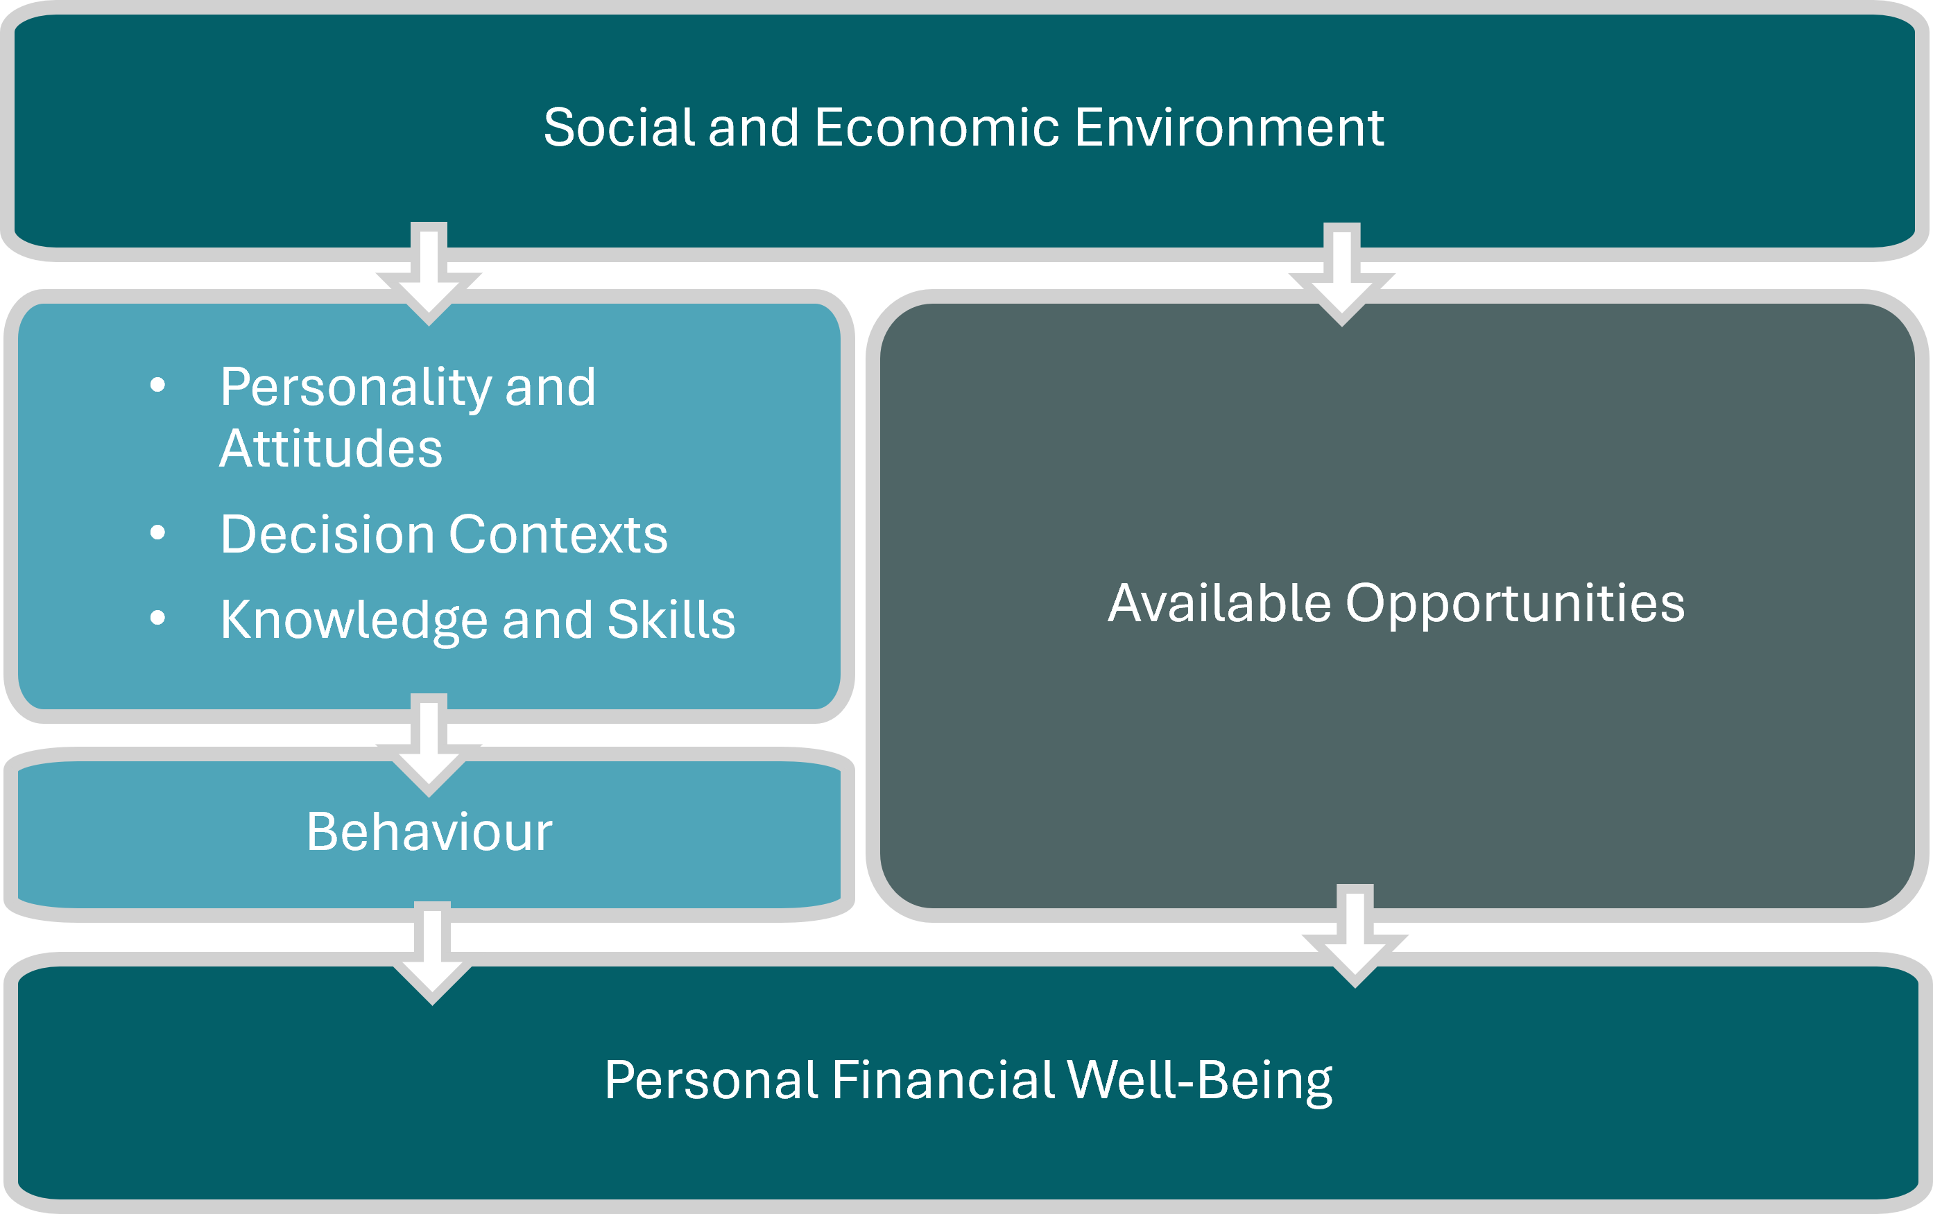
12.3 Factors that Promote Financial Well-being
Financial well-being is influenced by both controllable factors and external social and economic environments.
Some individuals benefit from financial security, quality education, and strong professional networks, giving them an advantage.
Others face financial hardship or limited access to resources, making financial growth more challenging.
Regardless of starting point, financial success is possible through effort, strategic decisions, and continuous learning.
Developing a strong work ethic, informed financial choices, and new skills fosters financial stability and creates further opportunities.
Image has been adapted from: Consumer Financial Protection Bureau. (2015, January). Financial well-being: The goal of financial education [PDF]. https://files.consumerfinance.gov/f/201501_cfpb_digest_financial-well-being.pdf

Slide 6
12.4 Saving
Savings involve setting aside a portion of income for future use rather than immediate expenses like rent, food, or transportation. Even small amounts can grow over time.
Income sources include full-time and part-time jobs, side hustles, scholarships, grants, gifts, inheritances, and investment returns.
Why save money? It provides a financial safety net for emergencies, short-term goals (vacations, gifts), and long-term goals (buying a house, retirement, education).
How much to save? It varies by individual, but common strategies include the 50-30-20 rule (50% needs, 30% wants, 20% savings) and the 10% rule ("pay yourself first" by saving 10% of each paycheck).
Practical ways to save: Automate savings, cut unnecessary subscriptions, buy groceries in bulk, use money-saving apps, and avoid hidden fees.
File annual tax returns to maximize refunds and avoid unnecessary penalties.

Slide 7

12.5 Investing
Investing vs. Saving: Saving keeps money safe, while investing helps it grow by putting it into stocks, bonds, or other assets.
Key Investment Terms: Interest is the cost or profit of borrowing/lending money, while compound interest grows over time by earning interest on interest.
Why Invest? Investing enables compound growth, where reinvested gains grow exponentially, and wealth building, helping money outpace inflation.
Types of Investments: Stocks (company shares), bonds (loans to companies/governments), mutual funds (professionally managed portfolios), and ETFs (low-cost funds tracking market indexes).
All Investments Involve Risk: There's always a chance of losing money or getting lower returns than expected. Understanding this helps in making informed decisions.
Know Your Risk Tolerance: If market fluctuations stress you, opt for stable investments like bonds. If you can handle volatility, consider higher-risk options like stocks.

Slide 8
12.6 Expenses
An expense is any outflow of money to cover a cost or obligation. They can be either fixed or non-fixed.
Fixed Expenses
Costs that remain the same each month over the course of a year:
rent
insurance
car payment
Non-Fixed Expenses
Costs that fluctuate month to month:
groceries
utility bills
entertainment
By categorizing expenses, you can see which are essential, which are adjustable, and which might be reduced to increase your savings.

Slide 9
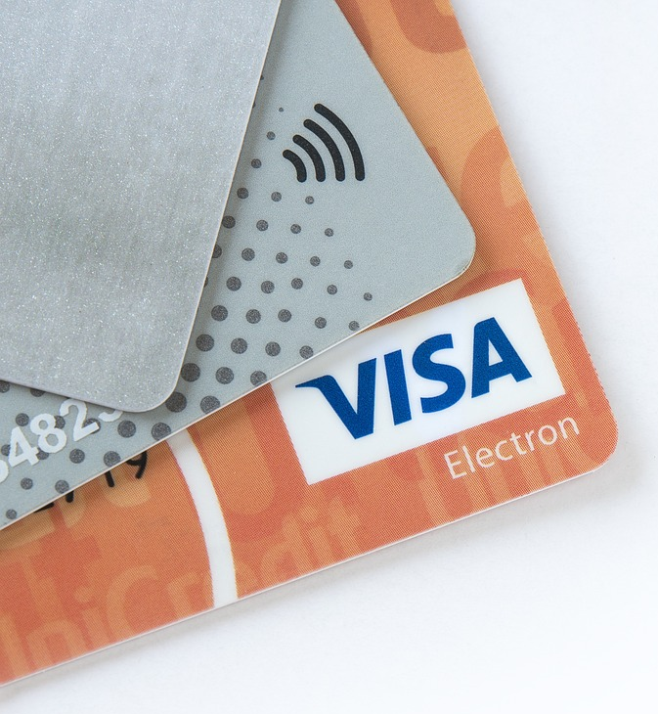
12.7 Borrowing
Borrowing Basics: Borrowing allows you to cover expenses when you don’t have immediate funds, but it usually comes with interest.
Loans vs. Credit Cards: Loans provide a fixed amount repaid over time, while credit cards offer flexible borrowing within a set limit.
Mortgage Loans: Used to buy a home, repaid in installments with interest.
Student Loans: Help cover tuition and educational costs, often with deferred repayment options.
Personal Loans: Can be used for various needs, such as debt consolidation or emergencies.
Credit Card Interest: If you don’t pay the full balance each month, interest accumulates, increasing the cost of purchases.
“Electronic Payments” by MBatty, Pixabay License

Slide 10
12.7 Advantages of Using a Credit Card
1. Convenience
Credit cards allow for quick and easy transactions, both in-person and online, without the need to carry cash.
2. Credit Building
Responsible credit card use can help establish and improve a credit score, which is beneficial for future financial opportunities, such as applying for a mortgage or car loan.
3. Rewards and Incentives
Many credit cards offer cashback, travel rewards, or points that can be redeemed for discounts, flights, or merchandise.
4. Emergency Financial Cushion
A credit card can serve as a financial backup in case of unexpected expenses.
5. Fraud Protection
Most credit cards offer robust fraud protection, including the ability to dispute unauthorized transactions.

Slide 11
12.7 Disadvantages of Using a Credit Card
1. High-Interest Rates (often exceeding 20%!)
Carrying a balance from month to month can result in significant interest charges, increasing overall debt.
2. Debt Accumulation
Misuse or overspending can lead to financial difficulties, making it challenging to pay off outstanding balances.
3. Additional Fees
Late payments, annual fees, cash advances, and foreign transaction fees can add unexpected costs.
4. Potential Credit Score Damage
Late payments, maxing out credit limits, or opening multiple credit accounts can negatively impact a credit score.
5. Encourages Impulse Spending
The ease of swiping a credit card can lead to unnecessary or excessive spending.

Slide 12
12.7 How to Use a Credit Card Responsibly
Proper credit card management is essential for maintaining financial health. The following strategies can help individuals use credit cards effectively and avoid common pitfalls:
Pay in Full: Avoid high interest by paying the full balance each month.
Make Timely Payments: Prevent late fees and maintain a strong credit score.
Keep Credit Utilization Low: Use less than 30% of your credit limit for better credit health.
Monitor Statements: Regularly check for errors or fraud.
Use Credit Wisely: Stick to planned and essential purchases.
Avoid Impulse Spending: Resist unnecessary purchases to prevent debt buildup.

Slide 13
12.8 Budgeting
What is a Budget? A budget is a financial plan that tracks income and expenses, helping manage money, prevent overspending, and achieve financial goals.
Benefits:
Tracks Income & Expenses: A budget helps individuals understand where their money comes from and where it goes, making it easier to identify spending habits and areas for improvement.
Prevents Overspending: By setting specific spending limits, a budget ensures that individuals live within their means and avoid unnecessary financial strain.
Reduces Debt: A structured budget allocates funds toward debt repayment, helping individuals pay off outstanding balances faster while reducing interest costs.
Encourages Saving & Investing: Budgeting prioritizes setting aside money for emergencies, retirement, and long-term financial goals, ensuring financial security.
Improves Financial Decisions: Knowing where money is allocated enables individuals to make informed choices, plan for major expenses, and set realistic financial targets.
Reduces Financial Stress: A well-planned budget provides financial stability, reducing uncertainty and anxiety about managing expenses and future financial obligations.

Slide 14
12.8 Steps to Create Your Own Budget
1. Determine Your Income
Calculate total earnings from wages, side jobs, and passive income.
Use after-tax income for an accurate financial picture.
2. Track Your Expenses
Review statements to identify spending habits.
Categorize expenses into fixed (rent, insurance) and variable (groceries, entertainment).
3. Choose a Budgeting Method
Zero-Based Budgeting: Assign every dollar a purpose.
50/30/20 Rule: Split income into needs (50%), wants (30%), and savings/debt (20%).
Wealthy Barber Approach: Save at least 10% of your income.

Slide 15
12.9 Summary
Key Takeaways:
The Micawber Principle emphasizes the importance of living within one’s means.
Financial well-being is influenced by both internal (e.g., spending habits, savings) and external (e.g., social and economic environments) factors.
Saving is essential for financial security, and even small, consistent contributions can accumulate over time.
Investing helps grow wealth over time, leveraging compound interest and asset appreciation, but it comes with risks.
Understanding fixed and non-fixed expenses enables individuals to prioritize essential costs and identify areas where they can reduce spending.
Credit cards offer convenience and financial flexibility, but they must be managed responsibly to avoid high-interest debt, fees, and credit score damage.
Budgeting is a key financial tool that allows individuals to track income and expenses, control spending, and set realistic financial goals.

Slide 16
12.9 Key Terms
Micawber Principle: Regularly spending more than your income, even a small amount, leads to stress and instability, while spending less than your income (living within your means) leads to security and contentment.
Savings: Represent the portion of your income you set aside for future use rather than spending it immediately. Saving focuses on keeping your money safe.
Income: Refers to any money received from full-time or part-time jobs, side hustles or freelance work, scholarships, grants or government benefits, gifts and inheritances, and/or investment returns (dividends, interest).
Investing: Focuses on helping your money grow by putting it to work in different places, such as buying shares of a company or lending money to the government.
Interest: The cost you pay when you borrow money or the profit you receive when you lend it to someone.

Slide 17
12.9 Key Terms (2)
Compound Interest: This is when interest grows on the original amount of money plus any interest earned before, like a snowball getting bigger as it rolls downhill.
Stocks: These are small parts of a company you can buy. If the company does well, your piece becomes more valuable.
Bonds: This is like lending money to a company or the government with a set term and interest rate. They promise to pay you back with some extra interest later.
Mutual funds: Your money joins other people’s money and is managed by a professional who buys a variety of stocks, bonds, or other assets.
Exchange-Traded Funds (ETFS): Similar to mutual funds, they usually track a market index (like a “basket” of different company stocks) and typically have lower fees.
Risk: The possibility that you might lose money or see lower-than-expected returns.
Expense: Any outflow of money to cover a cost or obligation. They can be either fixed or non-fixed.

Slide 18
12.9 Key Terms (3)(2)
Fixed expenses: Costs that remain the same each month over the course of a year (rent, insurance, car payment).
Non-fixed expenses: Costs that fluctuate month to month (groceries, utility bills, entertainment).
Loan: A specific amount of money you borrow from a financial institution and then pay back in regular chunks over time (plus interest).
Mortgage: A loan to buy a house.
Student loan: A loan for paying tuition or other school costs.
Personal loan: A loan you can use for different things, like consolidating debt or covering emergencies.
Credit card: Lets you borrow up to a set limit whenever you buy something. You can repay the borrowed amount each month, and any remaining balance will collect interest.
Budget: A budget is a financial plan that outlines income and expenses over a specific period, such as a month or a year. It serves as a roadmap for managing money, ensuring that expenses do not exceed income.

