Slide 1
CONGESTIVE HEART FAILURE
Uvbi Osatohangbon

Slide 2
Agenda
What is Heart Failure?
Causes
Diagnosis
Left vs. Right-sided Failure
Treatment Options

Slide 3
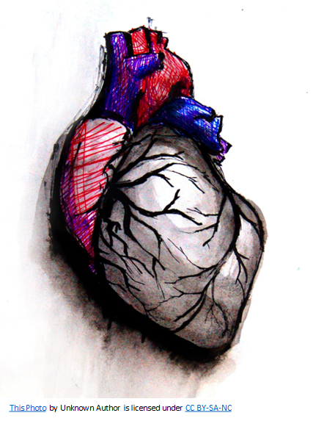
Anatomy of the Heart

Slide 4
Left vs. Right

Slide 5
Where to go from there
Treatment Options include:
  Lifestyle Changes
  Medications
  Devices and Surgical Procedures

