Slide 1
Navigating HR: The Art of Problem-Solving and Conflict Resolution
Chapter 9: Navigating Communication in Conflict

Slide 2
9.0 Learning Outcomes
In this chapter, we will:
Identify forms of verbal and non-verbal communication used in conflict resolution.
Examine emotional intelligence and the importance of remaining calm in conflict.
Practice remaining calm in a difficult workplace scenario.

Slide 3
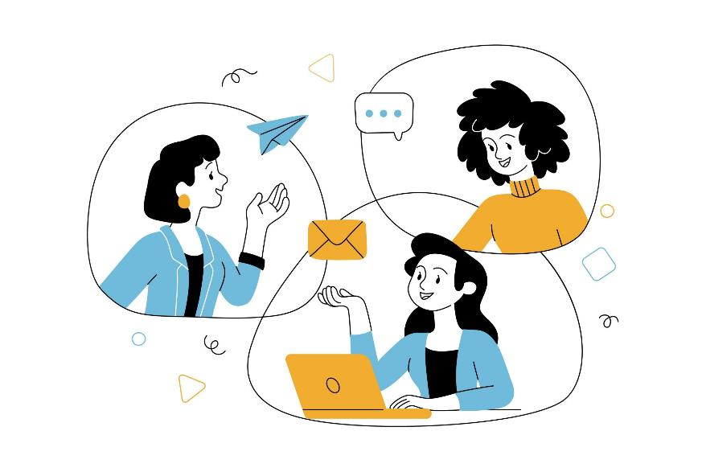
9.2 The Lesson: Communication Essentials
Verbal Communication
Verbal communication allows us to meet instrumental needs by asking questions and describing things, people, and ideas.
It serves to inform, persuade, and entertain, aligning with the general purposes of public speaking.
Language is inherently expressive, helping us share observations, thoughts, feelings, and needs.
Verbal expressions play a key role in forming and maintaining relationships.
Image by pikisuperstar, Freepik License

Slide 4
9.2 Verbal Communication Strategies
Expressing Observations
Observations involve reporting sensory information, focusing on what we see, hear, or feel.
Describing observations instead of evaluating them reduces defensiveness and promotes effective communication.
Observations form the first step in the perception-checking process, helping us understand experiences.
Expressing observations descriptively facilitates more competent communication.
Expressing Thoughts
Thoughts are conclusions drawn by interpreting sensory observations and assigning meaning.
They are influenced by beliefs (true/false), attitudes (like/dislike), and values (right/wrong).
Thoughts can sometimes be miscommunicated as feelings, leading to potential confusion.
Expressing thoughts helps clarify perspectives, as seen in contexts like jury deliberations.

Slide 5
9.2 Verbal Communication Strategies (continued)
Expressing Feelings
Feelings communicate emotions but are influenced by norms around when, where, and to whom they are expressed.
Cultural, age, and gender norms shape emotional expression, with women often expected to be more expressive than men.
Sharing emotions strengthens social bonds, but it can be challenging for listeners to process.
Expanding emotional vocabulary allows clearer communication of intensity, improving empathy and understanding.
Expressing Needs
Needs communication is instrumental in getting tasks done and maintaining healthy relationships.
Clearly expressing needs prevents frustration and resentment by providing actionable guidance.
Effective need expression avoids judgmental language, focusing instead on specific requests or solutions.
Stating needs clearly helps others understand and respond appropriately, improving communication outcomes.

Slide 6

9.2 Language Is Relational
Verbal communication helps initiate interpersonal relationships by allowing us to assess potential partners or friends.
Early exchanges help determine whether to pursue a relationship further.
It is used to maintain relationships by expressing feelings and checking in with others.
Verbal communication supports relationship maintenance through affirmations and dialogue.
It is also a key tool for ending relationships when negative feelings persist or other issues arise.
Image by pikisuperstar, Freepik License

Slide 7
9.2 Language Can Bring Us Together
Verbal communication fosters connection and maintains relationships, influenced by the intentional or unintentional use of pronouns like "I," "you," and "we.“
"We language" (e.g., we, our, us) promotes inclusiveness, while "I language" helps express personal emotions and avoid attributing blame.
"You language" can lead to defensiveness, making others feel attacked and potentially causing separation.
Frequent and supportive communication reduces stress and uncertainty in relationships, helping partners feel more connected.
Unsupportive messages, such as sarcasm, negative comparisons, or judgmental "you" statements, can escalate conflict and harm relationships.
Consistently unsupportive communication can lower self-esteem, create a toxic environment, and lead to the dissolution of relationships.

Slide 8
9.2 Common Types of Unsupportive Messages
Global labels: Sweeping judgments like "You're a liar" question a person's entire identity and escalate negativity.
Sarcasm: Disguised as humor, sarcasm often communicates passive-aggressive negativity.
Dragging up the past: Referencing past grievances avoids addressing current issues and releases pent-up negative feelings.
Negative comparisons: Comparing someone to others fosters feelings of inferiority and resentment.
Judgmental "you" messages: Accusatory overgeneralizations fail to address specific behaviors and hinder constructive communication.
Threats: Threats of violence or consequences end productive dialogue and reflect insecurity.

Slide 9
9.2 What is Non-Verbal Communication?
Non-verbal communication conveys emotions and attitudes without words, using gestures, facial expressions, and body language.
It allows us to express feelings like boredom, agitation, or surprise naturally and effectively.
Non-verbal signals can complement, modify, or contradict verbal messages.
Like verbal communication, non-verbal communication includes various categories that work together to create meaning.
Understanding non-verbal communication enhances our ability to interpret and convey nuanced messages.

Slide 10
9.2 Three Types of Gestures
Adaptors:
Touching behaviors and movements indicating internal states, often linked to anxiety or unease.
Common in social situations and public speaking, such as fidgeting, clicking pens, or scratching.
Emblems:
Gestures with specific, culturally agreed meanings, like the thumbs-up or "OK" sign.
These gestures can be still or in motion and convey a clear message within a culture.
Illustrators:
Gestures that illustrate or emphasize the verbal message, such as showing the size or shape of an object.
These largely involuntary gestures vary in intensity and frequency depending on the context.

Slide 11
9.2 Non-Verbal Communication
Head Movements and Posture:
Head nods are universal signs of acknowledgment, often replacing formal bows.
The headshake is an innate signal for rejection, beginning at birth.
Eye Contact:
Eye contact regulates interactions, signals when to speak, and indicates listening.
It helps monitor communication, conveys engagement, and expresses cognitive activity or emotion.
Facial Expressions:
Facial expressions like happiness, sadness, and anger are universally recognizable.
Smiles often serve social purposes, not just as responses to internal emotions.

Slide 12
9.2 Examples of Non-Verbal Communication
Rolling Your Eyes: Indicates disagreement or disbelief, signaling a negative reaction to what was just said.
Arms Crossed: Can suggest deep thought or closed body language, implying disagreement or discomfort with the conversation.
Hands on Your Hips: May be a comfortable stance for some but can also appear intimidating or signal frustration to others.
Looking Away: Often a sign of thinking or processing information but can be perceived as boredom by others.
Hands Clenched: Indicates frustration, anxiety, or nervousness about the situation.

Slide 13
9.3 Spotlight on Human Resources Skills
Emotional intelligence (EQ) is the ability to understand, manage, and use emotions to relieve stress, communicate effectively, empathize with others, and resolve conflicts, which is just as important as intellectual ability for building relationships, achieving goals, and making informed decisions.
Four key attributes of emotional intelligence:
Self-management: Control impulsive behaviors, manage emotions healthily, stay committed, and adapt to changes.
Self-awareness: Recognize emotions, understand their impact, and know personal strengths and weaknesses.
Social awareness: Empathize with others, understand emotional cues, and navigate social dynamics.
Relationship management: Build and maintain relationships, communicate clearly, inspire others, and manage conflict.

Slide 14
9.3 Why is Emotional Intelligence so Important?
Work performance: High EQ helps you navigate social complexities, lead others, and excel in your career, with many companies now valuing EQ as much as technical skills.
Physical health: Poor emotional management can lead to stress-related health problems like high blood pressure, heart disease, and weakened immune function.
Mental health: Uncontrolled emotions and stress can contribute to anxiety, depression, and difficulty forming strong relationships, affecting overall mental well-being.
Relationships: Understanding and controlling emotions allows better communication, helping to build stronger personal and professional relationships.
Social intelligence: EQ helps you connect with others, understand social cues, and balance your emotions, improving social interactions and overall happiness.

Slide 15
9.3 Emotional Intelligence Skills and Competencies
Self-awareness (Personal): Recognizing and understanding one's emotions, strengths, and weaknesses.
Self-regulation (Personal): Managing and controlling one’s emotions and behaviors in a healthy way.
Motivation (Personal): Using emotions and passions to pursue and achieve goals.
Empathy (Social): Understanding and showing compassion for others’ emotions and perspectives.
Social skills (Social): Inspiring, influencing, and collaborating effectively with others.

Slide 16
9.6 Chapter Summary
Verbal communication is one way of expressing your observations, thoughts, feelings and needs.
Ensure you are providing supportive messages rather than unsupportive messages.
Non-verbal communication can be helpful if it includes direct eye contact, indicating you are listening to the speaker.
Non-verbal communication can be challenging if it includes sitting with your arms crossed in front of you, which can be seen as closed body language.
Emotional Intelligence, or EI allows you to determine if you are too upset to enter into a conversation.
Presenting a calm approach in a difficult conversation makes the other person feel safe.

