Slide 1
Navigating HR: The Art of Problem-Solving and Conflict Resolution
Chapter 8: HR’s Role in Problem Solving

Slide 2
8.0 Learning Outcomes
In this chapter, we will:
Identify problem-solving strategies used to assess perceived grievances and resolve problems quickly.
Describe the benefits of curiosity and open-ended questions in problem-solving and conflict resolution.
Apply curiosity and open-ended questions to a workplace scenario.

Slide 3

8.2 The Lesson: Problem-Solving Strategies
Generational and cultural dimensions influence workplace conflict.
HR professionals play a key role in problem-solving within the workplace.
HR professionals are often approached with various issues, including non-conflict-related problems, due to their problem-solving skills.
Photo by Rayson Tan, Unsplash License

Slide 4
8.2 Common Workplace Problems
Resources: Assist managers in overcoming resource shortages (e.g., staffing or budget) by brainstorming creative solutions.
Communication: Develop strategies for effective communication across diverse and remote teams.
Training: Propose cost-effective internal training alternatives to reduce third-party expenses.
Performance Issues: Help managers implement structured plans, such as Performance Improvement Plans, to address underperformance.
Flexible Work Schedules: Accommodate employee needs by adjusting work hours to balance personal and professional responsibilities.

Slide 5
8.2 Common Workplace Problems (continued)
Recognition: Guide managers in creating meaningful employee recognition initiatives tailored to team preferences.
Work-Life Balance: Enforce policies to reduce off-hours communication and protect employee personal time.
Turnover: Investigate reasons for attrition and recommend strategies to improve retention.
Engagement: Boost participation in workplace activities by encouraging team collaboration and innovative event formats.
Growth Opportunities: Promote career growth through initiatives like job shadowing and skill rotation programs.

Slide 6
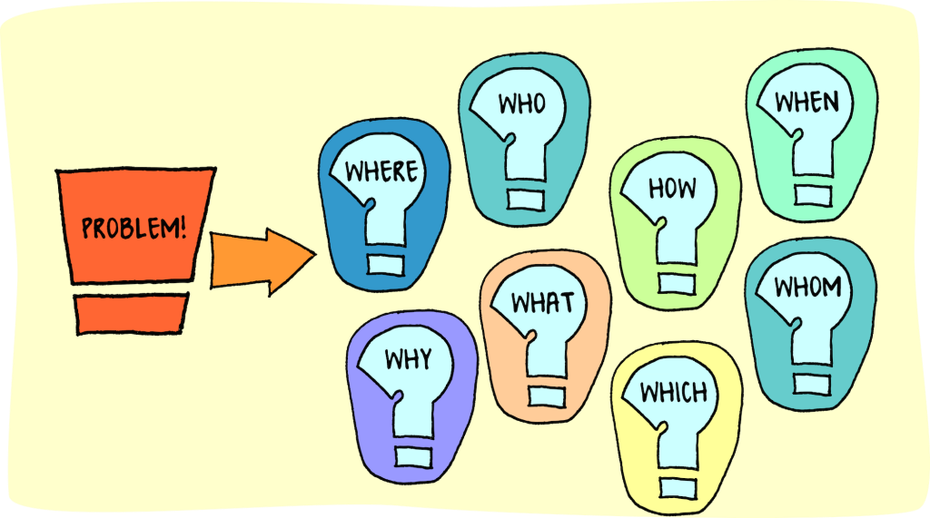
8.2 What is Problem Solving and Why is it Important?
Problem-solving is a fundamental life skill essential for navigating daily challenges at home, school, and work.
It involves identifying a problem, exploring possible solutions, and taking appropriate action.
Strong problem-solving skills empower personal and professional growth, demonstrating creativity, independence, and initiative valued by employers.

Slide 7
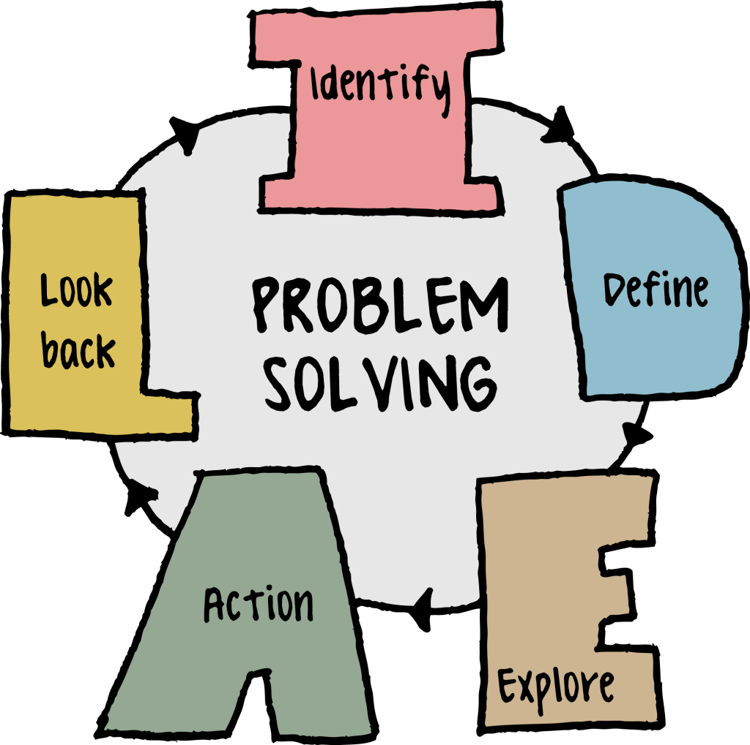
8.2 What Does Problem-Solving Look Like?
Problem-solving is a skill that improves with practice, involving learning and applying various strategies.
Problem-solving strategies typically follow a step-by-step process to identify problems and select the best solutions.
Algorithmic strategies are structured, step-by-step approaches ideal for problems with a single correct solution, like math problems or tasks with specific sequences.
Heuristic strategies are flexible guides, such as the IDEAL method, used for problems with multiple possible solutions.
Building a diverse toolbox of problem-solving strategies enhances your ability to tackle complex issues effectively.

Slide 8
8.2 Developing Problem-Solving Processes
The first step in problem-solving is recognizing and identifying the root cause, which often requires asking questions, gathering facts, and analyzing processes to avoid assumptions.
Root cause analysis (RCA) uses tools like the “5 Why Analysis” and “Cause and Effect Diagrams” to determine what happened, why it happened, and how to prevent recurrence.
Exploring possible strategies, such as brainstorming individually or in groups, helps generate a range of ideas for addressing problems effectively.
Asking for help when needed fosters collaboration, improves communication, and accelerates finding solutions to recurring issues.
Effective communication, particularly in workplaces with safety risks, is essential to address problems promptly, prevent recurrence, and reduce costs and injuries.
Daily team huddles improve collaboration, communication, and accountability, ensuring awareness of issues, schedule changes, and the interconnected impact of team members’ work.

Slide 9

8.3 Spotlight on Human Resources Skills
Curiosity fosters connection, growth, and engagement through intentional inquiry while respecting boundaries and privacy.
It helps challenge assumptions, promotes open-mindedness, and encourages listening and asking thoughtful questions over giving answers.
Cultivating curiosity brings benefits like calming the nervous system, fostering hope, encouraging mindfulness, and improving interpersonal understanding.
In peer support work, asking powerful questions enables others to tap into their wisdom and reflect, avoiding self-focused or intrusive inquiries.
Effective questions should prioritize the benefit to others, supporting self-reflection and meaningful connection.
Photo by Prograph Studio, Unsplash License

Slide 10
8.3 Traits of Powerful Questions
1. Powerful Questions Are Always Open-Ended and Promote Reflection
  Open-ended questions often begin with what, encouraging self-reflection and tapping into knowledge and insight, while avoiding specific expected answers.
  Avoid “why” questions in peer situations, as they can feel analytical or judgmental, focusing instead on past-focused discovery or future-forward planning.
2. Powerful Questions Are Fueled by Curiosity and Aren’t Focused on an Agenda
  Genuine curiosity drives powerful questions, avoiding hidden agendas or attempts to steer conversations toward specific outcomes.
  Replace leading questions with reflective ones, such as exploring what has worked in the past to encourage self-exploration.
3. Powerful Questions Stimulate Reflection
  Allowing silence creates space for reflection, helping people find answers within themselves.
  Embrace the discomfort of silence, recognizing its value for both the speaker and listener to process thoughts.

Slide 11
8.3 The Art of the Open-Ended Question
Open-ended questions help HR professionals gather detailed insights beyond simple "yes" or "no" answers.
Scenario 1: Missing Money
Closed question: “Did you take the money from the lockbox?” results in a simple denial without further context.
Open-ended question: “Someone removed $100 from the lockbox. Who was in the office when you arrived at work yesterday?” encourages broader insights into the situation.
Scenario 2: Unlocked Safety Supplies
Closed question: “Do you know who left the door unlocked?” only confirms a lack of knowledge.
Open-ended question: “The door to the safety supplies was unlocked. Where did you leave the key when you unlocked the supply cabinet yesterday?” invites reflection and potentially helpful details.
Scenario 3: Showroom Signage Feedback
Closed question: “Do you like the new signage in the showroom?” yields limited feedback.
Open-ended question: “How do you feel about the new signage in the showroom?” explores personal opinions and feelings.

Slide 12
8.3 Helpful Open-Ended Questions
Avoid using “yes” or “no” questions starting with words like "why" or "did," as they limit the depth of responses. Examples of open-ended questions include:
  Describe what you witnessed on the way to work.
  Would you share your understanding of what happened in the staff meeting?
  What did your co-worker do after the presentation?
  When did you notice the folder was missing?
  Who did you work with on this project?
  Where did you go after the safety training session?
  How would you describe a typical day in your role?
Open-ended questions foster better understanding and help uncover essential details for problem-solving and conflict resolution.
Unexpected responses from open-ended questions can reveal new insights, guiding discussions in unexpected but productive directions.
These responses may uncover details you didn't anticipate, leading to innovative solutions or resolutions.

Slide 13
8.6 Key Takeaways
Human Resources professionals are often called upon for their problem-solving skills.
People leaders are seeking quick solutions to everyday problems in the workplace.
When solving a problem, it is essential to brainstorm as many possible solutions as possible.
Remaining curious allows a human resources professional to gather helpful information to assist in finding a solution.
Whether interviewing a job candidate or solving a workplace problem, asking open-ended questions will keep the conversation going.
One benefit of asking open-ended questions is the unexpected responses you may receive.

