Slide 1
Navigating HR: The Art of Problem-Solving and Conflict Resolution
Chapter 3: Collaboration: Let’s Work Together

Slide 2
3.0 Learning Objectives
In this chapter, we will:
Identify the factors necessary to create an environment conducive to collaborative conflict resolution.
List the benefits of collaboration or working together.
Apply active listening skills to a workplace conflict scenario.

Slide 3
3.2 Creating a Collaborative Environment
What does a collaborative workplace look like?
Busy – there are employees visibly working together to solve problems
Structured – you might see meeting rules posted in meeting rooms
Organized – there is a sense of????
What does a collaborative workplace sound like?
Quiet – there are conversations rather than arguments
Professional – employees greet one another with respect
Diversified – there is an emphasis on gaining differing opinions
What does a collaborative workplace feel like?
Safe – employees are free to share their goals and opinions
Calm – employees don’t have to deal with toxic people or conversations
Welcoming – guests and new employees feel welcomed and included
Notes:
You can only control your own actions in a conflict, so be flexible and adapt your approach.
Understanding the underlying needs behind others’ conflict styles is crucial.
Choosing the right conflict approach can build trust, achieve goals, and de-escalate conflict.
Using the wrong approach can escalate conflict, damage relationships, and hinder goal achievement.
Everyone can learn and apply different conflict styles with practice and self-awareness.
Listening for underlying needs helps work towards common goals and build trust.

Slide 4
3.2 Collaboration – Establishing the Ground Rules
It is common for organizations to establish agreed-upon ground rules. These ground rules guide the meeting and the attendees. Let’s look at some common meeting rules.
Common Meeting Rules
Arrive at the meeting on time
No talking over other people
Appoint someone to take minutes
No working on your electronics during discussions
Stay on topic
While these common meeting rules are a great starting place, the list must be expanded when a meeting involves collaborative conflict resolution.
Collaborative Meeting Rules
All brainstorming ideas are welcome
We encourage active participation by all
No shouting or swearing
No blaming others
Listen with an open mind
These are some guidelines a Human Resources professional might consider adding to the rules.

Slide 5
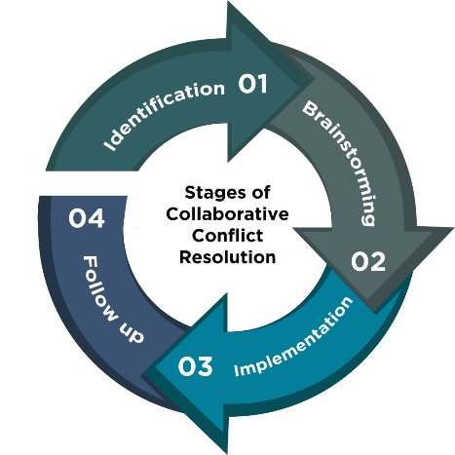
3.2 The Stages of Collaborative Conflict Resolution
Identification:
Identify the real source of the issue through discussions and active listening.
Understand the goals of the employees involved.
Brainstorming:
Include individuals in finding solutions, emphasizing teamwork.
Generate and discuss ideas without limiting or shutting down suggestions.
Implementation:
Implement the agreed-upon solution collaboratively.
Assign tasks and timelines, ensuring clarity and written plans.
Follow-up:
Check if the solution has improved the situation.
Revisit and adjust solutions if necessary until all parties are satisfied.
“Stages of Collaborative Conflict Resolution” by Sanaz Habibi CC BY-NC-SA

Slide 6

3.2 Collaborative Language
Use questions instead of statements to foster collaborative communication during conflict resolution.
Statement: It seems like this is important to you.
Question: Why is this so important to you?
Statement: It is pretty clear what is happening here.
Question: Can you tell me what happened from your perspective?
Statement: We should focus on the cost to our business.
Question: What do you want to focus on?
Statement: I know exactly what you mean.
Question: Can you tell me what it has been like for you?
Statement: I think we should invite others to join us.
Question: Do we need to include anyone else in this conversation?

Slide 7

3.3 Spotlight: Active Listening
Set Up Ideal Conditions: Manage physical and environmental noises by adjusting location, lighting, temperature, or furniture.
Manage Distractions: Avoid listening when distracted by psychological or physiological noise; plan ahead to alleviate these barriers.
Prime Yourself: Analyze the situation and set listening goals before it begins.
Maintain Focus: Find motivation to listen by considering how the message impacts your life, career, or relationships.
Overcome Selective Attention: Identify motivations to help remember the information presented.
Clarify Messages: As senders, help listeners by offering well-organized and clear messages tailored to the audience.

Slide 8
3.3 Active Listening Behaviours
Active Listening Preparation: Use cognitive strategies to enhance listening and engage in active listening behaviors while processing messages.
Paying Attention: Eye contact and body language signal attentiveness, but lack of eye contact can indicate cognitive processing.
Back-Channel Cues: Use head nods and verbal cues like "uh-huh" to show attention, but avoid pseudo-listening.
Probing Questions: Ask questions to indicate listening and encourage further conversation, seeking both clarification and elaboration.
Avoid Interruptions: Stay engaged without interrupting, especially when interacting with high-status individuals.
Note-Taking: Taking notes can help interpret and recall information, though it may not always be appropriate in casual settings.

Slide 9
3.3 Active Listening and Conflict
Conflict and Listening: Stress from conflict makes active listening challenging, often leading to missed key information.
Inattentional Blindness: In conflict, focusing on your own points can cause you to miss significant verbal and nonverbal cues.
Speech vs. Thought Rate: You process information faster than it can be spoken, which can hinder true listening during conflicts.
Recognize Distractions: Acknowledge that distractions are natural and you will likely miss something important.
Avoid Distractions: Maximize attention by eliminating distractions, such as turning off your phone.
Pause and Reflect: Don’t hesitate to slow down conversations to ensure you are actively listening, which helps build stronger relationships.

Slide 10
3.3 Paraphrasing
Paraphrasing: Paraphrasing involves repeating something using different words to make the original meaning clearer.
Different Words: Using different words shows true understanding and is not the same as parroting.
Check for Understanding: Paraphrasing helps ensure you have accurately understood the original message.
Scenario:
The original statement made by the employee: I know that Maurice is taking reams of paper, boxes of pens, and ink cartridges home with him every day, and he is bragging to people about making so much money off these supplies.
Your paraphrased statement as the Human Resources Coordinator: To clarify, you have observed Maurice stealing office supplies from our company and are suggesting he is selling them for profit. Is that correct?

Slide 11
3.6 Key Takeaways
Collaboration, or working together, is an effective approach to conflict resolution regardless of the scenario
Human Resources professionals should utilize active listening skills when meeting with employees in order to demonstrate a sincere interest in the matter
When paraphrasing, you are to summarize what you have heard to check for understanding
It is important to create an environment that is conducive to collaborative conflict resolution
Collaborative conflict resolution involves identifying the issue, brainstorming solutions, implementing an agreed-upon solution, and following up to ensure the matter has been addressed.

