Slide 1
Navigating HR: The Art of Problem-Solving and Conflict Resolution
Chapter 2: Approaches to Conflict Resolution

Slide 2
2.0 Learning Objectives
In this Chapter, we will:
Define the 5 Thomas-Kilmann approaches to conflict.
Create a list of the pros and cons of each conflict resolution approach.
Demonstrate the skill of empathy in solving a case study.

Slide 3
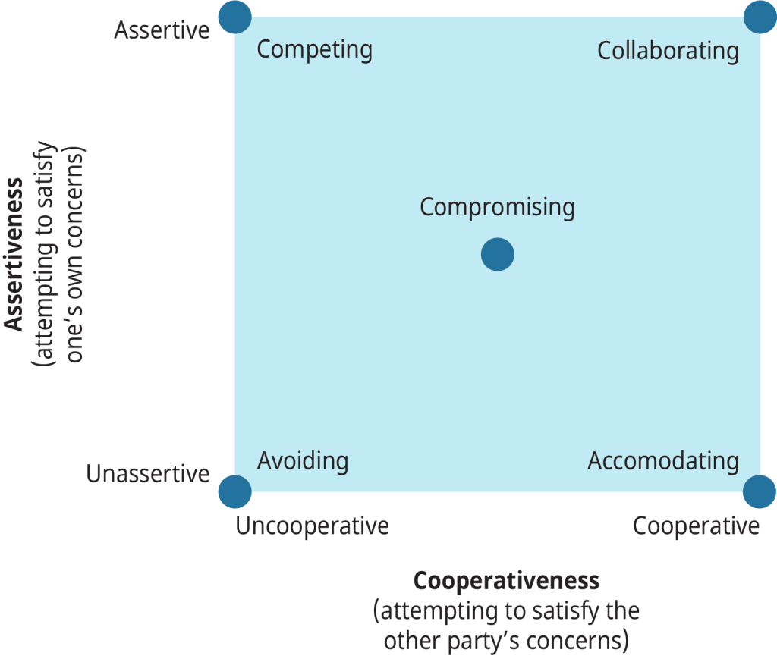
2.2 The Lesson: The Thomas – Kilmann Approach to Conflict
The TKI assesses conflict behavior based on two factors: assertiveness and cooperation.
Assertiveness measures how strongly a person pursues their own goals in a conflict.
Cooperation evaluates how much a person values and works to satisfy the other party’s concerns.
Using assertiveness and cooperation, Thomas and Kilmann identify five conflict approaches: avoiding, competing, accommodating, compromising, and collaborating.
Figure 2.2.1 Approaches to Conflict Resolution. Adapted from Thomas, K. (1976). Conflict and conflict management, In M. D. Dunnette (Ed.), Handbook of industrial and organizational behaviour (p. 900). Wiley. Reproduced from Rice University & OpenStax, Organizational Behavior, CC BY 4.0. Colour altered from original.
Notes:
Conflict resolution approaches vary among individuals and groups.
Kenneth W. Thomas and Ralph H. Kilmann created the Thomas-Kilmann Conflict Mode Instrument (TKI) in the 1970s.

Slide 4
2.2 Different Approaches: Avoiding
Characteristics:
Low commitment to goals and relationships.
Common among those who view conflict negatively.
Types of Avoidance:
Physical flight, mental withdrawal, changing the subject, blaming, minimizing, denial, postponement, emotional reactions.
Results:
Unresolved disputes, low satisfaction, stress spreads to others.
Appropriate When:
Issue is trivial, potential damage outweighs benefits, timing is inappropriate.

Slide 5
2.2 Different Approaches: Competing
Characteristics:
High commitment to goals, low commitment to relationships.
Pursues own goals at others’ expense, using necessary power.
Types of Competing:
Authority, persuasion, pressure techniques, disguising issues, tying relationship to substantive issues.
Results:
Escalation or withdrawal, reduced agreement quality, future problems, restricted communication, decreased trust.
Appropriate When:
Quick action needed, trivial issues, tough decisions requiring leadership.

Slide 6
2.2 Different Approaches: Accomodating
Characteristics:
Low commitment to goals, high commitment to relationships.
Ignores own concerns to satisfy others.
Types of Accommodating:
Playing down conflict, self-sacrifice, yielding to others.
Results:
Builds future problem-solving relationships, may lead to resentment if not reciprocated.
Appropriate When:
Outcome flexibility, preserving harmony, building good faith, avoiding damage from competition.

Slide 7
2.2 Different Approaches: Compromising
Characteristics:
Balances commitment to goals and relationships.
Seeks quick, mutually acceptable solutions.
Types of Compromising:
Splitting the difference, exchanging concessions, finding middle ground.
Results:
May lead to feelings of loss, no strong relationship, risk of stalemate, superficial issue exploration.
Appropriate When:
Quick solutions needed, collaboration or competition fails, short-term solutions required.

Slide 8
2.2 Different Approaches: Collaborating
Characteristics:
High commitment to goals and relationships.
Aims to meet all parties’ concerns, requires trust and risk-taking.
Types of Collaborating:
Maximizing resources, increasing resources, promoting understanding, learning from insights.
Results:
Builds relationships, promotes creative solutions, improves future problem-solving potential.
Appropriate When:
Important issues, need for creative solutions, working through hard feelings, diverse interests, future-focused participants.

Slide 9
2.2 What Does Each Approach Need?
Avoiders need to feel safe; assure them they will be heard.
Competitors need to achieve goals; reassure them a solution will be found.
Compromisers need future assurances; promise and follow through on concessions.
Accommodators need relationship security; ensure them the relationship remains intact.
Collaborators need clarity on your needs; share your needs first.
Notes:
You can only control your own actions in a conflict, so be flexible and adapt your approach.
Understanding the underlying needs behind others’ conflict styles is crucial.
Choosing the right conflict approach can build trust, achieve goals, and de-escalate conflict.
Using the wrong approach can escalate conflict, damage relationships, and hinder goal achievement.
Everyone can learn and apply different conflict styles with practice and self-awareness.
Listening for underlying needs helps work towards common goals and build trust.

Slide 10
2.3 How Conflict Escalates
The following is an example of an escalating conflict. Most people will recognize their own actions in the description.
Parties become aware of the conflict and try to resolve it sensibly, often attributing it to a misunderstanding.
Cooperation shifts to competition; positions harden, and defensiveness sets in.
Communication deteriorates, leading to assumptions and negative motives.
Groupthink intensifies as parties seek support, reinforcing their beliefs.
Cooperation breaks down, and aggressive actions are planned.
Parties feel righteous, blame others, and generalize the conflict.
Conflict becomes personalized and severe, with a focus on causing harm.
Destruction of the other, even at one’s own expense, becomes the driving force.
Notes:
You can only control your own actions in a conflict, so be flexible and adapt your approach.
Understanding the underlying needs behind others’ conflict styles is crucial.
Choosing the right conflict approach can build trust, achieve goals, and de-escalate conflict.
Using the wrong approach can escalate conflict, damage relationships, and hinder goal achievement.
Everyone can learn and apply different conflict styles with practice and self-awareness.
Listening for underlying needs helps work towards common goals and build trust.

Slide 11

2.4 Spotlight: Empathy
Understanding Empathy: Empathy involves understanding and vicariously experiencing others’ feelings and experiences (Merriam-Webster).
Work-Related Challenges: Employees may face work overload, lack of recognition, colleague tensions, unrealistic expectations, micromanagement, bullying, harassment, lack of advancement, unfair treatment, job insecurity, and insufficient resources.
Personal Life Challenges: Employees may also deal with marital or family stress, parental stress, caregiving stress, grief, illness, financial stress, addiction, and work-life balance issues.

Slide 12
2.5 Key Takeaways
The Thomas-Kilmann model highlights the five approaches to conflict: avoiding, accommodating, collaborating, compromising, and competing.
Empathy is essential for human resources professionals when dealing with workplace conflict and problem-solving.
Preparation and practice is vital to the conflict resolution process
You may resolve the conflict yourself or coach a people leader to resolve the conflict.

